Slide 1
Baby Yoda
Ironhack Project
Wrangling and messy data

Slide 2
Our three main questions:
How many jobs fit the Data Analyst skillset?
Which are the top employers by number of job ads?
What is the number of job ads which has salary information?

Slide 3
Our process:
Data cleaning/wrangling
created columns which validates if our list of keywords (Data Analyst skillset) are present in the description
- created filter for top employers - created new columns which validates if the description has salary information or not
dropped columns we don’t need
groupby based on position and location
Data visualisations
(matplotlib) created visuals to depict the answers

Slide 4
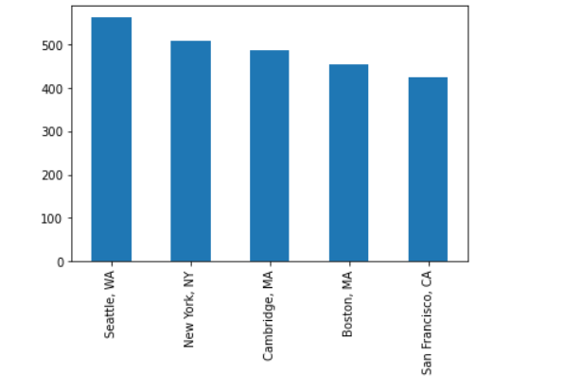
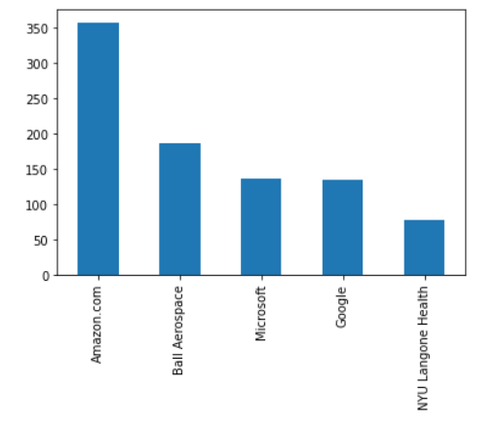
The top five locations for data analyst positions are
The top employers by number of vacancies

Slide 5
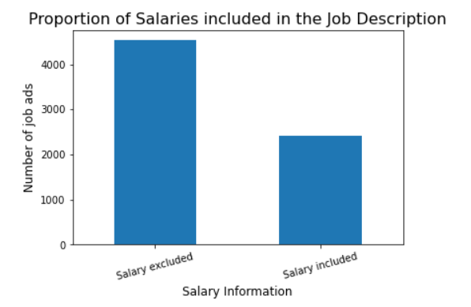
Only half of the job ads have salary information

Slide 6
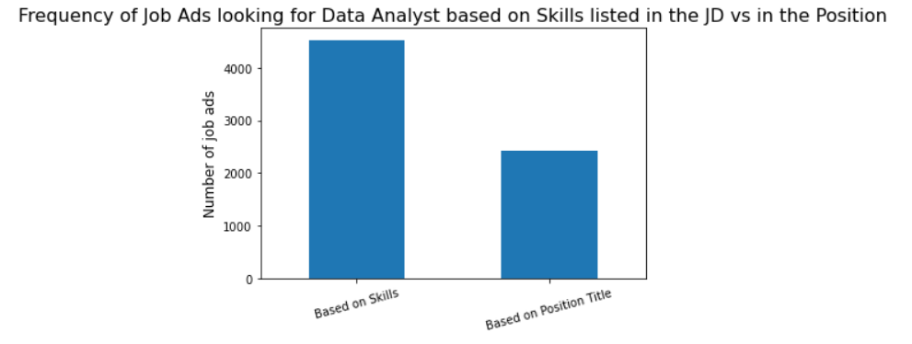
There are more DA jobs, than what they say in the title

Slide 7
Reflection
The team worked amicably, we thought we planned well but ran out of time to achieve all our aims. To meet the timeline, we rescoped the requirements.
Scraping; it was difficult to retrieve the key words in the description column.
We may have missed some data because the same tasks, skills, positions are expressed differently.

