Slide 1
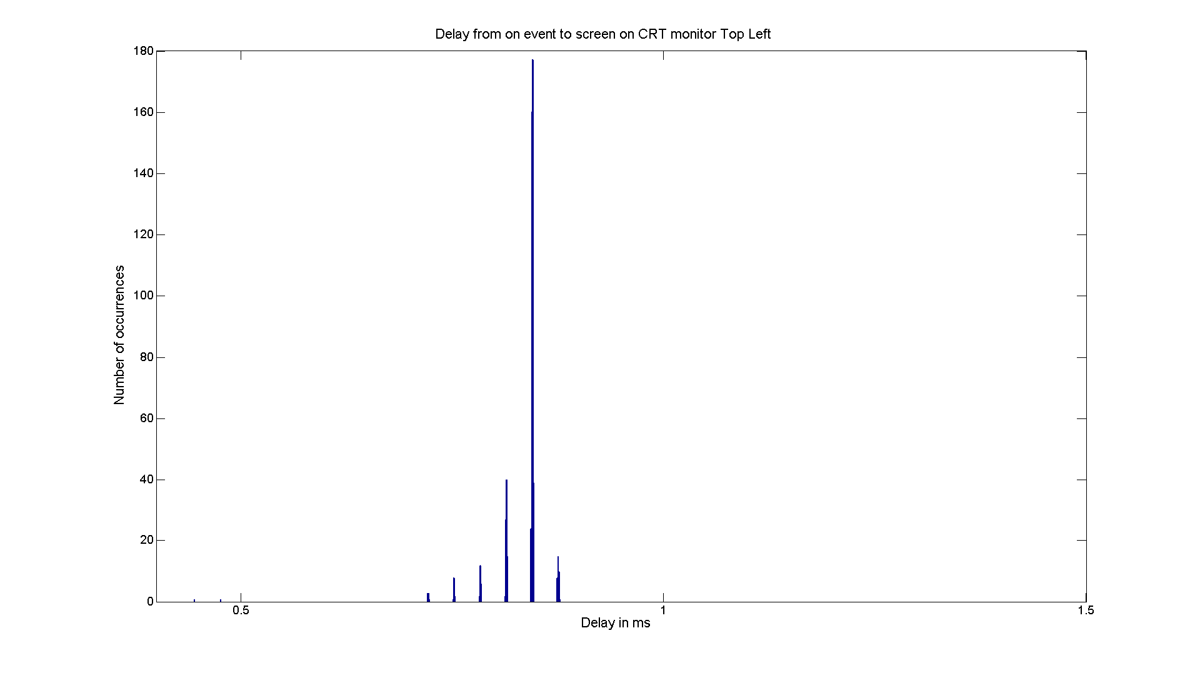
CRT monitor top left
Delay: 0.83487 ±0.033618
Min delay 0.445 Max delay 0.877

Slide 2
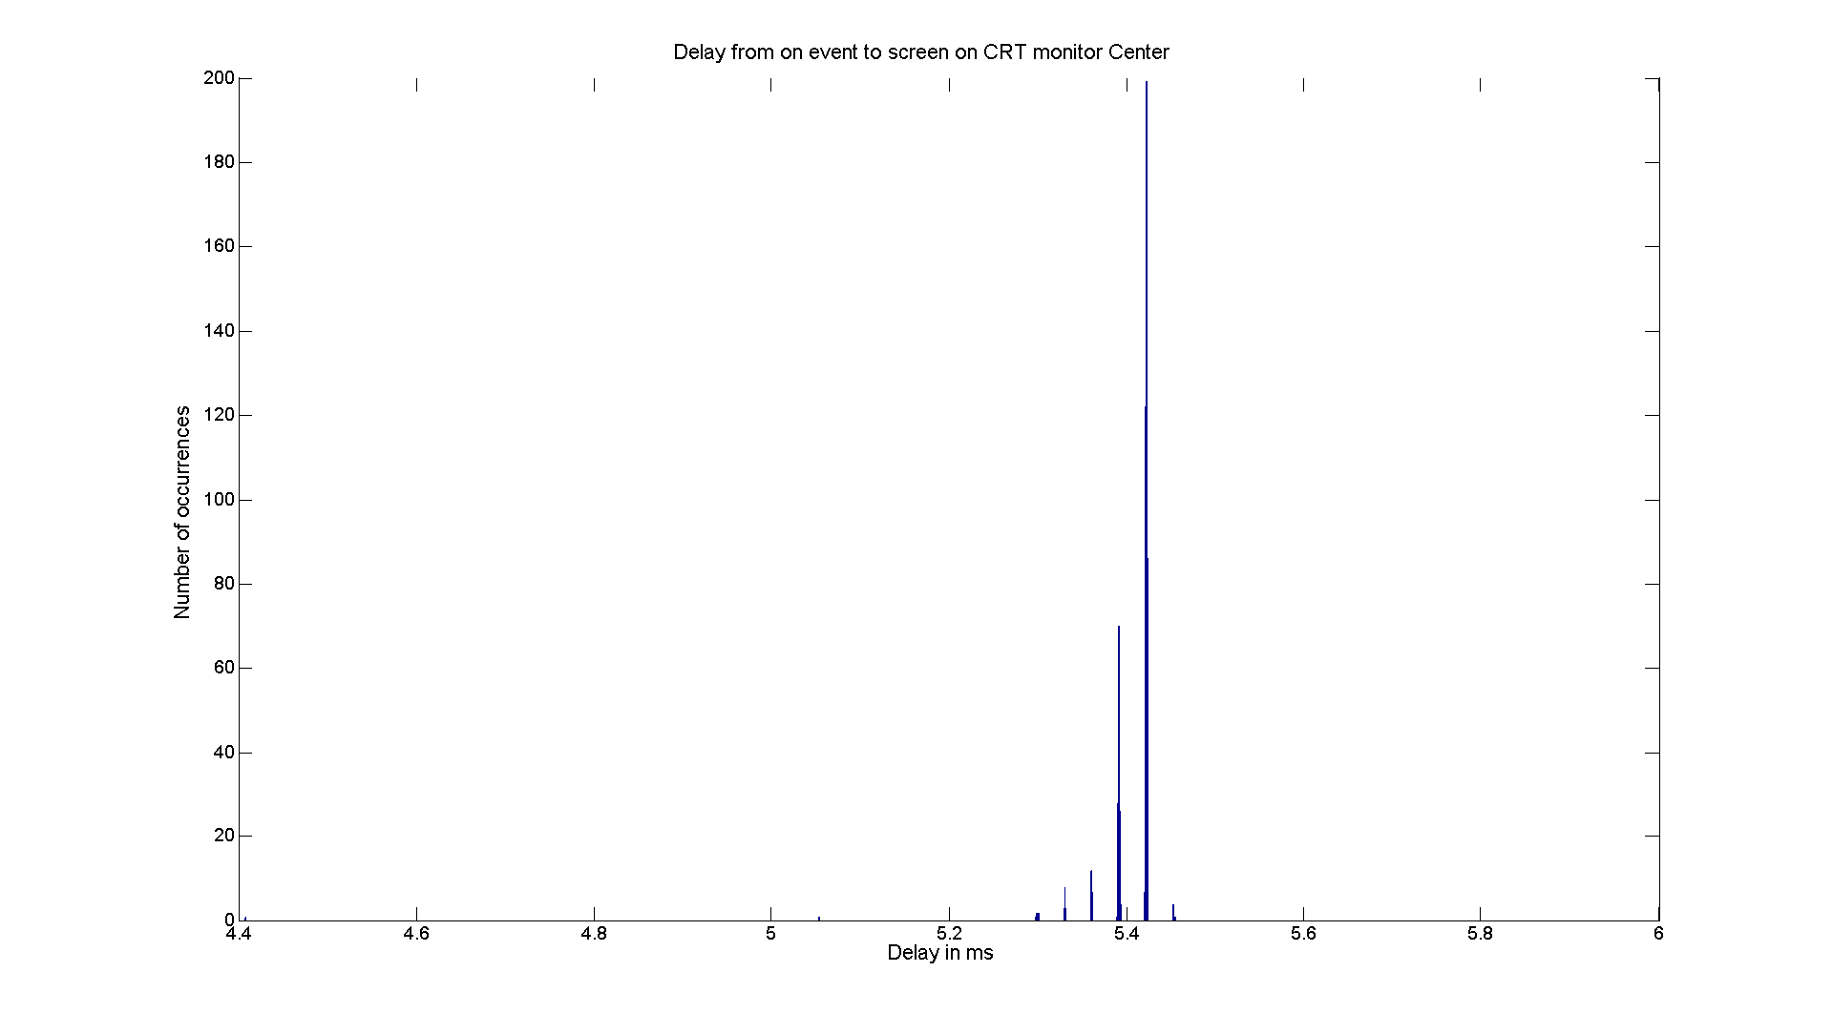
CRT monitor center
Delay: 5.4076 ±0.04971
Min delay 4.408 Max delay 5.454

Slide 3
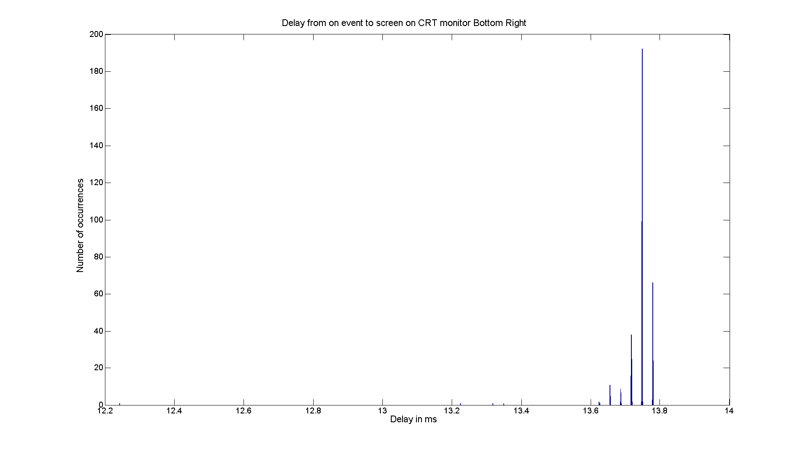
CRT monitor bottom right
Delay: 13.7414 ±0.070406
Min delay 12.242 Max delay 13.779

Slide 4
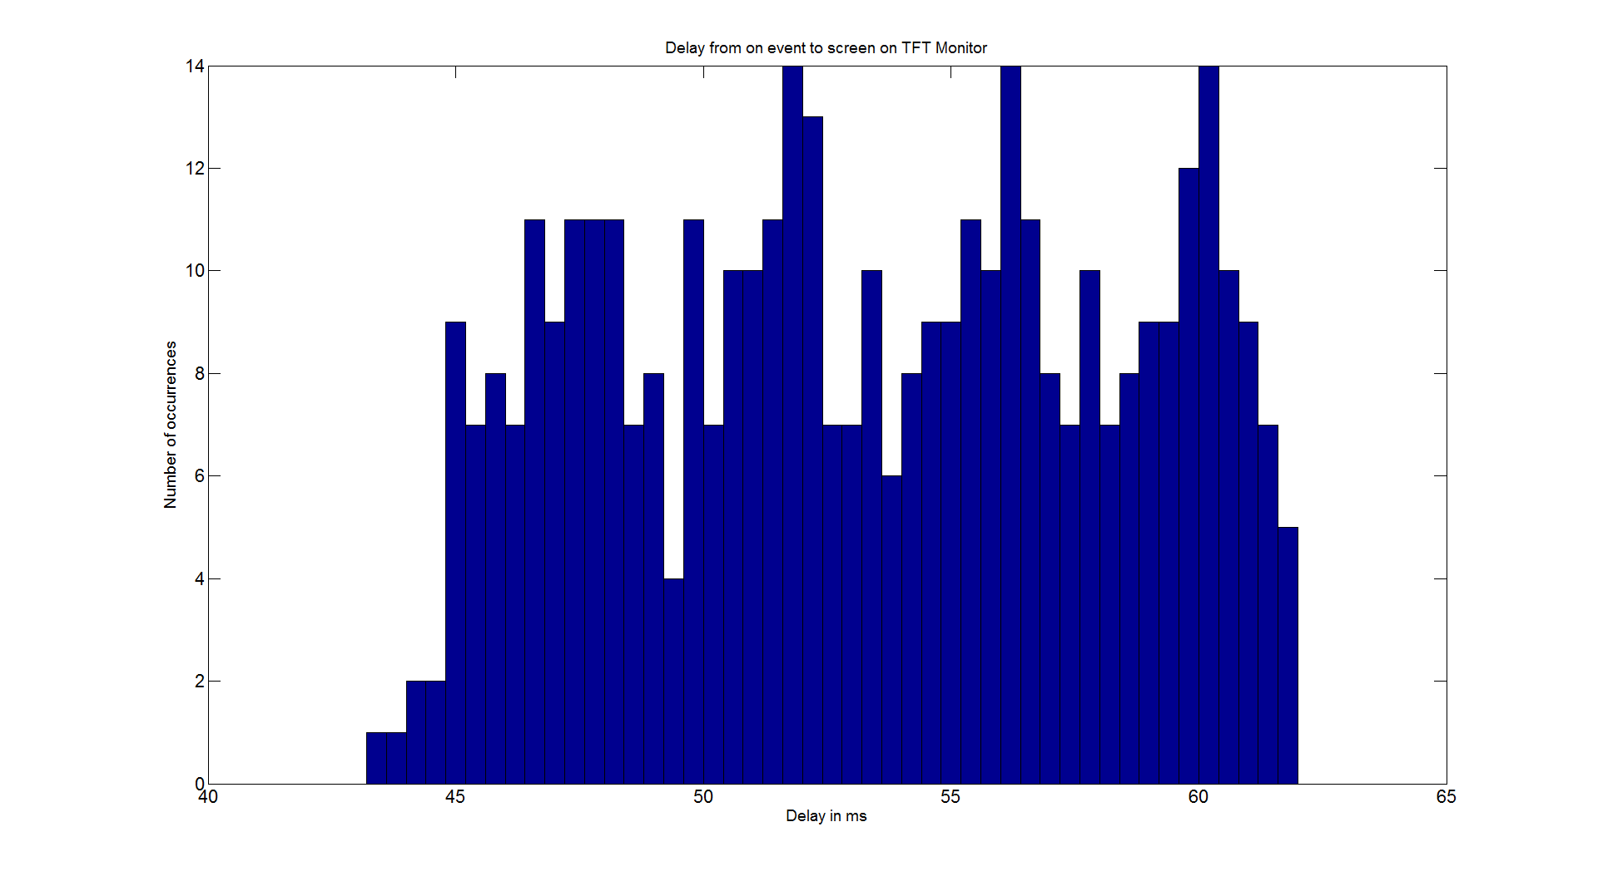
TFT monitor
Delay: 53.2504 ±5.1343
Min delay 27.048 Max delay 61.977

