Slide 1
Collaboration Tools and Code Management
Net Neuro 23

Slide 2

Toolbox for scientific collaboration
Many scientific fields are increasingly reliant on computational research approaches
Including visualization, data and code archiving
Simultaneously, research approaches rely on collaboration and team science
What are the tools and practices we can implement in scientific workflows to support collaboration?
Especially for computational work

Slide 3
Brainstorm
Think of one scientific collaboration you are part of
Who are the collaborators? What are their roles?
What products does each collaborator need access to? Raw data, processed data, code, manuscript, etc.
Jot down a few notes about your collaboration to return to later on

Slide 4
Different tools for different purposes
Category | Software | Version Control | Cloud-storage backup | Passive Collaboration | Active Collaboration | Free version available?
Multi-purpose | GitHub | ✓ | ✓ | ✓ | X | ✓
Multi-purpose | Open Science Framework | ✓ | ✓ | ✓ | ✓ | ✓
Long-term (public) data repositories | Zenodo | After publication | After publication | ✓ | X | ✓
Temporary drive storage (private) | Google Drive | ✓ | ✓ | ✓ | ✓ | ✓ but free version has restrictions
Collaborative code and text editors | Jupyter Notebook | ✓ | ✓ | ✓ | Via Colab | ✓
Git
Table adapted from Braga et al. 2023

Slide 5
Code management to support collaboration
Good code management is a habit worth cultivating
Brings project management into your analysis
Makes sharing code and outputs easier
Improves efficiency – personal level and project level
Version control is one element of good code management – other practices from the reproducibility lecture are also important!
Git is a system for version control – not the only one, but popular among scientists

Slide 6
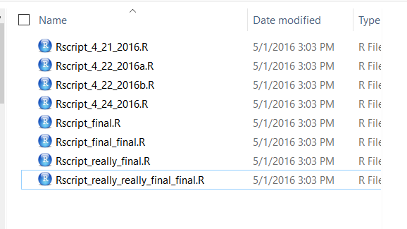
What is version control?
Version control is an organized way of maintaining a record of changes
Enhance reproducibility
Fix mistakes by reverting to earlier versions
Improve project structure
Backup versions in remote repositories**
Facilitate collaboration**

Slide 7
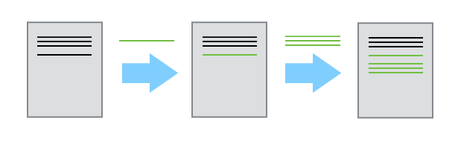
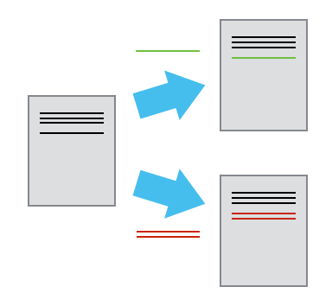
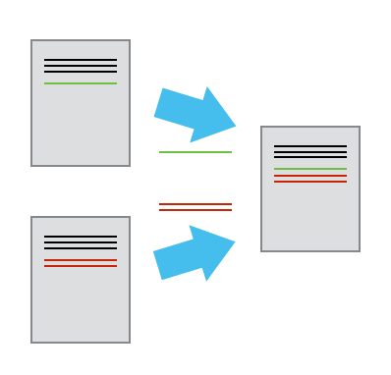
The mechanics of version control
Single user:
Multiple users:
Image credit: Software Carpentries

Slide 8
Some Git vocabulary
Repository/repo – the collection of files and directories associated with a project and tracked with version control
Commit – a snapshot of a repository’s history that is recorded by Git
Diff – Changes in the repository’s content associated with the commit
Branches – Concurrent work (changes to file content) can occur in parallel branches, so that you can focus on developing one aspect of the repository/project independently

Slide 9
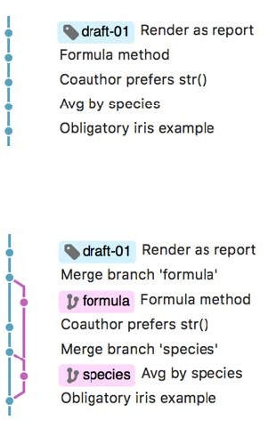
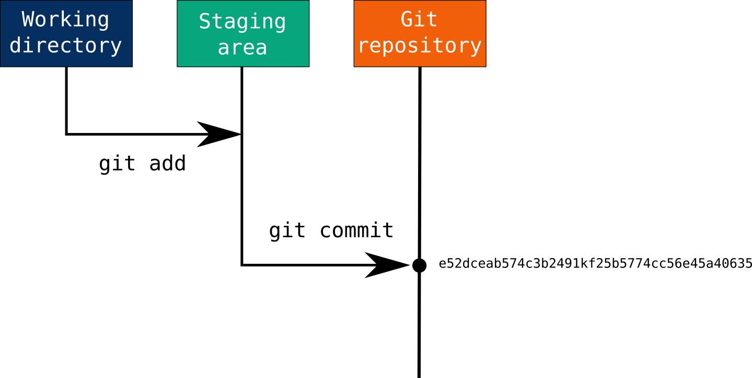
The basic Git workflow
Image credit: J. Bryan; M. Joseph

Slide 10

Use commits to anchor your code
if you make a mistake, you can’t fall past the previous commit.
Use more commits when you’re in uncertain or dangerous territory.
Commits are also helpful to others, because they show your journey, not just the destination.
Hadley Wickham, R Packages

Slide 11
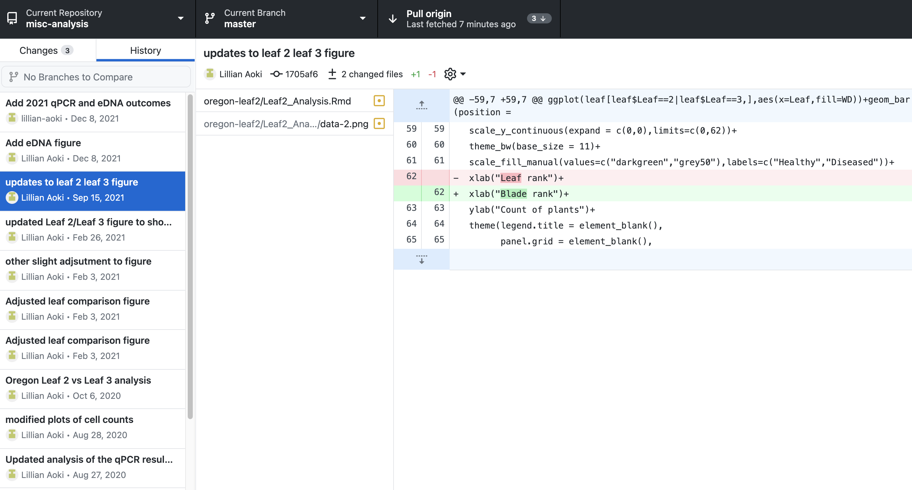
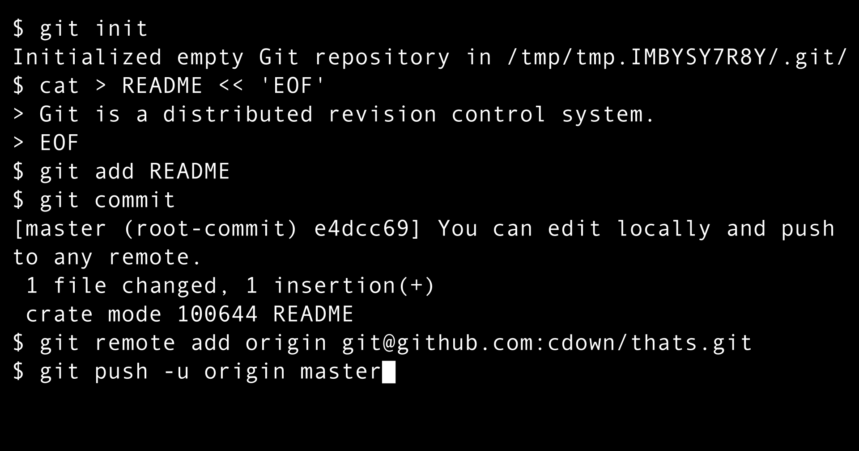
Command line vs. Git client

Slide 12
Limitations and strategies for using Git
Not effective for non-text files – binary files, data such as images, very large datasets
Steep learning curve
Not intuitive!
Resources for starting out
Software Carpentries – online tutorials and live workshops
Happy Git from Jenny Bryan – for the R user
Learn by doing
Build a mental model
What makes sense for your project?

Slide 13
Reflection
Do you use git in your current workflow?
Consider your collaboration – is there a place in your workflow that might benefit from using version control?
What barriers prevent you from using git right now?

Slide 14
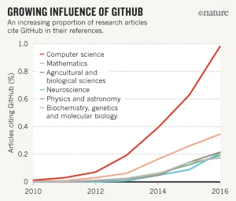
Get more out of Git with GitHub
Create a web presence for your project with little extra effort
Great for sharing intermediate products with collaborators
Allows for different collaborators to perform different roles
Supports literate programming – e.g. reports with R Markdown
Remote back-up and storage – but consider sensitive data and code
Participate in open science!

Slide 15
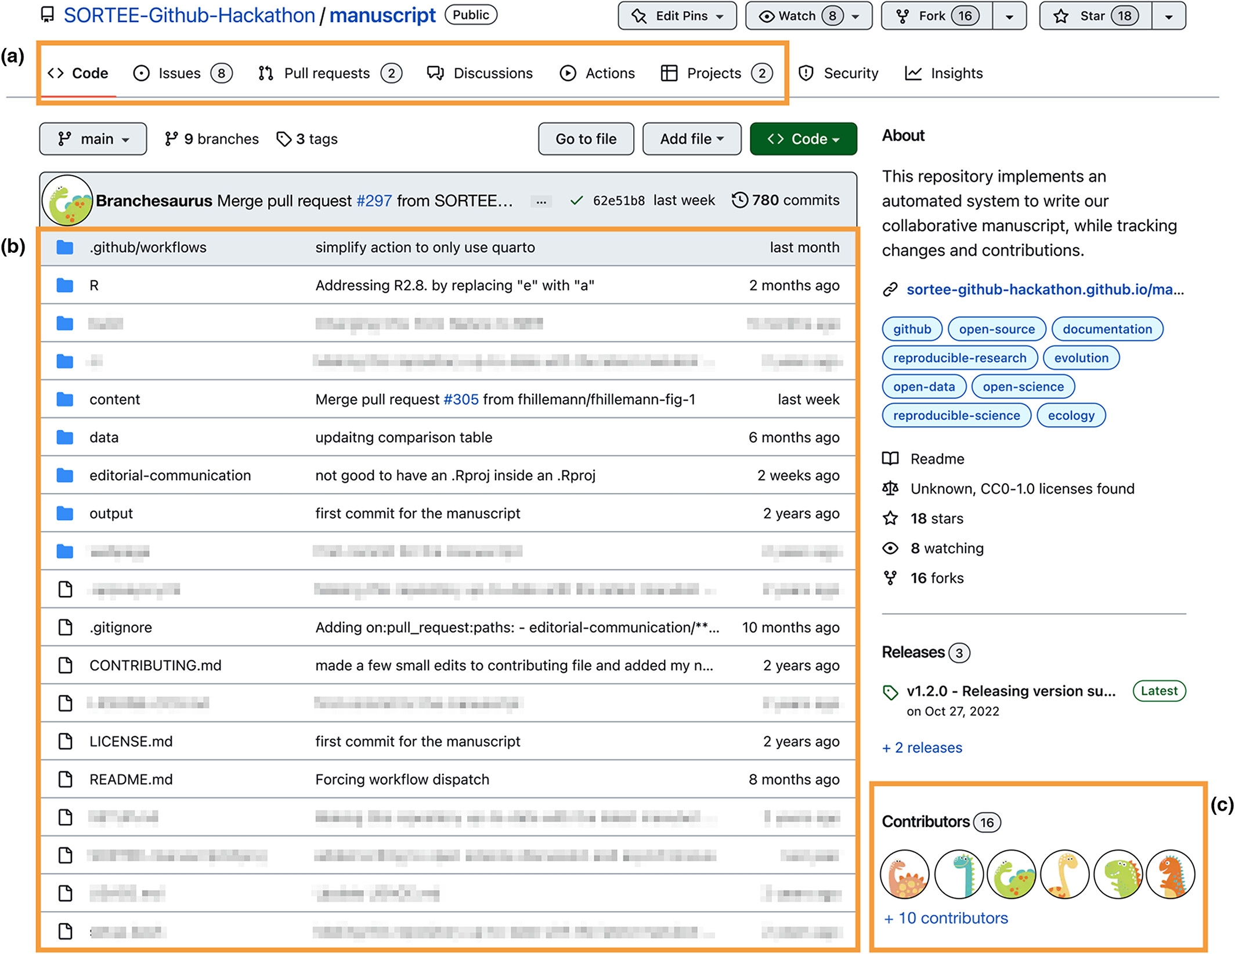
GitHub websites have layered functionality
Metadata
License
Control access
Edit within the browser
Project management
And more
NOT all necessary for all projects!

Slide 16
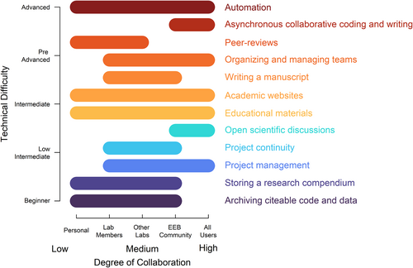
Braga et al. 2023

Slide 17
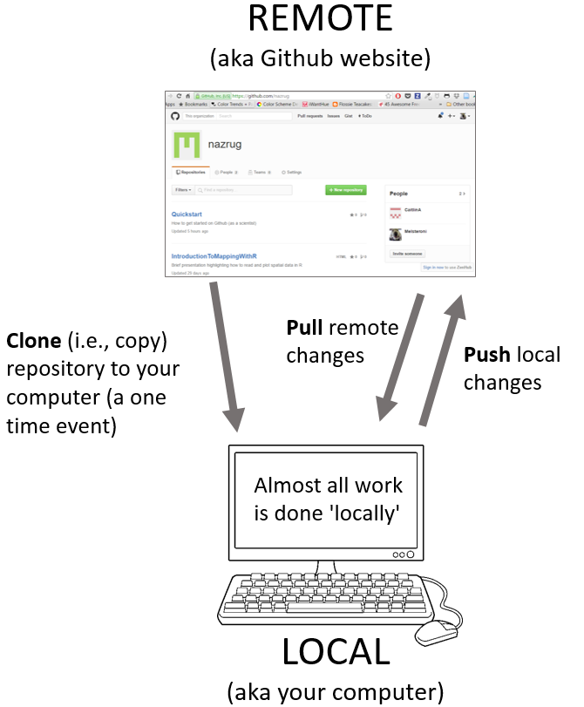
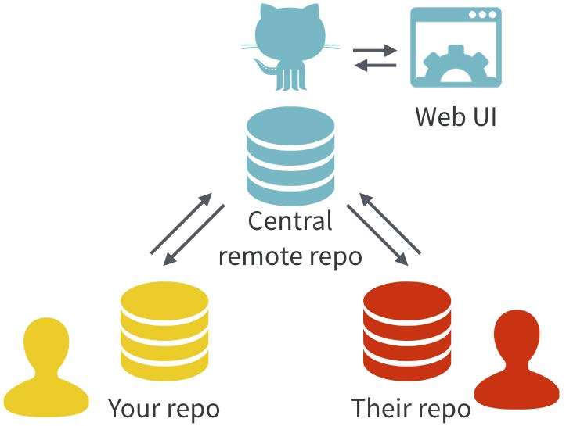
Personal GitHub workflow
Image credit: Ocean Health Index, J. Bryan

Slide 18
Best practices for incorporating GitHub
Personal workflow
Commit early and often
Pull from remote before you push
Divide work into separate repositories
Be descriptive – in commit messages, file naming, branch naming
No one size fits all!

Slide 19
GitHub workflows for collaboration
From Bitbucket:
Does the workflow scale with the team size?
Is it easy to undo mistakes and errors?
Does this workflow impose unnecessary cognitive overhead to the team?
Ideally, your workflow is simple and enhances productivity
Bitbucket tutorial on git workflows is thorough although dense

Slide 20
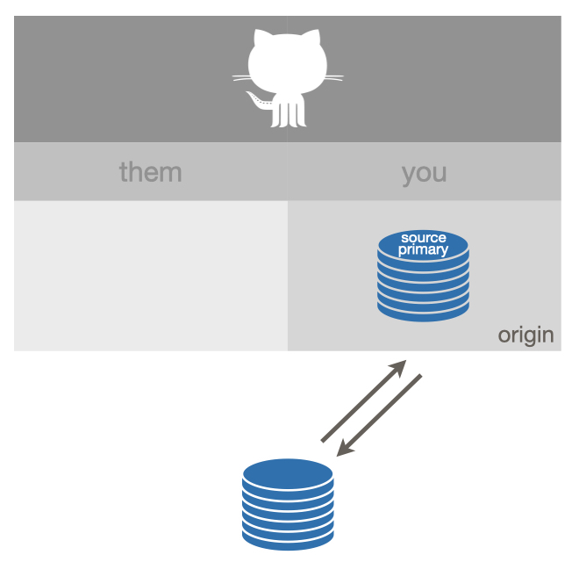
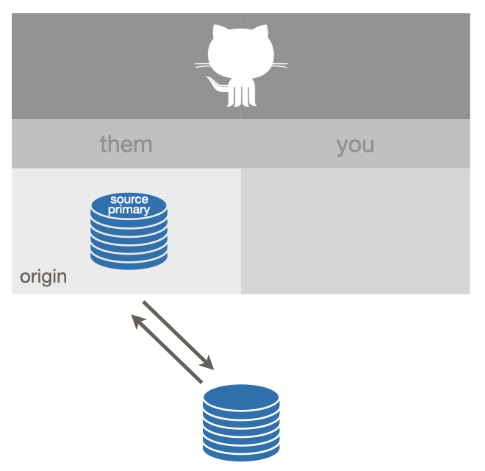
Simple collaborative workflows
https://github.com/lillian-aoki/misc-analysis
Image credit: J. Bryan

Slide 21
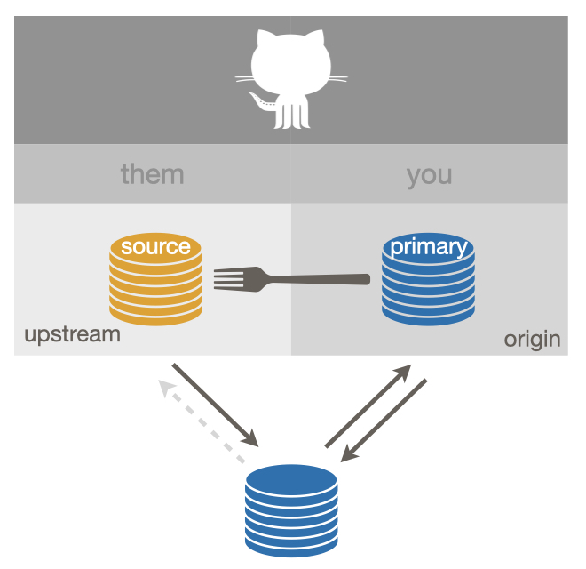
Fork-and-clone workflow
Enables multiple users to contribute in parallel
Maintainer of source repo retains control over accepting changes
Common for open source projects
Requires some Git proficiency from all users
Image credit: J. Bryan

Slide 22
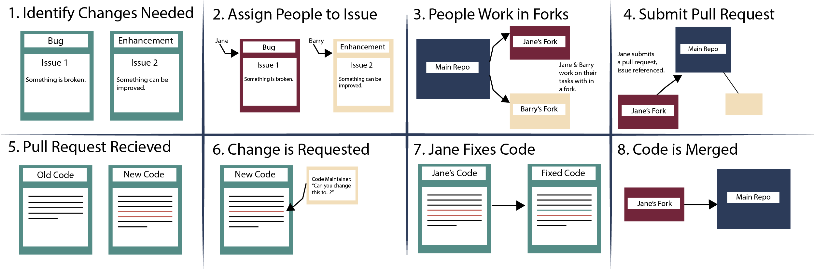
Fork and clone workflow
Image credit: A. Faller

Slide 23
Best practices for incorporating GitHub
Personal workflow
Commit early and often
Pull from remote before you push
Divide work into separate repositories
Be descriptive – in commit messages, file naming, branch naming
No one size fits all!
Collaborative workflow
Use GitHub to improve productivity
Have a clear organizational idea before you start
Be deliberate in choosing your workflow and roles

Slide 24
Reflection
Consider your collaboration, the roles of each collaborator, and the access they need to specific products during the project workflow
Does GitHub seem like a tool that can facilitate your collaboration? Why or why not?

Slide 25
Project management tools in GitHub
Issues - communicate on specific ideas/changes
Project boards
Milestones
Assigned people
Tags
Private repos
Can have internal and external facing repos

Slide 26
Publish your code with GitHub and Zenodo
GitHub repo ≠ long-term data repository
GitHub is a commercial product that can disappear at any time
HOWEVER, you can archive your GitHub repo with Zenodo and receive a DOI that is a persistent identifier
Guidelines for linking your GitHub repo to Zenodo

Slide 27
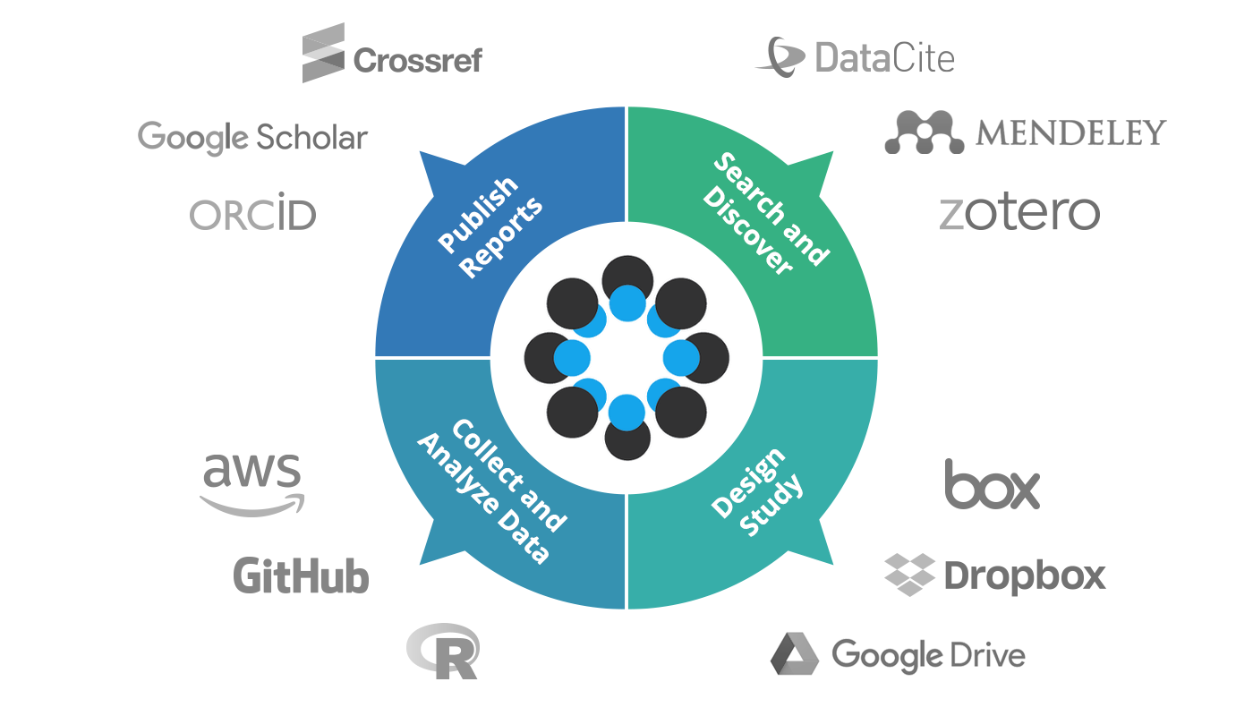
Tools beyond GitHub
Open Science Framework
Active co-writing works better in Google Docs / cloud-based Word
Sensitive data and code may need to be stored elsewhere, e.g. behind an institutional login

Slide 28
Getting started with Git & GitHub
Download git (if necessary)
Configure git with your email
Create a GitHub account
Authenticate your GitHub account on your computer
Recommend command line here though a client can also be used
Will need either SSH keys or Personal Access Token – documentation from GitHub is helpful here
https://docs.github.com/en/authentication/keeping-your-account-and-data-secure/managing-your-personal-access-tokens

