Slide 1
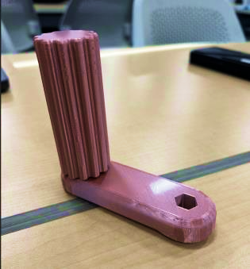
Wrench-a-Roni
Custom wrench design and testing
Michele Haugh
Lillian Letiecq
Mary Teifel
ENGR 1101 · Section 101
October 21, 2026

Slide 2
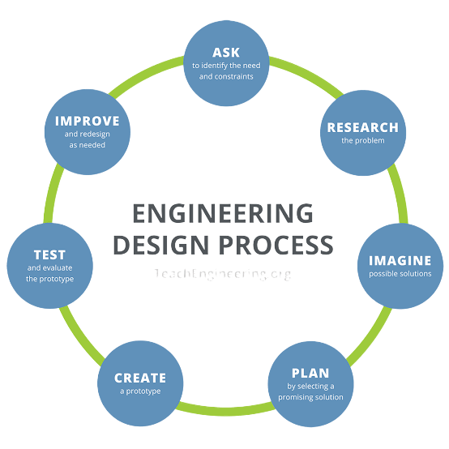
Project Overview
Customer needs and design requirements
Engineering principles
Prototype 1 and revised Prototype 2
Comparison, evaluation, and future improvements

Slide 3
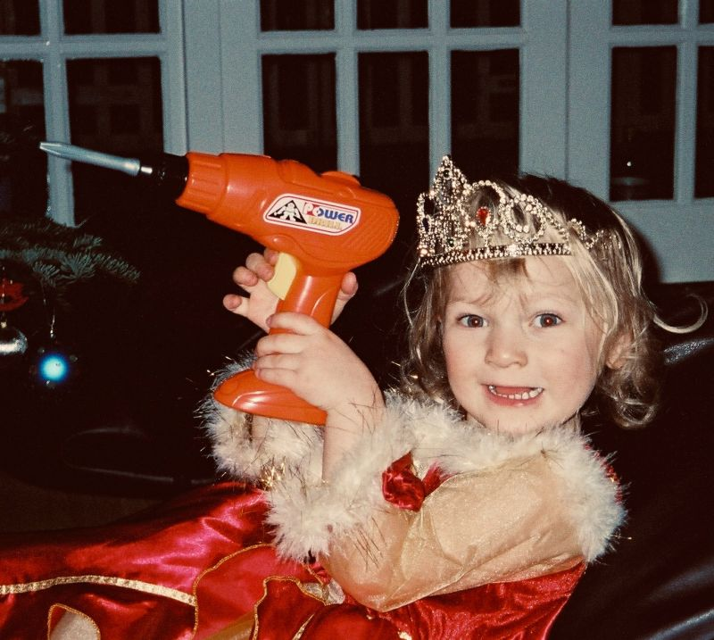
Define the problem
Twinkle Toes Inc.
A toy company producing toddler playsets
Needs an inexpensive, functional, reusable wrench
Objective: a comfortable twisting tool that is easy to reproduce

Slide 4
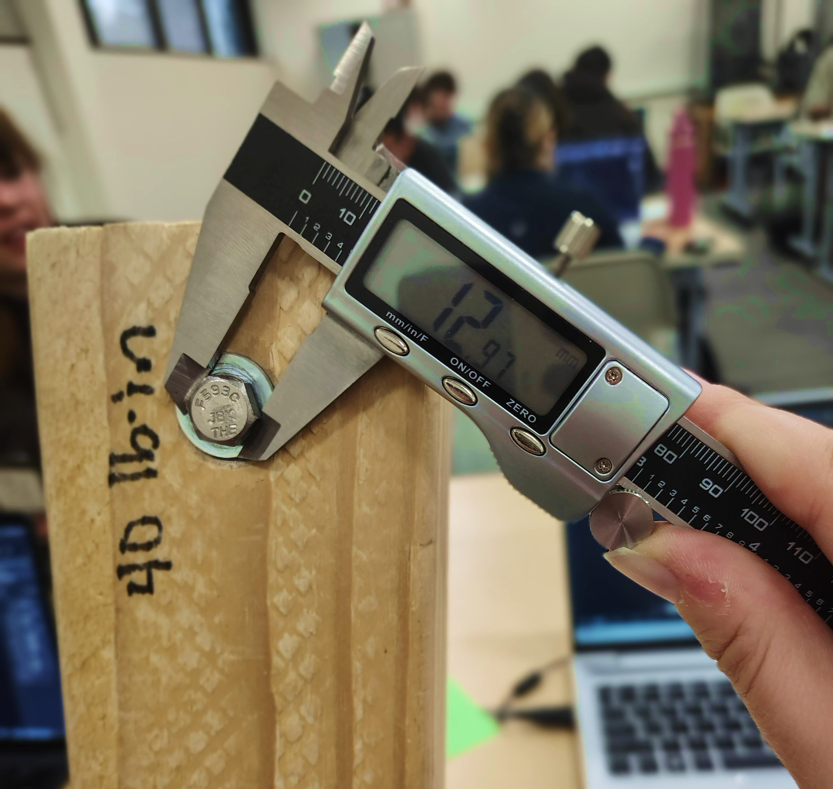
Generate concepts and requirements
Selected concept: three pieces with a two-handed twisting handle
Fit a standard ½-inch hex bolt head
Withstand at least 40 lb-in of torque
PLA printing with 0–50% infill allowed
Build plate: 203(W) × 232(H) × 203(L) mm
Both iterations use 20% triangular infill

Slide 5
Develop a solution
Torque
τ = rF sin θ= r x F
Force and effective lever arm
Average compressive stress
σ = F / A
Load distributed over contact area
Production cost
C = 0.40m + 0.02t
m in oz, t in minutes, C in dollars
Notes:
.

Slide 6
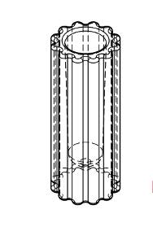
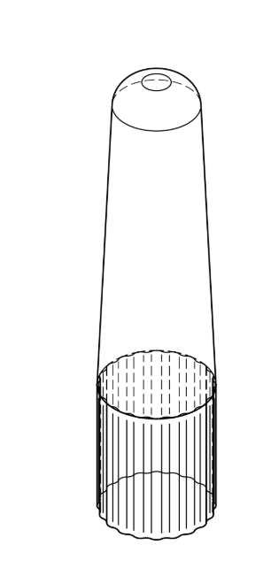
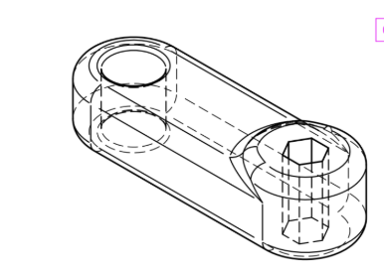
Prototype 1: construction
Main wrench body
Tapered inner handle
Textured outer handle
3.0 oz, no supports
330-minute print

Slide 7
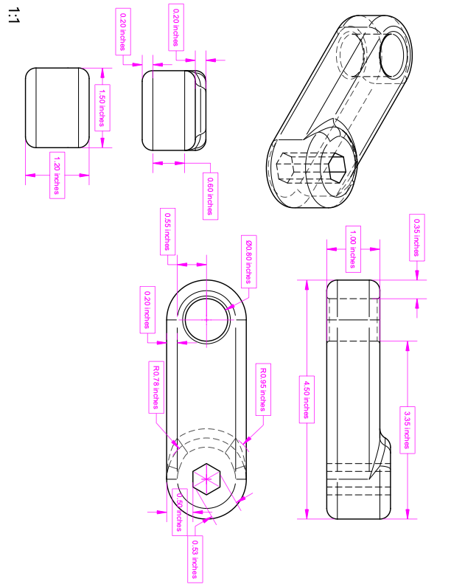
Base Wrench Design 1

Slide 8
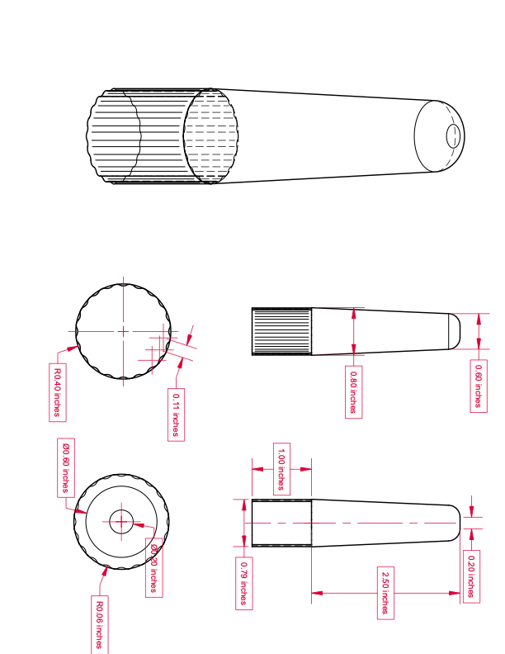
Peg Wrench Design 1

Slide 9
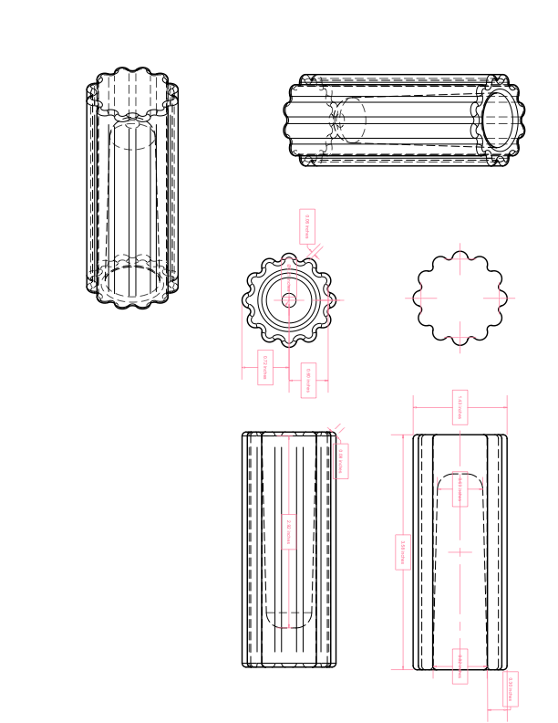
Handle Wrench Design 1

Slide 10
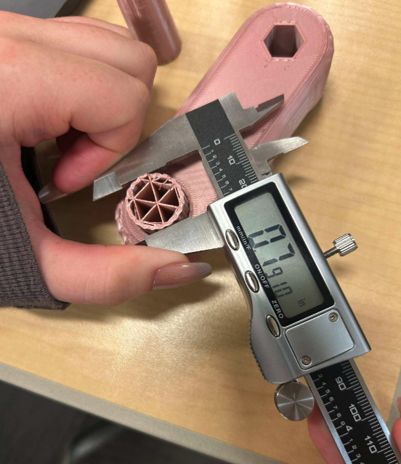
Prototype 1: testing
40 lb-in
70 lb-in
Requirement met
Reported failure torque
Tight fit required excessive assembly force
The inner handle broke along a printed layer
Revision priorities: assembly fit, strength, and printing efficiency

Slide 11
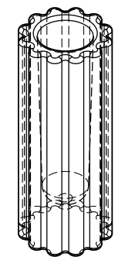
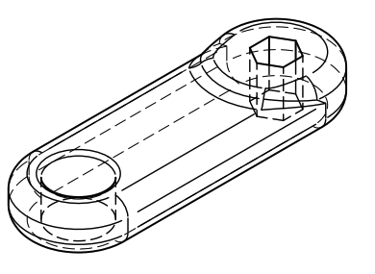
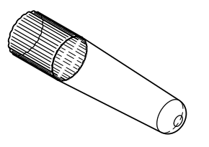
Prototype 2: design revisions
Revised body
Revised tapered inner handle
Body reduction in report: 1.0 to 0.6 in*
Cylinder fit reduction: 2%
Horizontal inner-handle print with supports
20% triangular infill retained

Slide 12
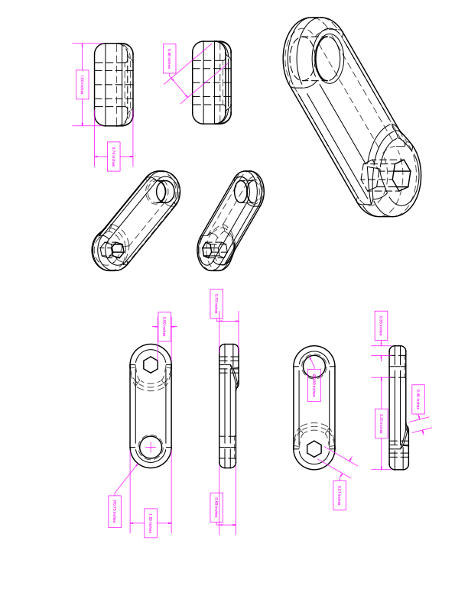
Design 2 Base Blueprint

Slide 13
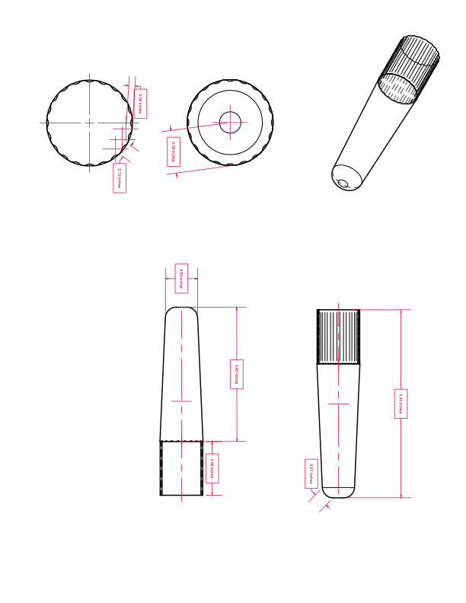
Design 2 Peg Blueprint

Slide 14
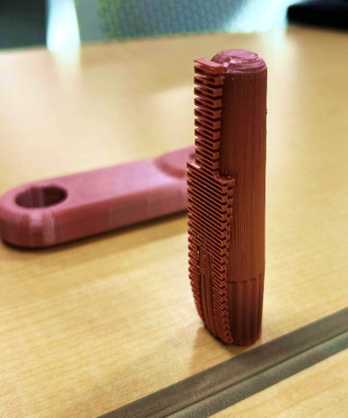
Prototype 2: testing
40 lb-in
80 lb-in
Requirement met
Hex opening deformed
2.5 oz including supports, 280-minute print
Some inner-handle material deformed during cooling
The prototype remained functional during the reported test

Slide 15
Comparison of both designs
Measurement | Design 1 | Revised Design 2
Reported weight | 3.0 oz, no supports | 2.5 oz, with supports
Printing time | 330 min | 280 min
Filament cost | $1.20 | $1.00
Printing cost | $6.60 | $5.60
Total production cost | $7.80 | $6.60
40 lb-in requirement | Met | Met
Reported failure torque | 70 lb-in | 80 lb-in
Design 2: $1.20 lower cost and 50 minutes less printing

Slide 16
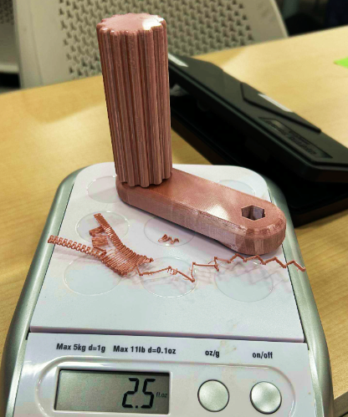
Evaluate the solution
Revised Design 2 is the stronger project candidate
Meets the assigned 40 lb-in torque requirement
Lower reported cost
Shorter print time
Remaining limitations: opening deformation and inner-handle print quality

Slide 17
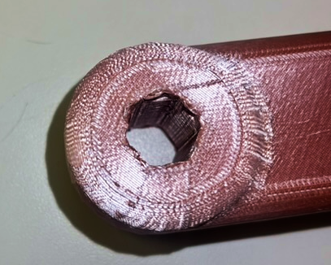
Future improvements
Strengthen the hex opening against deformation
Remove about 0.5 in of excess outer-handle height
Explore fewer components and simpler assembly
Refine print orientation and settings, then retest
Notes:
.

Slide 18

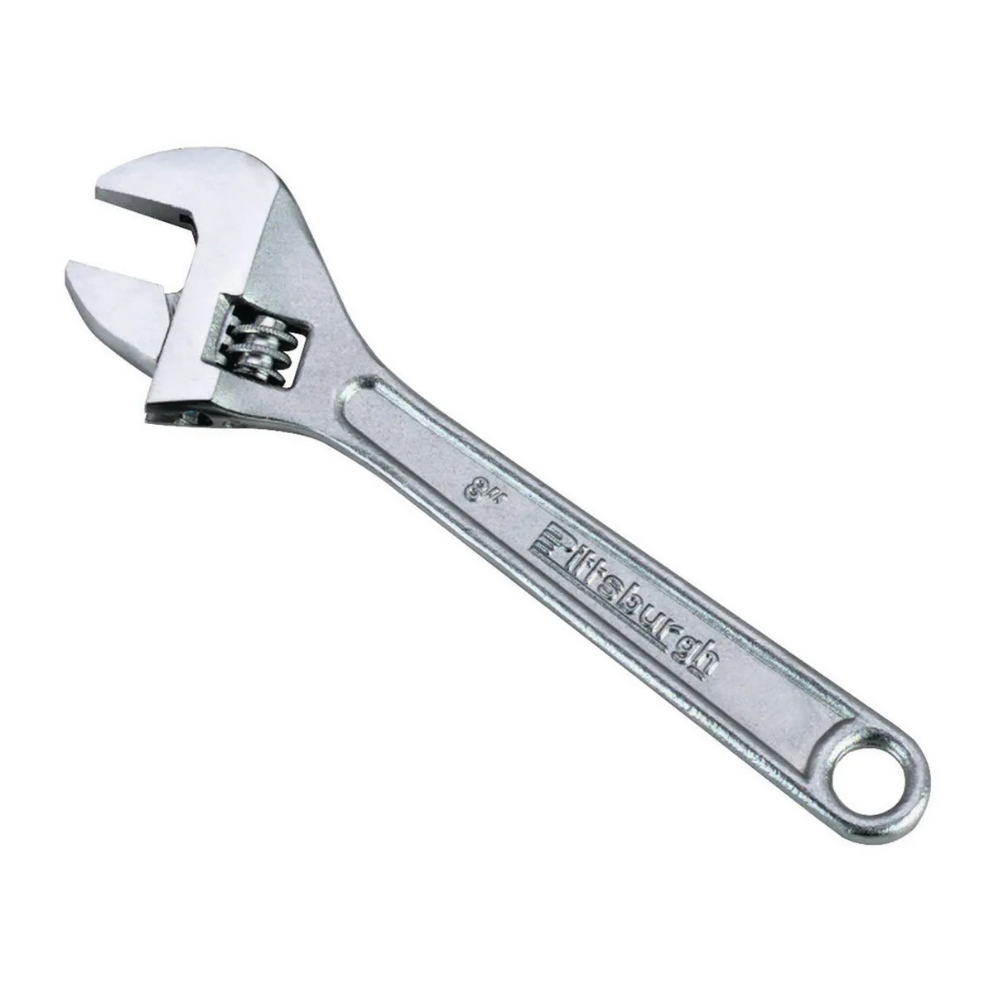
Why Twinkle Toes Inc. Should Choose Wrench-a-Roni
Fun unique design kids enjoy better than traditional wrench
Ease of use for children
Practice motor skills and hand eye coordination for toddlers
Lightweight design

Slide 19
Thank you
Questions?
Wrench-a-Roni
Michele Haugh, Lillian Letiecq, and Mary Teifel
Notes:
Thank the audience and invite questions.

