Slide 1


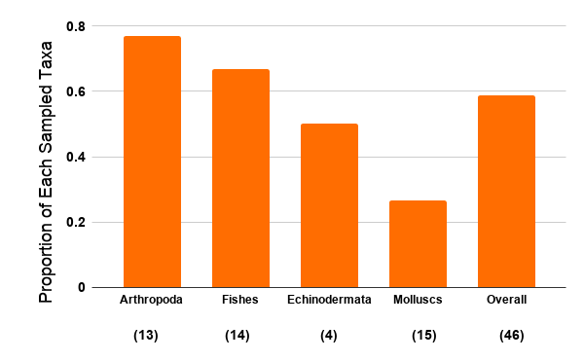
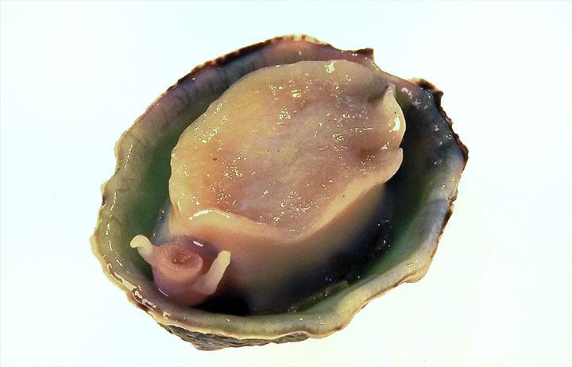
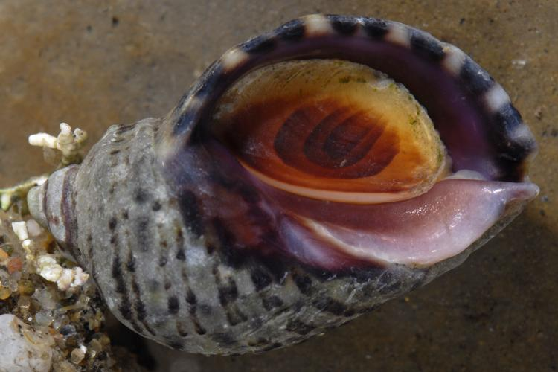
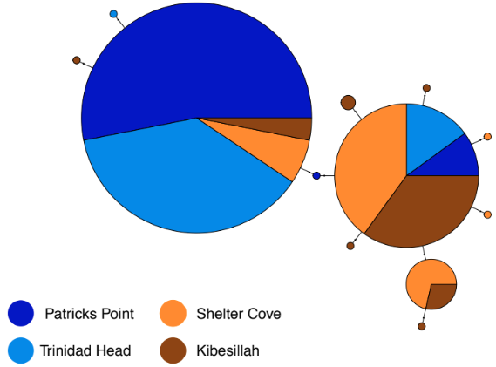
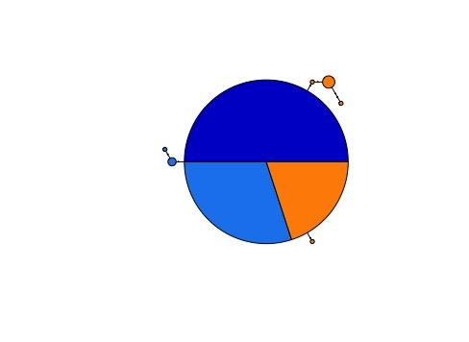
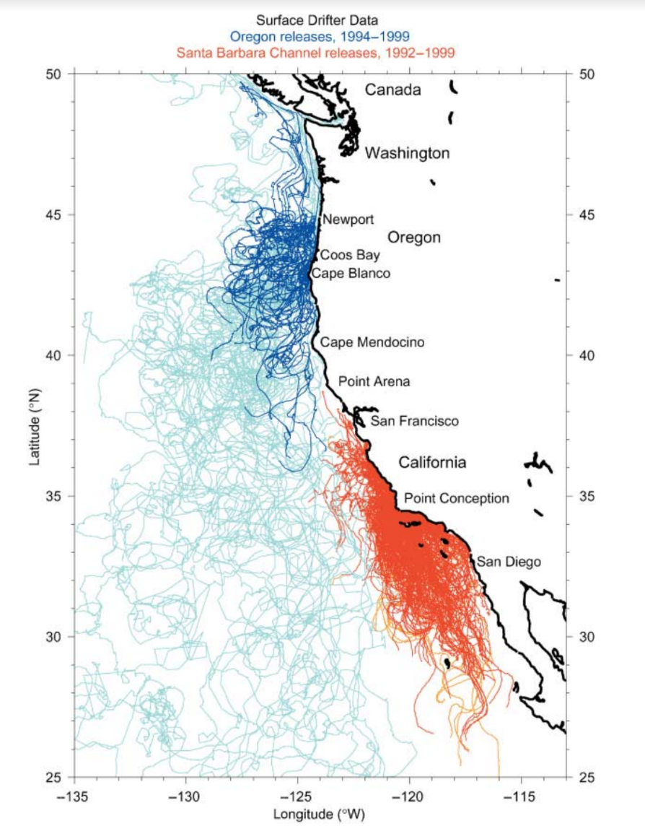
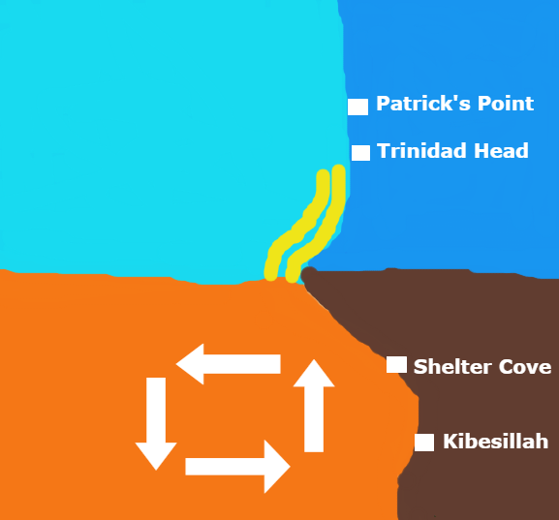
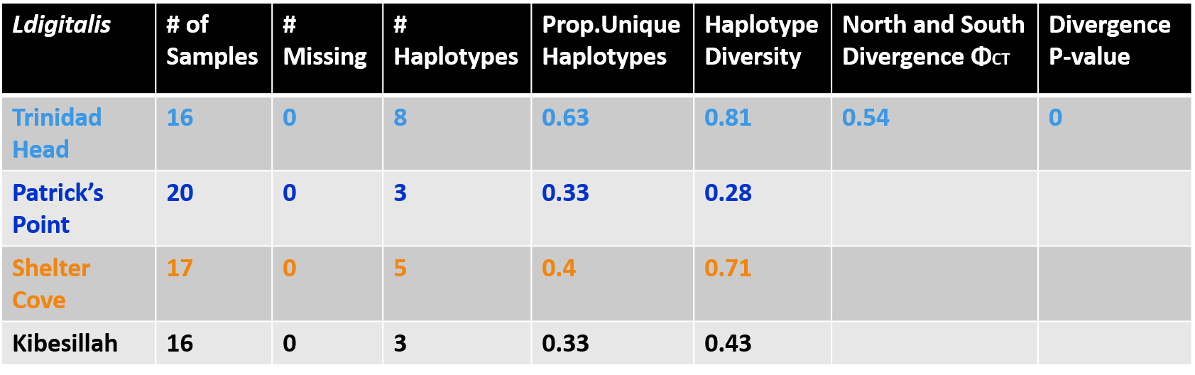
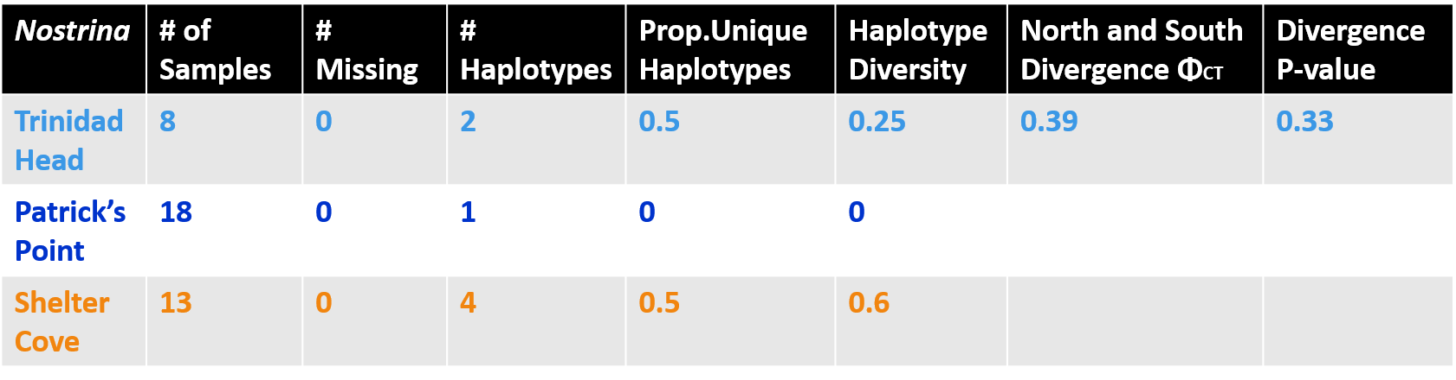
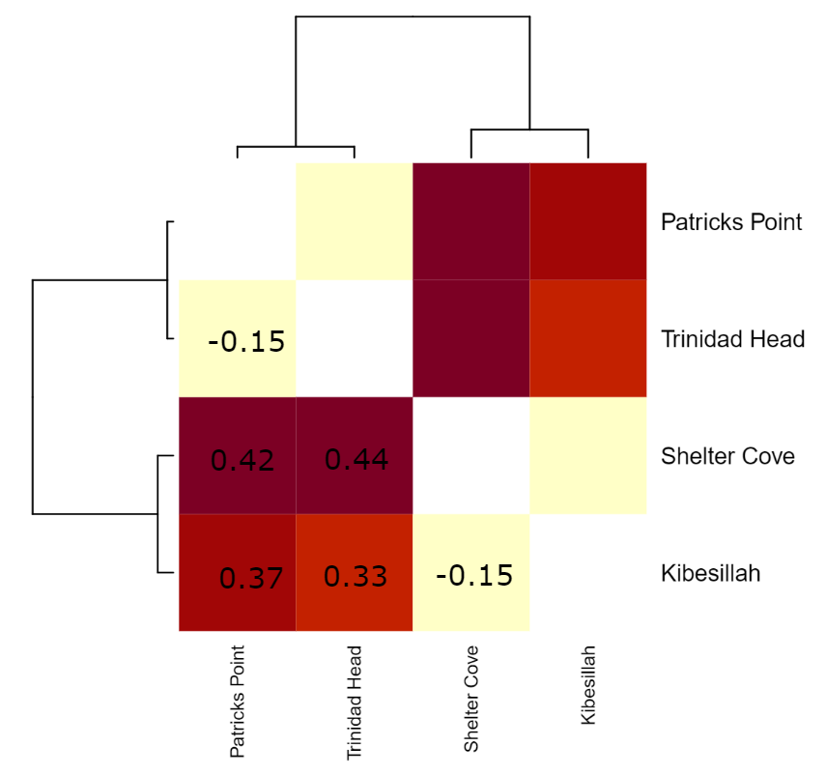
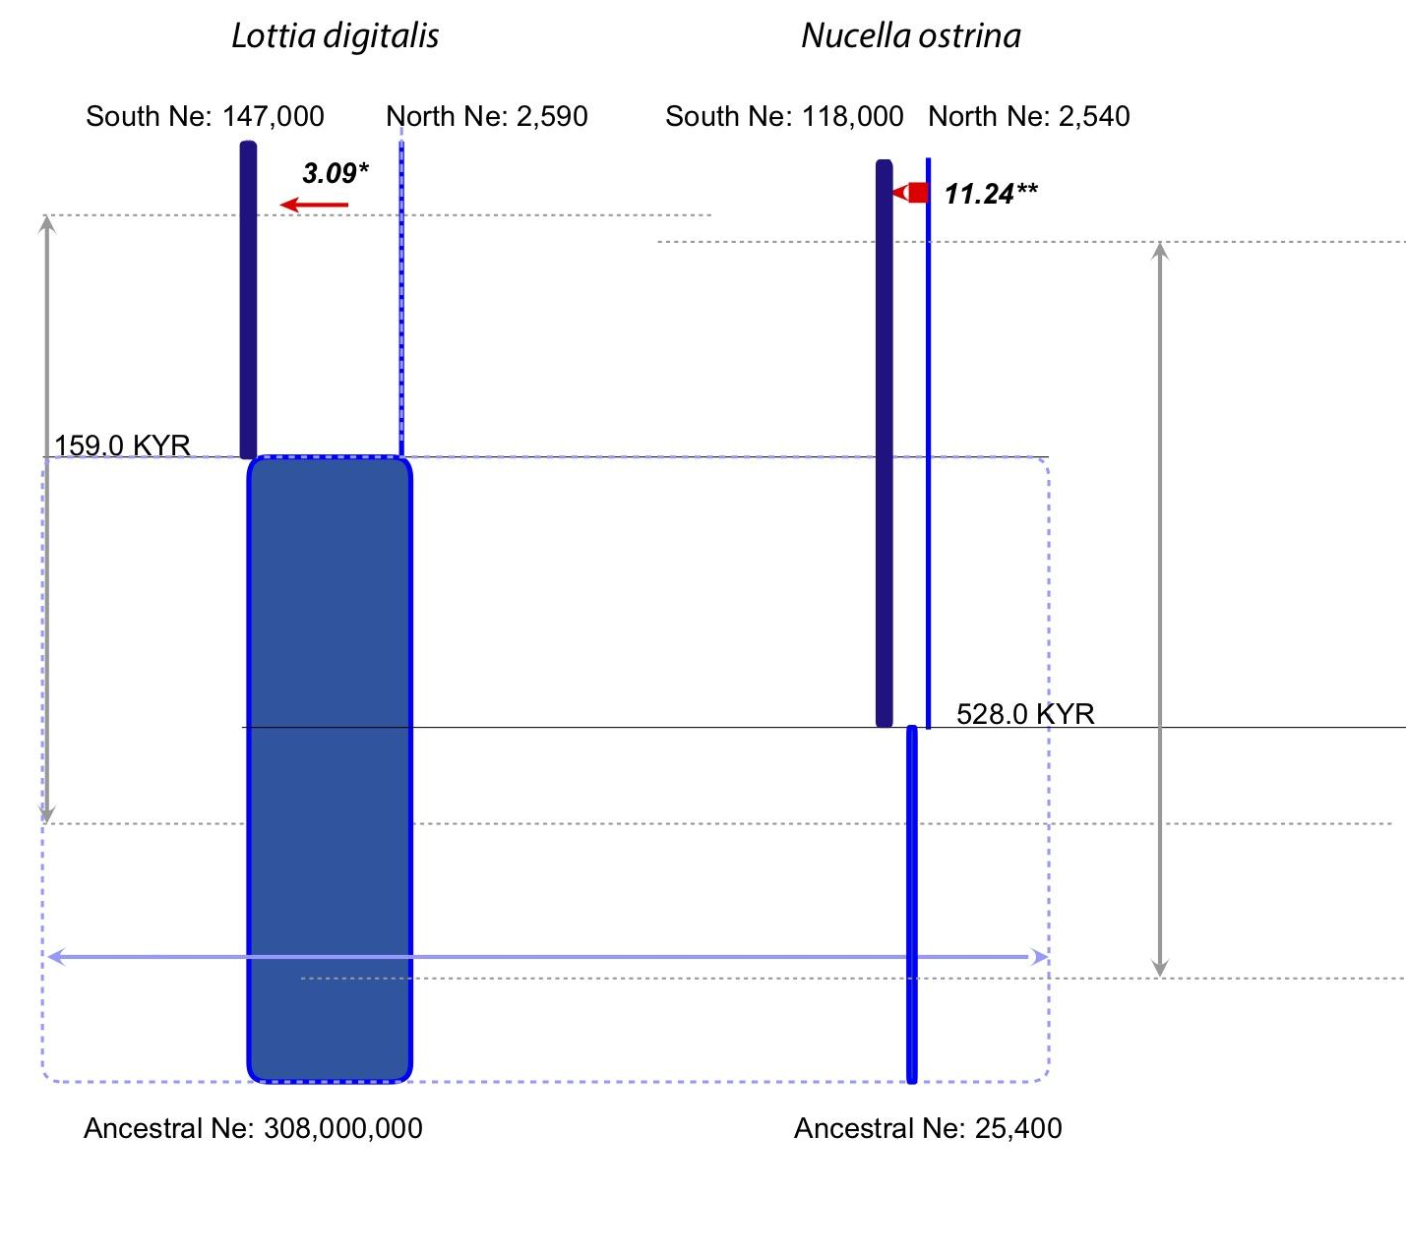
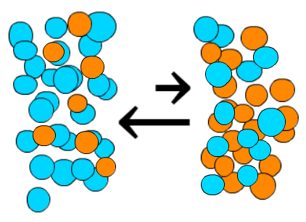
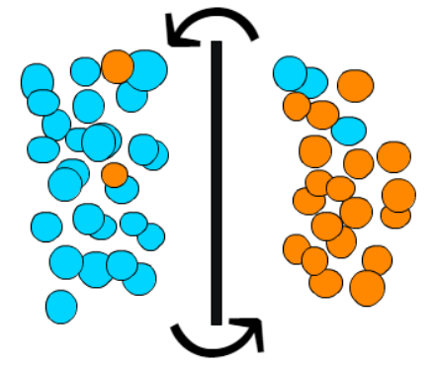
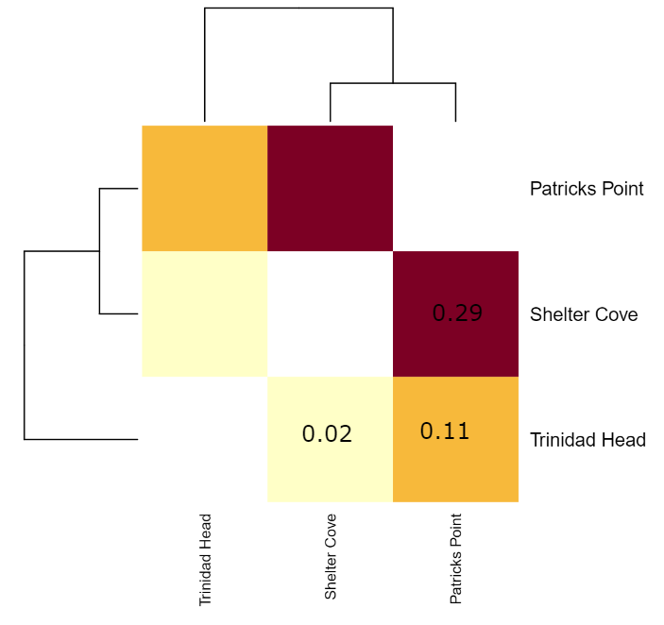
Discussion
Larva me now or larva me not: Cape Mendocino as a Barrier to Larval Dispersal using the Northern Striped Dogwinkle, Nucella ostrina and the Ribbed Limpet, Lottia digitalis
Lilli Krier^{1*}, Skylar Kensinger¹, Alison Haupt², Eric Crandall¹
California State University Monterey Bay: Department of Biology & Chemistry¹, Department Marine Science²
* lkrier@csumb.edu
Introduction
Results
Processes that influence the biogeographic distribution of species are also expected to impact the phylogeographic distribution of genetic diversity within a species (Avise 2000). Cape Mendocino projects far into the Pacific Ocean, creating strong upwelling and an associated eddy that can potentially force the drifting larvae of intertidal species offshore (Magnell et al. 1990). In addition, a large sandy stretch of coastline to the north of the Cape gives no opportunities for successful settlement by larvae of rocky intertidal species. The Cape has been identified as a biogeographic break for species with planktonic larval development, but not for direct developers (Fenburg et al. 2015). We first reviewed the literature, finding evidence of phylogeographic structure in 24 out of 46 species that have been sampled across the Cape. We then compared genetic structure across Cape Mendocino in two synchronously diverging, co-distributed intertidal gastropod species (Dawson et al. 2014): Lottia digitalis, with lecithotrophic larvae (PLD ~6 days), and Nucella ostrina, which is a direct developer. We hypothesized that if the Cape is a barrier to larval dispersal, L. digitalis populations to the north and south of the Cape will show significant genetic divergence, with Φ_{ST} (sequence analog of F_{st}) values and divergence times comparable to those found in the non-dispersive N. ostrina. Furthermore, population pairs that do not span the Cape will have Φ_{ST} values close to zero in L. digitalis, but not N. ostrina. If Cape Mendocino is a barrier to gene flow for planktonically dispersing coastal species, it could directly affect the way that conservation management policy is implemented.
Ribbed limpet Lottia digitalis. Pelagic Larval Duration ≈ 6 Days
Dogwhelk Nucella ostrina
Direct development
A
B
Proportion of 46 species exhibiting genetic structure across Cape Mendocino
Discussion
Our results show a clear and significantly large genetic divergence across Cape Mendocino in a coastal, planktonically dispersing species, Lottia digitalis. Genetic structure in this species was uniformly greater than divergences measured in the non-dispersive Nucella ostrina. While previous population genetic surveys (e.g. Kelly and Palumbi 2010) have detected population structure along the Northern California coast (Haupt 2011), ours is among the first to sample finely enough around Cape Mendocino to implicate it as a barrier to larval dispersal. The absence of structure between populations on the same side of the Cape demonstrates that, while these proximal populations are connected by larval dispersal, there is little to no successful larval dispersal across the Cape in this species.
It might be argued that the observed divergence is due to environmental differences north and south of the Cape, resulting in phenotype-environment mismatch. We agree that the ~130 km of sandy habitat north of the Cape plays a role in limiting successful dispersal. However, the fact that observed structure is greater than a non-dispersive species, and is only observed across the Cape, strongly supports the role of the Cape as a true oceanographic barrier to species with dispersive larvae. This inference is strengthened by Fenberg et al.’s 2015 conclusion that the Cape creates a biogeographic break only for planktonically dispersed species.
Significant genetic structure has been detected in just over half of all species that have been surveyed across Northern California (not always sampled finely enough to implicate the Cape; Haupt 2011). The absence of structure in the other half is not necessarily due to ongoing gene flow from larval dispersal. Large coalescent effective sizes in marine species mean that Φ_{ST} values can vary from 0 to nearly 0.5 even in the complete absence of gene flow for thousands of years (Crandall et al. 2019). Future work will survey more loci and more species.
Cape Mendocino as a putative barrier to larval dispersal for coastal species
Minimum spanning tree haplotype networks using mitochondrial CO1 for A) L. digitalis and B) N. ostrina generated in the pegas package for R. Circle sizes are proportional to haplotype frequency.
Summary statistics for the mitochondrial CO1 datasets for both species
Pairwise ΦCT
Coalescent Model of Divergence with Migration
Lottia digitalis
Surface drifter trajectories in the California Current. Drifters released off Newport and Coos Bay, Oregon, are coloured dark blue (first 40 days) and light blue (up to 2 years). Drifters released in the Santa Barbara Channel are coloured red (first 40 days) and orange (up to 90 days). Sotka et al. 2004.
Cape Mendocino as barrier with sandy beach in the north depicted with yellow lines. Arrows show cyclonic eddy.
Molecular Methods and Population Genetic Analysis
Literature Cited
Avise JC. 2000. Phylogeography: the History and Formation of Species. Harvard University Press, Cambridge.
Crandall ED, Riginos C, Bird CE, Liggins L, Treml E, Beger M, Barber PH, Connolly SR, Cowman PF, DiBattista JD, et al. 2019. The molecular biogeography of the Indo‐Pacific: Testing hypotheses with multispecies genetic patterns. Global Ecol Biogeogr 58:403–418.
Dawson. 2014. Dispersal potential and population genetic structure in the marine intertidal of the eastern North Pacific. Ecological Monographs 84(3): 435-456
Fenburg, P.B. 2015. Biogeographic structure of the northeastern Pacific rocky intertidal: the role of upwelling and dispersal to drive patterns. Ecography 38(1): 83-95
Geller J, Meyer C, Parker M, Hawk H. 2013. Redesign of PCR primers for mitochondrial cytochrome c oxidase subunit I for marine invertebrates and application in all‐taxa biotic surveys. Mol Ecol Resour 13:851–861.
Haupt. A.J. 2011.Historical and Oceanographic Influences on Phylogeography in the California Current Ecosystem and Applications to Management of Marine Species. Stanford University. Department of Biology.
Hey J. 2010. The Divergence of Chimpanzee Species and Subspecies as Revealed in Multipopulation Isolation-with-Migration Analyses. Molecular Biology & Evolution 27:921-933.
Magnell, B., Bray, N., Winant, C., Greengrove, C., Largier, Jl, Borchardt, J., et al. 1990. Convergent Shelf Flow at Cape Mendocino. Oceanography, 3(1): 1-11.
Marko, P. B. 2004. “What”s larvae got to do with it?ʼ Disparate patterns of post-glacial population structure in two benthic marine gastropods with identical dispersal potential. Molecular Ecology, 13(3), 597-611.
DNA Extraction with DNeasy Blood and Tissue Kit
PCR amplification of Cytochrome c oxidase subunit 1 (CO1) using primers LdigCOI_0112f & LdigCOI_00669r (Dawson et al. 2014) or jgLCO-1490 & jgHCO-2198 (Geller et al. 2013)
Visualize amplifications on 1% agarose gel with GelRed under UV light.
Sanger Sequencing at MCLab
Sequences edited and aligned in Geneious 9
Population genetic analysis with pegas, strataG packages in R, and coalescent sampler IMa2 (Hey et al. 2010)
Nucella ostrina
Haplotype frequency model of A) two neighboring populations exchanging larvae (Φ_{ST} ≈ 0) and B) restricted larval exchange due to a barrier (Φ_{ST} > 0.25)
A representation of a preliminary estimated Isolation with Migration model generated by IMa2 and the IMfig program (Hey 2010). The width of boxes is proportional to estimated effective size of the population (Ne). Splitting times are depicted as solid horizontal lines, with text values on the left. Confidence intervals for splitting times are shown as vertical gray arrows on the left, and parallel dashed lines. Red migration arrows indicate estimated number of effective female migrants from one population to another. Arrows are shown only for estimated migration rates that are statistically significant (* p < 0.05, ** p< 0.01).
Acknowledgments
We are grateful for support from startup funds to EC from CSUMB College of Science, from the CSU COAST Undergraduate Research Support Program to LK and SK, and a CSUMB Undergraduate Research Opportunity Center (UROC) Researcher Fellowship to LK. We thank Charles Nye for assistance and training in the lab.
Notes:
This template is for a 42w x 36h inch poster. You can change the poster size (in PowerPoint 2007 or later) by clicking the Design tab and then by selecting Page Setup in the upper left-hand corner. Please note that the longest edge of your poster cannot be greater than 42 inches because the maximum printable width of the UROC plotter is 42 inches..

