Slide 1
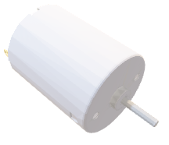
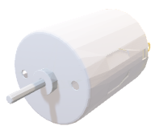
Advanced debugging during development
 | XL3 JTAG | XL7
XL0 | XUF216 | XL6
XL1 | IO | XL5
 | XL2 JTAG | XL4
IDC
 | XL3 JTAG | XL7
XL0 | XUF216 | XL6
XL1 | IO | XL5
 | XL2 JTAG | XL4
 | XL3 JTAG | XL7
XL0 | XUF216 | XL6
XL1 | IO | XL5
 | XL2 JTAG | XL4
CAT6
IDC
IDC
 | XL3 JTAG | XL7
XL0 | XUF216 | XL6
XL1 | IO | XL5
 | XL2 JTAG | XL4
FLASH | XL3 JTAG | XL7
XL0 | XUF216 | XL6
XL1 | IO | XL5
USB | XL2 JTAG | XL4
IDC
 | XL3 JTAG | XL7
XL0 | XUF216 | XL6
XL1 | IO | XL5
 | XL2 JTAG | XL4
 | XL3 JTAG | XL7
XL0 | XUF216 | XL6
XL1 | IO | XL5
 | XL2 JTAG | XL4
IDC
PC
PSU
IDC
IDC

