Slide 1



AIE7
PYTHONIC RAG
Olympia Lilly Bakalis

Slide 2

OVERVIEW
Explain Retrieval Augmented Generation and diagrams
Answers to 4 questions
Extra activity: PDF, distance metrics, metadata
Show concise core code snippets.
Summarize learning points

Slide 3
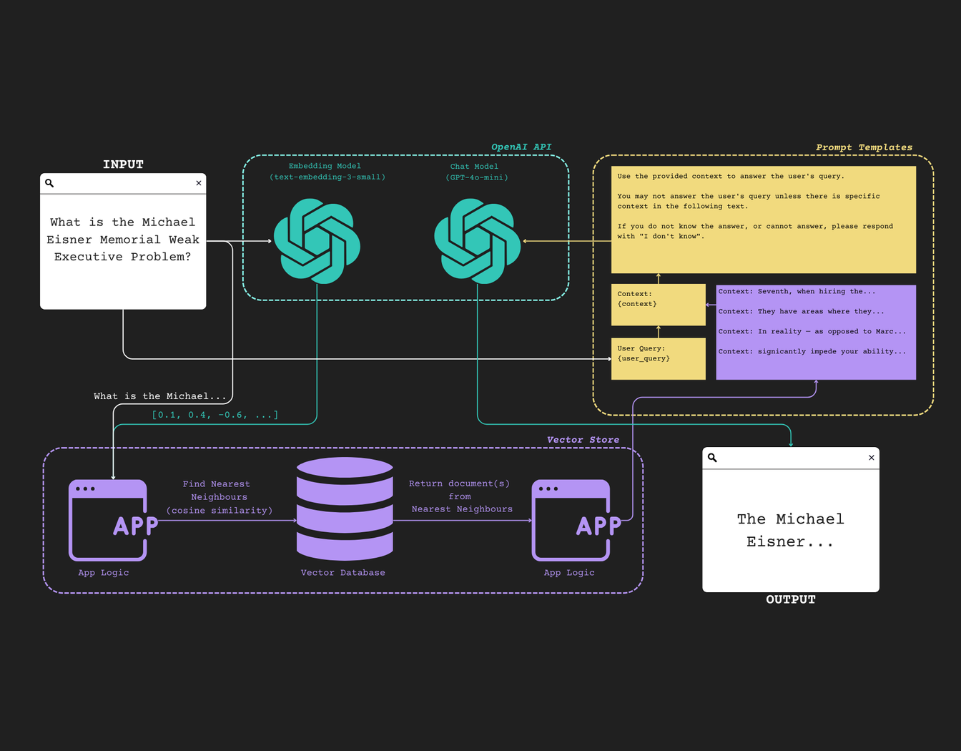

RAG FLOW DIAGRAM
QUERY EMBEDDING RETRIEVAL CONTEXT GENERATION

Slide 4
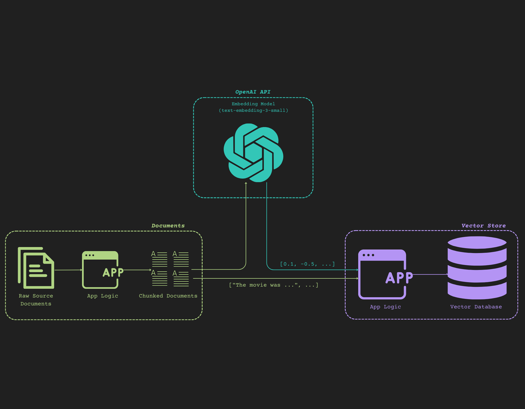
DOCUMENT CHUNKING FLOW

Slide 5
MODELS & DOCUMENTS
LLM Model: OpenAI gpt-4o-mini
Imbedding Model: OpenAI text-embedding-3-small
Document(s) for RAG (text, PDF, HTML, json)
PDF pipeline: PyPDF2 or pdfplumber

Slide 6
PROCESSING SEQUENCE
Load document (PDF, text, HTML, etc.)
Split documents into chunks
Manualy fix left-to-right writing on first page
Add metadata
Create Database
Perform semantic similarity:
Use a distance metric to score vectors by most relevance to each other
Try other distance metrics
Create RAG System prompt and User prompt
Initialize LLM
Create RAG pipeline: vector_db, LLM, scores
Test RAG pipeline with various queries
Use a RAG metric to test performance (in future homework).

Slide 7
QUESTIONS-ANSWERS
❓Question #1:
The default embedding dimension of `text-embedding-3-small` is 1536, as noted above.
Is there any way to modify this dimension?
What technique does OpenAI use to achieve this?
⚡Answer #1
Yes, it can be modified using the dimensions parameter, but the only to 512.
Parameter dimensions could be specified in these methods:
embedding_response = await self.async_client.embeddings.create(
input=batch, model=self.embeddings_model_name,
dimensions = 512)
aget_embeddings(list_of_text=list_of_text, engine=self.embeddings_model_name,
dimensions=512)
❓Question #2:
What are the benefits of using an `async` approach to collecting our embeddings?
⚡ANSWER #2
`sync`: synchronous: tasks executed one at a time, in order. Next task is blocked until previous completes.
`async`: asynchronous: tasks can run in background. Program does other tasks while waiting. Requires event loop (asyncio in Python).
Efficient for I/O tasks
Faster
Non-blocking
Efficient usage of CPU,GPU, network
Scalable: Handles large text lists
Responsive: in UI or other logic

Slide 8
QUESTIONS-ANSWERS
❓ Question #3:
When calling the OpenAI API - are there any ways we can achieve more reproducible outputs?
⚡ANSWER #3
Static model snapshot: Specify the exact model, to use every time.
Temperature = 0
Use seed parameter
Iterate on the prompt and evaluate
❓ Question #4:
What prompting strategies could you use to make the LLM have a more thoughtful, detailed response?
What is that strategy called?
⚡ ANSWER #4:
Depending on the goal, several prompting strategies exist:
Chain of Thought (CoT) reasoning: Ask the model to "think step by step"
Self-ask: Tell the model to ask itself questions and answer them
Simplify: Explain like I'm 5, analyze
Specify a format: step-by-step breakdown, bullet points, sections, etc.
Comparison analysis: pros/cons
Act as expert
Step-by-step reasoning in few-shot examples

Slide 9


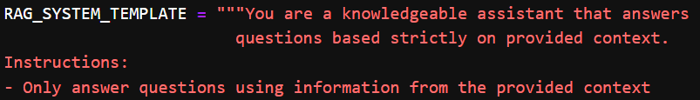
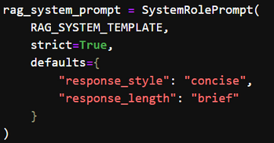
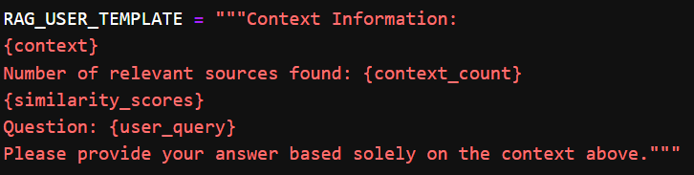
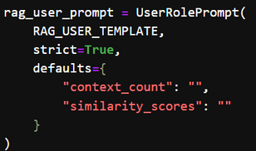
IMPLEMENTATION
RAG PROMPTS

Slide 10
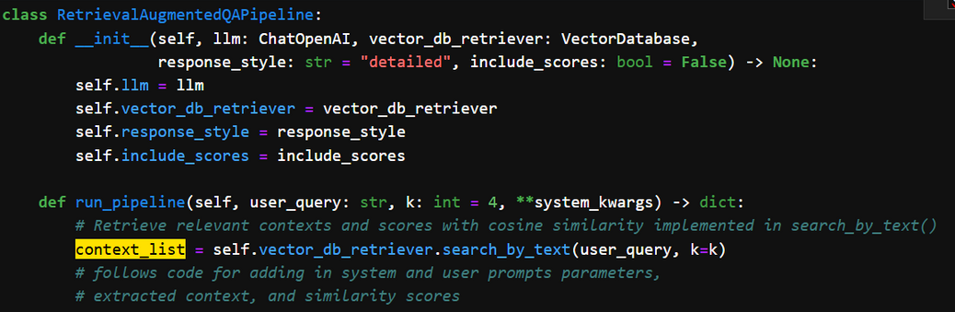
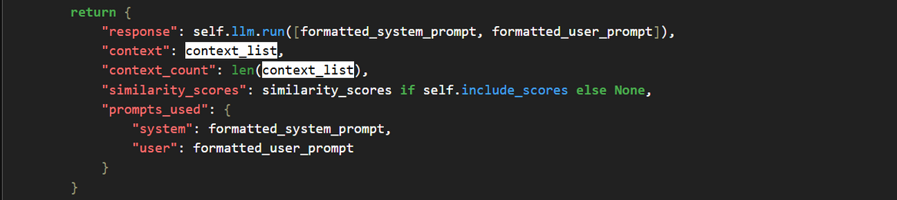
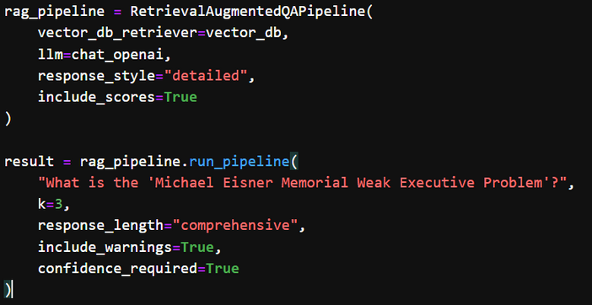
IMPLEMENTATION
RAG PIPELINE

Slide 11

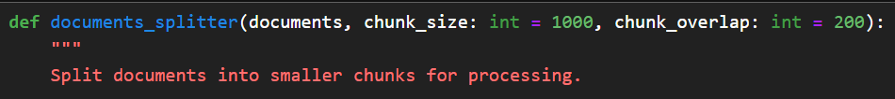

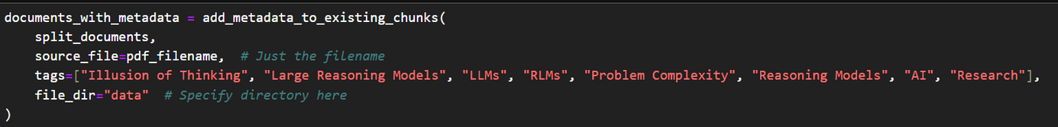
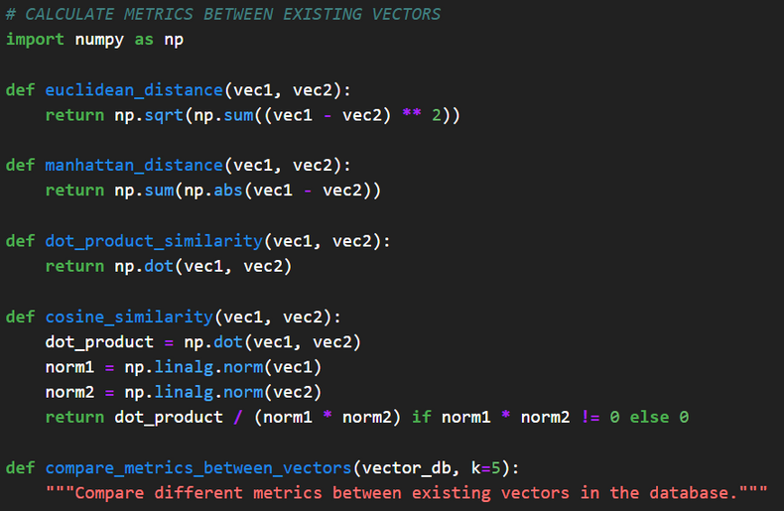
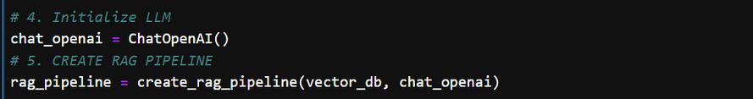
IMPLEMENTATION
PDF RAG PIPELINE

Slide 12
CONCLUSION & LEARNINGS
Understood RAG flow and vector DB.
Improved prompt design
Improved Metadata usage.
Implemented distance metrics.
Gained PDF handling experience.

