Slide 1
Pythonic RAG Assignment Presentation

Slide 2
Purpose & Overview
• Summarize my learning on RAG and vector DB concepts.
• Discuss questions and detailed answers explicitly.
• Show code work: chunking, PDF corrections, metadata, prompts.
• Note: Corrected PDF letters manually due to left-to-right reading.

Slide 3
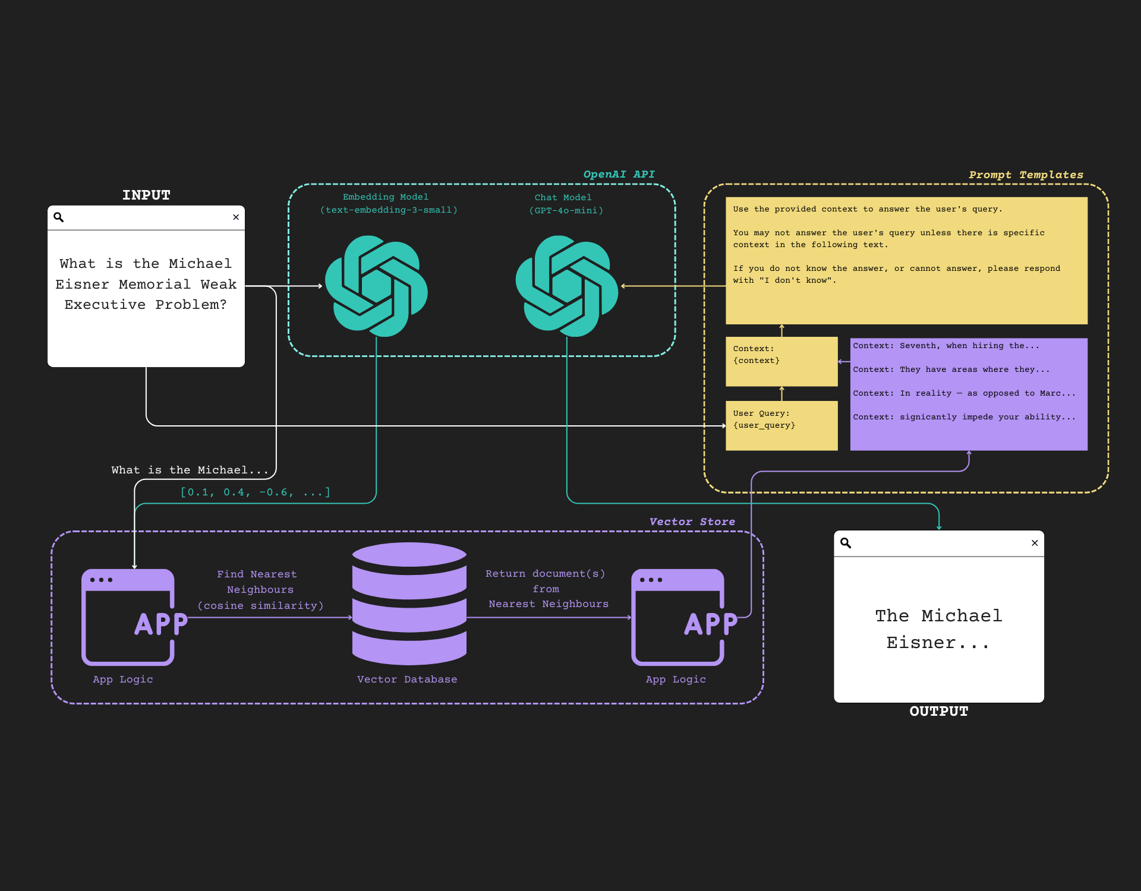
RAG Flow Diagram
Query embedding, retrieval, context, and generation.

Slide 4
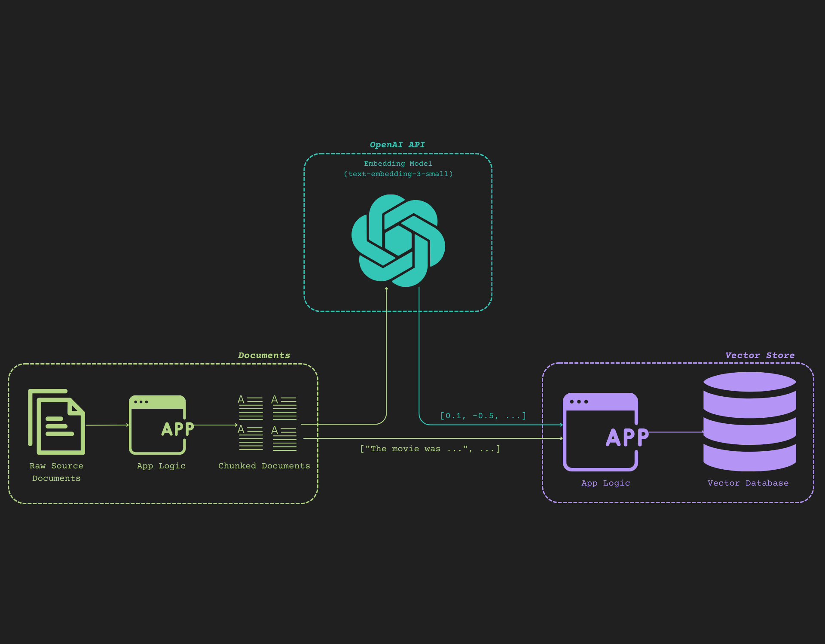
Document Chunking & Vector Flow
Flow from raw docs to chunks to embeddings to vector DB.

Slide 5
Answer #1
Answer #1:
The text-embedding-3-small model allows modifying dimensions via the `dimensions` parameter,
but only supports a smaller choice, 512.
Example code snippet for setting dimensions parameter in EmbeddingModel().

Slide 6
Answer #2
Answer #2:
`sync`: tasks executed one at a time, blocking.
`async`: tasks run in background, non-blocking. Program continues other tasks.
Benefits:
1. Faster overall processing.
2. Efficient use of CPU/GPU/network.
3. Scalable: handles large lists easily.
4. Keeps UI or logic responsive.

Slide 7
Answer #3
Answer #3:
1. Use exact static model snapshot.
2. Set temperature to 0.
3. Use seed parameter when supported.
4. Iterate and evaluate prompts systematically.

Slide 8
Answer #4
Answer #4:
1. Chain of Thought reasoning ('think step by step').
2. Self-ask approach: ask sub-questions internally.
3. Simplify or analyze (e.g., 'explain like I'm 5').
4. Specify output format explicitly.
5. Ask for comparisons or analyses.
6. Ask model to 'act as' an expert.
7. Few-shot examples with step-by-step reasoning.

Slide 9
Chunking & PDF Fix
Code Highlights: Chunking & PDF Fix
- Used CharacterTextSplitter to split large documents.
- Printed chunks to verify correctness.
- Fixed left-to-right PDF character issues manually.

Slide 10
Metadata Handling
Code Highlights: Metadata
- Preferred method: add metadata before creating vector DB.
- Improves filtering and retrieval relevance.
- Example: set metadata dict per chunk during insertion.

Slide 11
Prompt Design
Code Highlights: Prompt Design
- Customized prompt templates for clearer instructions.
- Encouraged model to provide grounded, detailed answers.
- Adjusted structure to match RAG pipeline.

Slide 12
Conclusion & Learnings
Conclusion & Learnings
- Deep understanding of RAG and vector DB usage.
- Importance of metadata strategy.
- Improved prompt engineering skills.
- Debugging skills (e.g., PDF correction) improved significantly.

