Slide 1
Pythonic RAG Assignment Presentation

Slide 2
Purpose & Overview
• Summarize my learning on RAG and vector DB concepts.
• Discuss questions and detailed answers explicitly.
• Show actual code snippets: chunking, PDF fixes, metadata, prompts.
• Note: Corrected PDF letters manually due to left-to-right reading.

Slide 3
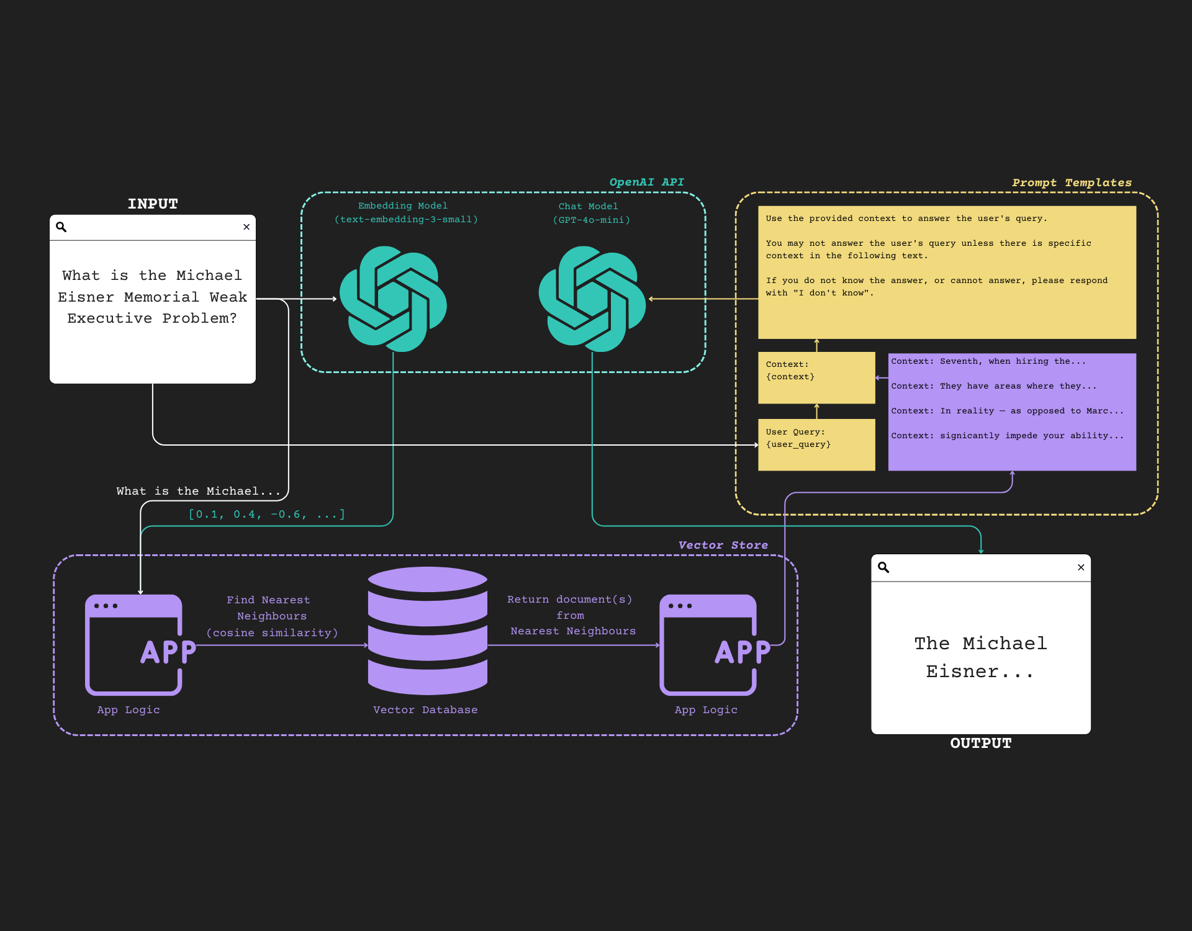
RAG Flow Diagram
Query embedding, retrieval, context, and generation.

Slide 4
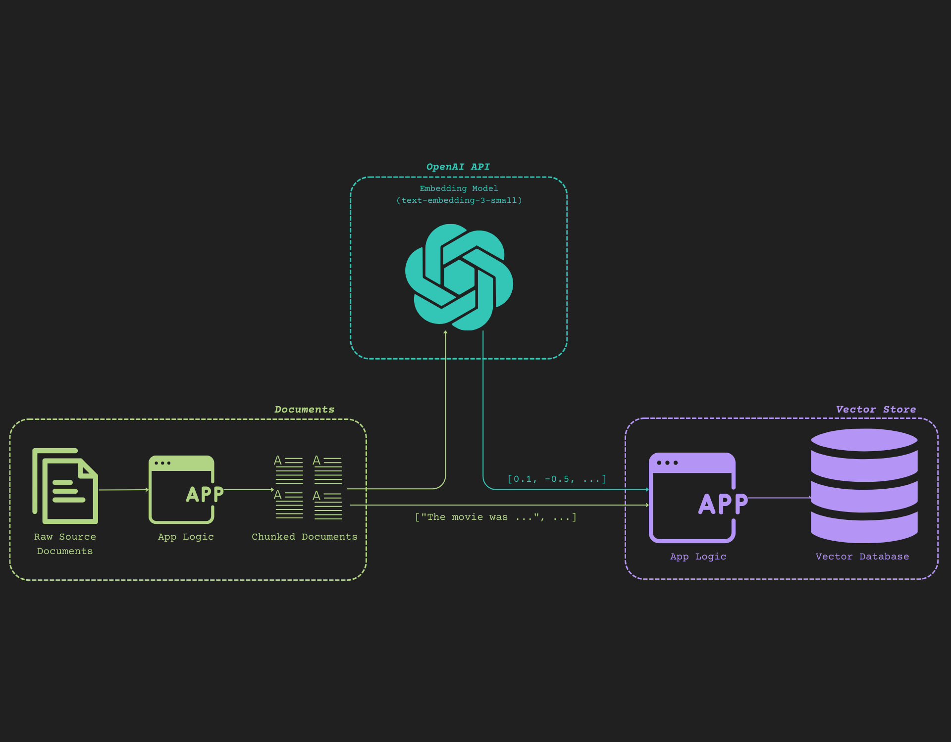
Document Chunking & Vector Flow
Flow from raw docs to chunks to embeddings to vector DB.

Slide 5
Answer #1
Question #1: Can we modify the embedding dimensions in text-embedding-3-small? How?
The text-embedding-3-small model allows modifying dimensions with `dimensions` parameter, but only to 512.
async def process_batch(batch): embedding_response = await self.async_client.embeddings.create( input=batch, model=self.embeddings_model_name, dimensions=512) return embedding_response

Slide 6
Answer #2
Question #2: Benefits of using an async approach for embeddings?
`async`: tasks run in background, faster, scalable, efficient; `sync`: blocks next task until finished.
async def get_embeddings(list_of_text): tasks = [process_batch(chunk) for chunk in list_of_text] results = await asyncio.gather(*tasks) return results

Slide 7
Answer #3
Question #3: How to achieve reproducible outputs with OpenAI API?
1. Use static model snapshot. 2. Set temperature to 0. 3. Use seed. 4. Iterate on prompt.
response = client.chat.completions.create( model='gpt-4o', messages=[...], seed=123, temperature=0 )

Slide 8
Answer #4
Question #4: Prompting strategies to guide LLM behavior?
Strategies: Chain of Thought, Self-ask, Explain simply, Specify format, Ask for analysis, Act as role, Few-shot.
prompt = ''' You are an expert. Think step by step and explain clearly. Format your answer as bullet points. '''

Slide 9
Code: Chunking & PDF Fix
text_splitter = CharacterTextSplitter() split_documents = text_splitter.split_texts(documents) print(split_documents[0])

Slide 10
Code: Metadata Before Vector DB
metadata = {"source": "PMarcaBlogs.txt"} vectordb.add_texts(split_documents, metadatas=[metadata]*len(split_documents))

Slide 11
Code: Prompt Design
prompt_template = ( 'Answer the question based only on context below.\n' 'Context: {context}\nQuestion: {question}\nAnswer:' )

Slide 12
Conclusion & Learnings
Conclusion & Learnings
- Mastered RAG and vector DB concepts.
- Understood metadata importance and placement.
- Improved prompt engineering skills.
- Gained debugging experience (PDF fixes).

