Slide 1
Pythonic RAG Assignment Presentation

Slide 2
Purpose & Overview
• Summarize learning points clearly.
• Show concise core code snippets.
• Explicit questions and answers included.
• Diagrams included.

Slide 3
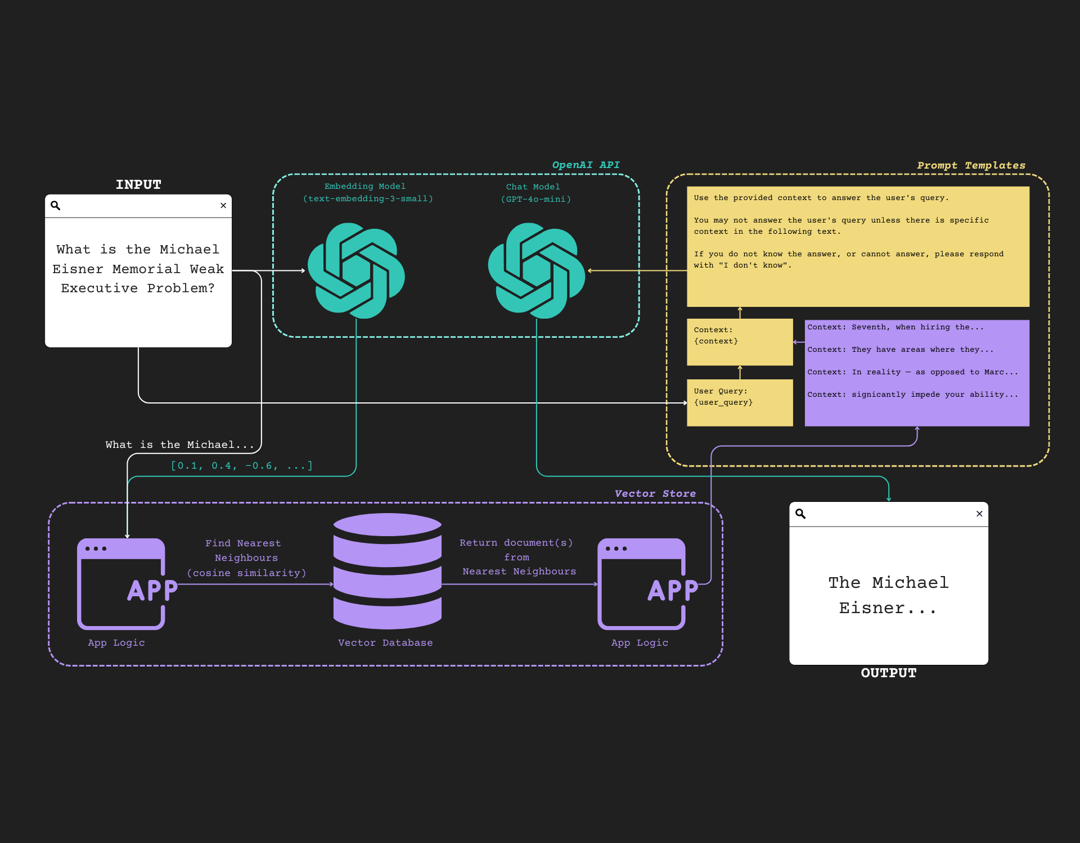
RAG Flow Diagram
Query embedding, retrieval, context, generation.

Slide 4
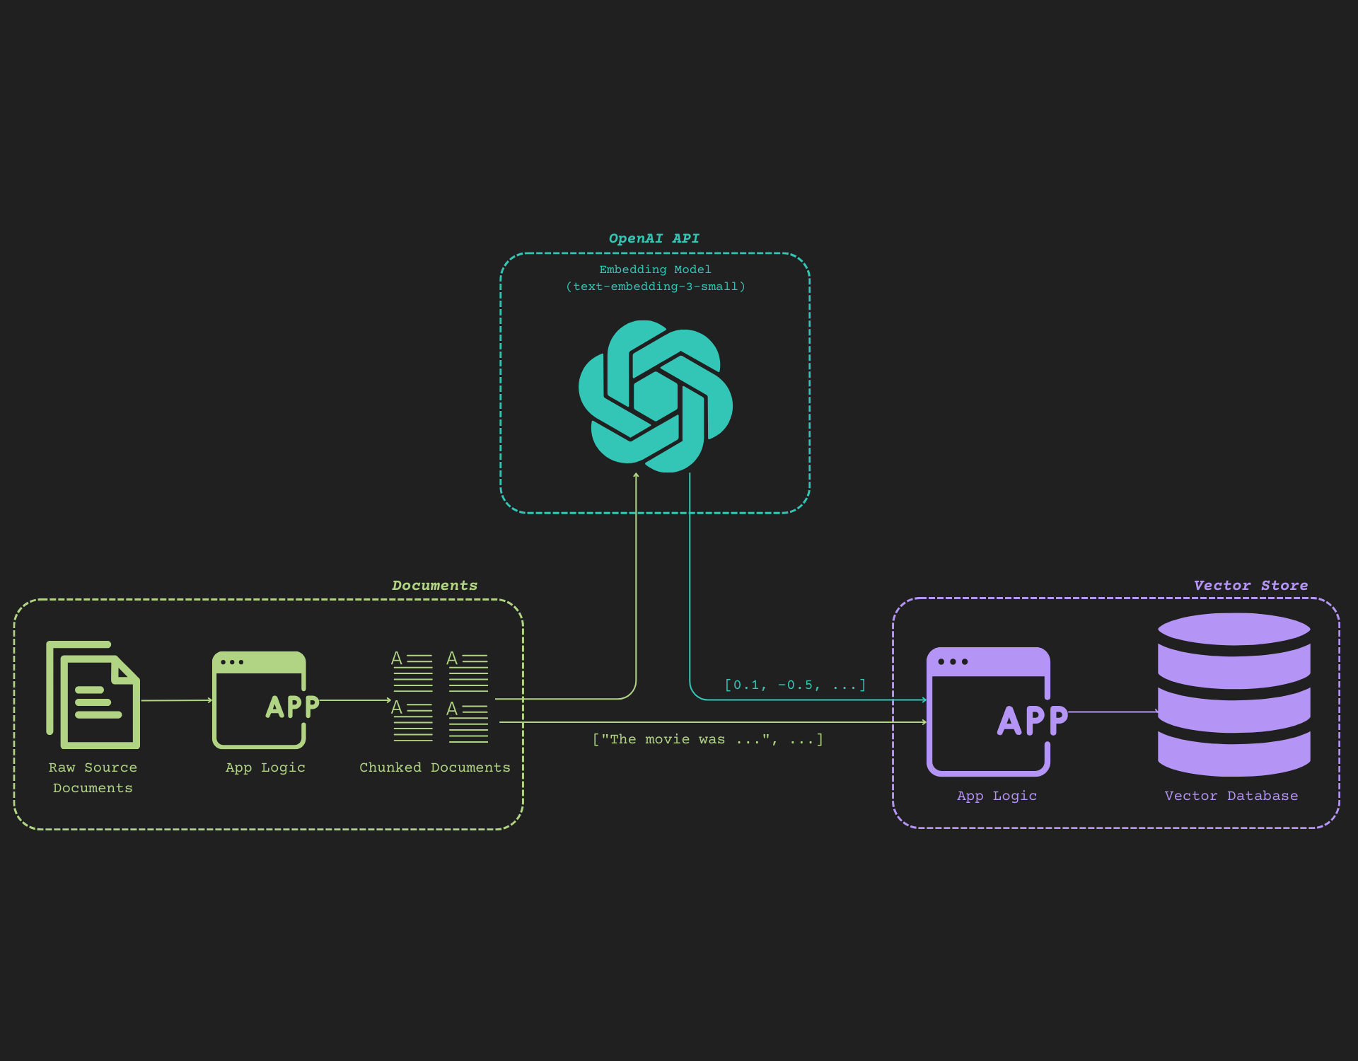
Document Chunking Flow
Document chunking to embeddings to vector DB.

Slide 5
Answer #1
Q1: Can we modify embedding dimensions?
A1: Yes, but only to 512 with `dimensions` parameter.

Slide 6
Answer #2
Q2: Benefits of async approach?
A2: Faster, non-blocking, scalable, efficient for I/O tasks.

Slide 7
Answer #3
Q3: How to achieve reproducibility?
A3: Static snapshot, temperature=0, seed parameter, iterate prompt.

Slide 8
Answer #4
Q4: Prompting strategies?
A4: Chain of Thought, self-ask, simplify, specify format, act as expert, few-shot.

Slide 9
Code: PDF Loading
documents = load_pdf_documents(pdf_path + pdf_filename)
if not documents: print('No documents loaded')

Slide 10
Code: Chunking
split_documents = text_splitter.split_texts(documents)
print(split_documents[0])

Slide 11
Code: Fix Reversed Text
def fix_reversed_text(text):
corrections = {'5202': '2025', 'viXra': 'arXiv'}
for wrong, correct in corrections.items():
text = text.replace(wrong, correct)
return text

Slide 12
Code: Metadata
metadata = {'source': 'PDF File'}
vector_db.add_texts(split_documents, metadatas=[metadata]*len(split_documents))

Slide 13
Code: Prompt Design
prompt_template = (
'Answer using context below.\n'
'Context: {context}\nQuestion: {question}\nAnswer:'
)

Slide 14
Code: Distance Metrics
def euclidean_distance(vec1, vec2):
return np.sqrt(np.sum((vec1 - vec2) ** 2))
def cosine_similarity(vec1, vec2):
return np.dot(vec1, vec2) / (np.linalg.norm(vec1) * np.linalg.norm(vec2))

Slide 15
Conclusion & Learnings
- Understood RAG flow and vector DB.
- Improved prompt design and metadata usage.
- Implemented distance metrics.
- Gained PDF handling experience.

