Slide 1
Pythonic RAG Assignment Presentation

Slide 2
Purpose & Overview
• Summarize the assignment and show understanding.
• Describe questions, images, and activities clearly.
• Explain code and metadata approaches.
• Note: Corrected left-to-right PDF letters manually.

Slide 3
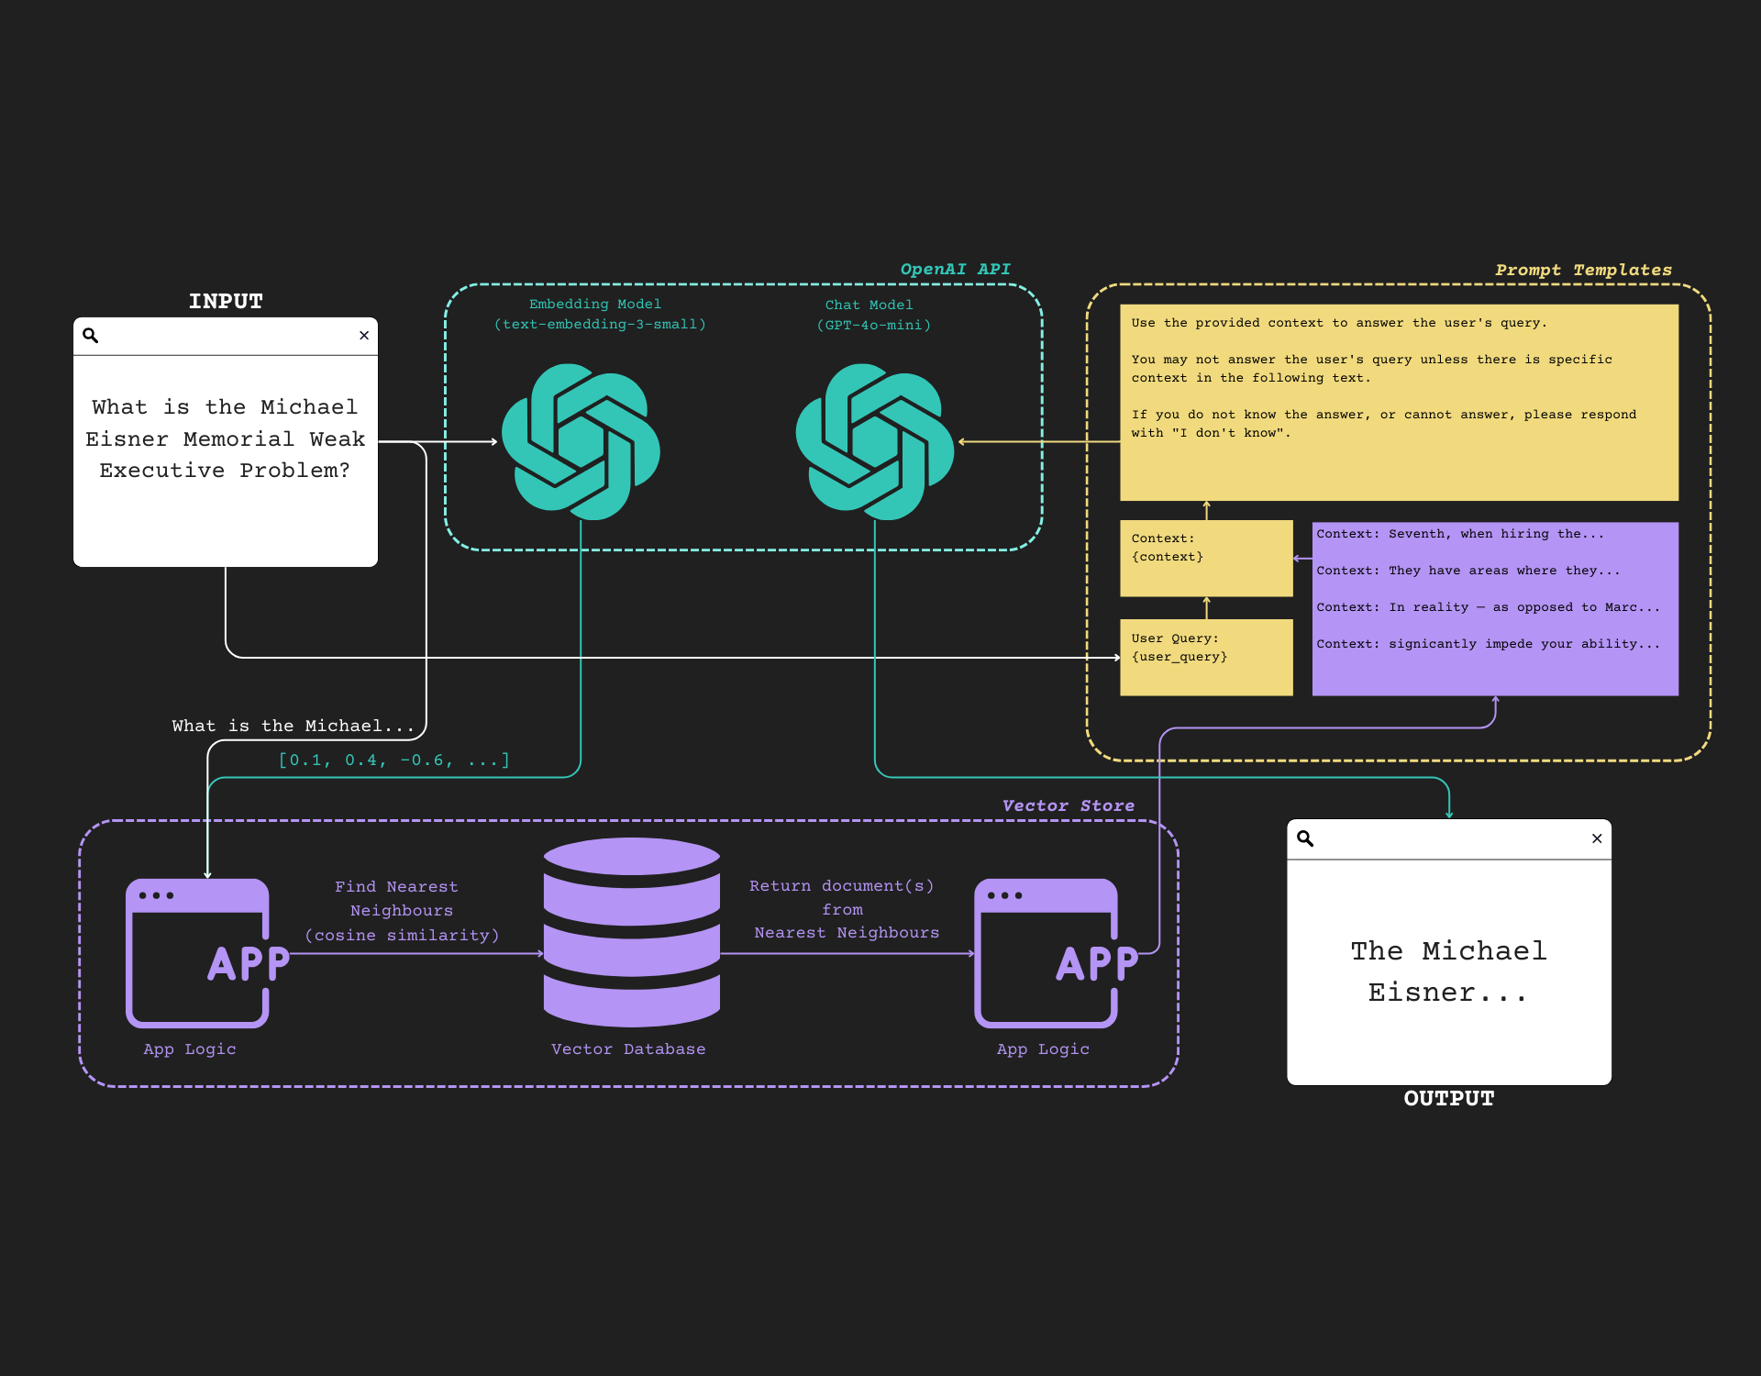
RAG Flow Diagram
Shows query embedding, retrieval, context, generation flow.

Slide 4
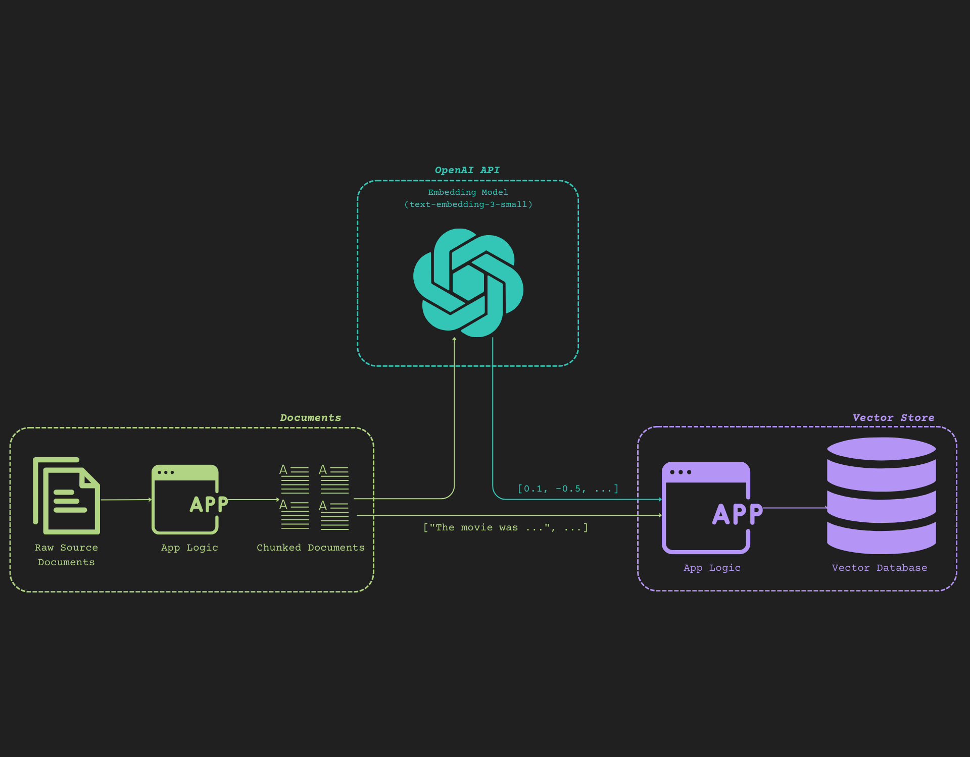
Document Chunking & Vector Flow
Flow from raw documents to chunks to embeddings to vector DB.

Slide 5
Questions & Answers (1/2)
Q1: What is RAG?
• Combines retrieval with generation, grounded on context.
• QA might rely only on parametric model knowledge.
Q2: Query vs Question?
• Query: keywords or partial text.
• Question: full natural language sentence.

Slide 6
Questions & Answers (2/2)
Q3: Metadata advantages?
• Adds context, improves relevance, enables filtering.
Q4: Metadata in vector DB?
• Method 1: After DB creation (initial approach).
• Method 2: Before DB creation (preferred & used).

Slide 7
Activity #1 Overview & Challenges
• Activity #1: Extend RAG pipeline with challenges.
• Challenge 1: Custom chunking logic.
• Challenge 2: Add metadata before vector DB.
• Challenge 3: Improve prompt design and analyze.

Slide 8
Code Highlights (1/2)
• Used CharacterTextSplitter for chunking.
• Checked chunk integrity manually.
• Managed PDF text corrections.
• Prepared documents for embeddings.

Slide 9
Code Highlights (2/2)
• Used async embedding collection.
• Added metadata before creating vector DB.
• Improved filtering relevance with metadata.
• Designed clear, specific prompts.

Slide 10
Conclusion & Learnings
• Learned RAG and vector DB flow.
• Importance of metadata usage and timing.
• Clearer prompt design strategies.
• Debugging skills improved (PDF text fix).

