Slide 1
Ice breaker
Change a movie title to include “AI” or similar terms. Funniest movie title wins!
(Bonus points if you can think of a funny plot twist!)
Notes:
Matt

Slide 2
Welcome to Provider’s AI Monthly Townhall
May 2025
Notes:
Kishore / Sarma

Slide 3
1
Overview
2
Highlights & Updates
Agenda
3
AI SDLC and Platform
4
OPERA AI SDLC Recap
5
Knowledge Spotlight
6
Q & A
Notes:
Kishore / Sarma

Slide 4







Responsible Use of AI
Use Approved Tools Only
No Personal Credentials
Protect IDs & Credentials
Limit usage to AI tools approved by UAIS; avoid unapproved platforms.
Use only official accounts; do not use personal credentials to access AI tools.
Never share login credentials or account information with anyone.
Maintain Confidentiality
Follow Policies
Verify Outputs
Report Issues Promptly
Avoid entering sensitive or proprietary information into AI tools unless authorized
Adhere to organizational guidelines and policies for ethical AI use.
Ensure AI-generated outputs are accurate before using or sharing them.
Report misuse, suspicious activity, or security concerns to the appropriate team.
Notes:
Kishore / Sarma

Slide 5
Provider Data
LOBs
Consumers
Agentic AI
E&I
M&R
C&S
IFP
Optum
Medical
Behavioral
Dental
Vision
Physical
Member
Provider
Clinical
Advocates
Claim
EDI
Regulatory
Customer
50 % AI Enablement for all "Jobs to be done"
Provider Data Load & Maintainence
Demographics automation
Rates Automation
Contracts Automation
Cred Automation
Events orchestration
Provider Directory Accuracy and Maintainence
Provider Search (Keyword, Semantic, Hybrid)
Provider Selection (Member enrollment, Claims adjudication, Clinical, Contracting etc)
Quality Control
Audits
Monitoring
Alerting
Reporting
More…
Credentials
Pricing
Contracts
Demographics
Provider Search & Directories
Provider Pick
Network Configuration
Data

Slide 6


Provider Data Load & Maintenance
Agentic AI* Transformation
Business Opportunity:
Changes in provider data, including demographics, contracts, credentials, and rates, are currently initiated through over 10+ different channels and processed manually or through automation by more than 15+ different personas. The potential exists to implement AI Agents to fully automate all manual processes (end-to-end), thereby enhancing the automation of data loads and increasing the volume per hour (VPH). This approach can significantly decrease turnaround time for updates, enhance the quality of provider data, and lessen the burden of manually updating provider information. It will also have a direct positive effect on both provider and customer Net Promoter Scores (NPS).
Goals:
Enhance Load Automation, Improve Data Accuracy, Reduce Turnaround Time (TAT), Minimize Claim Rework
Rosters
Solution: Near Zero Touch Agentic AI* Workflow Automation
Websites
Intake Agents
Triage Agents
Research Agents
Automation Agents
Exception Handler Agents
Quality Control Agents
Service Agents
Emails
Listener agent to intake & perform initial cleansing activity.
Evaluate the input and allocate it to the appropriate worker agents.
Examine and perform basic business rule validations.
Load data into backend systems.
Handle fallouts from automation.
Perform audit on the data loaded.
Utility agents E.g., Notification, reporting etc.,
Flat Files
Outcome
Automation
23%
100%
TAT
Low
High
Tools Complexity
Low
High
Process Complexity
Low
High
Current State
Future State
Notes:
Add actual intake sources details like website, roster, API etc.,
From the actual intakes, align to domains..no specifics needed. Keep at provider data load & maintenance level..no specifics
In the outcome section, add ‘high touch to low touch’
Remove ’current state process’ & elaborate ‘outcome’
Add ‘Service agents’ to the solution & cover reporting, notification etc.
Remove #’s from outcome..be generic
Slide 1 would cover why, what & benefits.
Move MVP to slide 2
Task mining for ‘how’ will be later
Ask for $6M for demo agents.

Slide 7
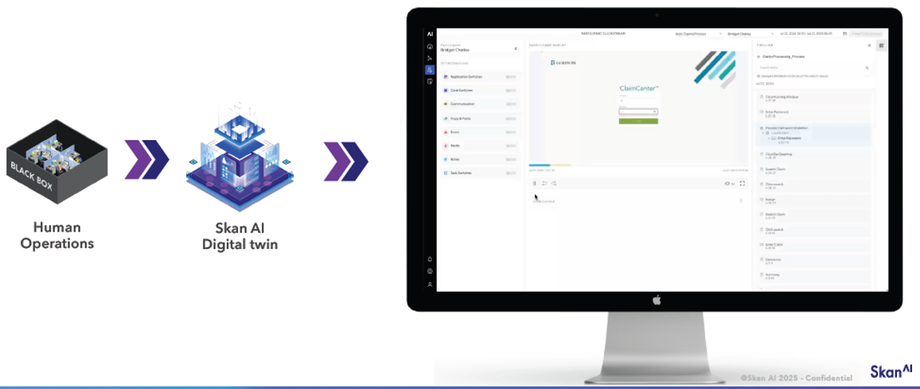
Digital Twins can provide the ‘Reality of Work’ – serving as Training Data for Agentic AI platforms
Direct modeling of human actions powered by SKAN AI’s Digital Twin Architecture – a proxy replica for of end-end digital processes and human-centric workflows!

Slide 8

Highlights & Updates
Notes:
Sarma

Slide 9
Agent Status
S.No | Agent | Capability | Status | Date | Comments
1 | NPPES (National Plan & Provider Enumeration System) Registry | Data Research | Deployed | 04/30 | Pending MLRB
2 | Network Database Provider ID Validation | Data Research | Deployed | 04/30 | Pending MLRB
3 | Peoples Health | Data Research | Development | 05/31
4 | NDB Active Hold | Data Research | Development | 05/31
5 | CME Assist | Data Research | UAT | 05/31
6 | Address Automation | Data Research | UAT | 05/31
7 | Determining a Delegated Provider | Data Research | Grooming | 06/30
8 | Determining a Shared Provider | Data Research | Grooming | 06/30
9 | Check Medicaid ID Requirement | Data Research | Grooming | 06/30
10 | Determining Credentialing requirements | Data Research | Grooming | 06/30
Notes:
Sarma

Slide 10
Agent Status
S.No | Agent | Capability | Status | Date | Comments
11 | Provider Type Determination | Data Research | Grooming | TBD
12 | Rocky Mountain validation | Data Research | Grooming | TBD
13 | Med Nec validation | Data Research | Grooming | TBD
14 | Open Market validation | Data Research | Grooming | TBD
15 | Dup Address validation | Data Research | Grooming | TBD
16 | Effective date Validation | Data Research | Grooming | TBD
17 | Best Phone Number validation for Calling a provider. | Data Research | Grooming | TBD
18 | On-Base Voice call transcription | Data Research | POT | TBD | Waiting for confirmation
19 | PDA Provider Website Data Extractor | Data Accuracy | MLRB | 05/13 | MLRB Review
20 | Trust Evaluator- MS Address Model | Data Accuracy | Dev |  | MLRB Pending
Notes:
Sarma

Slide 11
AI Agents for CLM Migration
Work Streams | Capabilities | AI Agents | Config
Cleanse Assist | Ability to pull contractual data elements and house into CLM internal database. This will allow the data cleanse utility to pull the appropriate data elements to be cleansed for data migration. | 1. Retrieval Agent 2. Timely Filing 3. Reg App Agent (App name & Footer) | Auto Job, Batch processing
PayApp Digitizer | Ability to digitize, capture and report on critical data, that supports UB and Free-Standing Migrated Payment Appendices and allows for future rate escalator or charge master adjustments. | 4. Table Extraction Agent 5. Language/Clause/Rates Extraction Agent | User can load any type of contracting payment appendices.
Intake Assist | Enable best in class user experience, accounting for integrations with source applications including Provider elastic Search and Market Pricing Schedule Database (MSPS) and allows for Approval workflows-including termination, Notifications and Alerts, Roster management, Mass Actions (Mass Contract, Mass Amend, Mass Attach) and complex rate conditions. | 6. Validation/Rule Agent 7. Rate Table Creation Agent | User can bring any rule tool and integrate with existing pipeline.
Migration Assist | Allow the data cleanse utility to pull the appropriate data elements to be cleanse as well as define data elements for data migration. Allow cleansed data to be migrated to Contract Hub | 8. Migration Agent 9. Quality Agent | User can bring any quality check tool and integrate with existing pipeline.
Integration Assist | Ability to retrieve data from Contract Hub (SOR) and map it to downstream applications SOT i.e Provider Data Platform. | 10. Mapper Agent 11. Integration Agent 12. Email Agent | User can bring any email generation tool and integrate with existing pipeline.
Report Assist | Ability for end users to generate reports on data out of Contract Hub, that aligns to the data model, including pushing the data to Provider Data Platform for all business partners to consume, including contract load teams, Overpayment Recovery Management Services (ORMS), NDAR, Clinical Teams (OCM), IMPACT, INSIGHTS, etc. | 13. Load Agent 14. Notification Agent 15. Report Agent | User bring in any report generation/email generation tool..

Slide 12

AI SDLC and Platform
Notes:
Tom

Slide 13
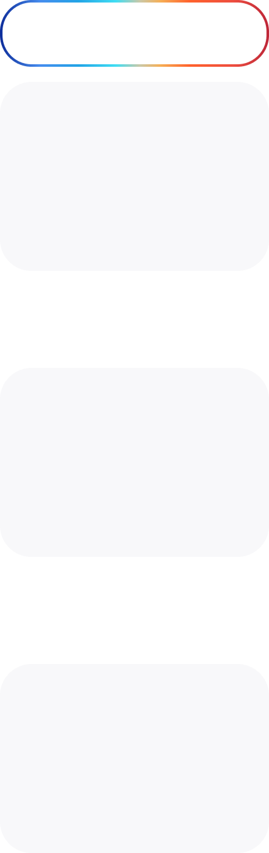









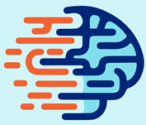



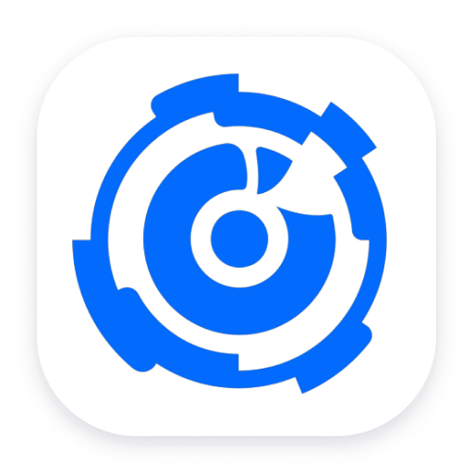



Software Development Lifecycle (SDLC) powered by AI
Plan
Arch & Design
Code
Test
Release
Deploy
Operate
Monitor
Create stories, capabilities, apply acceptance criteria
Design Arch Docs & UI with AI, incl. coding, wireframes
Code with AI partner
Enable self healing, observability with Gen AI
Automate with AI
Plan and orchestrate
Automate push-button deployments
Route tickets, prioritize, analyze and optimize with AI
Personas in the journey
Product
Owner
UI/UX Designers & Developers
Engineers
QA/Testing
Engineers
Engineers
Ops
Engineers
Ops
Engineers
Product
Manager
SRE
Architects
Apps in the journey
ArchWizard
PR review
Data Factory
Storycraft
DSPy AI
Locust AI
Origin Release Calendar
GitHub Actions
Helix
Dynatrace Davis AI
Netra AI
Github
Copilot
TestGenie
Story Lens
Codey

Slide 14


GCP Platform Stack – Opera AI
Sandbox
Non-Prod Environment
Prod Environment
Internally segregated with Dev, Test and Stage environment
Access granted for approved projects
UAT Signed off and MLRB Approved projects deployed
Hackathons
POT Experimentation
Access will be granted for 30 days
Notes:
Kyle

Slide 15
OPERA AI
SDLC Recap
Notes:
Tom

Slide 16




What is OPERA AI Assistant?
Problem Statement
Current processes for data researchers and loaders are heavily reliant on manual validations and intricate standard operating procedures (SOPs), resulting in inefficiencies and complexity when performing even basic tasks.
Approach to AI Adoption
OPERA AI leverages AI to streamline task automation and enhance integration with tools such as Digital First Intake, Provider Console, PhyCon, and CORE, deploying AI agents tailored to user workflows for improved efficiency and productivity.
Accomplishment Goals
Increase VPH for teams with Opera AI Agents (10%+) in 2025
Provide AI Assistance to 50% of PDO teams in 2025
Notes:
Tom

Slide 17
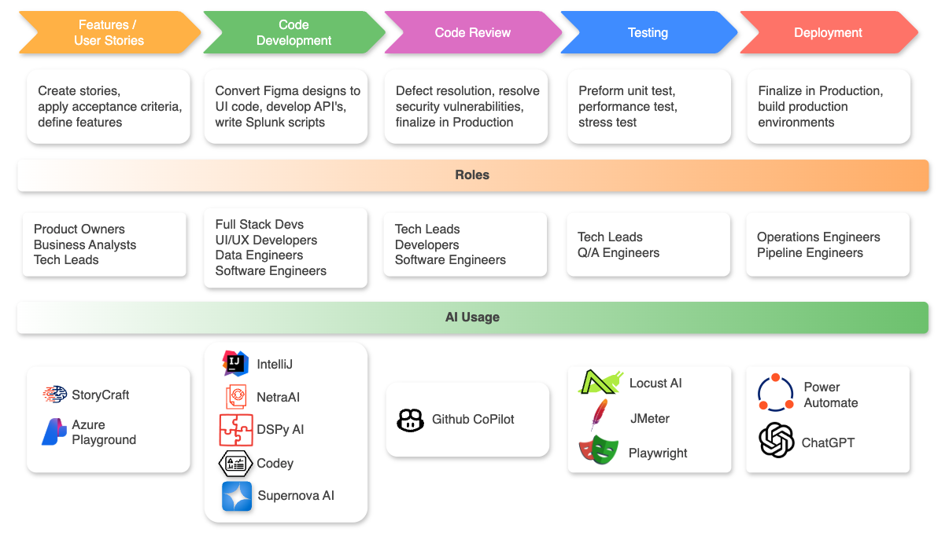
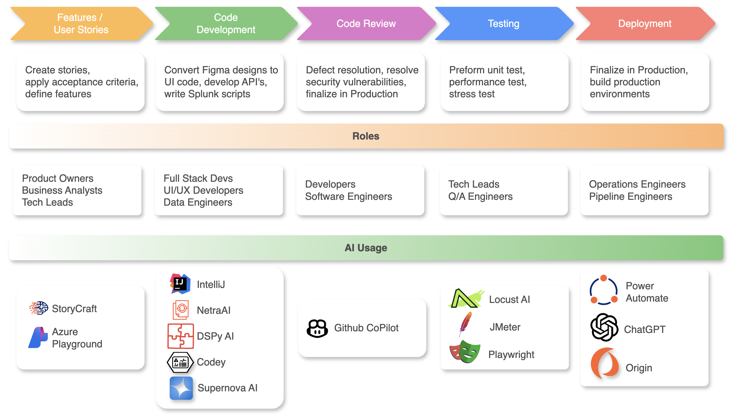
Notes:
Tom

Slide 18
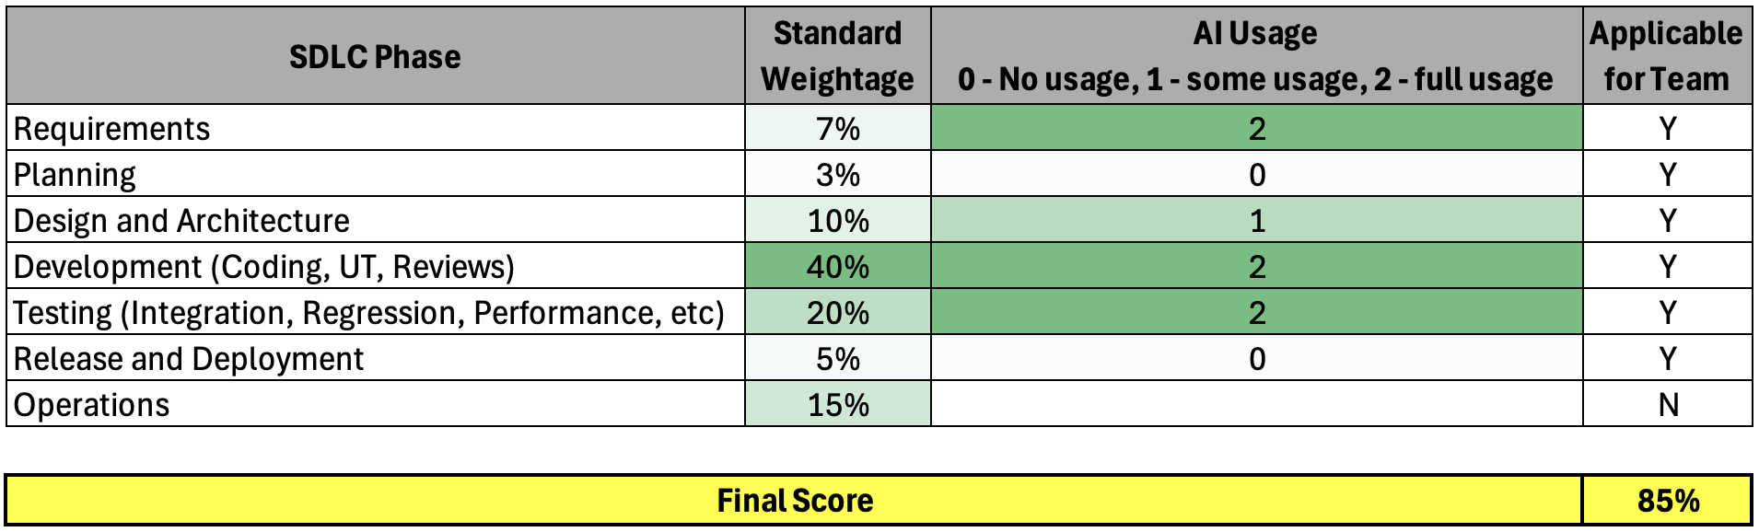
Scoring
Notes:
Tom

Slide 19







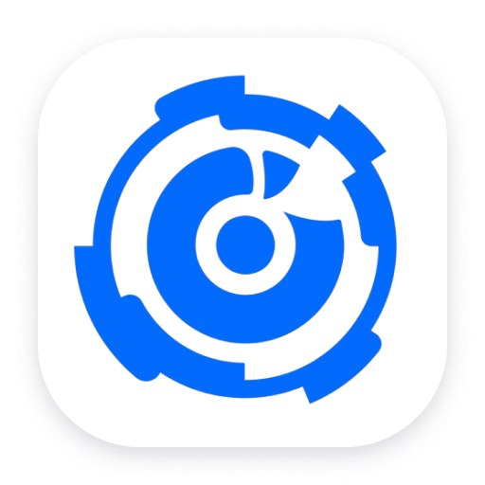


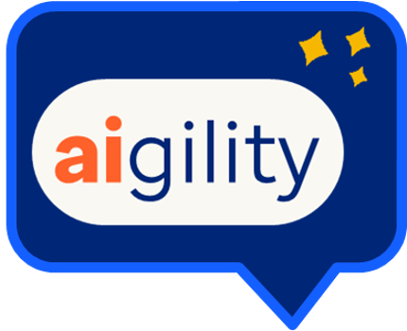
Future AI Adoption
Planning & Requirements
Architecture & Design
Development
Testing
Deployment & Monitoring
Netra AI
PR Review Agent
AccelQ
Davis AI
StoryLens
Codey
Github Copilot
TestGenie
Aigility
ArchWizard
Notes:
Tom

Slide 20
Rapid Learning: Splunk Dashboards using LLM
Problem
Solution
Results
Used DSPy, an open-source framework for building AI systems with LLMs.
Created a DSPy script to:
Break down complex Splunk SPL queries into simpler sub-commands.
Leverage parallel LLM calls to explain each query component.
Generate structured, automatic markdown documentation.
🥇
Production-ready dashboard completed in less than 2 days
Automated, reusable documentation for ongoing use
Accelerated onboarding of team members to complex SPL queries
Needed to quickly build Splunk API monitoring dashboards with no prior Splunk experience.
🥈
Coded in < 2 Days
🥉
Notes:
Kyle

Slide 21

Knowledge
Spotlight
MCP & ADK
Notes:
John or Matt

Slide 22





Model Content Protocol (MCP)
Supercharging Task Automation
Why use MCP for Task Automation?
MCP is an open, standardized protocol that connects AI applications to a wide range of tools and data sources.
It follows a client-server architecture: an MCP host connects to MCP servers, each exposing specific capabilities.
The Opera AI chatbot is in the process of becoming an MCP host application to streamline task automation.
Plug-and-Play Extensibility: New capabilities can be added by simply connecting new MCP servers—minimal changes needed to the chatbot
Standardized Integration: Any team can build an MCP server to extend the chatbot’s skills, following a common protocol.
Future-Proof: Easily switch or add new tools, APIs, or data sources as business needs evolve.
How it works
Results
The chatbot (MCP host) connects to MCP servers.
Each server provides focused automation tasks (e.g., validating NPIs, checking for corresponding MPINs).
The chatbot routes user requests these modular, composable services.
Rapidly expand your MCP host's automation power with minimal code changes—just connect more MCP servers!
Notes:
John

Slide 23

Agent Developer Kit (ADK)
What is ADK?
ADK is a toolkit that allows developers to design and build hardware accessories that communicate with Android devices via USB or Bluetooth. It simplifies the process of enabling hardware components to interact with Android apps and features.
Advantages
Seamless Integration: Enables smooth hardware-Android communication.
Cross-Platform: Works across Android devices and versions.
Flexible Connectivity: USB and Bluetooth support.
Developer-Friendly: Pre-built libraries and open-source resources.
Enhanced
Agent Creation
Orchestration
Centralized Control: Coordinate multiple agents from a single Android device.
Distributed Systems: Synchronize AI agents across platforms for scalability.
Task Management: Assign roles and adjust workflows in real-time.
Error Handling: Monitor and recover from agent issues seamlessly.
Notes:
Kyle

Slide 24




AI SDLC Guild Top 5 Posts
Github Copilot Chat + Locust = Performance Testing Made Easy!
Jonathan Dorogoer,
April 24th, 2025
Leveraging AI to Accelerate Vulnerability Resolution
Rohit Chauhan,
April 24th, 2025
Bringing Better Productivity and Quality with StoryCraft
Narpendra Napit,
April 23th, 2025
Streamlining Git Commits with GitHub Copilot
Kyle Mooney,
May 6th, 2025
Revolutionizing Mainframe Development
Asad Farooq,
April 25th, 2025
"Hey Team! Here's a quick tip: Use Copilot with Locust to generate a functional performance test script instantly—faster, easier, and perfect for rapid API testing. Give it a try!"
"Our Cloud Teams are excited to introduce the Vulnerability Information Assistant (VIA)—an AI-powered, collaborative platform designed to streamline security vulnerability remediation across the organization by transforming isolated efforts into a centralized knowledge base."
“The Premium Designation Team is excited to share the positive impact of StoryCraft, our smart AI tool designed to assist product owners in efficiently transforming requirements into actionable work items like capabilities, features, user stories, and acceptance criteria.”
"I streamline Git commits using GitHub Copilot's Agent Mode and custom prompts in VSCode to draft consistent messages based on staged changes following the Conventional Commits format."
"Integrating GitHub Copilot with our legacy mainframe codebase using zOWE has revolutionized code reviews, boosting productivity by automating best practices, identifying improvements, and ensuring coding standards for COBOL and JCLs."
Notes:
John

Slide 25
Q&A

