Slide 1
Health Insurance

Slide 2
Agenda
Is high-deductible insurance good?
What is the tax treatment of insurance?
Economic view of health insurance

Slide 3
Out-of-Pocket Max vs Deductible
Insurance pays full bill
Patient has met out-of-pocket max
Out-of-Pocket Max
Patient and insurance split bill
Patient has met deductible but not out-of-pocket max = max amount on bills the patient is liable for in a given year
Deductible
Patient pays full bill
Patient hasn’t met deductible = the amount a patient pays in a given year before insurance pays any part of bills

Slide 4
What Counts Towards Out-of-Pocket Max?
Out-of-pocket max = max amount on bills the patient is liable for in a given year
premiums (monthly fees for insurance) do not count toward out-of-pocket max
deductible + coinsurance (percent of each bill that the patient pays for) + copay (flat rate for each service) count toward out-of-pocket max

Slide 5
Design a Health Insurance Offering to Reduce Health Care Costs
Deductible = amount patient pays in a year before any insurance pays for any bills
Copay = flat rate patient pays for each service
Coinsurance = percent of each bill that patient pays for
Out-of-pocket max = max amount of provider bills patient pays in a year
What should be High? | What should be Low?
- deductible – create patient sensitivity to cost; but no deductible for preventative care; deductible creates a non-linearity where health care becomes “free” after a certain month of the year - coinsurance high, instead of deductible, to avoid a kink in incentives - copay high - maybe have an income specific level (what is “high” for one person is “low” for another) | - need a max out of pocket because we need to pool

Slide 6
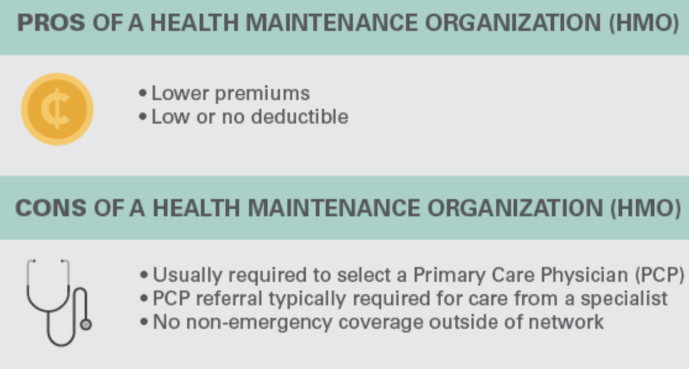
Health Maintenance Organization (HMO)
Financial Costs of a Health Maintenance Organization (HMO)
Relatively low premiums (monthly payments)
Low deductible or no deductible
Service in a Health Maintenance Organization (HMO)
Usually required to select a Primary Care Physician (PCP)
PCP referral typically required for care from a specialist
Only emergency coverage outside of network (usually)
Source: Medical Mutual

Slide 7
Preferred Provider Organization (PPO)
Financial Costs of a Preferred Provider Organization (PPO)
Higher premiums (monthly payments)
Usually have a deductible
Service in a Preferred Provider Organization (PPO)
No need to select a Primary Care Physician (PCP)
No referral needed to see a specialist
Coverage outside of network
Source: Medical Mutual

Slide 8
High Deductible Health Plan
Financial Costs of a High Deductible Health Plan
Relatively low premiums (monthly payments)
High deductible
Service in a High Deductible Health Plan
Can be within a PPO or HMO plan and have related service features
Usually has a broader network of providers than a traditional HMO
Eligible for an HSA – a health savings account that is pretax money you can put aside to cover medical expenses; this money can be withdrawn after age 65 with no penalty

Slide 9

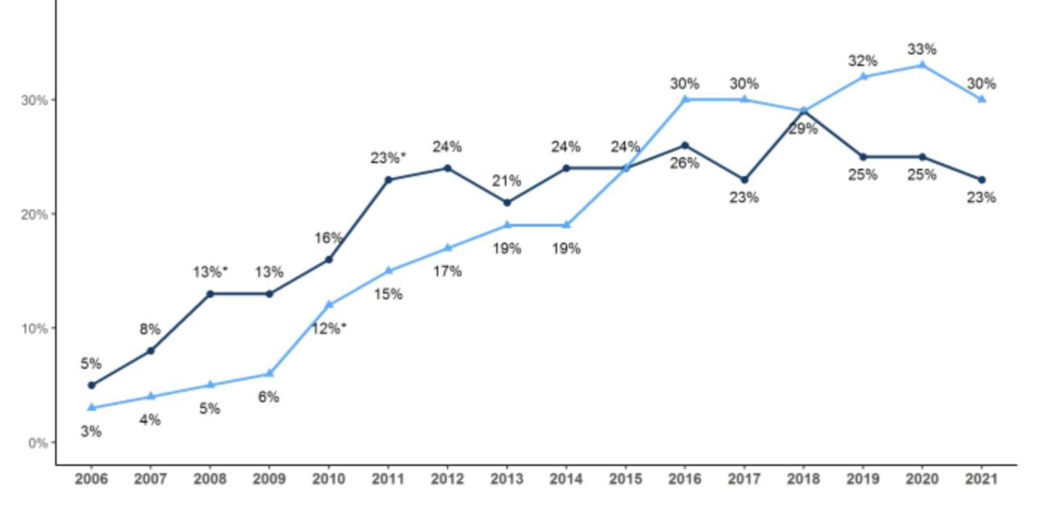
High Deductible Health Plan Growth
Employees Covered by High-Deductible Health Plan
Source: KFF 2021 Survey

Slide 10
Which plan? Why?
Plan | Why
Health Maintenance Org.
Preferred Provider Org. | - given that PPO comes with options, and that certain levels of the Definity plan have a deductible that would mean paying more than the PPO if surgery is above $6k, go with PPO to minimize cost
High Deductible | - family; husband is planning to get surgery-will hit deductible quickly; better options in terms of where to get surgery

Slide 11
Is high-deductible health insurance good for employers? For society?
Yes | No
- good for younger patients? - but what about for employers and society? – depends on the income of the employees (high-deductible may be too big a burden for low-income employees) - good to have as an option to meet different preferences | - not good for elderly patients?

Slide 12
How much of your money (vertical axis)?
PCA - prem
-premium
HMO
Low
-premium
PPO
Med
-oop - prem
High

Slide 13
How much of your money?
 | HMO (Health Part) | PPO (Medica) | Definity Low | Definity Medium | Definity High
Monthly premium | -146 | -243 | -115 | -71 | -33
Annual premium | -1,752 | -2,913 | -1,382 | -847 | -398
PCA (=HRA) |  |  | 2,000 | 2,000 | 2,000
Out-of-Pocket Max | -3,000 |  | -1,000 | -3,000 | -5,000
Example -7,000 | -1,762 | -2,953 | -2,382 | -3,847 | -5,398
In-Network, Annual Financial Impact on Patient:
HMO = -$10 copay - $1752 premium
PPO = -$40 copay - $2913 premium
Definity = Max of [(PCA + visit costs), Out-of-Pocket Max] + premium

Slide 14
Health insurance plans—attractiveness as a patient
In general...
HMOs good if patient is happy with in-network care
PPOs good for out-of-network care
Consumer directed care good if the patient is healthy and unlikely to need care

Slide 15
Do HMO, PPO, and High Deductible Plans Enable Value?
Delivery Model | HMO | PPO | High Deductible
Stakeholder | Patient/Provider | Patient | Patient
Autonomy: PCP gets to dictate care
Information: similar to PPO, not much for shopping around with (but PCP interaction can produce info)
Incentives: weak in terms of cost saving
Autonomy: Patient gets to dictate care
Information: similar to HMO
Incentives: weak, like HMO
Autonomy: Patient gets to dictate care
Information: - definity gives info to shop around
Incentives: patient has incentives to manage cost of care
V-Rank: Autonomy V-Rank: Information V-Rank: Incentives | __2_ __2_ _2__ | _3__ _3__ __2_ | _1__ _1__ _1__
Notes:
Providers, All models – information, autonomy
Providers fee-for-service – incentives to go high cost
Providers fully capitated – incentives to go low cost and high quality (high prevention) to avoid downstream costs
Providers per-member per-month primary care – incentives to go low cost and not necessarily high quality (high prevention) to avoid downstream costs, but some incentives to do this to justify expense—substantially different than fee-for-service? Unclear – so looks like an innovative model but isn’t set up in a way for that model to really work – (maybe from the patient perspective there is more incentive to get primary care because copays aren’t involved, and maybe that reduces downstream costs)

Slide 16
How Can Medtronic Improve its Health Insurance Offering Strategy?
Employee satisfaction?
Options are good
Consumer support because Definity is more complex
Value? (it’s self-insured, paying 75% to 80% of care costs)
Give more incentives to get high quality, low cost care
Incentives for wellness and preventative care

Slide 17
Agenda
Is high-deductible insurance good?
What is the tax treatment of insurance?
Economic view of health insurance

Slide 18
Tax Treatment and Opportunity Cost
$10,000 contributed by employer for health insurance
What is the opportunity cost?
What are the implications?

Slide 19
Average Employer and Individual Payment for Premiums
Source: Kaiser Family Foundation Employer Health Benefits 2022 Annual Survey
Notes:
Figures 6.6
Worker paid nearly all premium indirectly (in wages foregone)

Slide 20
$10,000 in Health Insurance or Taxes
Health insurance
Taxes
Income after taxes

Slide 21
Tax treatment of insurance is inefficient and unfair
Tax deductibility of insurance premiums
unfair (disproportionately benefits those who work full time at firms with more than 50 people)
inefficient (increases demand for health care)
2014: Affordable Care Act included “Cadillac Tax” – 40% excise tax on high-cost employer health plans
Barrier to choice: pre-tax employer money pays premiums for employer sponsored plans
2019: DHHS final rule allows employers to provide a Health Reimbursement Arrangement (HRA) so that employers can get market-place insurance that they choose and get premiums reimbursed for with pre-tax employer money

Slide 22
Agenda
Is high-deductible insurance good?
What is the tax treatment of insurance?
Economic view of health insurance

Slide 23
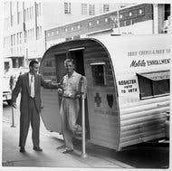
Why does the US have Employer-Sponsored Health Insurance?
WW2 and Wage Freezes:
US workers diverted into military service
Labor shortage caused a spike in wages as companies competed
Pres. Roosevelt worried this would cause inflation and so froze wages
Companies offered benefits instead
IRS Rule:
In 1943, the IRS made employer-based health insurance exempt from taxation
Does this make sense anymore?

Slide 24
How does tying health insurance to an employer affect health care?
Market efficiency?
Restricts choices
Health?
Subsidizes care, but that could be done outside of an employer

Slide 25
An economist’s view of US insurance
Consumer-driven care
Is efficient. Who knows you best?
Requires information
Is not a panacea for uninsured or controlling costs for outliers
Taxes and insurance
Tax treatment of insurance encourages insurance
Which encourages health care
Which increases spending

Slide 26
“Payvider” – From Humana, April 3 2023
Humana's Dr. Vishal Agrawal sheds light on insurer investment trend
Dr. Vishal Agrawal, chief strategy and corporate development officer at Humana
Insurance companies have been increasingly investing in clinician operations, particularly primary care and home health providers who service Medicare enrollees.
Over the past few years, we’ve seen so much insurer investment in provider assets. What’s behind this increase in funding?
“We believe the broader construct behind the “payvider” phenomenon is the realization that the provider’s patient and the payer’s member [are] really the same customer. If [providers and payers] are both looking after the customer’s best interests, we actually want the same thing, and so our intention is to start acting like that.
Integration helps us evolve what sometimes can be an adversarial relationship into a highly collaborative one by designing workflows that simplify the experience for all the stakeholders, as well as better aligning incentives and building tools that reduce waste in the system. Both of those lead to better health outcomes for our patients and members.
...why we are buying and building assets like primary care and home health: Ultimately, [the strategy is] driven by the underlying health risk of [members in] our core lines of business, like Medicare Advantage, Medicaid and dual-eligibles. About 70% of our Medicare Advantage book has two or more chronic conditions. Those same members are largely served today by a health system that’s oriented toward acute-care services. In some markets, patients are still using the emergency room for their primary care needs. So we started to build out what we’re calling our value-based care ecosystem, which is effectively a chronic care management platform specifically oriented toward managing chronic care needs both upstream and downstream from our acute-care delivery partners. The components of that ecosystem are primary care, home health, pharmacy, social determinants of health and behavioral health services. When you bring those together, you can have a more holistic view of managing chronic health.”

Slide 27
“Payvider” – From Humana, April 3 2023
What excites you about health care?
“Many comment about how the U.S. healthcare system is not a healthcare system, but a sick care system. Well, I’m really hopeful that sentiment changes as we continue to build out CenterWell, and as, frankly, several of the other innovators that are out there are merging.
I’m hopeful that the care from a customer perspective is more personalized; it’s more simple; it’s more coordinated. [I’m hopeful] it’s more omnichannel, so customers can access services however they want. I’m hopeful from a provider perspective that care delivery becomes more team-based; that we enable providers to work at the top of their licenses; that we have technology that supports actual care delivery versus simply billing.
Ultimately, I’m hopeful from a system perspective that all of this leads to reduction in morbidity and mortality of our nation’s chronic disease burden.
There’s a lot to be hopeful for, and we’re certainly excited to continue our journey and be part of the solution."

