Slide 1

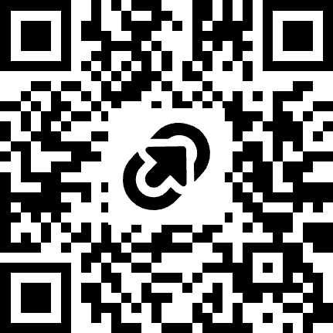
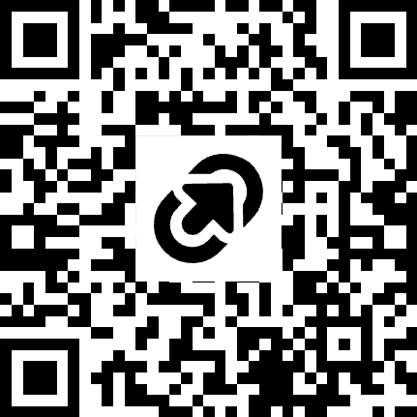
ALL EVENT INFO
SUBMISSION GUIDELINES
massaicoalition.com/hackachusetts
SUNDAI.CLUB
Notes:
Updated schedule from Durkin: 11:00–11:30 am brunch and getting to know each other; 11:30–11:45 opening remarks; 11:45 am–1:15 pm finalist pitches; 1:15–1:30 break and judges’ deliberation; 1:30–2:00 awards. Sunday, October 25, WHOOP headquarters.

Slide 2
WIFI: TheEngine-Event
PASSWORD: ToughTechWeek
Notes:
Updated schedule from Durkin: 11:00–11:30 am brunch and getting to know each other; 11:30–11:45 opening remarks; 11:45 am–1:15 pm finalist pitches; 1:15–1:30 break and judges’ deliberation; 1:30–2:00 awards. Sunday, October 25, WHOOP headquarters.

Slide 3
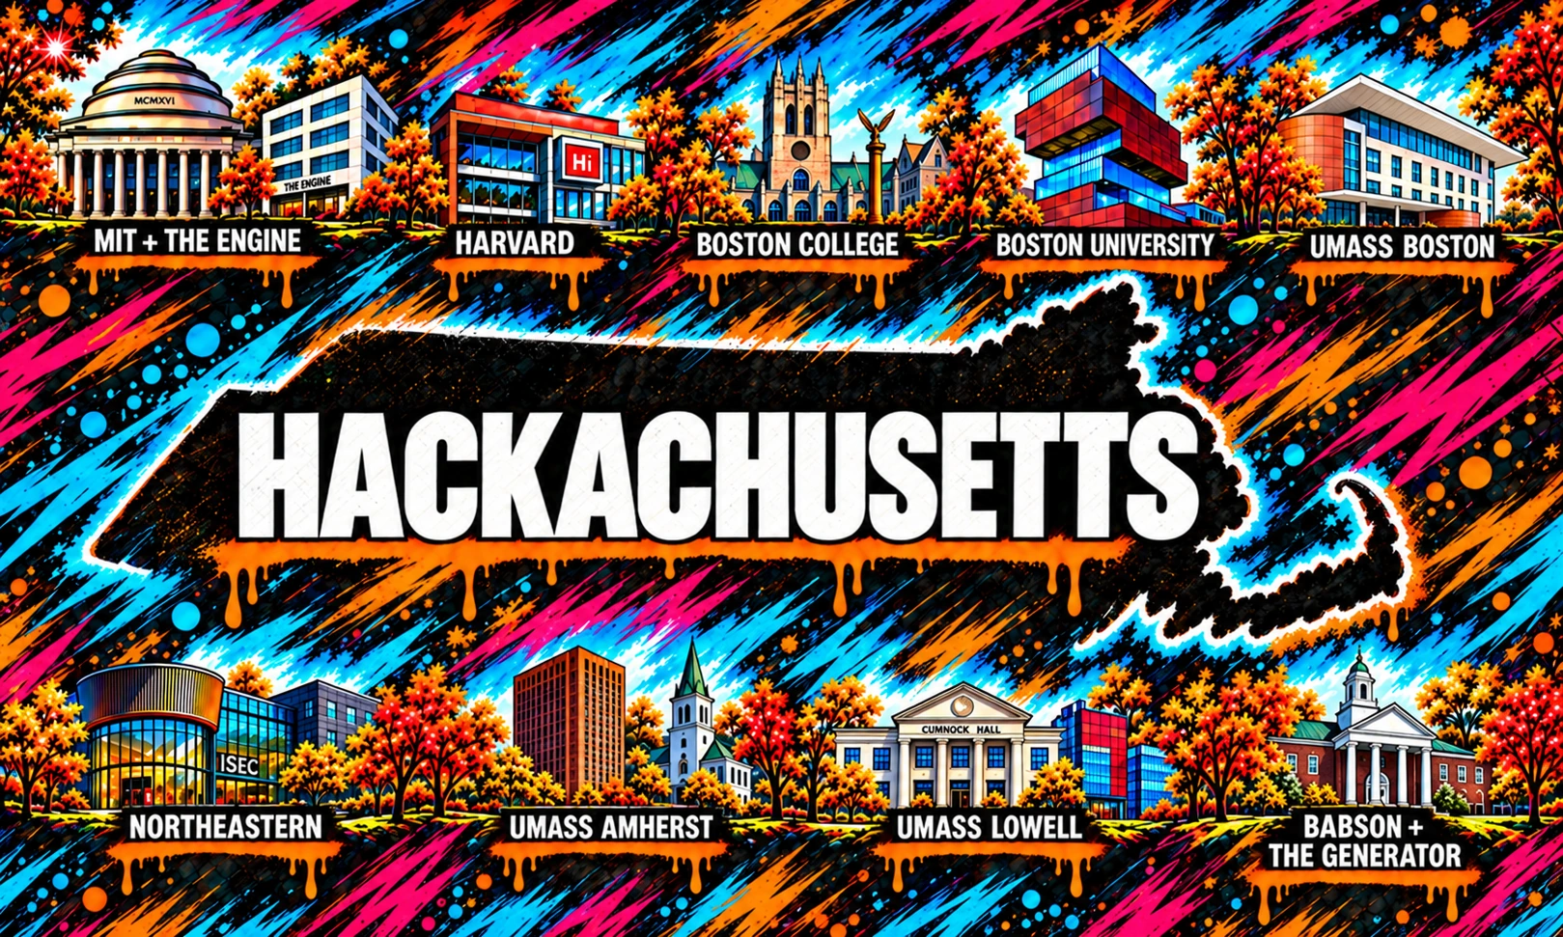

Slide 4
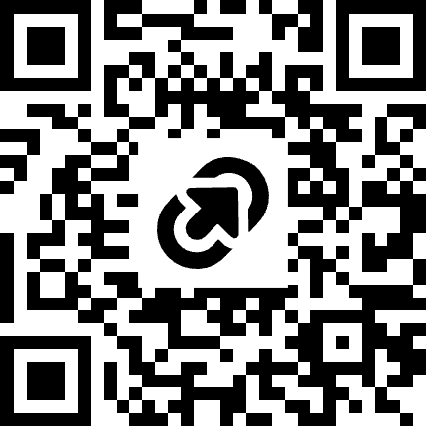
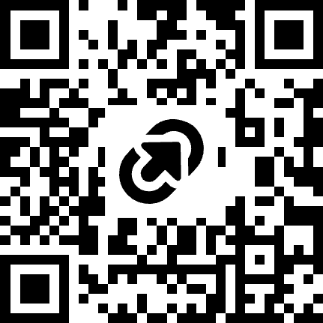
Make sure you are in the discord channels!
Sundai
Kiro
Notes:
Updated schedule from Durkin: 11:00–11:30 am brunch and getting to know each other; 11:30–11:45 opening remarks; 11:45 am–1:15 pm finalist pitches; 1:15–1:30 break and judges’ deliberation; 1:30–2:00 awards. Sunday, October 25, WHOOP headquarters.

Slide 5
SCHEDULE
08:00 - 09:00 AM
Registration & breakfast
09:00 - 09:30 AM
Welcome!
09:30 - 09:40 AM
AI News
09:40 - 10:00 AM
Hackachusetts Playbook: Challenges & Guidelines
10:00 - 10:30 AM
How to use Kiro?
10:30 - 11:30 AM
Hack kick off! Idea pitching & finding my team
12:00 - 1:00 PM
Lunch
05:00 - 06:00 PM
Dinner
08:00 PM
SUBMISSION DEADLINE
Notes:
Updated schedule from Durkin: 11:00–11:30 am brunch and getting to know each other; 11:30–11:45 opening remarks; 11:45 am–1:15 pm finalist pitches; 1:15–1:30 break and judges’ deliberation; 1:30–2:00 awards. Sunday, October 25, WHOOP headquarters.

Slide 6
Feeling overwhelmed by the pace of AI?
Notes:
Our students are Massachusetts’ greatest asset. Hackachusetts gives them support and opportunities by bringing people together across campuses, embracing casual connections, and organizing industry-focused initiatives. Those relationships and shared projects help students build the future we want to live in. Based on Durkin’s revised framing.

Slide 7

All the news that happened in AI last week
EVERYONE
Notes:
Our students are Massachusetts’ greatest asset. Hackachusetts gives them support and opportunities by bringing people together across campuses, embracing casual connections, and organizing industry-focused initiatives. Those relationships and shared projects help students build the future we want to live in. Based on Durkin’s revised framing.

Slide 8
To ride the AI wave, you need to get hands-on experience
with new releases at least weekly
Notes:
Our students are Massachusetts’ greatest asset. Hackachusetts gives them support and opportunities by bringing people together across campuses, embracing casual connections, and organizing industry-focused initiatives. Those relationships and shared projects help students build the future we want to live in. Based on Durkin’s revised framing.

Slide 9
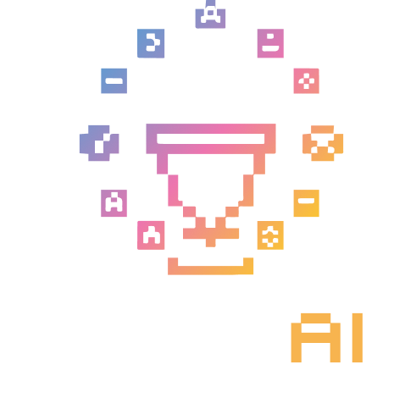
MIT/Harvard-born
Rapid prototyping of AI MVPs
every Sunday.
Notes:
Our students are Massachusetts’ greatest asset. Hackachusetts gives them support and opportunities by bringing people together across campuses, embracing casual connections, and organizing industry-focused initiatives. Those relationships and shared projects help students build the future we want to live in. Based on Durkin’s revised framing.

Slide 10
WEEK 146
MIT/Harvard-born
Rapid prototyping of AI MVPs
every Sunday.
HACKACHUSETTS
Notes:
Our students are Massachusetts’ greatest asset. Hackachusetts gives them support and opportunities by bringing people together across campuses, embracing casual connections, and organizing industry-focused initiatives. Those relationships and shared projects help students build the future we want to live in. Based on Durkin’s revised framing.

Slide 11
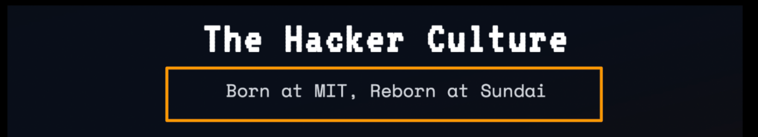
The origins of hacking
In the 1950s, MIT's Tech Model Railroad Club gave rise to the original hacker culture.
A hacker was someone driven by curiosity, technical ingenuity, and creative problem-solving.
The term later spread to MIT's early computer culture, where hacking meant exploring technology and finding clever, unconventional solutions.
Hacking wasn't about breaking systems.
It was about understanding, improving, and reinventing them.
Notes:
Our students are Massachusetts’ greatest asset. Hackachusetts gives them support and opportunities by bringing people together across campuses, embracing casual connections, and organizing industry-focused initiatives. Those relationships and shared projects help students build the future we want to live in. Based on Durkin’s revised framing.

Slide 12
Hacker vs. engineer
def hack():
/ˈhak’/
def hacker_vs_engineer():
/ˈhakər/
1. “an ingenious move”
2. “a shortcut”
→ fast
→ uses structure
→ flexible, prototypes, iterates
i) bad → break into systems
ii) good → do impressive things fast.
/ˌenjəˈnir/
→ meticulous
→ builds structure
→ stable, robust systems
Notes:
Our students are Massachusetts’ greatest asset. Hackachusetts gives them support and opportunities by bringing people together across campuses, embracing casual connections, and organizing industry-focused initiatives. Those relationships and shared projects help students build the future we want to live in. Based on Durkin’s revised framing.

Slide 13
Our mission
0 1
Build something meaningful
users | $$$ | github stars
Grow the best hackers
learn to build fast with AI.
Spread the Hacker mindset
teach the skills we learn at MIT and beyond
02
03
Notes:
MC Notes:
Build things that matter, not just tinkering.
Get out of the rat race (chasing valuations)
Who learn how to build together

Slide 14
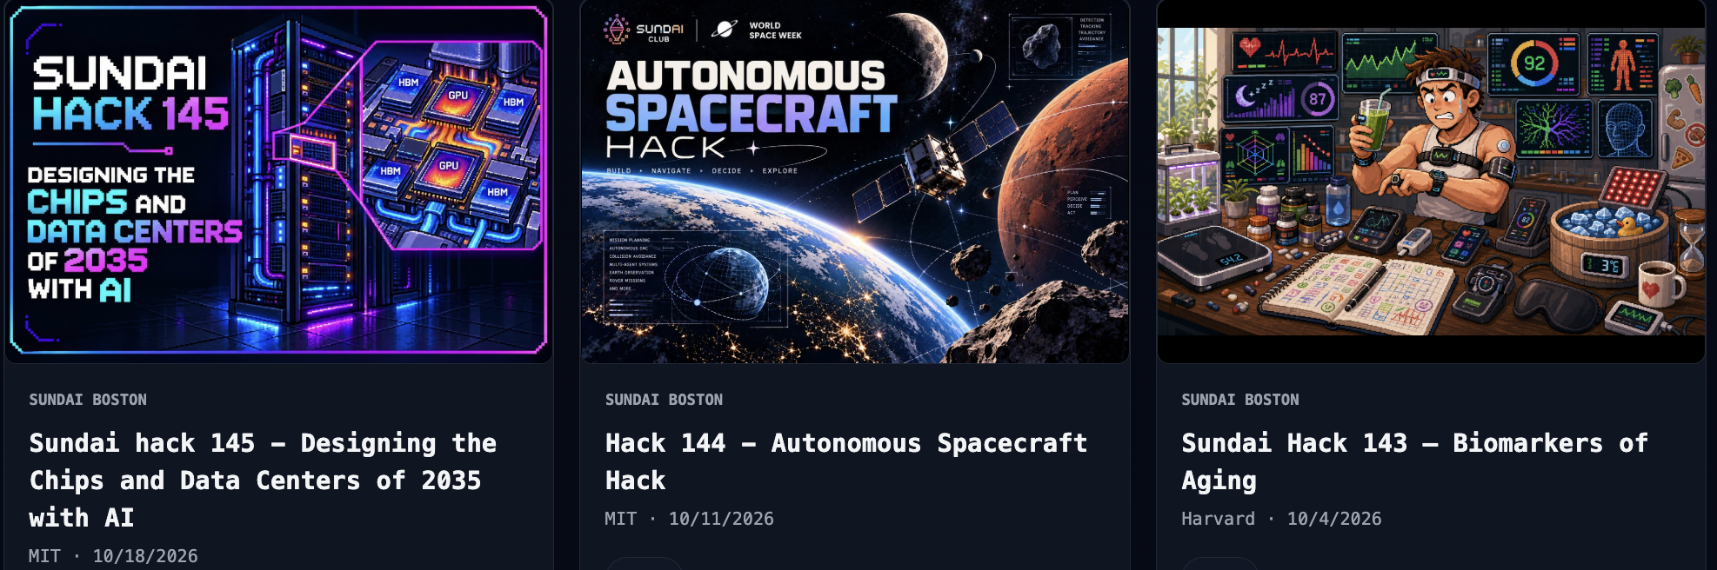
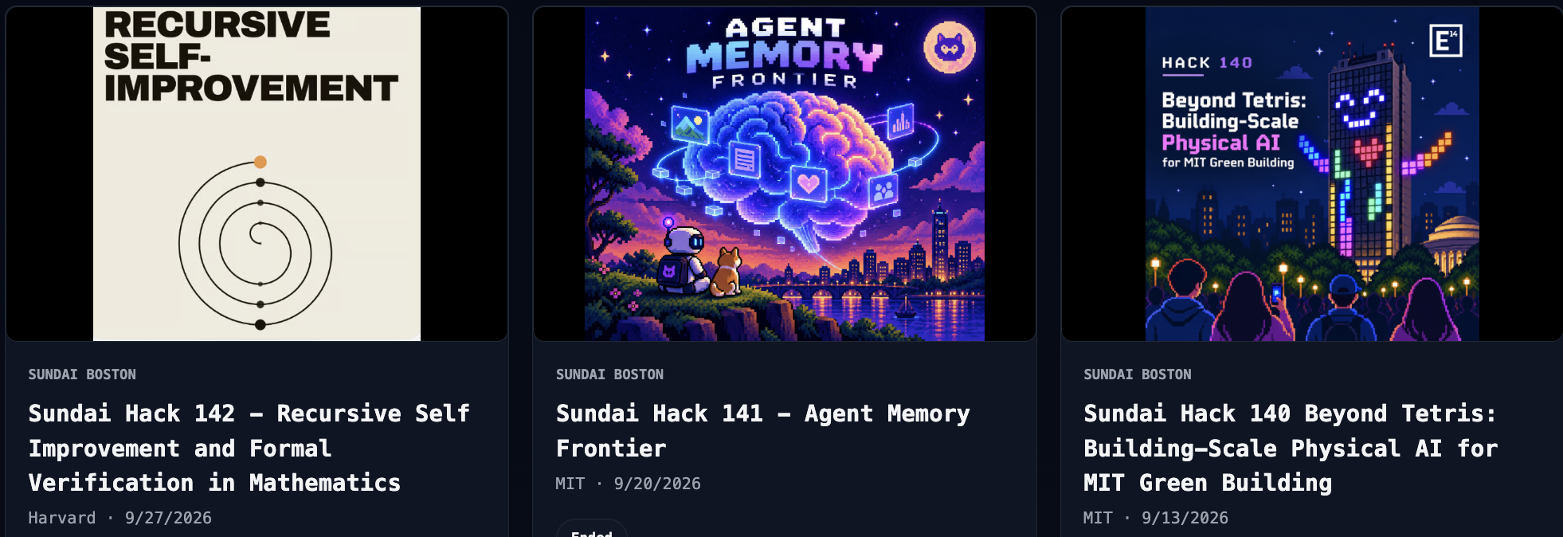
State-of-the-art
Notes:
Our students are Massachusetts’ greatest asset. Hackachusetts gives them support and opportunities by bringing people together across campuses, embracing casual connections, and organizing industry-focused initiatives. Those relationships and shared projects help students build the future we want to live in. Based on Durkin’s revised framing.

Slide 15
WHY HACKACHUSETTS
Our students are Massachusetts’
greatest asset. YOU are the future.
Bring students together across campuses and industries.
Turn casual connections into opportunities to build.
Give them the support to create the future we want to live in.
Notes:
Our students are Massachusetts’ greatest asset. Hackachusetts gives them support and opportunities by bringing people together across campuses, embracing casual connections, and organizing industry-focused initiatives. Those relationships and shared projects help students build the future we want to live in. Based on Durkin’s revised framing.

Slide 16
















CO-SPONSORS
TITLE SPONSORS
STATE PARTNERS
CITY PARTNER
COALITION SUPPORT

Slide 17
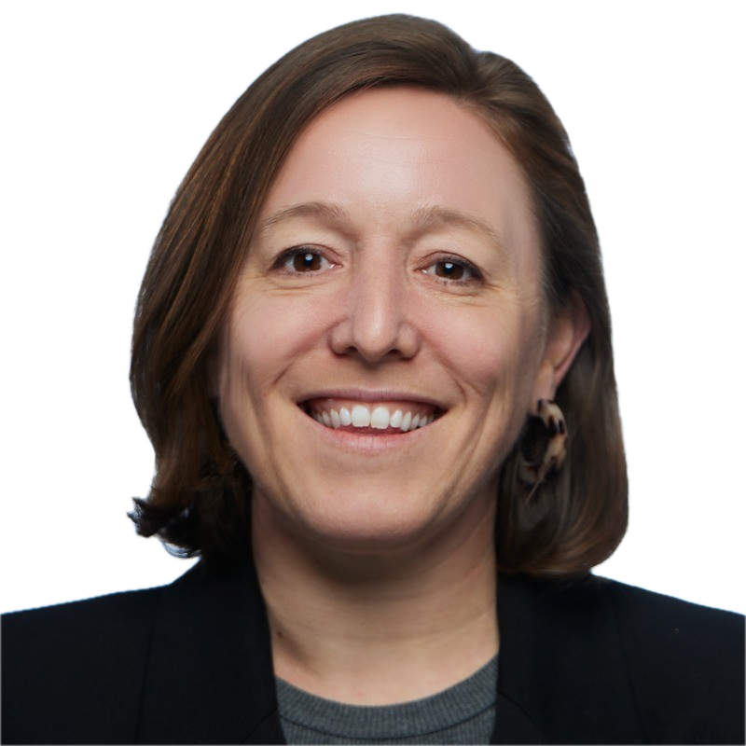
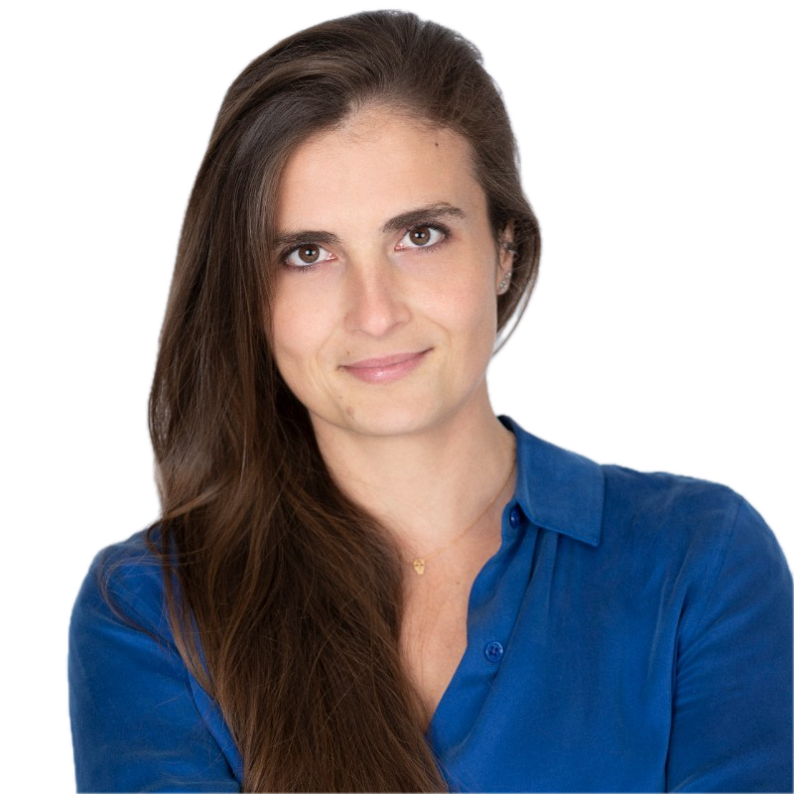
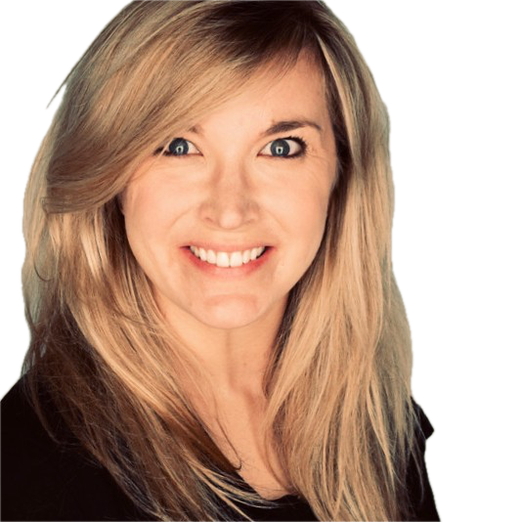
THANK YOU TO OUR SPONSORS!
Emily Knight
Sophie Panarese
Brittany Bennett
City of Boston
MA AI Coalition
AWS

Slide 18
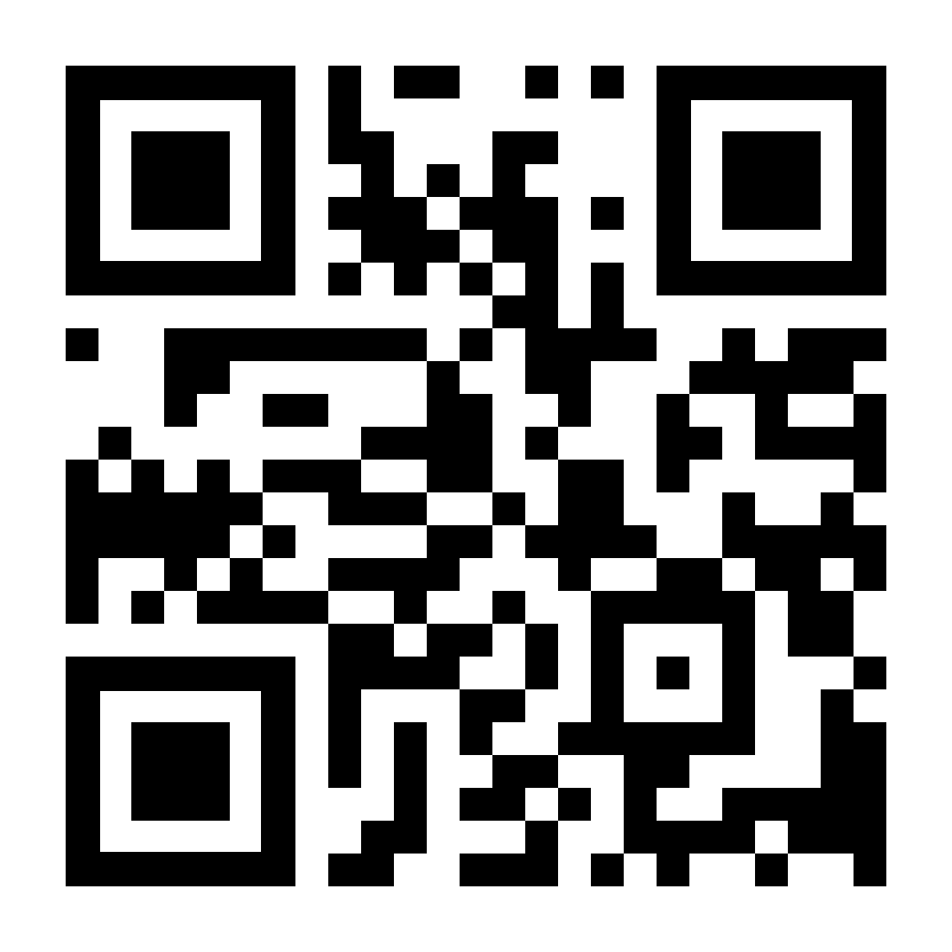
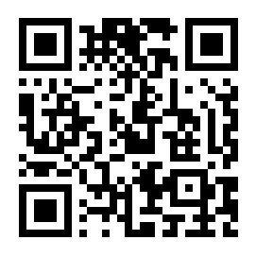

AI NEWS
Tuesdays 5 PM
AI Tools Club @Sundai discord

Slide 19
Explain the four tracks
Challenges
Rules
Judging criteria
Discord Links
Important deadlines
HACKACHUSETTS PLAYBOOK

Slide 20
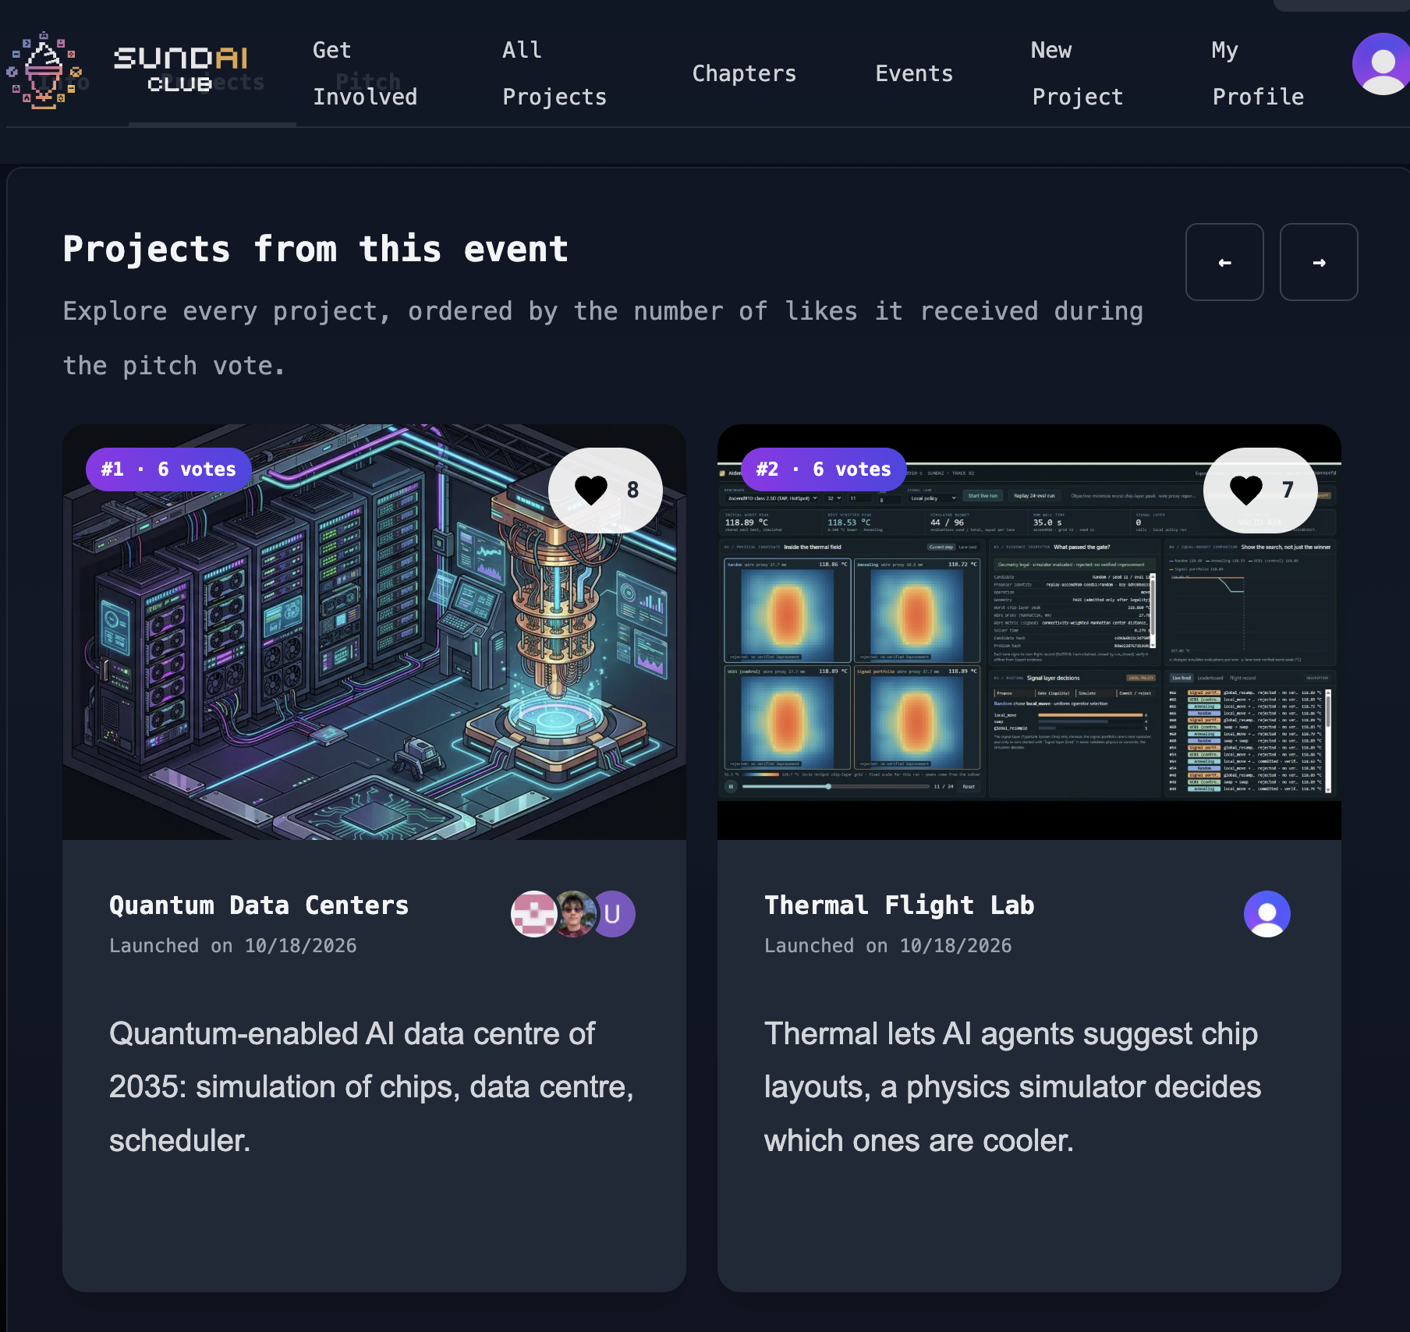
TODAY’S GOAL
Have your project submitted by 8pm

Slide 21
ALL EVENT INFO
GUIDELINES & CHALLENGES
massaicoalition.com/hackachusetts
SUNDAI.CLUB
Notes:
Updated schedule from Durkin: 11:00–11:30 am brunch and getting to know each other; 11:30–11:45 opening remarks; 11:45 am–1:15 pm finalist pitches; 1:15–1:30 break and judges’ deliberation; 1:30–2:00 awards. Sunday, October 25, WHOOP headquarters.

Slide 22
MAKE SURE TO FOLLOW…
QUALIFIED PROJECTS
Choose one track
Max 4 people per team
Use Kiro
Deadline 8pm

Slide 23
MAKE SURE TO FOLLOW…
QUALIFIED PROJECTS
SUBMISSION REQUIREMENTS
Choose one track
Max 4 people per team
Use Kiro
Deadline 8pm
Description
Video max 3 min
Public github
How Kiro was used?

Slide 24
JUDGING CRITERIA
Potential Value
Solves a real problem with a scalable, accessible, and user-friendly solution that meets community needs.
Implementation
Demonstrates effective and thoughtful use of Kiro, AI development strategies, and creative integrations.
Quality and Design
Evaluates originality, creativity, intuitive user experience, and polished design.

Slide 25
JUDGING CRITERIA
Potential Value
Solves a real problem with a scalable, accessible, and user-friendly solution that meets community needs.
Implementation
Demonstrates effective and thoughtful use of Kiro, AI development strategies, and creative integrations.
Quality and Design
Evaluates originality, creativity, intuitive user experience, and polished design.
Best use of Kiro!

Slide 26
BUILDING FOR KEY SECTORS IN MASSACHUSETTS

Slide 27
TRACK 1 - HEALTHCARE & BIOTECH
Turning wearable data into better healthcare
Keeping residents connected to health coverage
Improving healthcare access and coordination
Accelerating biotechnology innovation
Making clinical research more accessible

Slide 28
TRACK 2 - ROBOTICS
Making automation accessible to manufacturers
Robo-Gym training environments
Real-time control for data quality
Swarm robotics for collaborative exploration and search-and-rescue
The "messy desk" dynamic object sorting
Safer inspection of critical infrastructure
Path planning classifier

Slide 29
TRACK 3 - CLIMATE TECH
Resilient communities in a changing climate
Cleaner, more affordable buildings
A more reliable clean energy system
Understanding and protecting the ocean
Sustainable blue economy and coastal livelihoods

Slide 30
TRACK 4 - CIVIC ACTION
Better together: Improving where we live, work, study & play
Citizen-friendly digital government
More responsive neighborhood services
Stronger community emergency readiness

Slide 31
ALL EVENT INFO
GUIDELINES & CHALLENGES
massaicoalition.com/hackachusetts
SUNDAI.CLUB
Notes:
Updated schedule from Durkin: 11:00–11:30 am brunch and getting to know each other; 11:30–11:45 opening remarks; 11:45 am–1:15 pm finalist pitches; 1:15–1:30 break and judges’ deliberation; 1:30–2:00 awards. Sunday, October 25, WHOOP headquarters.

Slide 32
HOW TO USE ?

Slide 33
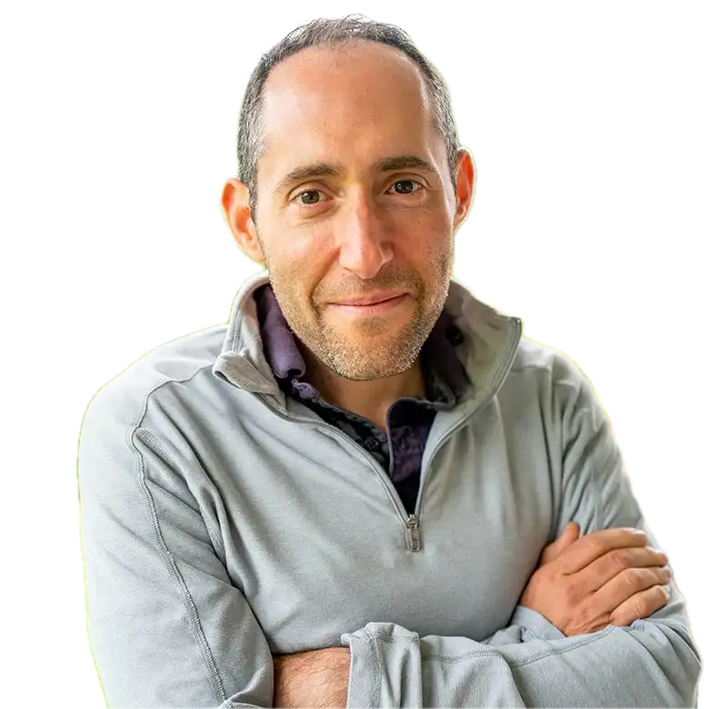
LET’S HACK!
Eric Paley
Secretary of Economic Development
Commonwealth MA

Slide 34
LET’S HACK!

Slide 35
LET’S HACK!
Eric Paley
Secretary of Economic Development
Commonwealth MA

Slide 36
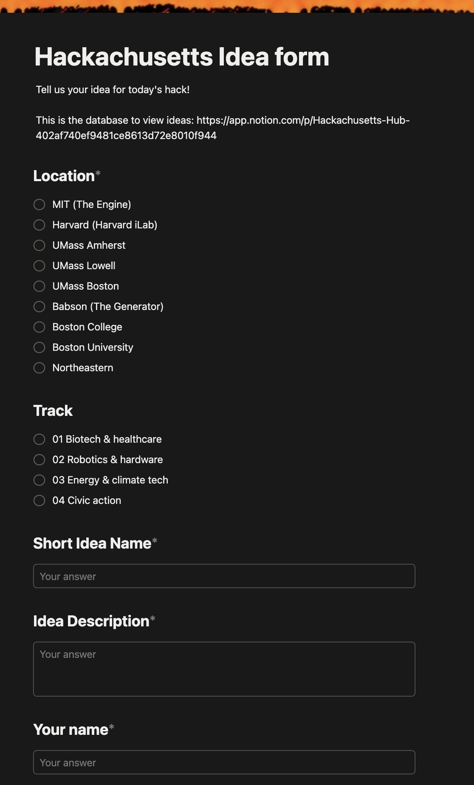
IDEA PITCHING & FINDING MY TEAM
1
Read challenges & submit a short description of your idea
2
Join a track for brainstorming
3
1 min pitch your idea
and /or find a team

Slide 37
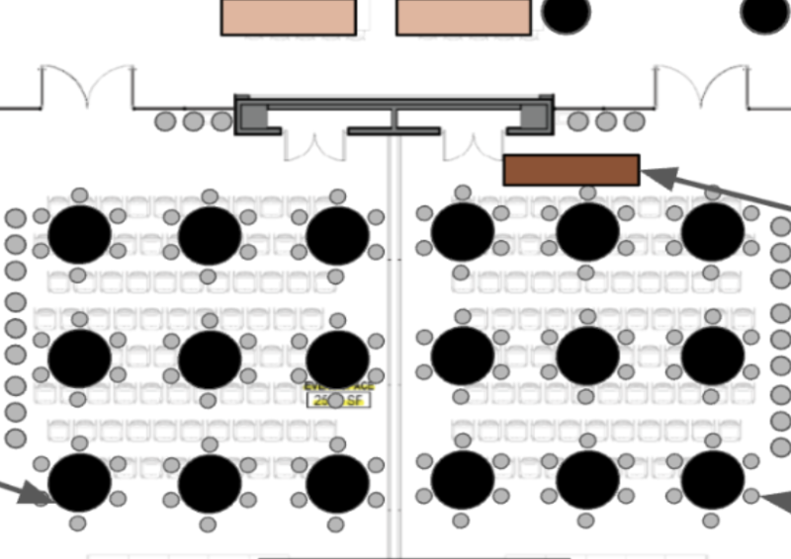
IDEA PITCHING & FINDING MY TEAM
1
Read challenges & submit a short description of your idea
ROBOTICS
HEALTHCARE
2
Join a track for brainstorming
CLIMATE TECH
CIVIC ACTION
3
1 min pitch your idea
and /or find a team

Slide 38
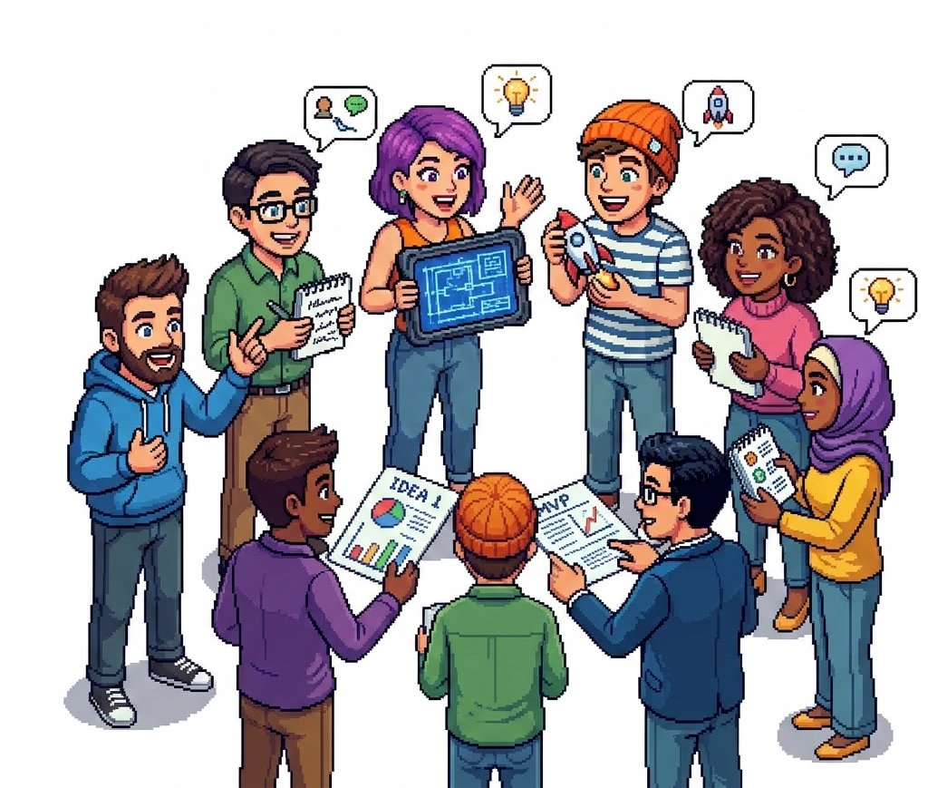
IDEA PITCHING & FINDING MY TEAM
1
Read challenges & submit a short description of your idea
2
Join a track for brainstorming
3
1 min pitch your idea
and /or find a team using the

Slide 39
IDEA PITCHING & FINDING MY TEAM
1
Read challenges & submit a short description of your idea
2
Join a track for brainstorming
3
1 min pitch your idea
and /or find a team using the

Slide 40
SCHEDULE
08:00 - 09:00 AM
Registration & breakfast
09:00 - 09:30 AM
Welcome!
09:30 - 09:40 AM
AI News
09:40 - 10:00 AM
Hackachusetts Playbook: Challenges & Guidelines
10:00 - 10:30 AM
How to use Kiro?
10:30 - 11:30 AM
Hack kick off! Idea pitching & finding my team
12:00 - 1:00 PM
Lunch
05:00 - 06:00 PM
Dinner
08:00 PM
SUBMISSION DEADLINE
Notes:
Updated schedule from Durkin: 11:00–11:30 am brunch and getting to know each other; 11:30–11:45 opening remarks; 11:45 am–1:15 pm finalist pitches; 1:15–1:30 break and judges’ deliberation; 1:30–2:00 awards. Sunday, October 25, WHOOP headquarters.

Slide 41

IDEA PITCHING & FINDING MY TEAM

Slide 42
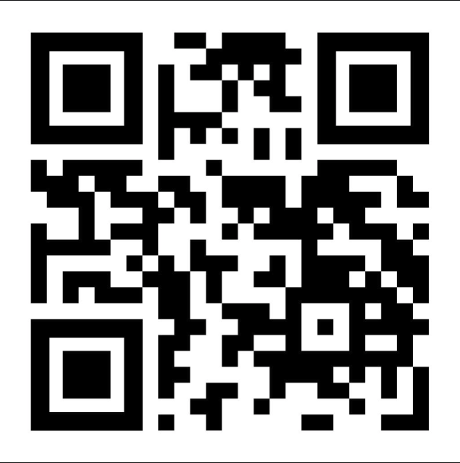
READ CHALLENGES & SUBMIT IDEAS
tinyurl.com/submitideahack

Slide 43

FORM

Slide 44
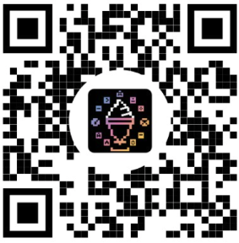
IDEA PITCHING & FINDING MY TEAM
2. Check other ideas
3. Join a track a pitch
ROBOTICS
HEALTHCARE
CLIMATE TECH
CIVIC ACTION
tinyurl.com/myhackidea

Slide 45
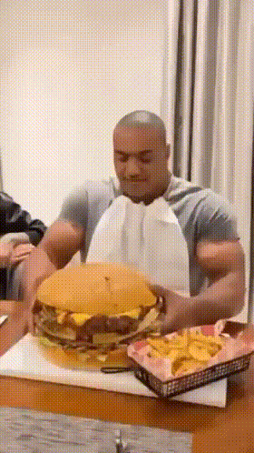
LUNCH TIME!
12:00

Slide 46
DINNER
05:00PM

Slide 47
FINAL SUBMISSION
8PM

