Slide 1
PREDICTIVE MAINTENANCE
AI Model for Predictive Maintenance
Detecting machine failure before it happens, using sensor data and machine learning
AI4I 2020 Predictive Maintenance Dataset • Decision Tree & Random Forest Classification

Slide 2
PROJECT OVERVIEW
Why Predictive Maintenance?
Unplanned equipment failure is costly and disruptive. This project builds a machine learning model that predicts machine failure from live sensor readings — enabling maintenance before breakdown occurs.
⚙
⚙
⚙
Goal
Data
Approach
Classify each machine reading as Failure / No Failure using operating conditions.
10,000 records of simulated industrial sensor data (AI4I 2020 dataset).
EDA, preprocessing, feature selection, and two classification models compared.
2

Slide 3
THE DATASET
AI4I 2020 Predictive Maintenance Dataset
10,000
Key Features
Failure Modes (target components)
Machine records
Type — product quality variant (L / M / H)
Air & Process temperature [K]
Rotational speed [rpm]
Torque [Nm]
Tool wear [min]
TWF — Tool Wear Failure
HDF — Heat Dissipation Failure
PWF — Power Failure
OSF — Overstrain Failure
RNF — Random Failure
14
Original columns
0
Missing or duplicate rows
3.4%
Target variable: “Machine failure” — a binary flag (1 = any failure occurred, 0 = normal operation), derived from the five failure-mode columns above.
Failure rate (339 failures)
3

Slide 4
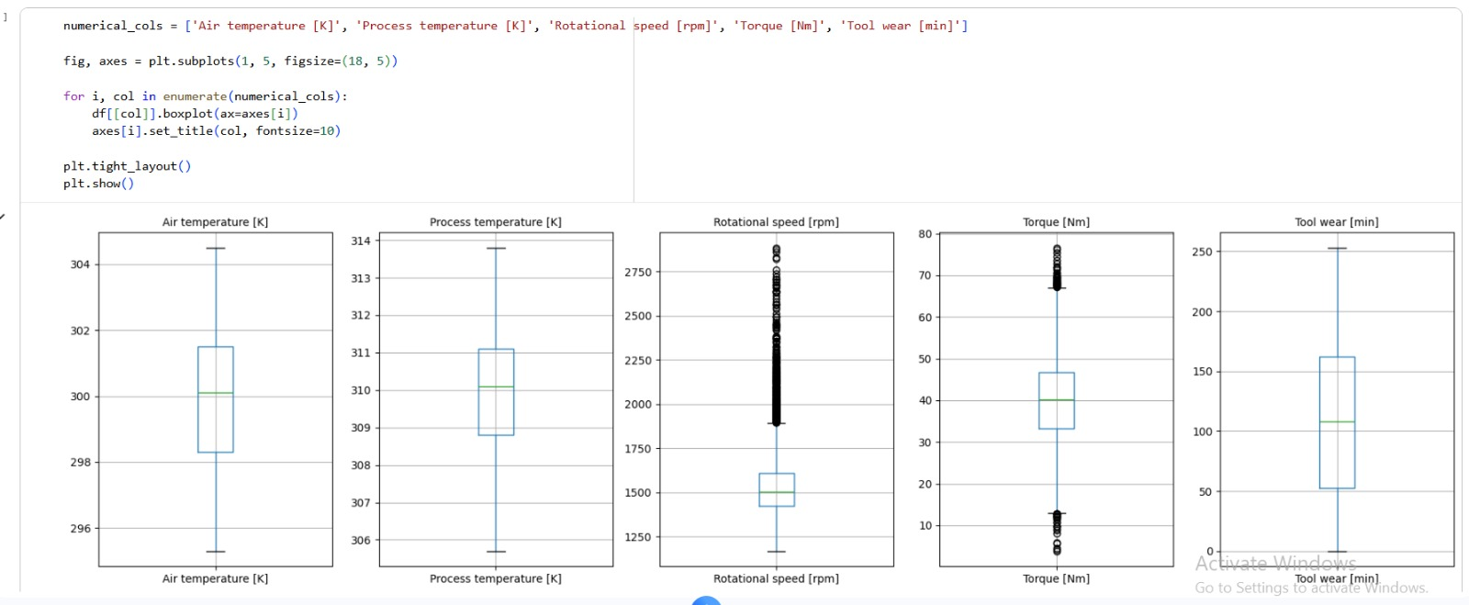
EXPLORATORY DATA ANALYSIS
Checking for Outliers
Boxplots of all numerical sensor features were used to spot extreme values before modeling.
Insight: Rotational speed and Torque show a noticeable number of outliers — these were capped rather than dropped, since extreme readings often coincide with failure events.
4

Slide 5
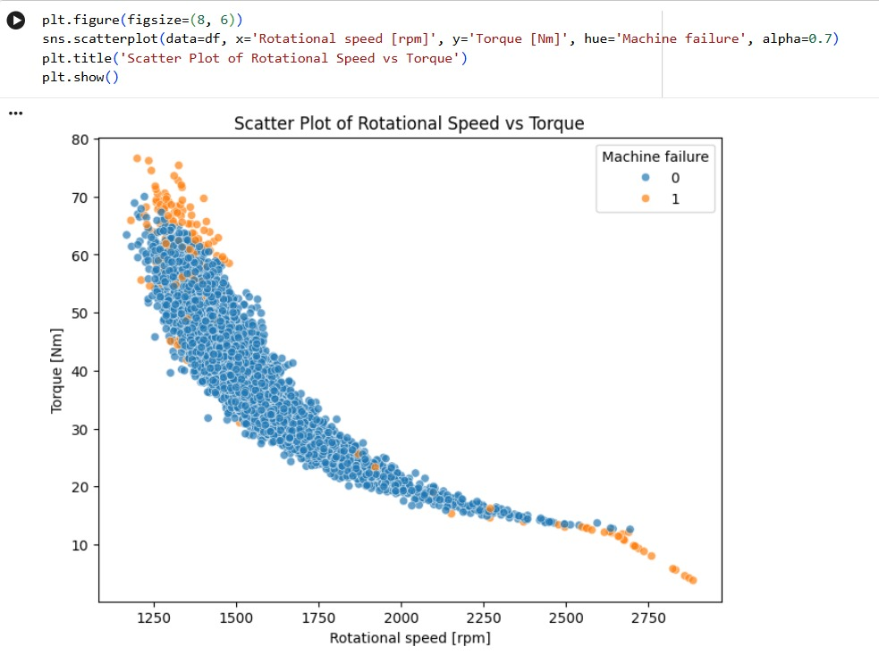
EXPLORATORY DATA ANALYSIS
Rotational Speed vs. Torque
A clear inverse relationship exists between rotational speed and torque — expected from motor physics.
Failures (orange) cluster at the extremes: very high torque with low speed, and very high speed with low torque.
This confirms both features carry strong predictive signal for failure.
5

Slide 6
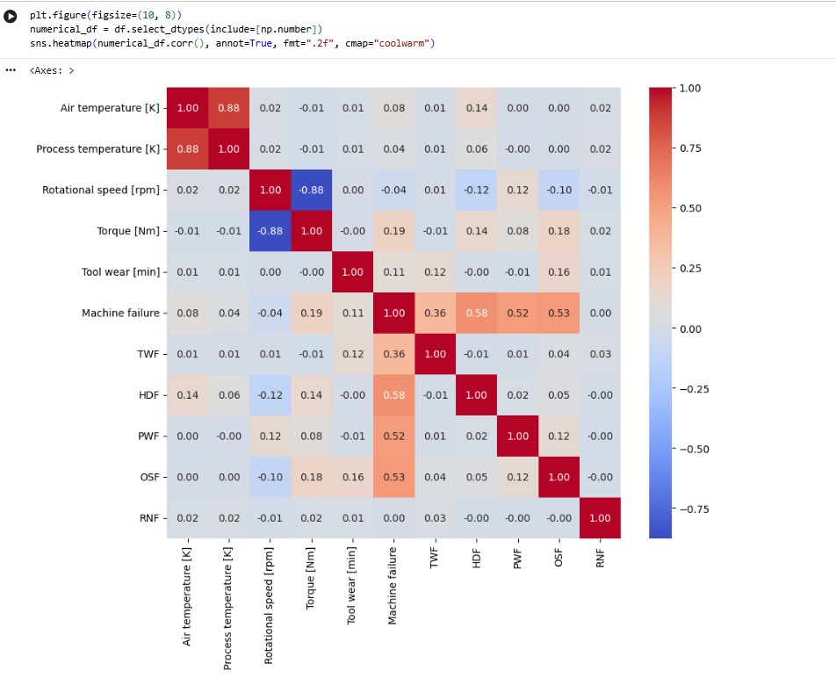
EXPLORATORY DATA ANALYSIS
Feature Correlation
Air temperature and Process temperature are highly correlated (0.88) — near-duplicate signals.
Rotational speed and Torque are strongly negatively correlated (-0.88), consistent with the scatter plot.
Machine failure correlates most with HDF (0.58), OSF (0.53), and PWF (0.52) — the dominant failure modes.
6

Slide 7
METHODOLOGY
Data Preparation Pipeline
01
02
03
Clean
Encode
Cap Outliers
Dropped ID columns (UDI, Product ID); confirmed zero missing values and zero duplicates.
One-hot encoded the categorical “Type” feature (L / M / H product quality).
Capped extreme values in speed, torque, and temperature features identified via boxplots.
04
05
06
Scale
Select Features
Split
Standardized all numeric features with StandardScaler.
Used SelectKBest (mutual information) to keep the 7 most informative features.
80/20 stratified train–test split to preserve the ~3.4% failure rate in both sets.
7
7

Slide 8
METHODOLOGY
Models & Validation
Decision Tree
Random Forest
Why both?
max_depth = 6, min_samples_leaf = 20, min_samples_split = 40 — tuned to limit overfitting on the imbalanced target.
An ensemble of decision trees, trained on the same selected features for a stronger, more stable predictor.
A single interpretable tree is compared against an ensemble to check whether added complexity meaningfully improves failure detection.
Validation Strategy
Stratified 5-Fold Cross-Validation on the training set, preserving the failure ratio in every fold.
Scored on Accuracy, Precision, Recall, F1-score, and ROC-AUC — not accuracy alone, since failures are rare.
Final performance confirmed on a held-out 20% test set (2,000 records) the models never saw during training.
8

Slide 9
RESULTS
Model Performance Comparison
Scores on the held-out test set (2,000 records, 68 true failures).
Model | Accuracy | Precision | Recall | F1-Score | ROC-AUC
Decision Tree | 0.9275 | 0.3046 | 0.8824 | 0.4528 | 0.9057
Random Forest | 0.9270 | 0.3050 | 0.8971 | 0.4552 | 0.9126
Highest-Recall Model: Random Forest
Recall is the priority metric here: missing a real failure (a false negative) is far more costly than a false alarm. Random Forest catches 89.7% of true failures, and both models trade some precision for that safety margin — typical, and desirable, in predictive maintenance.
88.2%
89.7%
DT Recall
RF Recall
9

Slide 10
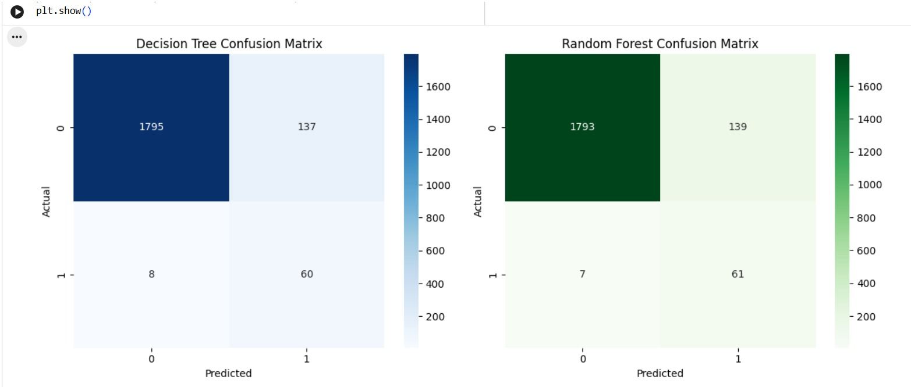
RESULTS
Confusion Matrices
Actual vs. predicted outcomes on the 2,000-record test set.
Both models correctly flag over 88% of true failures (60/68 for Decision Tree, 61/68 for Random Forest), with only 7–8 failures missed — the key requirement for a maintenance early-warning system.
10

Slide 11
CONCLUSION
Key Takeaways
1
Both models generalize well
2
Random Forest edges ahead on recall
Train and test accuracy stay within ~0.5–0.6 points of each other (RF: 93.3% → 92.7%), showing minimal overfitting.
89.7% vs. 88.2% for Decision Tree — marginally better at catching real failures, the most costly type of error to miss.
3
Feature selection paid off
4
Ready for the next step
Rotational speed, torque, temperature, and tool wear carried most of the predictive signal for failure.
A promising foundation for a deployed early-warning system — next: threshold tuning and richer failure-type classification.
11

Slide 12
Thank You
Questions & Discussion
AI Model for Predictive Maintenance

