Slide 1
Enhancing global explainability and reducing explanation latency in phishing email detection

Slide 2
Team members
01
02
03
04
05
Kevin Lu (25701855)
Luu Tran (14522561)
Hooward Kangdrew (25008970)
Thien Bao Minh Dang (14512584)
Viet Anh Pham (14515011)​

Slide 3
Research Aim
Improve the explainability of phishing detection models
This research focus specially on phishing email detection
Provide a faster and more interpretable to small businesses without high cost.
Transparency of phishing detection model is needed to increase its trustworthiness, and accountability for security incidents (Sarker et al., 2024)​.

Slide 4
Significance or potential impact of the research
1 | Improve the transparency of phishing detection systems​
2 | Help small businesses understand why the email is classified as phishing
3 | Reduce the cost and risk compared to traditional detection tools​
4 | Provide an interpretable solution for small businesses

Slide 5
Literature Review
Authors | Title | XAI methods | AI models | Venue
Al-Subaiey et al. (2024) | “Novel interpretable and robust web-based AI platform for phishing email detection” | LIME | Support Vector Machine, Multinomial Naive Bayes, Random Forest Classifier | Computers and Electrical Engineering
Al-E'mari et al. (2025) | A Cognitive BDI–BiLSTM Hybrid Framework for Interpretable Email Threat Detection | SHAP, Belief–Desire–Intention cognitive agent | Bidirectional Long Short-Term Memory | IEEE
Shendkar et al. (2025) | Enhancing Phishing Attack Detection Using Explainable AI: Trends and Innovations | SHAP, Grad-CAM | Deep learning models | AJSTD / UBD (2025)

Slide 6
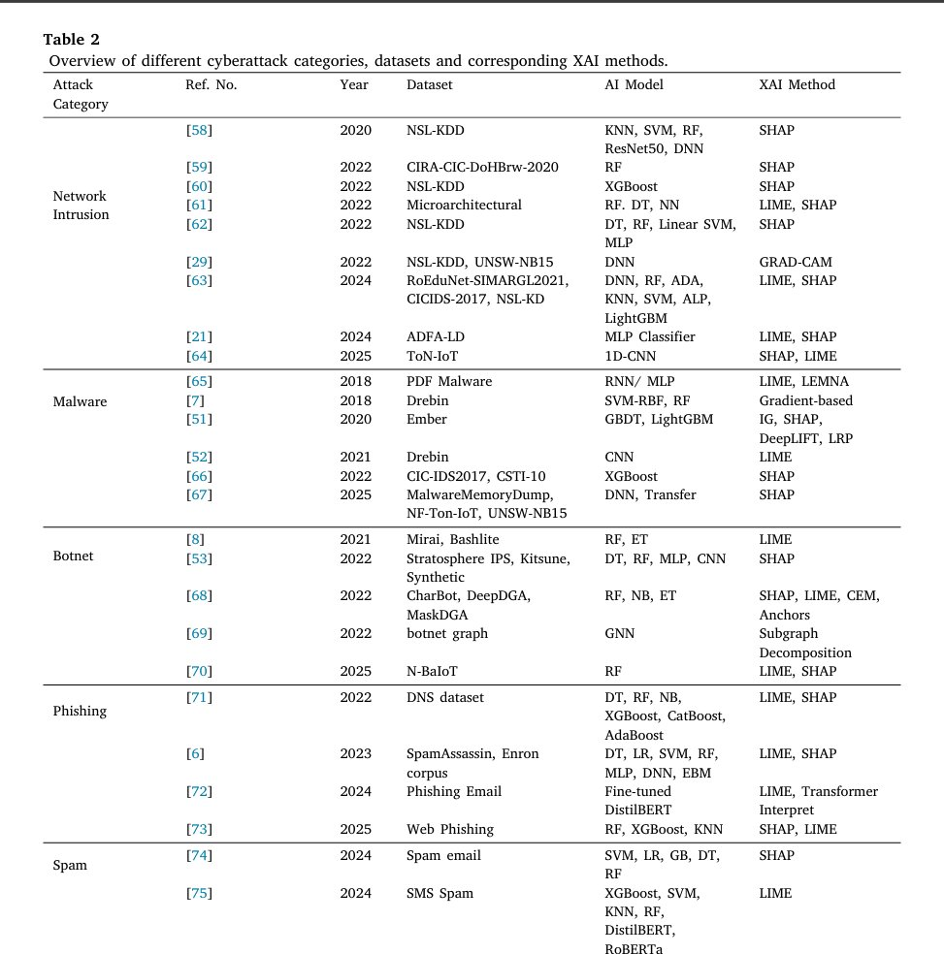
Literature Review
Local Interpretable Model-agnostic Explanations (LIME) and SHapley Additive exPlanations (Shap) are two most used methods used most to explain original models in phishing email.
Sharma et al. (2025)

Slide 7
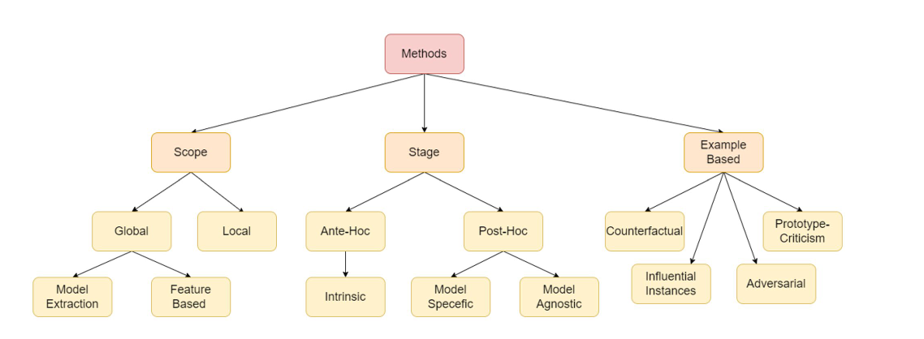
Hassija et al. (2023)
SHAP and LIME fall in these categories
This means it does not intrinsically and globally explain the model!

Slide 8
Gaps for further research
1. Research on Global Post-hoc XAI in phishing detection machine learning model is underexplored.
2. Common methods not fully uncover the black-box.

Slide 9
Literature review on Global Post-hoc XAI
Author | XAI method | Feasible | Risk
(Apley & Zhu, 2020) | Accumulated Local Effects | Computationally Efficient and Truly Mathematical explanation | Complex interpretations
(Friedman & Popescu, 2008) | Rule Ensembles | Human-Readable Logic | Linear Assumption and sensitive to threshold

Slide 10
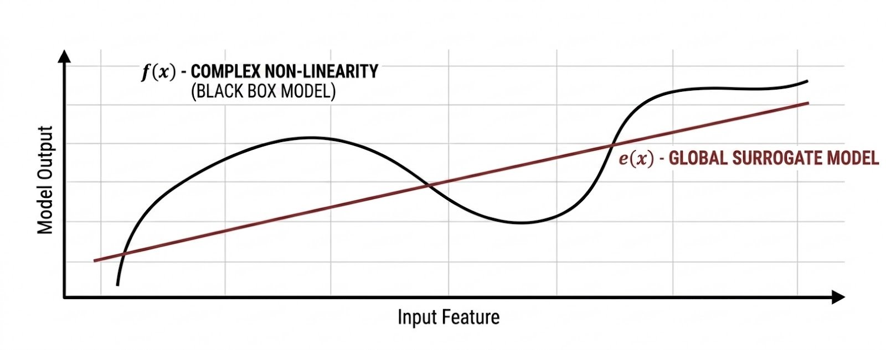
Hypothesis and Initital Proposed Method
Hypothesis: A global surrogate model can approximate a black-box phishing email classifier with high fidelity while providing faster explanations than perturbation-based explainability methods.
Possible surrogate models: Generalized Additive Model (GAM) or Explainable Boosting Machines (EBM)

Slide 11
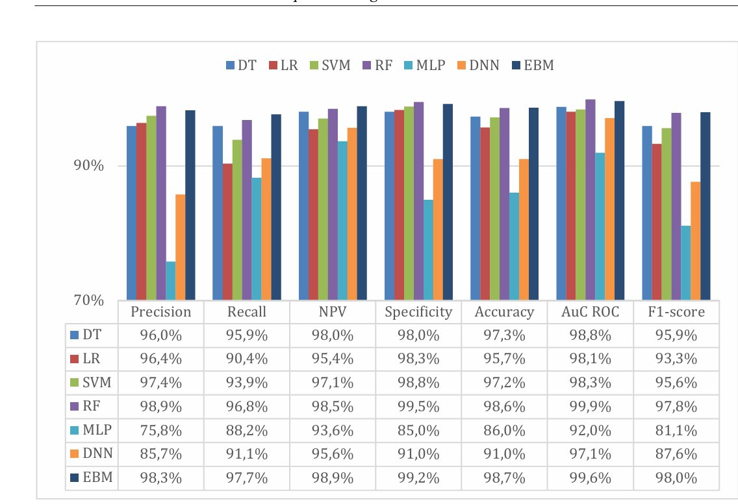
Feasibility of the hypothesis and method
Feasible:
Tan(2019) demonstrated that a global additive explanation approach can approximate and explain deep neural networks in two case studies.
Explainable Boosting Machine (EBM) perform well in the original model, hinting high-fidelity. (Greco et al., 2023)
Risk:
To be able explain the original model using the surrogate model, the fidelity between surrogate and original model need to be high.
The surrogate model may be too simple to capture the full complexity of the original model
(Greco et al., 2023)

Slide 12
Expected outcome
1. An evaluation of the proposed methods on trained phishing detection machine learning models
2. Explanation attempts on the final result
3. Benchmark of explanation time with permutation-based methods

Slide 13
How this research fill in the gaps
If the research is implemented successfully:
Explanation of existing email phishing detection model would be more faithful and less ambiguity
Lead to higher trust on the explanation especially for security teams and businesses
Faster explanation time hence reduce email quarantine period (suitable for urgent emails).

Slide 14
Business environment
2020-2026
DATASET OVERVIEW
Context
Sample period

Slide 15
DATASET STRUCTURE
Size
Balanced distribution
Phishing
Type of dataset
Focus
40,000 – 80,000
Cross -sectional
Email classification
Legitimate

Slide 16
DATA COLLECTION METHOD
Gather phishing and legitimate emails datasets
Converts all data into a consistent structure
Filter the merged dataset, only keep related emails
Using cleaning methods to transform and organize data in text format
Structure the final dataset as a large cross-sectional dataset of individual emails
Collection finished

Slide 17
DATA SOURCES
Phishing Datasets
Nazario Phishing Corpus
Kaggle Phishing Email
Figshare curated phishing
Legitimate datasets
Eron Email Dataset

Slide 18
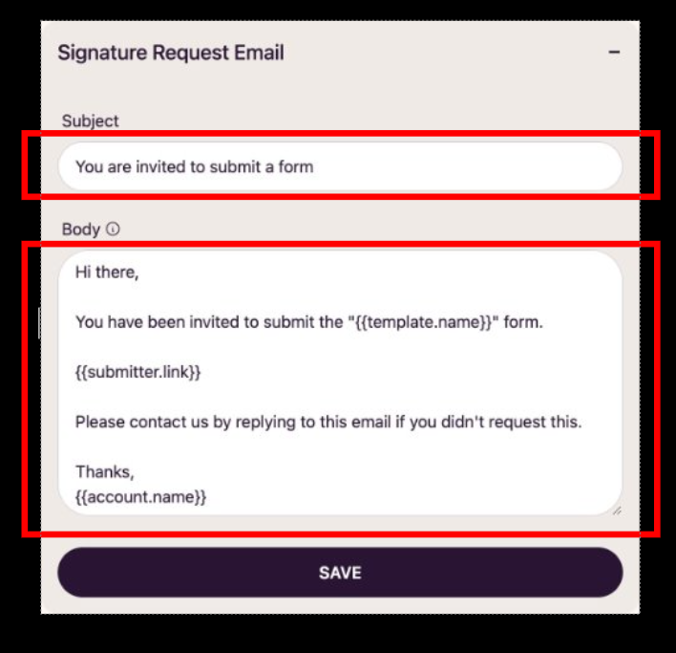
DATA FEATURES
Textual data:
Email subject
Email body

Slide 19
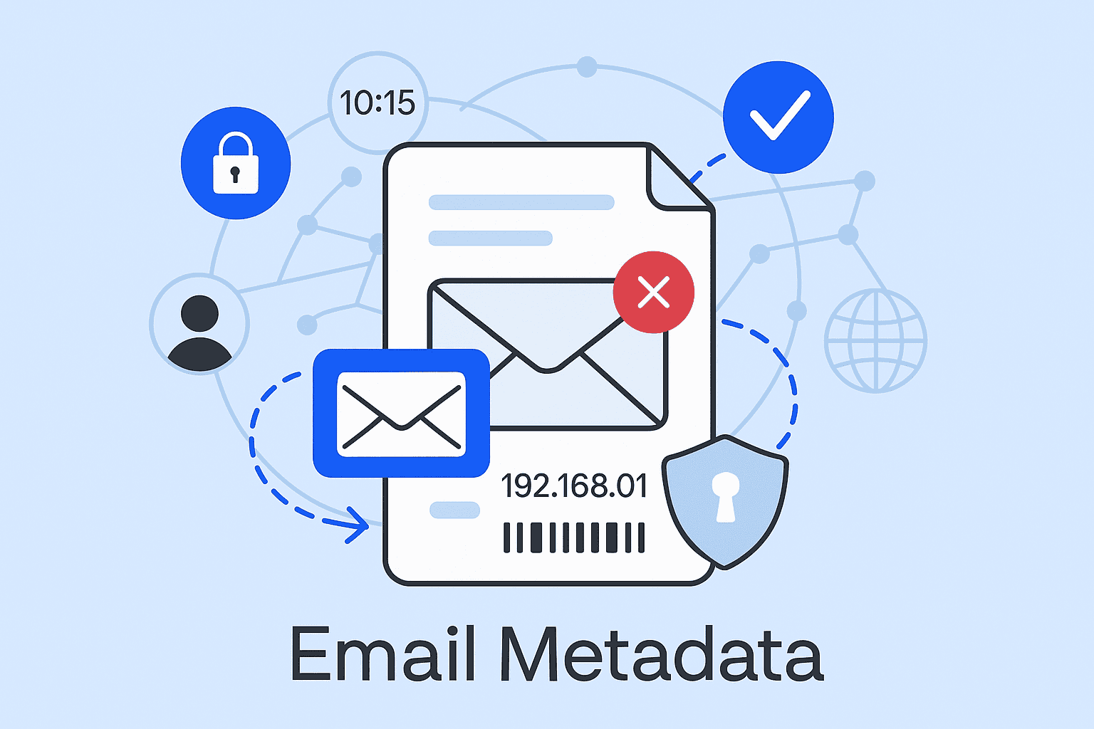
DATA FEATURES
Metadata:
Sender domain
Link domains
Attachment indicators

Slide 20
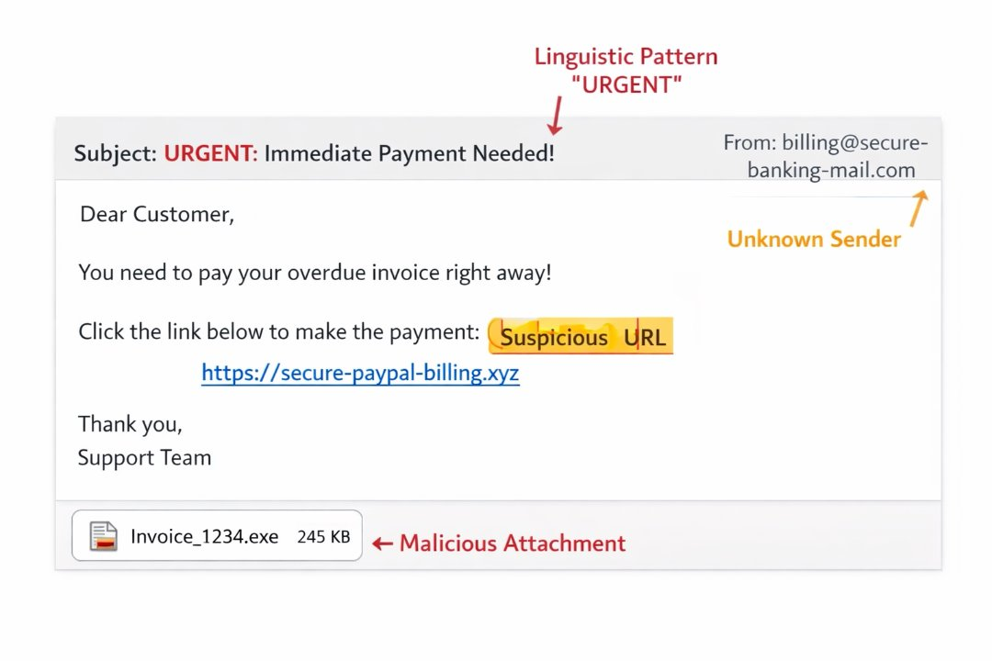
DATA FEATURES
Derived features:
Linguistic patterns
URL characteristics
Security indicators

Slide 21
SOLUTION DESIGN & IMPLEMENTATION
1) Incoming emails
Customers
2) Mail server
Email gateway
Email traffic monitoring
3) Phishing Detection Model
Classifies phishing vs legitimate
4) Surrogate Model
Generate explanation
Identifies important features
5) Security Dashboard
Classification result
Risk indicators
Explanation of prediction
6) Threat Intelligence Team
Review alerts
Investigate suspicious emails
Deciding security actions
Partners
Externals

Slide 22
Feasibility
Experimental Verification
Model Comparison
Baseline phishing detection model
Explainable model with our solution
Other comparison approaches
Evaluation Metrics
Accuracy
Precision / Recall
F1-score
Explainability Evaluation
Explanation fidelity
Interpretability metrics

Slide 23
Feasibility
Ethical Consideration
Data Privacy
Publicly available datasets
Remove identifiable information
Data Security
Secure dataset storage
Used only for academic research
Responsible Research
Avoid releasing sensitive details
Prevent misuse by phishing attackers

Slide 24
Timeline & Milestone
Phase | Activities | Duration | Key Milestone
Phase 1: Project Initiation & Planning | Finalise research design, ethics approval, dataset access confirmation | Week 1-3 | Research proposal approved
Phase 2: Data Collection & Integration | Collect phishing datasets, extract legitimate emails, filtering the emails | Week 4 | 40k-80k email dataset consolidated
Phase 3: Solution Implementation | Implement the research methodology by applying selected machine learning techniques to the datasets. | Week 5-9 | Detection models and solution implementation completed
Phase 4: Evaluation & Validation | Performance testing | Week 10 | Model benchmark report completed
Phase 5: Analysis & Write-up | Results interpretation, theoretical positioning, policy implications | Week 11 | Draft paper completed
Phase 6: Final Review & Submission | Editing, formatting, submission preparation | Week 12 | Final submission

Slide 25
Roles & Responsibilities
Name | Role | Responsibilities
Thien Bao Minh Dang | Data Collector | Collecting data from public sources
Hooward Kangdrew | Note Taker | Recording timelines and milestones
Viet Anh Pham | Researchers | Collecting relevant papers for the project, conduct experiment
Xuxian Lu | Researchers | Collecting relevant papers for the project, conduct experiment
Luu Minh Thong Tran | Leader | Lead the team and ensure team members are on track, conduct experiment

Slide 26
Budget & Resources
Technical Resources:
Python
High-performance workstation/GPU
Budget:
- Do not cost due to computation is perform locally

Slide 27
Risk Management Plan
Risk | Probability | Impact | Mitigation Strategy
Data imbalance (phishing vs legit) | Medium | High | Use stratified sampling, SMOTE
Poor performance of solution implementation | Medium | High | Brainstorm and conduct feasibility test prior
Computation resource limitation | Medium | Medium | Schedule training, migrate to cloud computing for higher computation power
Data privacy concerns | Low | High | Use only public datasets

Slide 28
Communication Plan
Communication Type | Frequency | Medium | Purpose
Offline/class meet up | Weekly | In-person | Progress review
Online meet up | Weekly/ fortnightly | Zoom Meeting | Progress review and continuation
Text Message | Anytime | Discord/Email | Basic communication

Slide 29
References
Abdulla Al-Subaiey, Al-Thani, M., Naser Abdullah Alam, Kaniz Fatema Antora, Amith Khandakar, & SM. (2024). Novel interpretable and robust web-based AI platform for phishing email detection. Computers & Electrical Engineering, 120, 109625–109625. https://doi.org/10.1016/j.compeleceng.2024.109625
Al-E’Mari, S., Sanjalawe, Y., Fraihat, S., Kurdi, G., & Allehyani, B. (2025). A Cognitive BDI–BiLSTM Hybrid Framework for Interpretable Email Threat Detection. IEEE Access, 1–1. https://doi.org/10.1109/access.2025.3641123
Apley, D. W., & Zhu, J. (2020). Visualizing the effects of predictor variables in black box supervised learning models. Journal of the Royal Statistical Society. Series B (Statistical Methodology), 82(4), 1059–1086. JSTOR. https://doi.org/10.2307/26937906
Friedman, J. H., & Popescu, B. E. (2008). Predictive learning via rule ensembles. The Annals of Applied Statistics, 2(3), 916–954. https://doi.org/10.1214/07-aoas148
Greco, F., Desolda, G., & Esposito, A. (2023). Explaining Phishing Attacks: An XAI Approach to Enhance User Awareness and Trust. https://ceur-ws.org/Vol-3488/paper22.pdf
Hassija, V., Chamola, V., Mahapatra, A., Singal, A., Goel, D., Huang, K., Scardapane, S., Spinelli, I., Mahmud, M., & Hussain, A. (2023). Interpreting Black-Box Models: a Review on Explainable Artificial Intelligence. Cognitive Computation, 16(1), 45–74. https://doi.org/10.1007/s12559-023-10179-8
Sarker, I. H., Janicke, H., Mohsin, A., Gill, A., & Maglaras, L. (2024). Explainable AI for cybersecurity automation, intelligence and trustworthiness in digital twin: Methods, taxonomy, challenges and prospects. ICT Express, 10(4). https://doi.org/10.1016/j.icte.2024.05.007
Saves, P., Palar, Pramudita Satria, Robani, Muhammad Daffa, Verstaevel, N., Garouani, M., Aligon, J., Gaudou, B., Shimoyama, K., & Morlier, J. (2025). Surrogate Modeling and Explainable Artificial Intelligence for Complex Systems: A Workflow for Automated Simulation Exploration. ArXiv.org. https://arxiv.org/abs/2510.16742v2
Sharma, A., Rani, S., & Shabaz, M. (2025). A comprehensive review of explainable AI in cybersecurity: Decoding the black box. ICT Express. https://doi.org/10.1016/j.icte.2025.10.004
Shendkar, B. D., Chandre, P. R., Sulochana Sagar Madachane, Kulkarni, N., & Deshmukh, S. (2024). Enhancing Phishing Attack Detection Using Explainable AI: Trends and Innovations. ASEAN Journal on Science and Technology for Development, 42(1). https://doi.org/10.61931/2224-9028.1604
Tan, H. F. (2019). Interpretable Approaches to Opening Up Black-Box Models. https://doi.org/10.7298/j1fj-qj88

Slide 30

THANKS!
Do you have any questions?

