Slide 1
SMARTWATCHES
And finally watches are not just timekeeping devices.
By Nsikam Onla Brice

Slide 2
Agenda
Introduction
Pros & Cons
Future
Conclusion

Slide 3
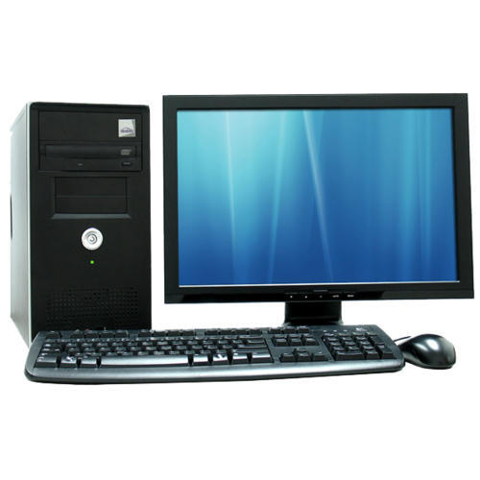
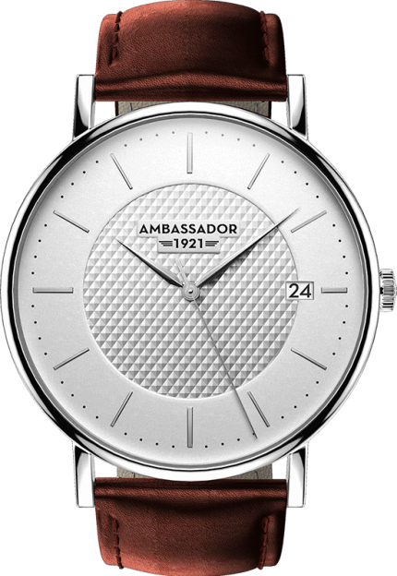
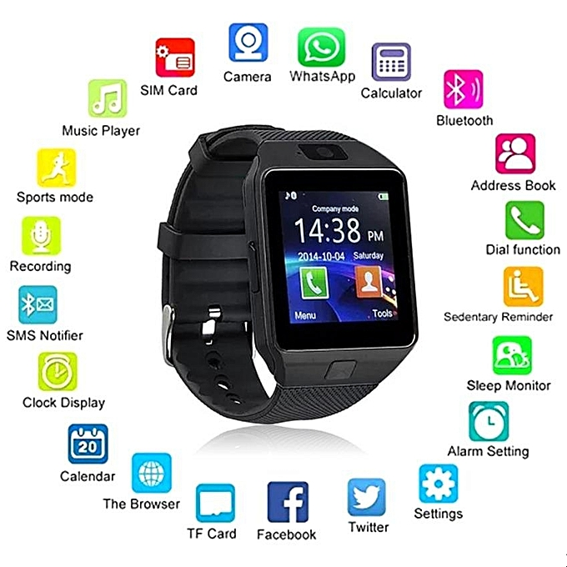
3
What is the Smartwatch?
Watch
Computer
Smartwatch
Introduction
Function of the Smartwatch
Advantages & Disadvantages
Future
Conclusion

Slide 4
4
What is the Smartwatch?
A Smartwatch is a computerised Watch capable of doing more than just the usual task of keeping time.
Introduction
Function of the Smartwatch
Advantages & Disadvantages
Future
Conclusion

Slide 5
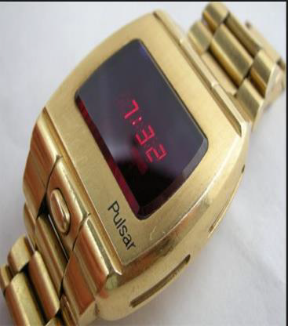
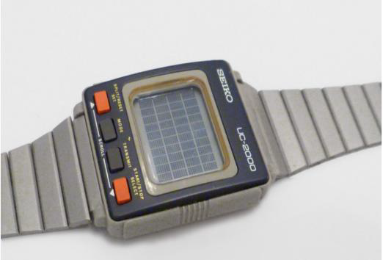
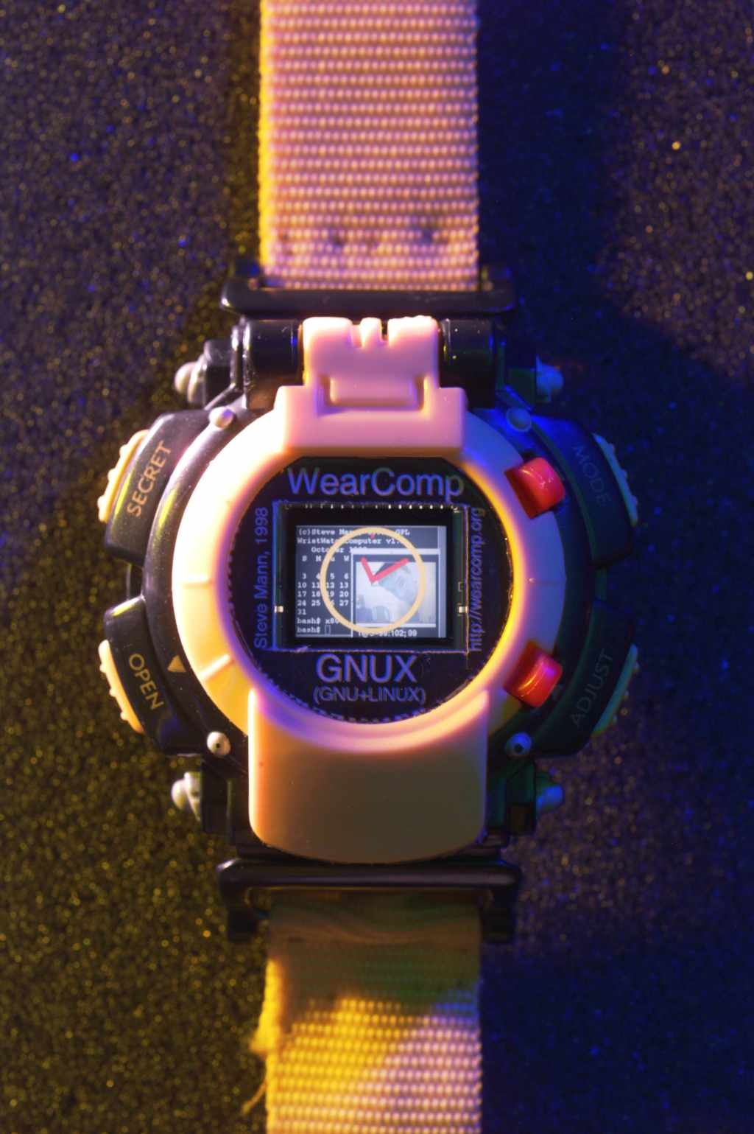
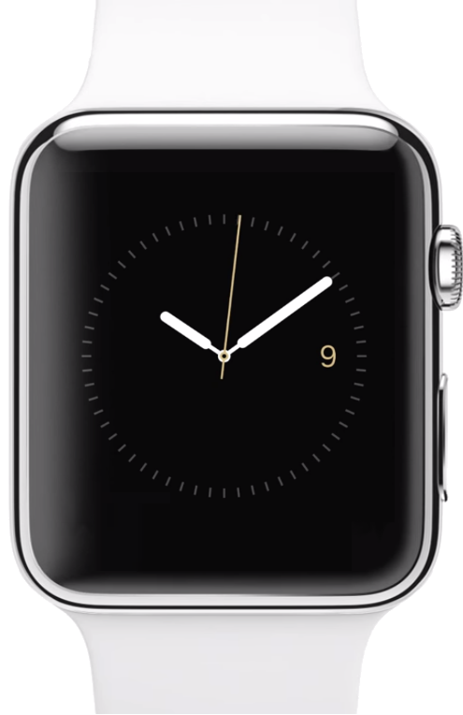
5
History of the Smartwatch
Pulsar
Seiko
Timex Data-Link
Samsung
Samsung 2018
Linux
Apple
Introduction
Function of the Smartwatch
Advantages & Disadvantages
Future
Conclusion

Slide 6
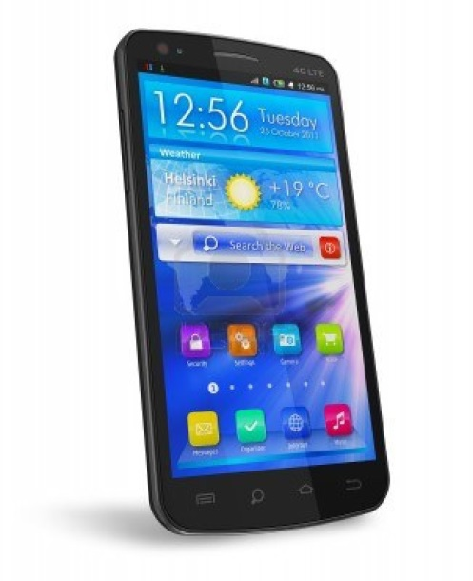
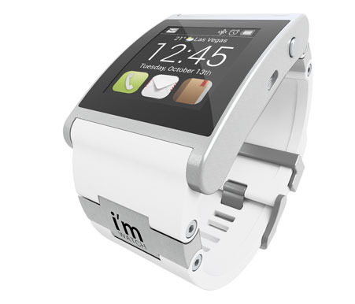
The Modern Smartwatch
5
Today’s smartwatch is designed to pair with one’s smartphone in order to amplify and to enhance the user experience
Introduction
Function of the Smartwatch
Advantages & Disadvantages
Future
Conclusion

Slide 7

The Modern Smartwatch
5
Functions of the Smartwatch include:
1
2
3
Making and sending calls
Connecting to the internet
Ability to run mobile applications
Introduction
Function of the Smartwatch
Advantages & Disadvantages
Future
Conclusion

Slide 8
The Modern Smartwatch
5
Functions of the Smartwatch include:
4
5
6
monitoring your heart rate
tracking your activity
providing reminders throughout the day
Introduction
Function of the Smartwatch
Advantages & Disadvantages
Future
Conclusion

Slide 9
The Modern Smartwatch
5
Smartwatch Developers
Sony
Samsung
Apple
Introduction
Function of the Smartwatch
Advantages & Disadvantages
Future
Conclusion

Slide 10
Impact on Life
5
Advantages
Disadvantages
Faster access to social networks
Reduce need to take out phone
Less likely to miss calls, messages, and notifications
Dangerous distraction when driving Dangerous distraction when driving
Further withdraws people from social activities
Further withdraws people from social activities
Introduction
Function of the Smartwatch
Advantages & Disadvantages
Future
Conclusion

Slide 11
5
Advantages
Disadvantages
Displays e-mail, call, and text notifications
Camera features
Able to synchronize data with smartphones
Access to the Web
Must work in conjunction with a smartphone
Short battery life
Unclear display in direct sunlightFurther withdraws people from
Introduction
Function of the Smartwatch
Advantages & Disadvantages
Future
Conclusion

Slide 12
The Future of Mobile Technology
5
1
2
3
Minimal size and portability
Varying functionality
Intriguing and innovative new features
Voice-activation
3D Video communication
Introduction
Function of the Smartwatch
Advantages & Disadvantages
Future
Conclusion

Slide 13
5
Summary
1
The smartwatch is a computerized wristwatch
2
It is a growing technology
3
The future is uncertain
Introduction
Function of the Smartwatch
Advantages & Disadvantages
Future
Conclusion

