Slide 1
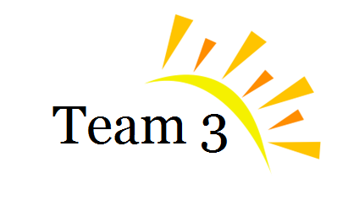
1
The Smartwatch
BUS 237 – Group Project
TA: Kevin Chua
Anthony Siu
Devin Zheng
Eve Ho
Louisa Lin

Slide 2
2
Agenda
Introduction
Pros & Cons
Examples
Future
Conclusion
Notes:
Before we jump right into it, here’s a quick glimpse into the agenda for today’s presentation.

Slide 3
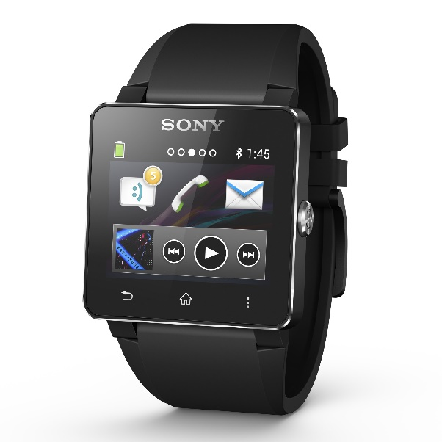
What is the Smartwatch?
3
The smartwatch is a computerized wristwatch
A
Introduction
Pros & Cons
Examples
Future
Conclusion
Alternatives
Recommendation
Notes:
So what is the smartwatch? Let’s begin with the smartwatch is a computerized wristwatch.

Slide 4
What is the Smartwatch?
4
Considered by many as the newest addition to the “smart technology” family
A
Introduction
Pros & Cons
Examples
Future
Conclusion
Alternatives
Recommendation
Notes:
And it is considered by many to be the newest member of the “smart technology family”

Slide 5
History of the Smartwatch
5
Invented in 1982: Pulsar NL C01 by Seiko
Catered towards business-users
Manufacturers are beginning to build smartwatches for both business and general use
Risks and
Mitigations
Introduction
Pros & Cons
Examples
Future
Conclusion
Alternatives
Recommendation
Notes:
But the interesting thing is, is that the Smartwatch has actually been around for quite a bit.
It was first introduced in 1982 as the Pulsar NL C01, manufactured by Seiko. Back then, smartwatches were catered towards the business users 31 years later to today, the smartwatch is beginning to build up traction as we see more and more big name companies such as Samsung begin to develop smartwatches not only for business users, but for everyday users as well.

Slide 6
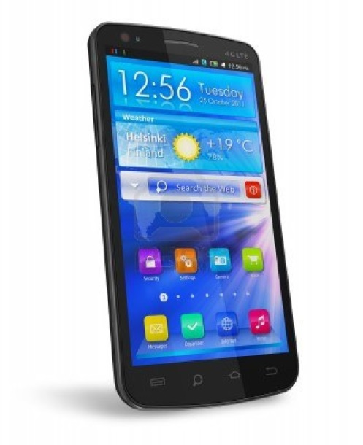
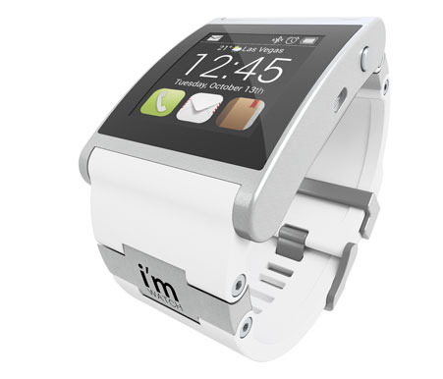
The Modern Smartwatch
6
Today’s smartwatch is designed to pair with one’s smartphone in order to amplify and to enhance the user experience
Introduction
Pros & Cons
Examples
Future
Conclusion
Alternatives
Recommendation
Notes:
Today’s smartwatch is primarily designed to pair with an individual’s smartphone to amplify and to enhance the overall user experience
http://us.123rf.com/400wm/400/400/scanrail/scanrail1111/scanrail111100008/11107876-black-glossy-touchscreen-smartphone-with-blue-interface-isolated-on-white-background.jpg http://s3.amazonaws.com/bonanzleimages/afu/images/9010/9591/01_classy-watch-white.jpg

Slide 7
The Modern Smartwatch
7
Functions of the Smartwatch include:
1
2
3
Making and sending calls
Connecting to the internet
Ability to run mobile applications
Introduction
Pros & Cons
Examples
Future
Conclusion
Alternatives
Recommendation
Notes:
A majority of today’s smartwatches have capabilities similar to those of smartphones, including :
Ability to make and send calls
Connecting to the internet
Running mobile applications and much more

Slide 8
8
Agenda
Introduction
Pros & Cons
Examples
Future
Conclusion

Slide 9
Impact on Life
9
PROS
CONS
Faster access to social networks
Reduce need to take out phone
Less likely to miss calls, messages, and notifications
Dangerous distraction when driving
Further withdraws people from social activities
Introduction
Pros & Cons
Examples
Future
Conclusion
Alternatives
Recommendation

Slide 10
Features
10
PROS
CONS
Displays e-mail, call, and text notifications
Camera features
Able to synchronize data with smartphones
Access to the Web
Must work in conjunction with a smartphone
Short battery life
Glitches, bugs, and lag
Unclear display in direct sunlight
Introduction
Pros & Cons
Examples
Future
Conclusion
Alternatives
Recommendation

Slide 11
11
Agenda
Introduction
Pros & Cons
Examples
Future
Conclusion

Slide 12
12
Examples of Smartwatch Developers
Smartwatch Developers
Sony
Samsung
Pebble Technology
Introduction
Pros & Cons
Examples
Future
Conclusion
Alternatives
Recommendation

Slide 13
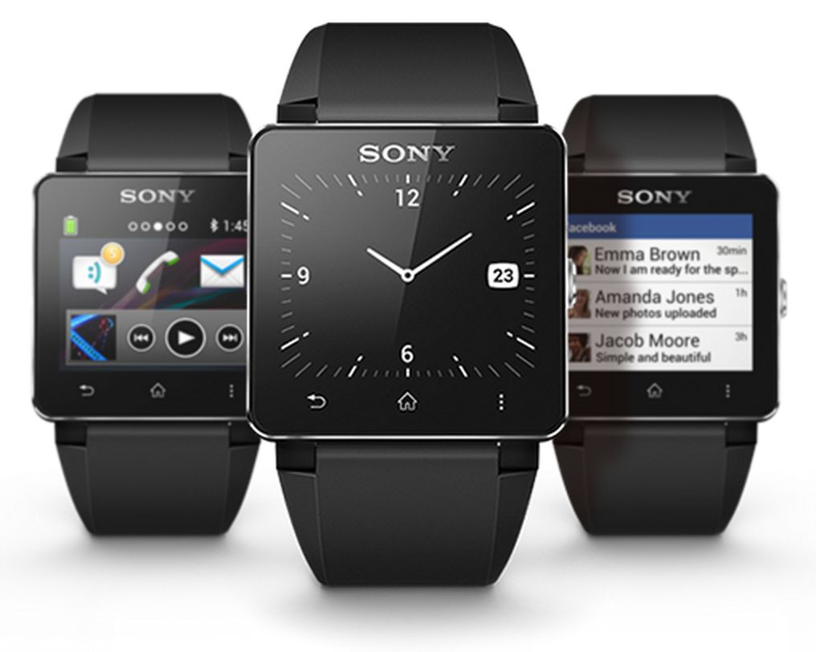
13
Sony Smartwatch 2
Up to 300 apps available for download from the Google Play Store
Compatible with Android 4.0 and later
Wristband is customizable
Introduction
Pros & Cons
Examples
Future
Conclusion
Alternatives
Recommendation

Slide 14
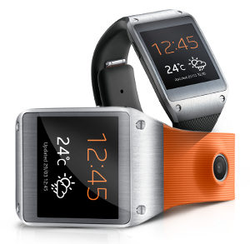
14
Samsung Galaxy Gear
Only compatible with Samsung Galaxy Note 3 smartphone
Includes a Memographer, which is a feature that allows you to take photos and record voice memos
Introduction
Pros & Cons
Examples
Future
Conclusion
Alternatives
Recommendation

Slide 15
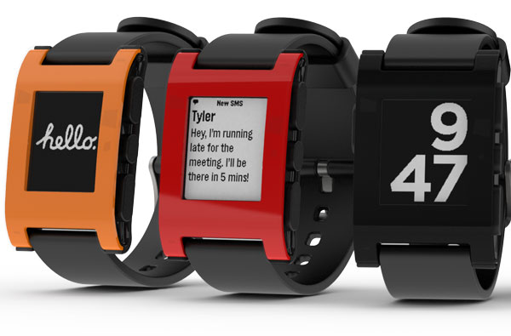
15
Pebble Smartwatch
Can read content on screen in any lighting
Simple and easy to use
Compatible with Apple iOS and Android phones
Can tap buttons to light up backlight and flick wrist to light up display
Introduction
Pros & Cons
Examples
Future
Conclusion
Alternatives
Recommendation

Slide 16
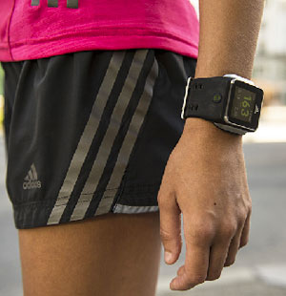
Smartwatch Users
16
A
It is uncertain whether companies would consider smartwatches as the cost can add up quickly
B
Mostly tech-savvy users who have an interest in the functionality of the gadget
C
Most common are athletes
Issues
Conclusion
Introduction
Pros & Cons
Implementation Plans
Recommendations
Future
Alternatives
Examples
Recommendation

Slide 17
17
Agenda
Introduction
Pros & Cons
Examples
Future
Conclusion

Slide 18
The Future of Mobile Technology
18
1
2
3
Minimal size and portability
Varying functionality
Intriguing and innovative new features
Voice-activation
3D Video communication
Introduction
Pros & Cons
Examples
Future
Conclusion
Alternatives
Recommendation

Slide 19
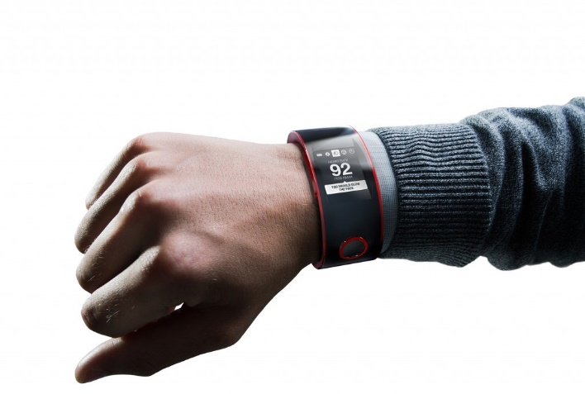
19
The Future of the Smartwatch
Enhances convenience of the use of mobile smartphones
May not be the ultimate form of personal devices
Introduction
Pros & Cons
Examples
Future
Conclusion
Alternatives
Recommendation

Slide 20
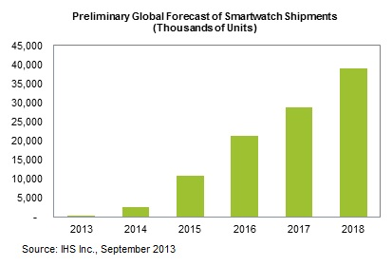
20
The Future of the Smartwatch
Introduction
Pros & Cons
Examples
Future
Conclusion
Alternatives
Recommendation

Slide 21
21
Summary
1
The smartwatch is a computerized wristwatch
2
It is a growing technology
3
The future is uncertain
Issues
Conclusion
Introduction
Pros & Cons
Recommendations
Future
Alternatives
Examples
Recommendation
Notes:
In summary, the smartwatch is a computerized wristwatch designed to pair with one’s smartphone to enhance the overall experience.
It is a growing technology that has been building traction over the past half decade
And while we cannot predict the future success of the smartwatch, we can definitely see that companies big and small are racing to capture the newbourne market

Slide 22
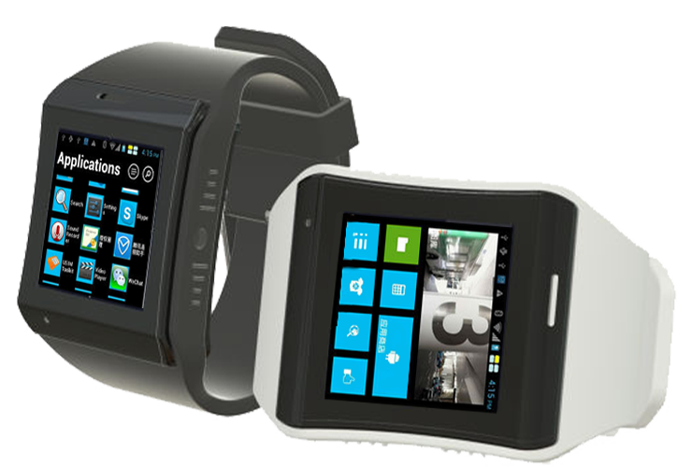
22
Conclusion
Thank you for your time.
Introduction
Pros & Cons
Examples
Future
Conclusion
Alternatives
Recommendation

Slide 23
23
References (Articles used)
http://www.techradar.com/news/portable-devices/before-iwatch-the-timely-history-of-the-smartwatch-1176685 http://www.forbes.com/sites/anthonykosner/2013/01/09/from-kickstarter-to-ces-the-pebble-watch-is-finally-here-and-shipping-jan-23/ http://www.electronicsweekly.com/gadget-master/gadget-watch/gadget-watch-samsung-galaxy-gear-smart-watch-2013-09/ http://press.ihs.com/press-release/design-supply-chain-media/ihs-news-flash-fast-facts-and-analysis-todays-smartwatch-ann http://www.cio.com/article/741602/Why_Smartwatches_Glasses_and_Other_Wearable_Tech_are_No_Gimmick http://mustified.com/2013/09/02/best-smart-watches/ http://gigaom.com/2013/06/25/sorry-sony-i-expected-more-from-the-new-smartwatch-2/ http://www.pcmag.com/article2/0,2817,2415719,00.asp http://www.t3.com/reviews/samsung-galaxy-gear-review http://www.martianwatches.com/
Introduction
Pros & Cons
Examples
Future
Conclusion
Alternatives
Recommendation

Slide 24
24
References (Graphic sources)
http://cdn.androidpolice.com/wp-content/uploads/2013/06/nexusae0_1_Smartwatch_2_Black_Angled.jpg http://us.123rf.com/400wm/400/400/scanrail/scanrail1111/scanrail111100008/11107876-black-glossy-touchscreen-smartphone-with-blue-interface-isolated-on-white-background.jpg http://s3.amazonaws.com/bonanzleimages/afu/images/9010/9591/01_classy-watch-white.jpg http://gigaom2.files.wordpress.com/2013/06/sonysmartwatch2trio.jpg?w=637&h=509 http://static.electronicsweekly.com/gadget-master/wp-content/uploads/sites/4/2013/09/Samsung-Galaxy-Gear-smart-watch.jpg http://blogs-images.forbes.com/anthonykosner/files/2013/01/Family-of-3-Pebbles.jpg http://www.technewsworld.com/images/article_images/79214_300x310.jpg http://images.thecarconnection.com/lrg/nissan-nismo-smart-watch_100439274_l.jpg http://images.indiegogo.com/file_attachments/191839/files/20131112001201-IMG_0773-00.png?1384243921
Introduction
Pros & Cons
Examples
Future
Conclusion
Alternatives
Recommendation

