Slide 1



Auréva
E-COMMERCE APP

Slide 2
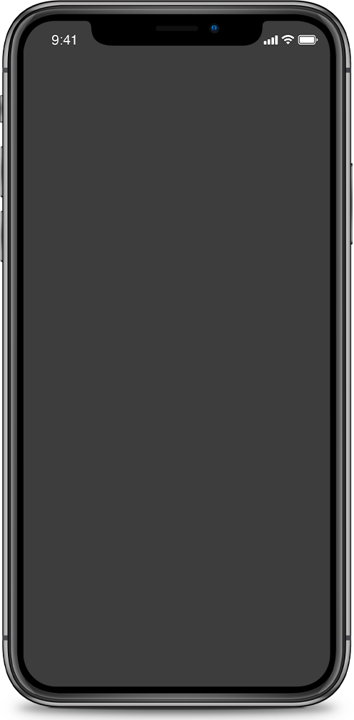
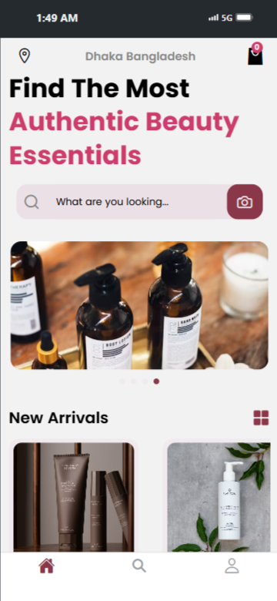
INTRODUCTION
Aureva is a mobile e-commerce app for cosmetics, built with React Native. It offers product browsing, search, cart, favorites, and secure checkout, providing a smooth and user-friendly shopping experience for Bangladeshi customers.

Slide 3
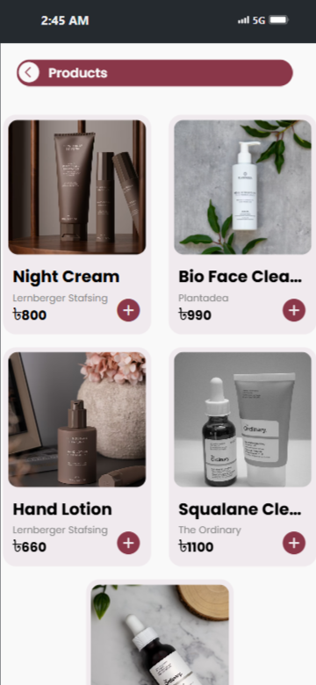
OBJECTIVES
Develop a user-friendly mobile cosmetics store
Enable product search, cart & wishlist
Provide secure checkout and payment options
Ensure smooth and responsive UI

Slide 4
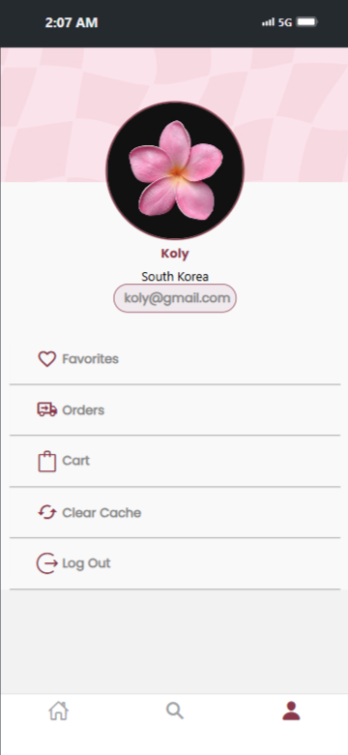






KEY FEATURES
Cart: Add/remove products
Authentication: User login & signup
Favorites: Save wishlist items
Home Page: Product carousel & new arrivals
Orders: View order history
Search: Find products easily
Checkout: Multiple payment methods (Credit Card, Bkash, COD)

Slide 5
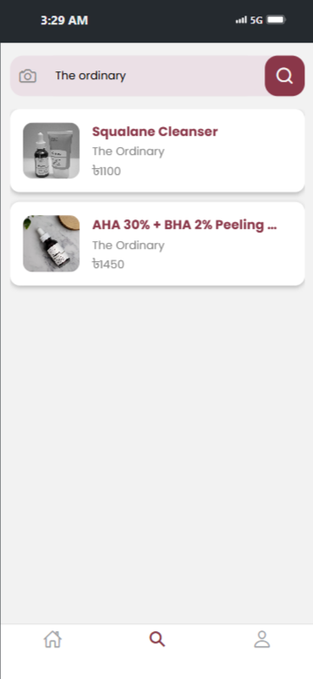

Slide 6
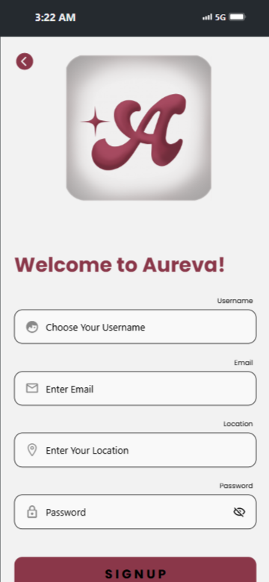
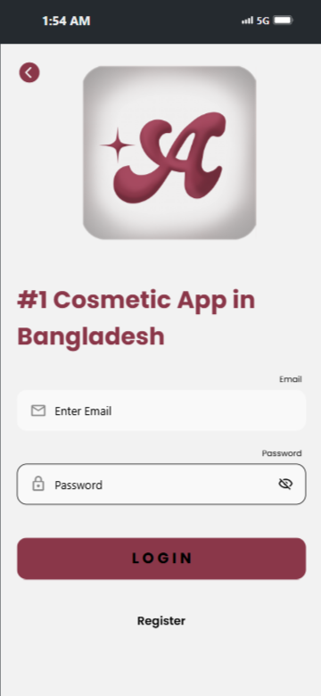
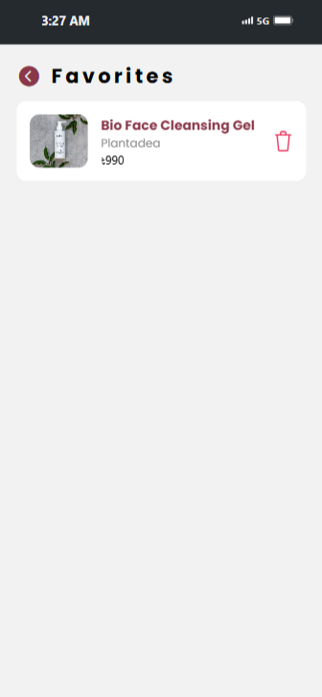
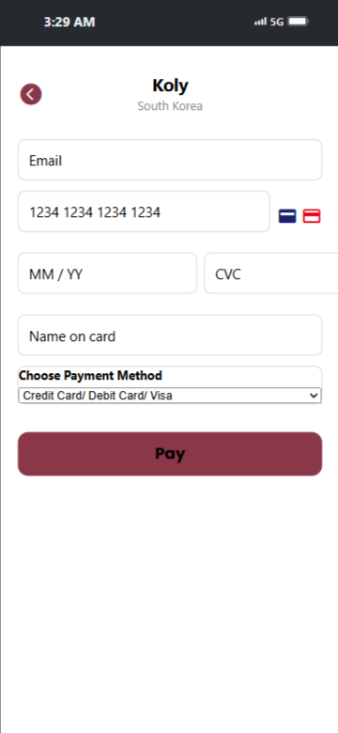

Slide 7





FRONTEND
BACKEND
DATABASE
React Native + Expo
Node.js
Mongodb
API
PAYEMENT
Restful API
Bank (Simulation)

Slide 8
CHALLANGES
Handling async API requests & errors
Secure token storage & authentication
Synchronizing cart with backend
Maintaining responsive design across devices

Slide 9
SOLUTIONS & IMPROVEMENTS
Implemented Axios with error handling
Used JWT authentication for security
Reusable components for cleaner code
Added auto-scroll carousel & modern UI design

Slide 10
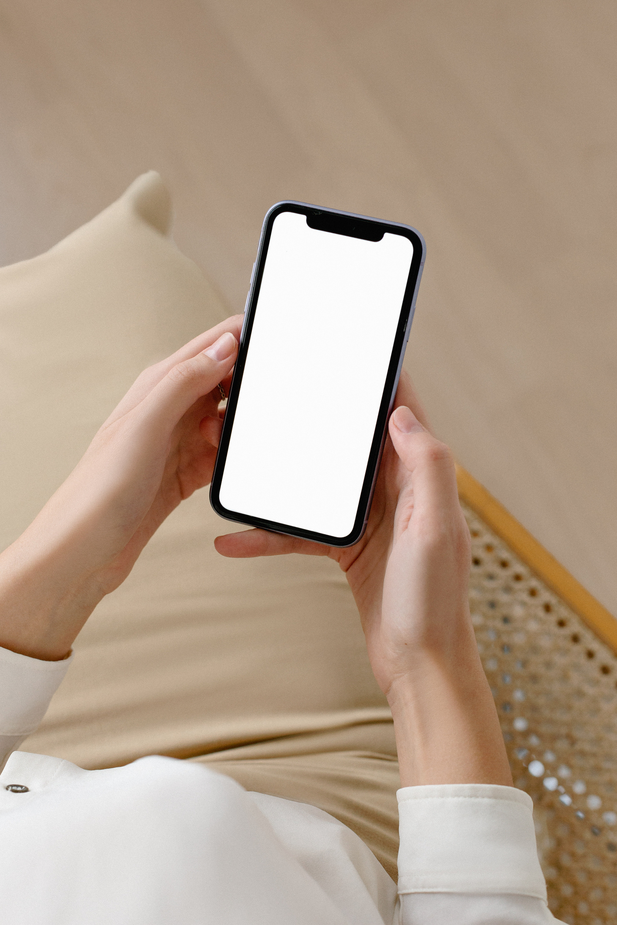
CONCLUSION
Aureva provides a modern, user-friendly cosmetics shopping app with essential e-commerce features. It has strong potential for real-world use and can be expanded with advanced features in the future.

Slide 11
Meet Our Team
Jeba Tabassum Urbi
2231034642
Samia Islam
2231642042
Sheikh Mahpara Ema
2021784642

Slide 12
Thank You!

