Slide 1
Supix DAQ

Slide 2
new trigger | post trigger | action
0 | 0 | nframes_in_buffer ++
1 | 0 | record pre-trigger nframes_in_buffer = 0 set post-trigger
1 | 1 | record this
0 | 1 | record this post_trigger --
read a frame
trigger
&
record
stop DAQ?
stop
update read buffer pointer
time
pre-trigger
post-trigger
trigger

Slide 3
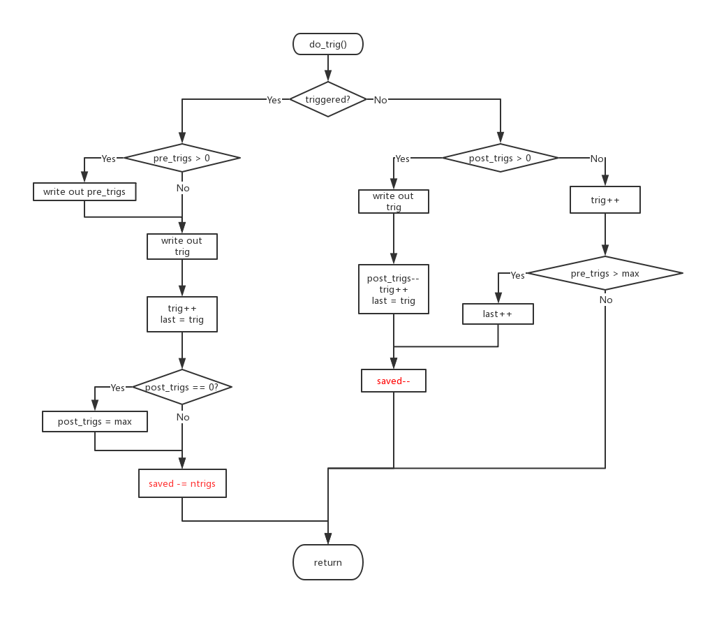

Slide 4
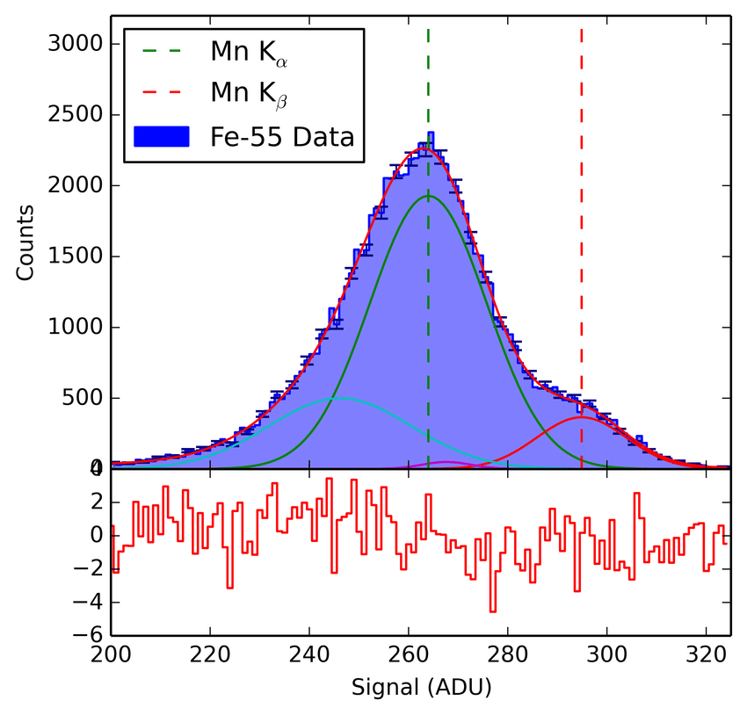
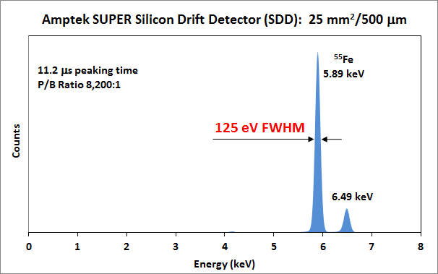

Slide 5
event display

Slide 6
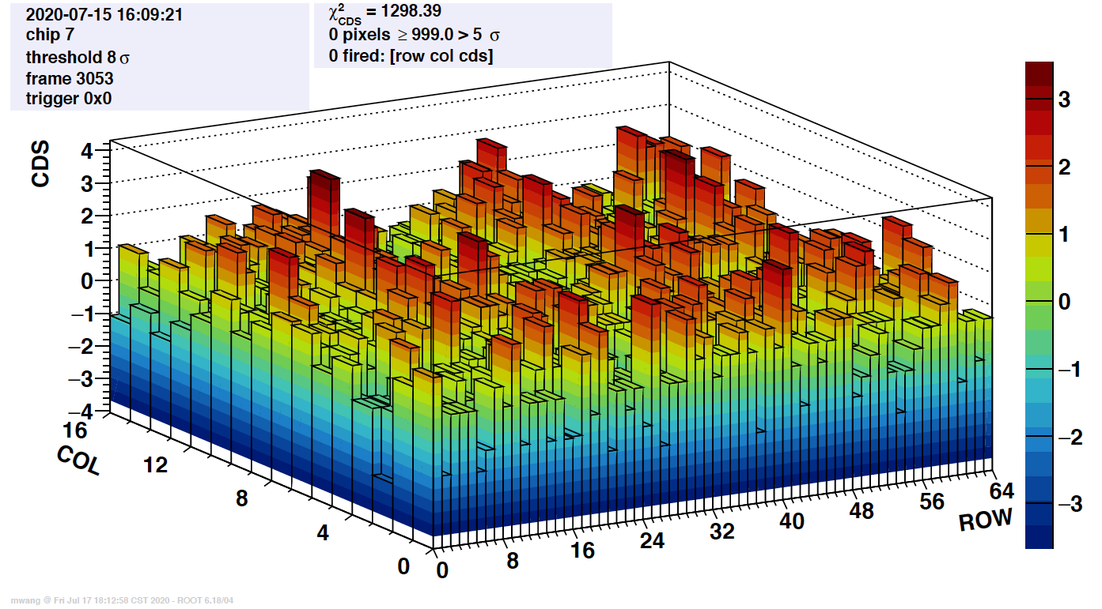

Slide 7
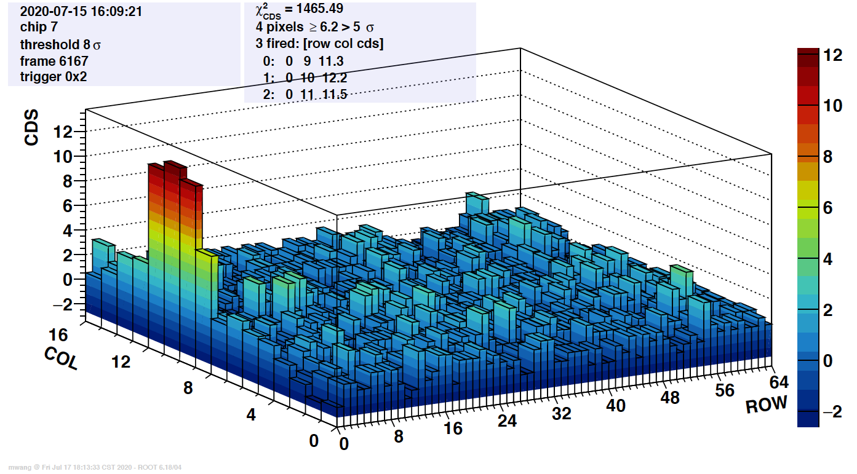

Slide 8
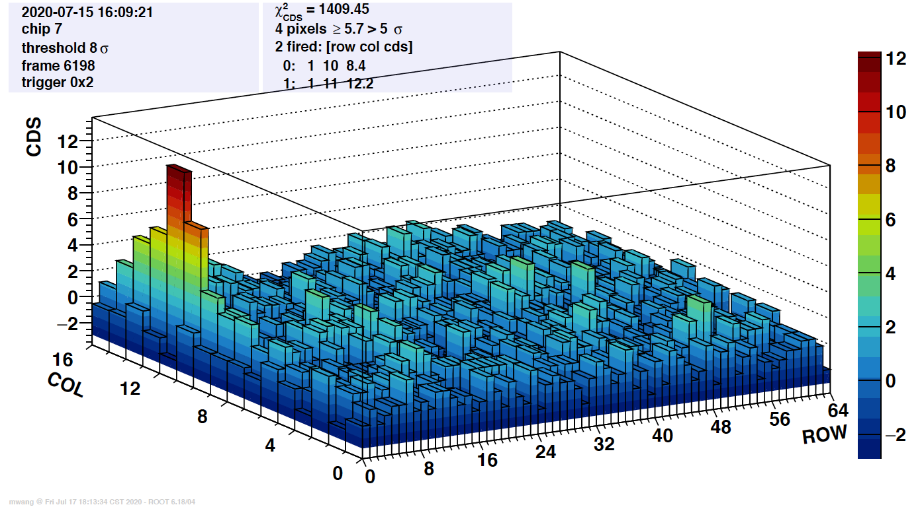

Slide 9
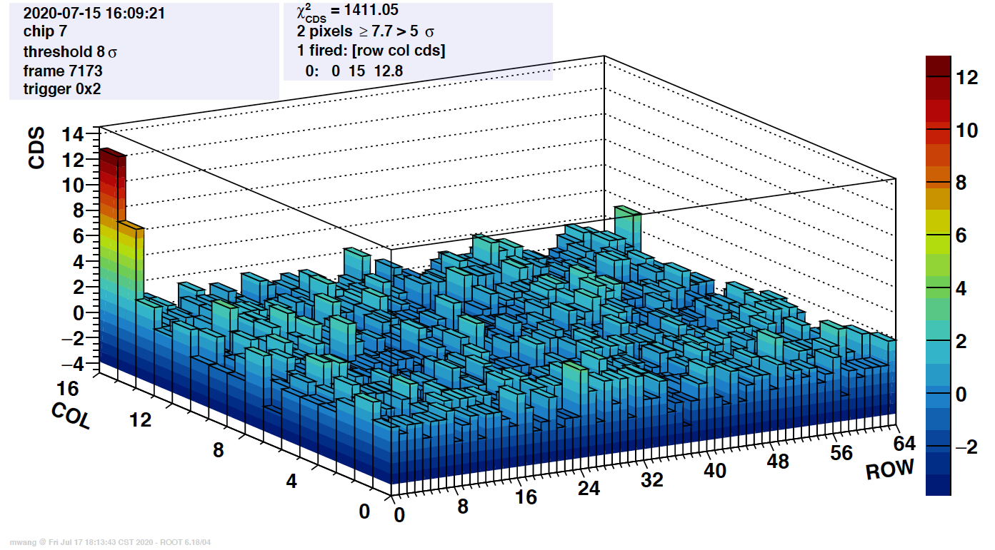

Slide 10
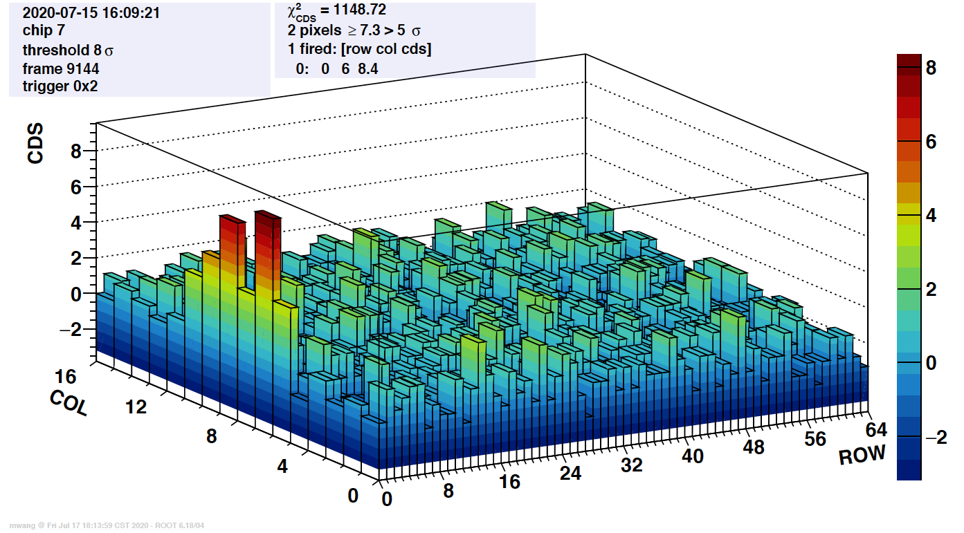

Slide 11
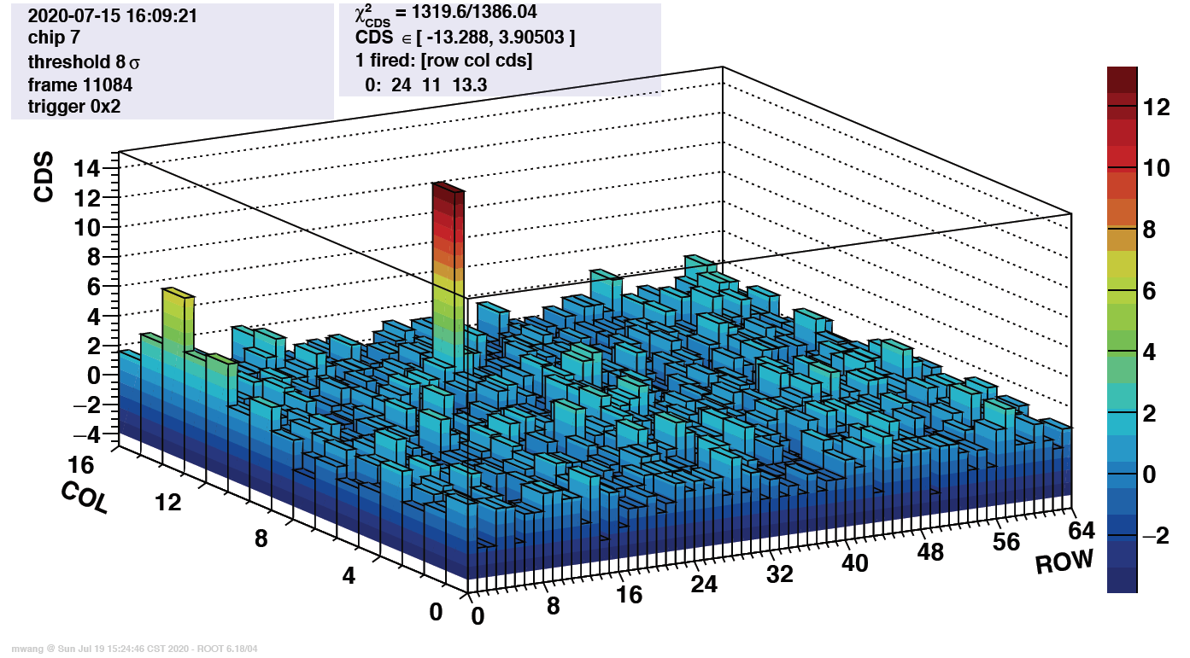

Slide 12
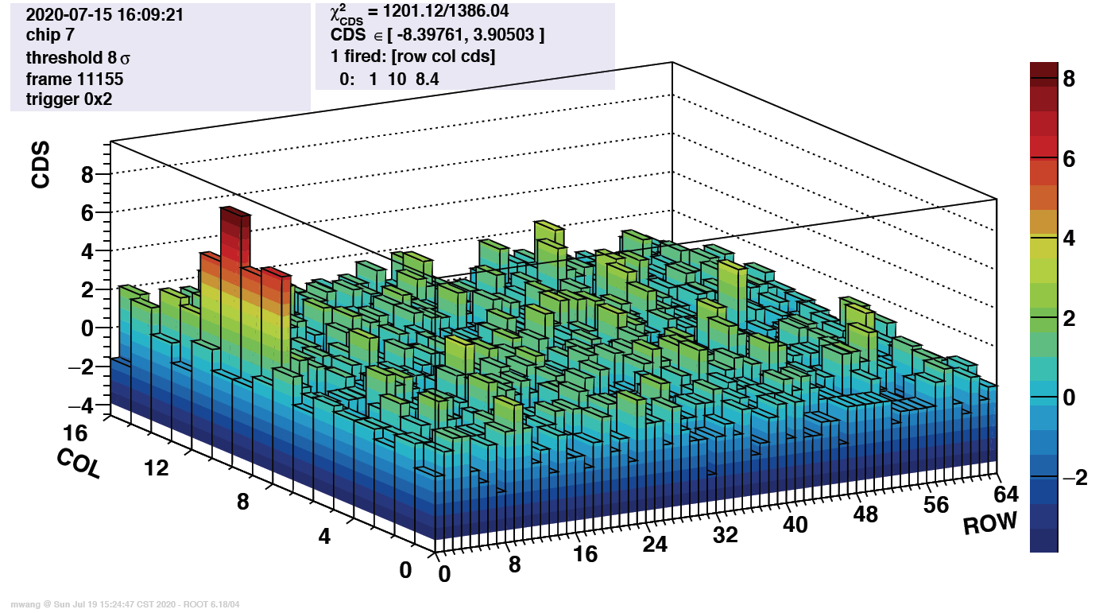

Slide 13
