Slide 1
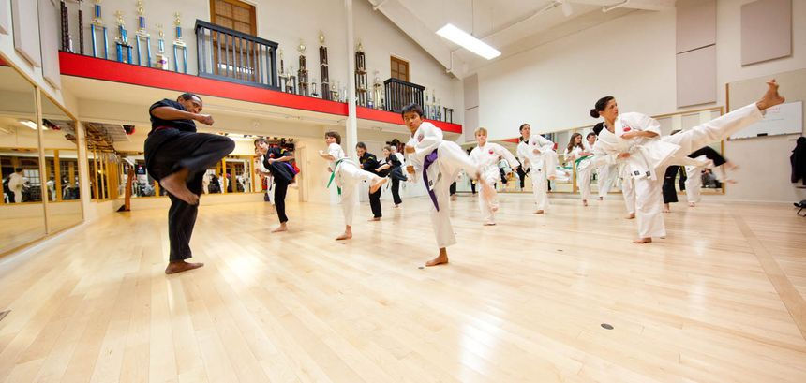
Martial Arts in schools
Josiah Schmitz
Introduction
Background
Martial arts are a form of combat that are taught along with traditional virtues.
They come from all over the world, but primarily East Asia.
They encompass such arts as karate, taekwondo, kung fu, jiu jutsu, and judo.
Martial arts have been practiced by millions of people across the globe for hundreds of years.
Almost 1 in 4 high school students in the USA have been in a fight.
These fights often stem from a lack of social support and self-esteem.
Roughly 1 in 5 students ages 12-18 have been bullied
These students are at a higher risk of having academic problems.
44% of high school students are suffering from sadness or hopelessness.
New Ideas
Benefits
Schools need to add martial arts clubs and programs to schools to reduce the prevalence of these issues.
This would involve the school taking surveys of students to determine their interest in various martial arts, then working to implement the most-liked ones as sports clubs.
Schools can hire professional martial arts teachers and trainers and rent out dojos to allow their students to train in, like in the image shown below.
Martial arts have been shown to decrease aggressive behavior in elementary schoolers.
They also allow students to learn self-defense techniques in case they get into fights.
Studies have shown that people capable of self-defense tend to have higher levels of self-esteem.
Martial arts also greatly improve one’s physical fitness, strengthening parts of the body such as muscular endurance, agility, and bone strength.
Figure 1 (Example Karate Dojo )
What It Would Look Like
In this example, karate students practice a side kick (known as “yoko geri” in Japanese) together in line drills.
This is a modern martial arts dojo, like one that could be used for a school martial arts program.
What is happening here is very similar to how an actual martial arts club could look if added to schools.
References
Bhattarai, Deepa, et al. “Prevalence and Factors Associated with Depression among Higher Secondary School Adolescents of Pokhara Metropolitan, Nepal: A Cross-Sectional Study.” BMJ Open, U.S. National Library of Medicine, 31 Dec. 2020, pmc.ncbi.nlm.nih.gov/articles/PMC7780534/.
“Fast Facts: Bullying.” National Center for Education Statistics (NCES) Home Page, a Part of the U.S. Department of Education, nces.ed.gov/fastfacts/display.asp?id=719. Accessed 25 Nov. 2024.
Huang, Caiyun. “Power Decline and the Change of Self-Esteem: The Moderating Effect of Self-Defense.” Frontiers, Frontiers, 6 Dec. 2022, www.frontiersin.org/journals/psychology/articles/10.3389/fpsyg.2022.1052208/full.
Miyamoto, Musashi. The Book of Five Rings. Translated by William Scott Wilson, Shambhala Publications : Distributed in the U.S. by Random House, 2012.
“Physical Fights on School Property and Anywhere.” Coe - Physical Fights on School Property and Anywhere, National Center for Education Statistics, May 2021, nces.ed.gov/programs/coe/indicator/a12/physical-fights.
Vankar, Preeti. “High School Students with Feelings of Sadness or Hopelessness U.S. 2011-2021.” Statista.Com, Statista, 29 Nov. 2023, www.statista.com/statistics/1384754/share-high-school-students-feelings-of-sadness-or-hopelessness/.

