Slide 1

Sinhgad Technical Education Society’s
SINHGAD COLLEGE OF ENGINEERING, Pune-41
Department of Information Technology
Final project review
Presented By
Asmita Nalawade
Shraddha Agre
Shubham Malpure
Swapnil Bhalerao
Guided By
Prof. J.S. Kulkarni

Slide 2
“Disease Prediction Using ML- Lung Cancer Detection and Classification Using Efficient Net”

Slide 3
Contents
Introduction
Motivation
Problem Statement
Objective
Existing System
Literature Survey
Software
Hardware
Project Scope
Project Timeline Chart
Assumptions and Dependencies
Functional Requirements
Algorithm
Architecture
DFD 0
DFD 1
DFD 2
UML Diagrams
Advantages
User Interface
Application
References

Slide 4
Introduction
Manifestation of Lung cancer in the body of the patient reveals through early symptoms in most of the cases
Lung cancer is a disease which arises due to growth of unwanted tissues in the lung and this growth which spreads beyond the lung are named as metastasis which spreads into other parts of the body
The classification is performed and the results were evaluated with the performance comparison of various algorithms. This prediction system is useful for the doctors to take an appropriate decision based on patient’s condition.
To reduce the time taken for feature extraction of all dataset images. The training time will be reduced by sharing the work among different local processors

Slide 5
Motivation
Lung cancer is one of the commonest cancers and cause of cancer related deaths all over the world. It accounts for 13 per cent of all new cancer cases and 19 per cent of cancer related deaths worldwide. There were 1.8 million new lung cancer cases estimated to occur in 2012 [32].
With this research we would like to help doctors save time, that is otherwise spent in the analysis of the CT Scans, for trying to identify the Lung Cancer. This also indirectly saves precious time of the patient, which can otherwise be used for the treatment. We aim to build a system where the CT Scans be automatically analyzed using the Deep-Convolutional-Neural-Network technology.
.

Slide 6
Problem Statement
The project integrates different topics in Computer Science to try and solve a real world problem in the medical domain. The project consists of CNN and software development to deliver a proof of concept. The application is a lung cancer detection system to help doctors make better and informed decisions when diagnosing lung cancer using efficient Net

Slide 7
Objective
Self-Learning: To understand the CT scan technology and how the images formed can be used to identify the cancerous nodule.
Self-Learning: To understand the deep learning algorithms and the working principles of convolution techniques in deep neural networks.
Development: Develop CNN based Lung Cancer Detection and Nodule Classification algorithm.
Research: To research various CNN based deep learning architectures, and their detection and classification performance on the dataset

Slide 8
Existing System
Input Image
Pre-processing
DT-Scan Image
Feature Classification
Database Image
Feature
CNN
Abnormal
Normal

Slide 9
Literature Survey
Sr.No. | Author Name | Journal | Name | Description
1 | Amin Saif, Yakoop Razzaz Hamoud Qasim, Habeb Abdulkhaleq Mohammed Hassan Al-Sameai | Int. J. Advanced Networking and Applications 2020 | Multi Paths Technique on Convolutional Neural Network for Lung Cancer Detection Based on Histopatho-logical Images | Lung cancer is the leading cancer cause of death and it's survival rate is very small. An early diagnosis is a good solution to increase the survival rate for lung cancer. To diagnose lung cancer using deep learning we present a convolutional neural network to diagnose three types of lung cancer (Adenocarcinoma, Benign and Squamous) based on histopatho- logical images. The proposed model consists of a main path and three sub-paths. The main path works to extract the small features and creates feature maps at low-level. As for the sub-paths is responsible for transferring the medium and high levels feature maps to fully connected layers to complete the classification process, also the VGG16 was prepared to compare it with the performance of the proposed.
2 | K. Narmada, G. Prabakaran | INTERNATIONAL JOURNAL OF SCIENTIFIC & TECHNOLOGY RESEARCH VOLUME 9, ISSUE 01, JANUARY 2020 | An Effective Lung Cancer Detection And Classification Using Enhanced Fully Convolution Neural Networks | The lung cancer tumor can be identified through this technique and also obtained the effective and accurate classification of stages of cancer. The CT images are used and also training samples can be identified. Even though the increase of training samples, it will give more accurate results over the detection methodology. In future, the optimization technique will used to improve the effectiveness of the detection and classification mechanism. Even more the treatment prediction will also identify in further improvements.
3 | Prathamesh Gawade* and R.P. Chauhan | International Journal of Advanced Technology and Engineering Exploration, 2016 | Detection of lung cancer using image processing techniques | The diagnosis of lung cancer at an early stage is of utmost importance if it is meant to degrade high mortality rate. The global lung screening program points to visualize positron emission tomography (PET) and computed tomography (CT) examinations amongst most aged groups at risk to enhance the early detection rate. Although use of invasive techniques, symptoms hardly appear until disease is advanced making it difficult for radiologist to identify lesions.

Slide 10
Sr.No. | Author Name | Journal | Name | Description
4 | Hunter Park, Connor Monahan | IJCERT, July 30, 2019 | Genetic Deep Learning for Lung Cancer Screening | Convolutional neural networks (CNNs) have shown great promise in improving computer aided detection (CADe). From classifying tumors found via mammography as benign or malignant to automated detection of colorectal polyps in CT colonography, these advances have helped reduce the need for further evaluation with invasive testing and prevent errors from missed diagnoses by acting as a second observer in today’s fast paced and high volume clinical environment. CADe methods have become faster and more precise thanks to innovations in deep learning over the past several years. With advancements such as the inception module and utilization of residual connections, the approach to designing CNN architectures has become an art.
5 | K. Senthil Kumar , K. Venkatalakshmi , and K. Karthikeyan | Computational and Mathematical Methods in Medicine Volume 2019 | Lung Cancer Detection Using Image Segmentation by means of Various Evolutionary Algorithms | various optimization algorithms have been evaluated to detect the tumor. Medical images often need preprocessing before being subjected to statistical analysis. +e adaptive median filter has better results than median and mean filters because the speckle suppression index and speckle and mean preservation index values are lower for the adaptive median filter. Comparing the five algorithms, the accuracy of the tumor extraction is improved
6 | K.Mohanambal, Y.Nirosha, E.Oliviya Roshini, S.Punitha, M.Shamini | International Journal of Advanced Research in Electrical, Electronics and Instrumentation Engineering Feb 2019 | Lung Cancer Detection Using Machine Learning Techniques | The computed tomography(CT) scanfrom the lung image database consortium and image database resource initiative datasets provide knowledge concerning nodule positions and their malignancy levels is been deployed here as a model. Support vector machine is been used as a classifier which is (i) to classify the nodule images into malignant or benign nodules and (ii) to classify the lung nodules into malignancy levels (1 to 5).These experimental results reveal that the SCM successfully extracted features of the nodules from the images and, therefore may be considered as a promising tool to support medical specialist to make a more precise diagnosis concerning the malignancy of lung nodules

Slide 11
Software
Anaconda
Python3.0
All Libraries of Python
Hardware
Processor: 1 gigahertz (GHz) or faster processor or SoC.
RAM: 1 gigabyte (GB) for 32-bit or 2 GB for 64-bit.
Hard disk space: 16 GB for 32-bit OS 20 GB for 64-bit OS

Slide 12
Project Scope
The system will be trained with large datasets to diagnose the type of cancer with its size and shape. The overall accuracy of the system can be improved using Convolutional Neural Network and also by improving the hidden neurons with deep network.

Slide 13
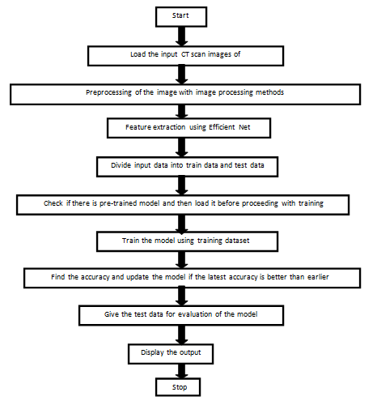
FLOW CHART

Slide 14
Algorithms
STEP-1: Collect the lung cancer images from respective cancer Dataset.
STEP-2: Analyze the dataset for variety of lung cancer’s information present in the database.
STEP-3: Prepare the methodology for lung cancer detection model development and training-&-testing.
STEP-4: Prepare the dataset, with data augmentation for training.
STEP-5: Design the Deep CNN architecture to identify the Lung Cancer in the CT scan image. Train the model.
STEP-6: Train the CNN model and measure its performance. Finetune the algorithm if necessary
STEP-7: Create the system for using the trained DCNN model to identify lung cancer in new images.

Slide 15
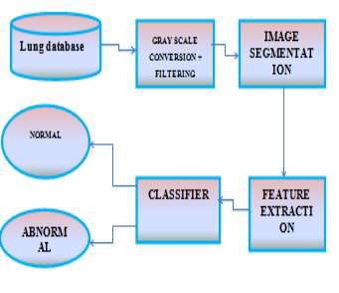
BLOCK DIAGRAM

Slide 16
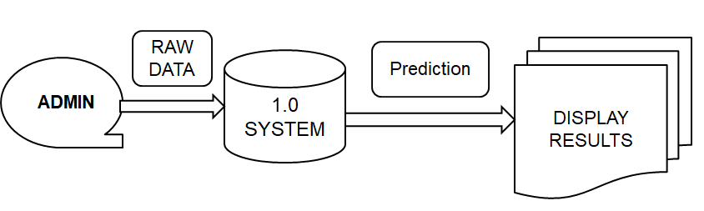
DFD 0

Slide 17
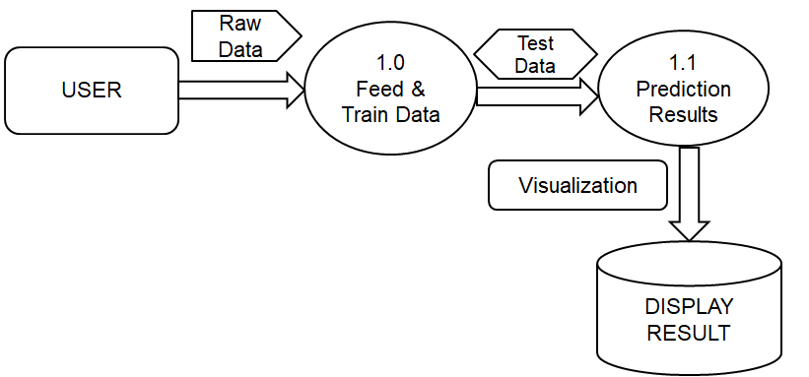
DFD 1

Slide 18
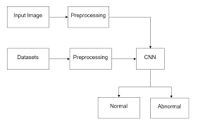
DFD 2

Slide 19
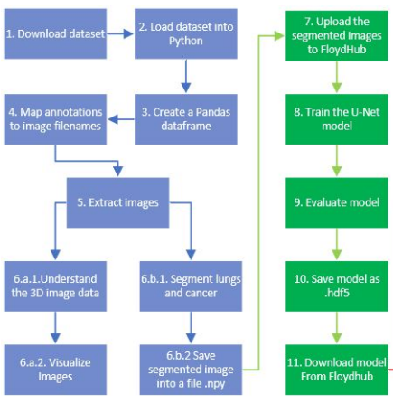
WORK FLOW

Slide 20
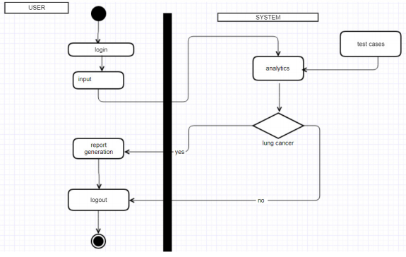
ACTIVITY

Slide 21
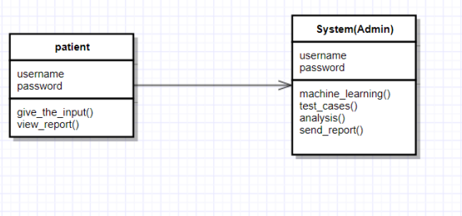
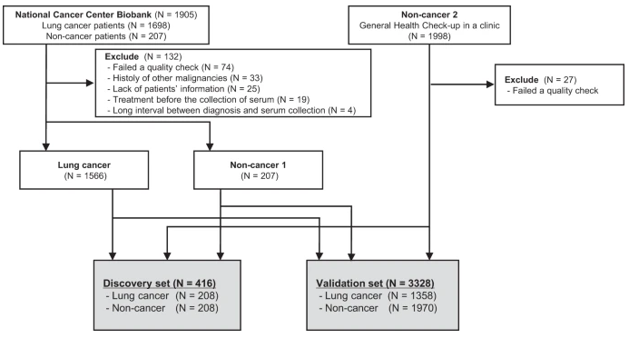
CLASS DIAGRAM

Slide 22
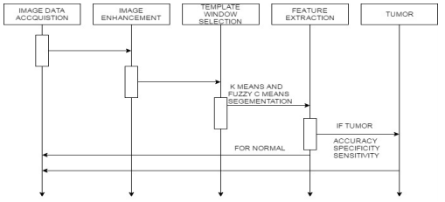
SEQUENCE
Cancer
If Cancer

Slide 23
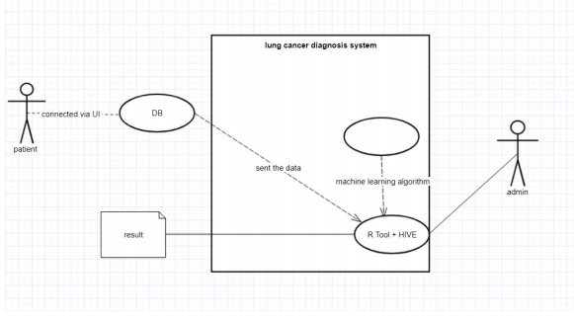
USECASE
USER
SYSTEM

Slide 24
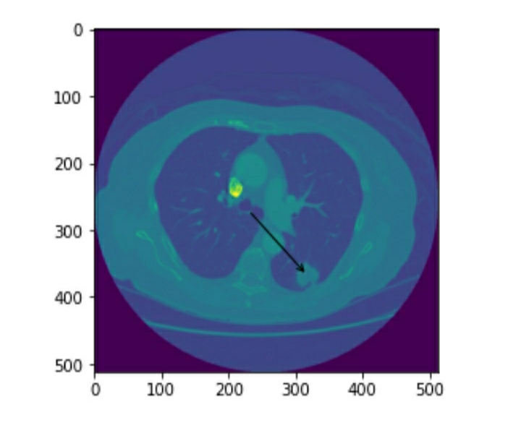
Implementation (I/P Image)

Slide 25
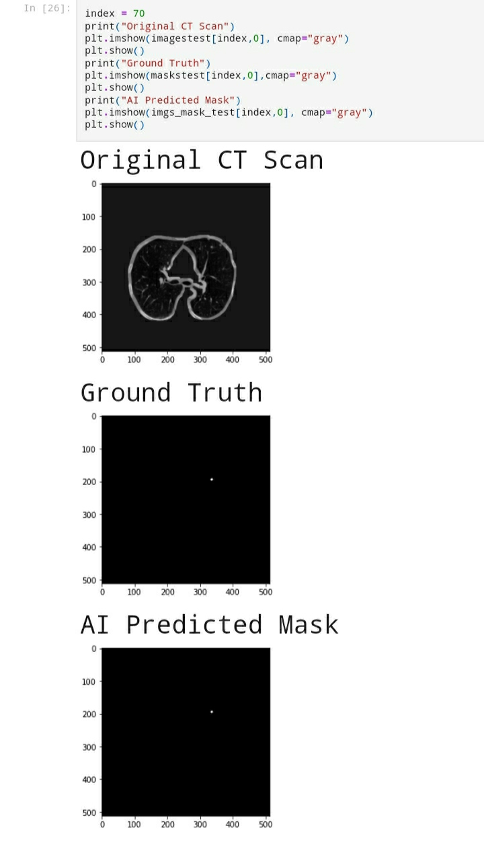
Implementation (O/P Image)

Slide 26
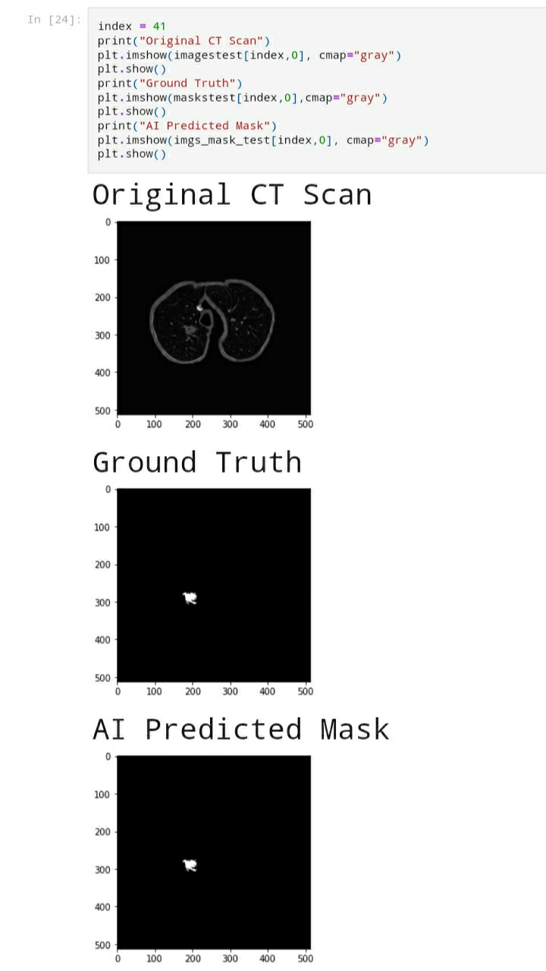
Implementation (O/P Image)

Slide 27

Implementation (O/P Image)

Slide 28
Advantages
Early detection of cancer greatly increases the chances for successful treatment.
With the use of this treatment is often simpler and more likely to be effective.
The proposed systems are more efficient and give the better result. (d)Provides better image quality and accuracy

Slide 29
FUTURE SCOPE
Doctor’s who work in this field are prone to observer fatigue from viewing so many CT scan images. The research on that suggests that observer fatigue increases the risk of errors that can be made by doctors while analyzing these scans. Many images in a CT scan also are irrelevant to Doctors e.g. for 200-300 images only 3 scans would show cancer depending on the stage of the patient. Although this feature was not implemented on the website, a more efficient deep learning model would be capable of alleviating these additional challenges.

Slide 30
EXPECTED OUTCOMES
The model Higher accuracy using the dice coefficient on the training set. The dice coefficient is much lower on the training set however the confusion matrix outputs a high true and false positive rate on a set that contains positive and negative samples. This indicates that the model is great at distinguishing between CT scan slices with no cancer nodules compared to the ones with cancer. I believe with more hyper-parameter tuning and model training the accuracy could be increased.

Slide 31
References
World Health Organization. (2020). WHO report on cancer: setting priorities, investing wisely and providing care for all.
Arnaud A. A. Setio, Francesco Ciompi, Geert Litjens, Paul Gerke, Colin Jacobs, Sarah J. van Riel, Mathi”Pulmonary nodule detection in CT images: false positive reduction using multi-view convolutional networks”(2016).
Mario Buty1, Ziyue Xu1 , Mingchen Gao” Characterization of Lung Nodule Malignancy using Hybrid Shape and Appearance Features”(2017)
Teramoto, A., Tsukamoto, T., Kiriyama, Y., & Fujita, H. (2017). Automated classification of lung cancer types from cytological images using deep convolutional neural networks. BioMed research international, 2017.
Song, Q., Zhao, L., Luo, X., & Dou, X. (2017). Using deep learning for classification of lung nodules on computed tomography images. Journal of healthcare engineering, 2017.
Wang, S., Dong, L., Wang, X., & Wang, X. (2020). Classification of pathological types of lung cancer from CT images by deep residual neural networks with transfer learning strategy. Open Medicine, 15(1), 190-197.
Tan, M., & Le, Q. V. (2019). Efficientnet: Rethinking model scaling for convolutional neural networks. arXiv preprint arXiv:1905.11946.
Asuntha, A., & Srinivasan, A. (2020). Deep learning for lung Cancer detection and classification. Multimedia Tools and Applications, 1- 32.

Slide 32
THANK YOU

