Slide 1

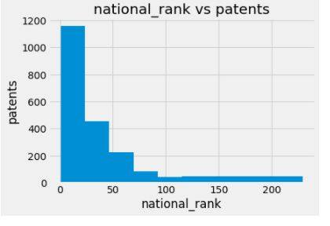
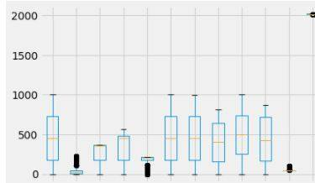
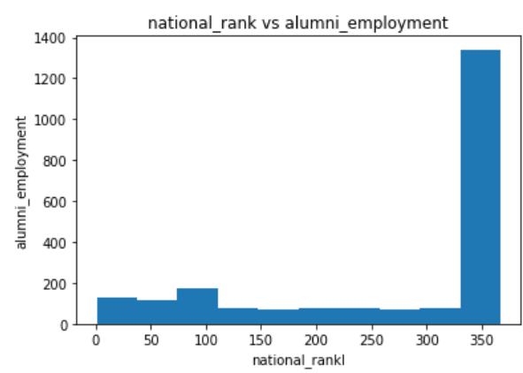
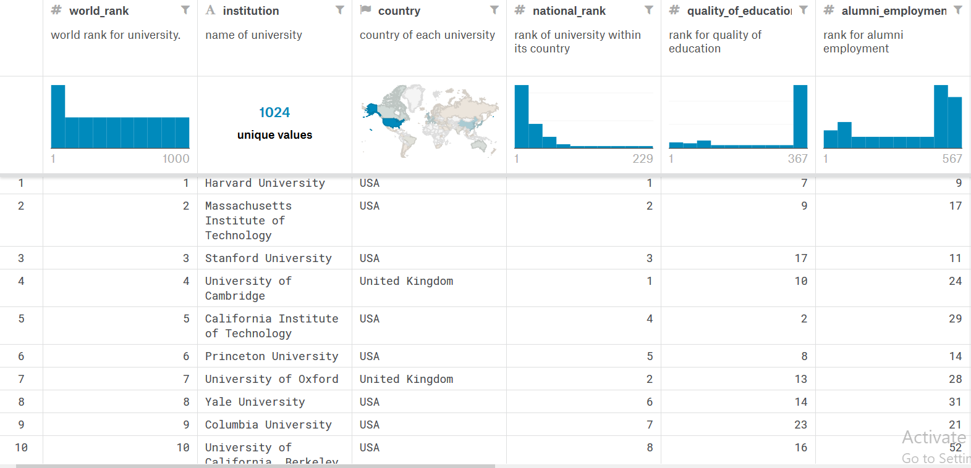
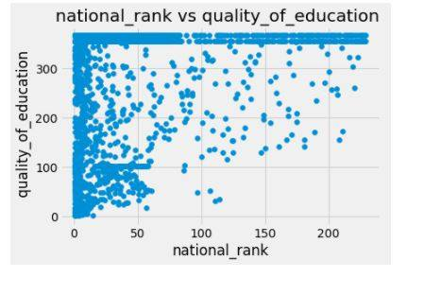
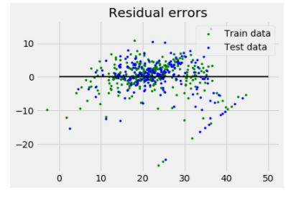
IPE-205
EXPLORATORY DATA ANALYSIS ON
WORLD RANKING UNIVERSITIES
Submitted to
TANMOY DAS
Summary
It is based on a
world ranking universities.by using this dataset ,
Some graphical
Plots are shown
here by doing the
python code
Submitted by
Humayara Samiha
Roll- 201736005
Lipa Akter
Roll- 201736009
Jannatul Ferdous Shorna
Roll- 201736041
DIAGRAMS
IPE 02
DATASET
CODE
x=df['national_rank']
y=df['quality_of_education'] z=df['quality_of_faculty'] import matplotlib.pyplot as plt import seaborn as sns plt.title('national_rank vs quality_of_education ') plt.xlabel('national_rank') plt.ylabel(' quality_of_education') plt.scatter(x,y)
plt.scatter
Kaggle link : https://www.kaggle.com/humayrasamiha/world-university-ranking Github link: https://github.com/jannatshorna/jannat

