Slide 1
Color Use in Fauvism: An Artistic Exploration

Slide 2
Introduction to Fauvism
Matisse and Marc used color in non-traditional ways to convey emotions
1
Fauvist artists emphasized bold and unconventional color choices in their works
2
The use of vivid colors and distorted forms was a key characteristic of Fauvism
3

Slide 3
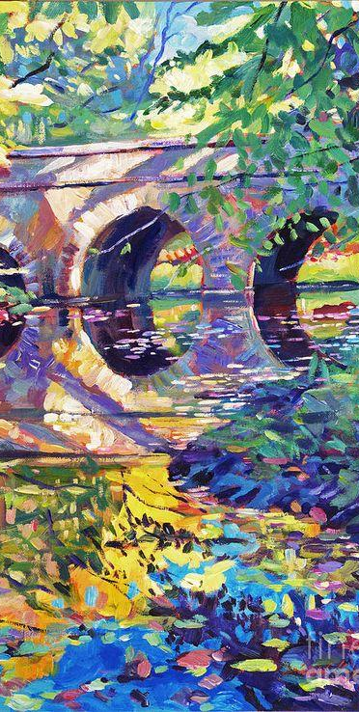
Color Use in Fauvism
Artistic Use of Color
Matisse and Marc used bold and unconventional colors in their artworks.
The use of non-traditional colors was a way to convey emotions and capture the essence of the subject matter.
Fauvist artists often used color in a way that defied reality, opting for emotional impact over naturalism.

Slide 4
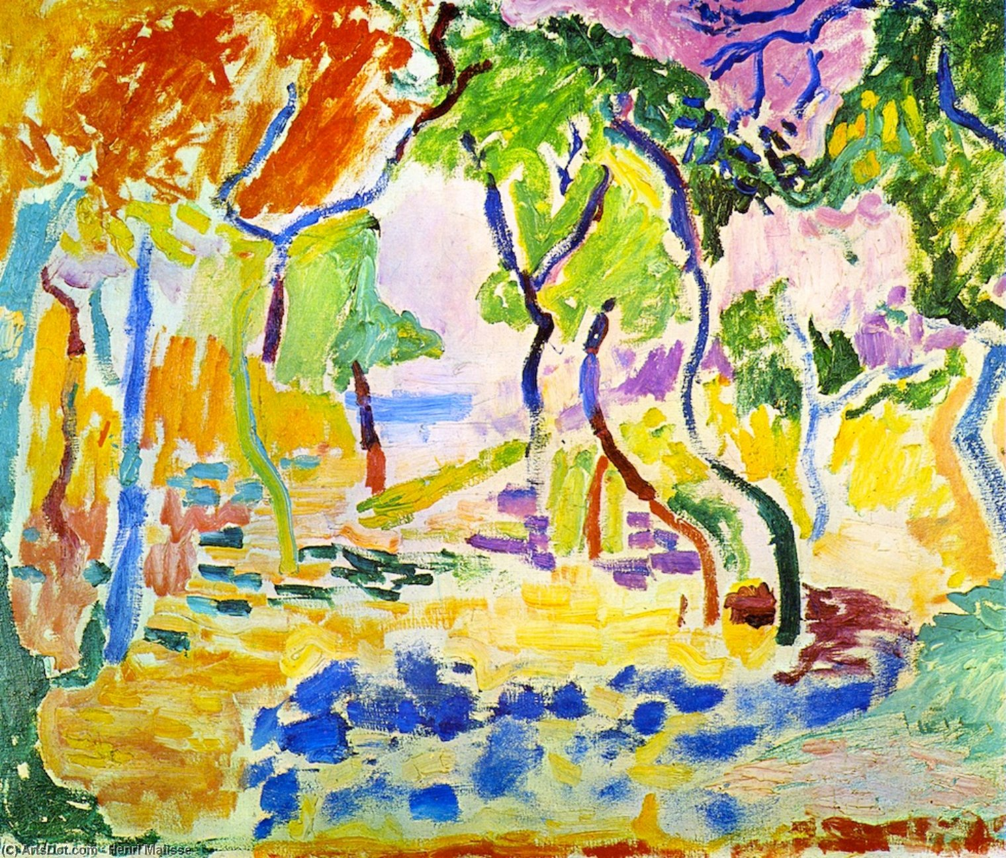
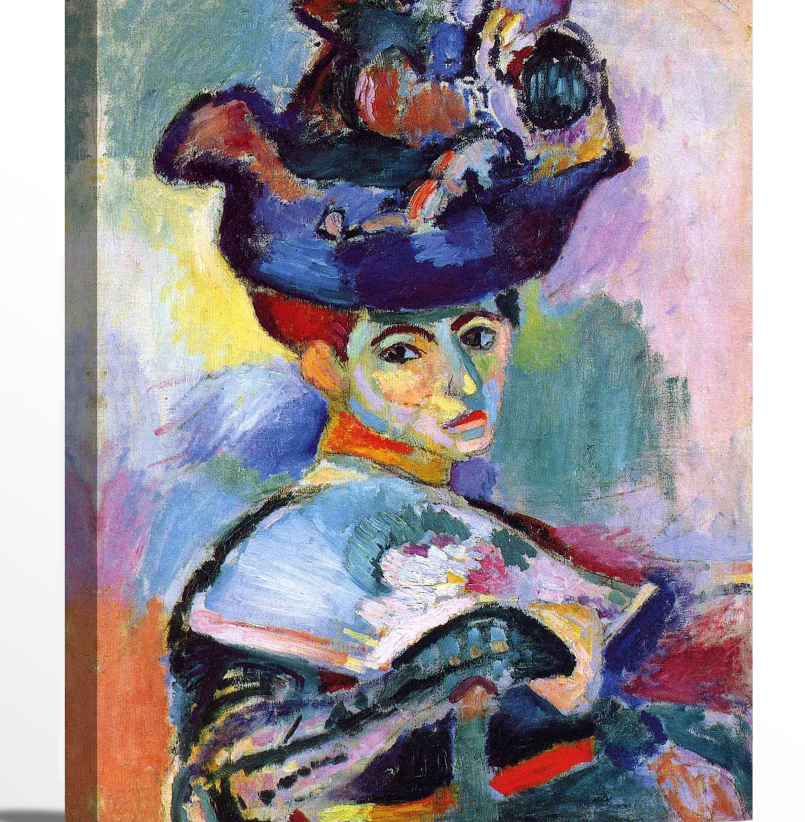
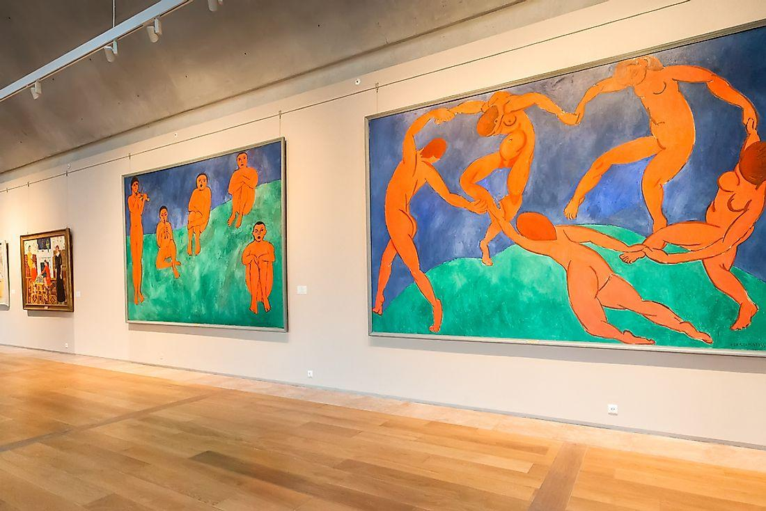
Examples of Matisse's Artworks
Dance
The Joy of Life
Discussion of the artwork's bold and expressive use of color to convey the joy of dance.
Example of Matisse's use of bold and unconventional colors to convey joy and vitality.
Woman with a Hat
This artwork showcases Matisse's use of vibrant colors and loose brushwork to convey emotion.

Slide 5
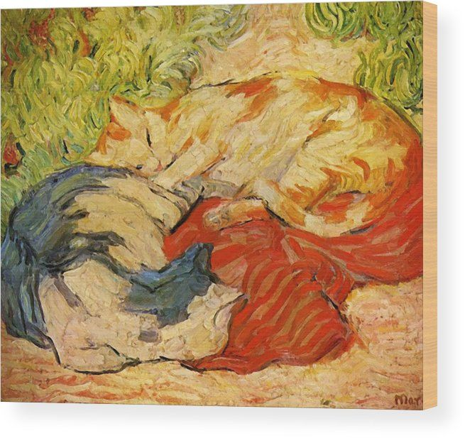
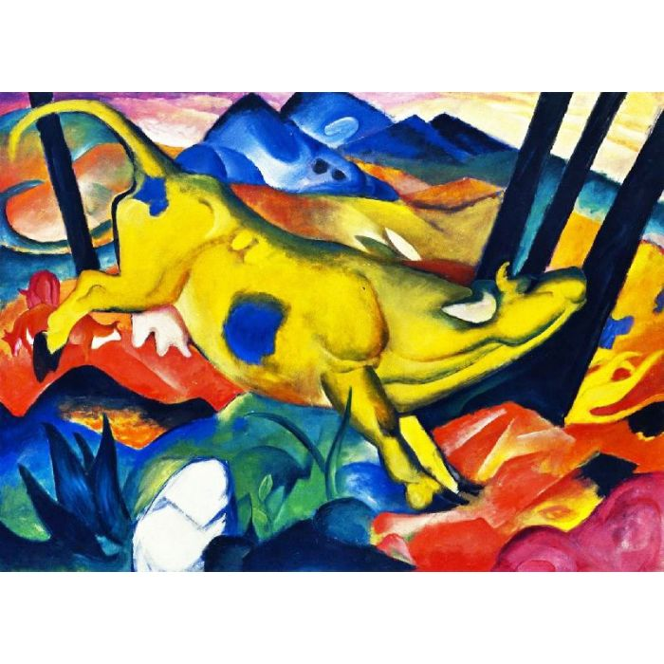
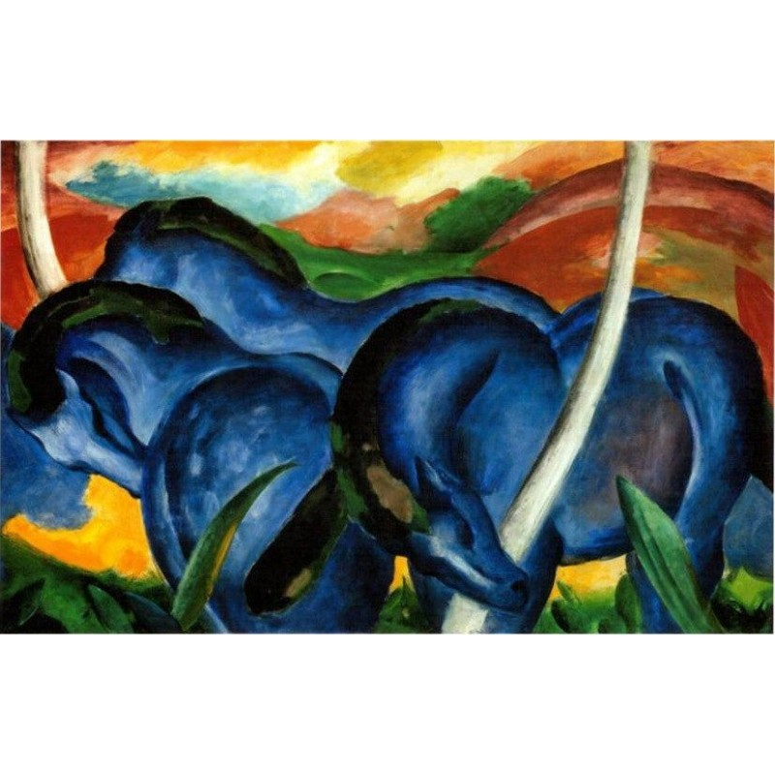
Examples of Marc's Artworks
The Cat on the Red Cloth
Yellow Cow
Blue Horses Series
Emotional use of bold colors to depict the cat's presence and impact.
Marc's unconventional use of color to evoke feelings of warmth and vibrancy.
Exploration of emotional depth through use of vivid blue tones for the horses.

Slide 6
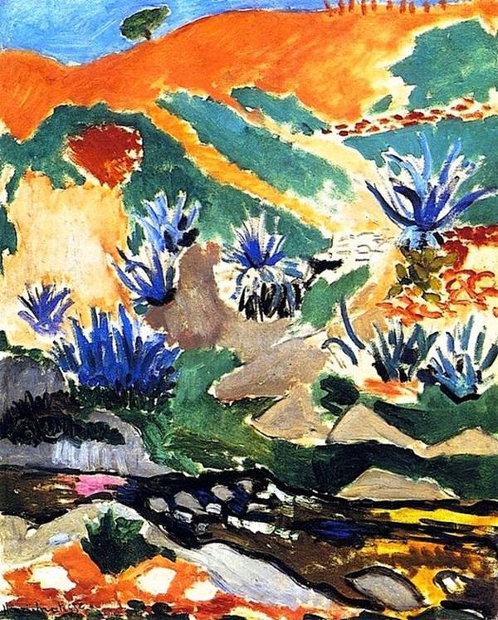
Emotional impact of Fauvists' use of non-traditional color
The Basics of Color Theory
Fauvists' use of non-traditional color: bold, vivid, non-representational, evokes emotion
Color theory basics: primary colors (red, yellow, blue), secondary colors (green, orange, purple), tertiary colors (yellow-green, red-orange, etc.)
Example artworks: 'The Joy of Life' by Matisse, 'Woman with a Hat' by Matisse, 'Landscape at Collioure' by Derain, etc.

Slide 7
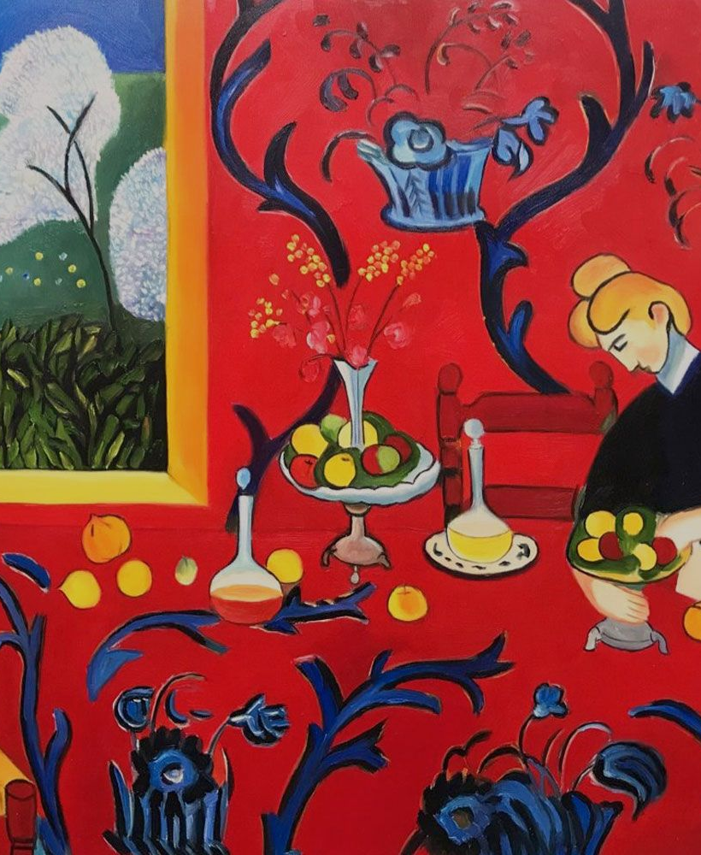
Primary Colors
Definition of Primary Colors
Primary colors refer to a set of colors that can be combined to produce a broad spectrum of hues.
The primary colors are red, yellow, and blue.
These colors are considered primary because they are fundamental and cannot be created by mixing other colors together.

Slide 8
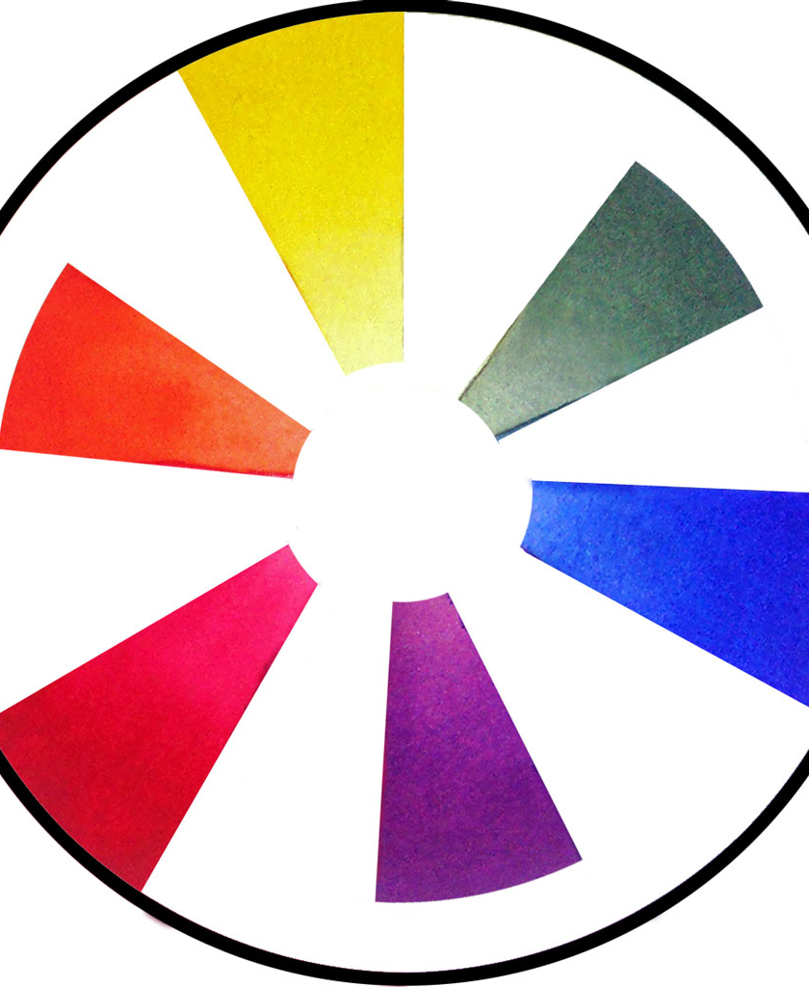
Using Secondary Colors in Art
The Art of Secondary Colors
Fauvist artists often used secondary colors prominently in their artworks, showcasing the bold and unconventional use of these hues to convey emotions and moods.
Secondary colors play a vital role in color theory and art, as they are the building blocks for creating harmonious color palettes and evoking specific feelings.
Designers and artists often utilize secondary colors to add vibrancy and contrast to their creations, creating visually appealing compositions and balance.

Slide 9
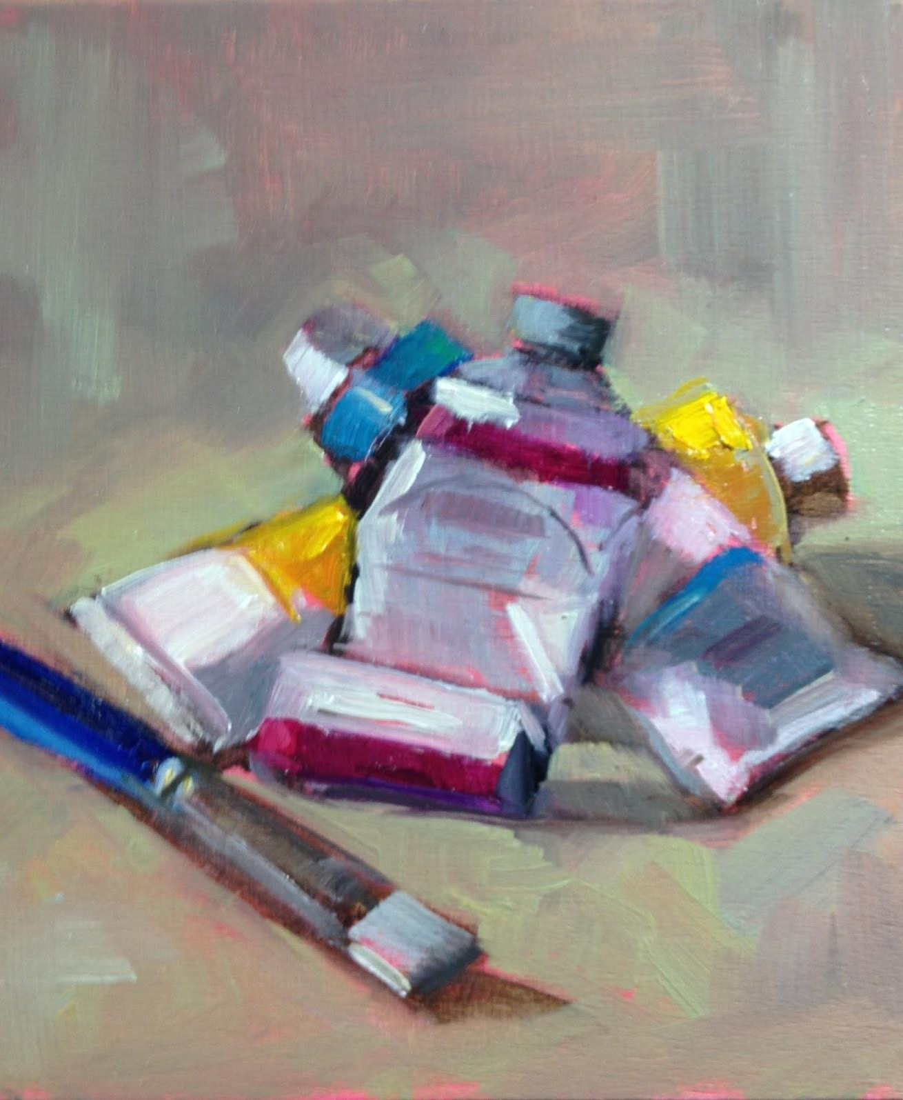
Understanding Tertiary Colors
The Tertiary Color Wheel
Tertiary colors are created by mixing a primary color with a secondary color.
The color wheel includes six sections, each representing a tertiary color created by combining adjacent primary and secondary colors.

Slide 10
Color Moods and Feelings - Part 1
Emotional Impact of Colors
Color Use in Fauvism
Exploring how warm colors like red and yellow can evoke feelings of joy and energy.
Understanding how cool colors like blue and green are often associated with calmness and tranquility.
Discussing the use of neutral colors for balance and sophistication in artworks.
Recap how Matisse and Marc used color in non-traditional ways to convey emotions.
Highlight the bold and unconventional color choices in their artworks.
Connect the emotional impact of the colors to the principles of Fauvism art.

Slide 11
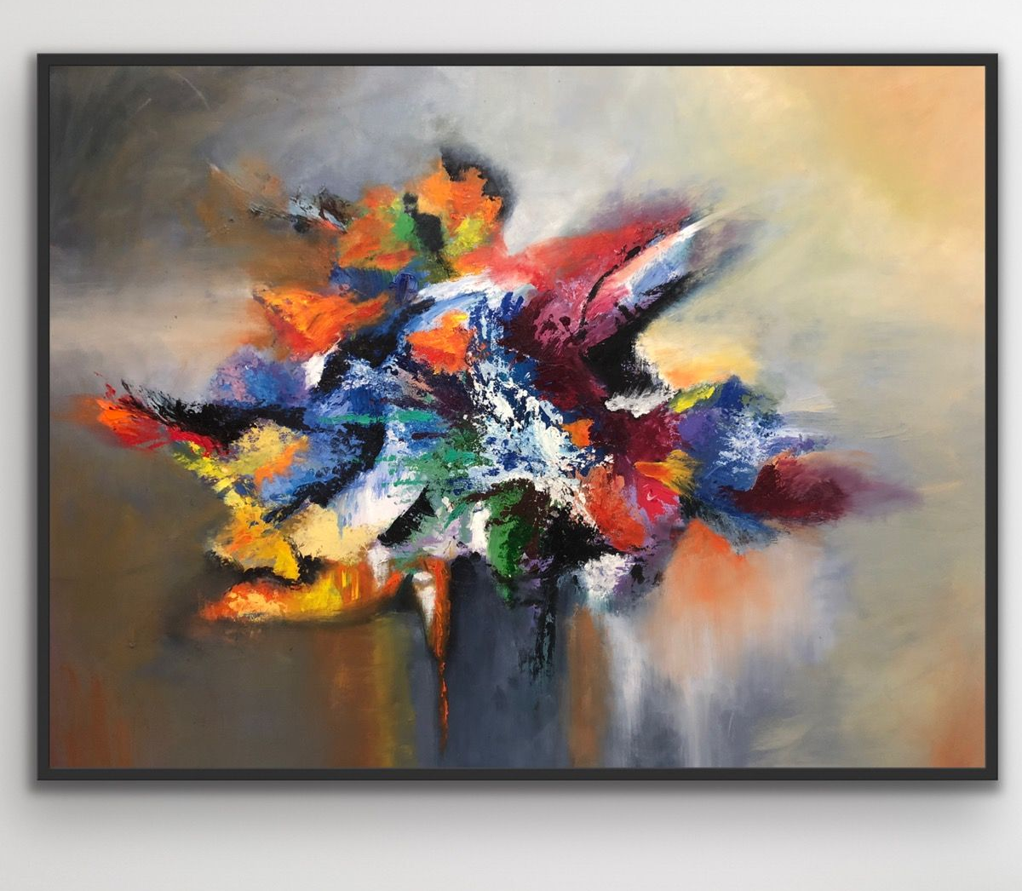
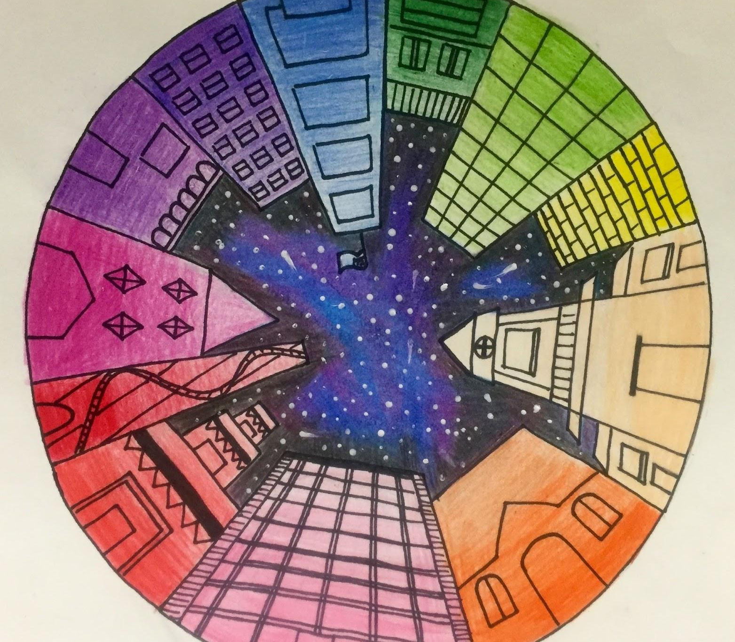
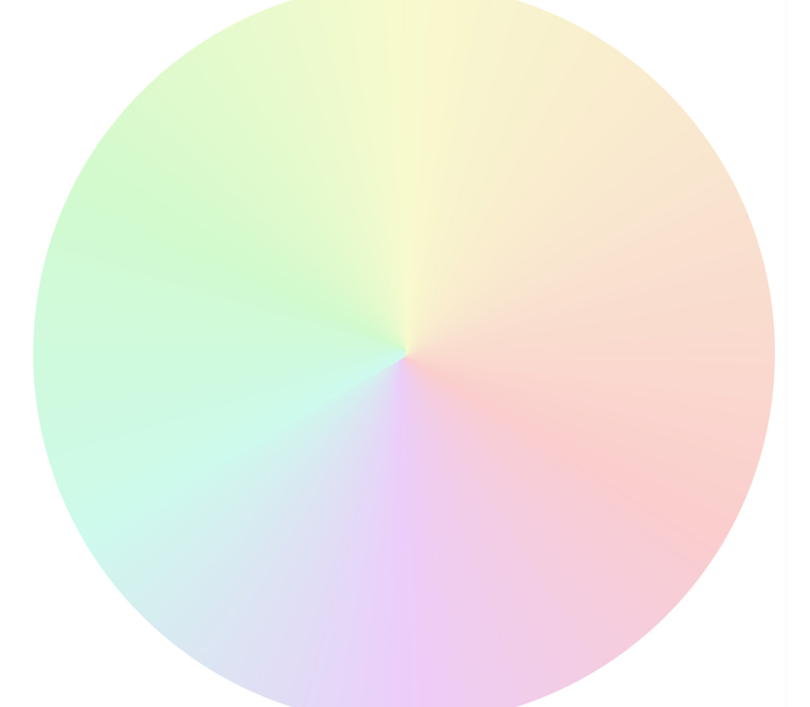
Color Moods and Feelings - Part 2
Vibrant Color for Emotional Impact
Color Theory and Emotions
Subtle use of color for emotional depth
Vibrant colors evoke strong emotions and grab attention, essential for impactful designs and visual content.
Exploring the psychological effects of different colors and their impact on human emotions.
Using understated and muted colors to create a sense of calm, depth, and sophistication in art and design.

