Slide 1
Examination of Organic Shapes in Fauvism

Slide 2
Understanding Fauvism
01
02
03
04
Fauvism was an early 20th-century art movement known for its bold use of color and strong brushwork.
The artists associated with Fauvism often depicted scenes from everyday life, using simplified forms and vibrant colors.
Fauvist artworks were characterized by the use of organic shapes, conveying a sense of emotional intensity and spontaneity.
The movement was short-lived but had a significant impact on the development of modern art, influencing artists like Matisse and Derain.

Slide 3
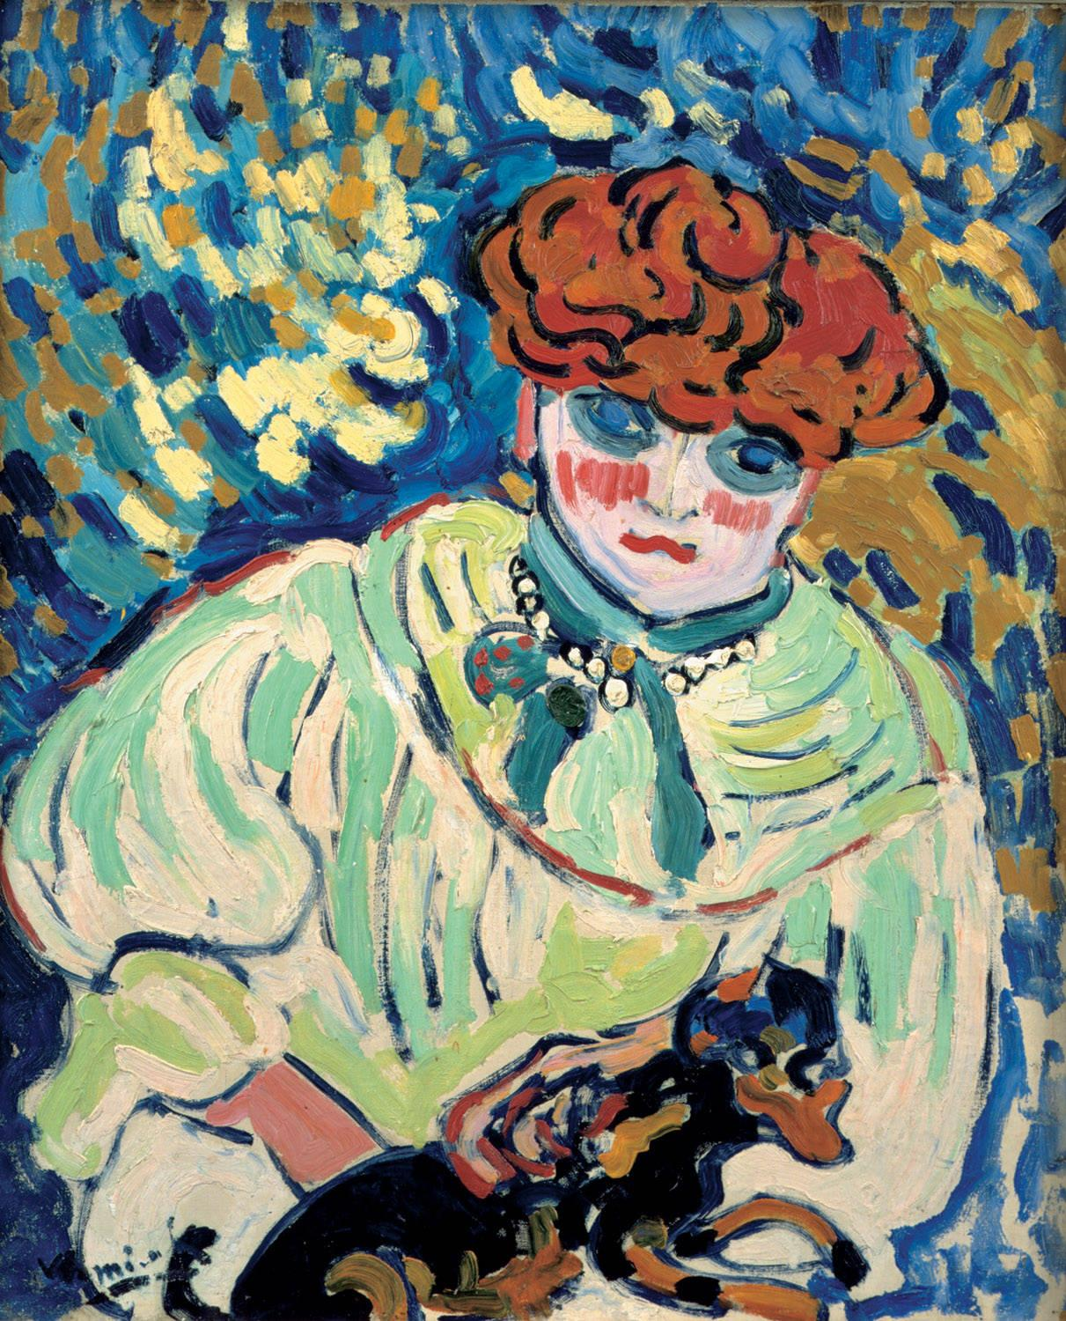
Fauvism and Organic Shapes
Recap: What is Fauvism?
Fauvism was an early 20th-century art movement led by Henri Matisse and André Derain.
It is characterized by vibrant colors, spontaneous brushwork, and an emphasis on emotional expression over realistic representation.
Fauvist artists often used organic shapes to depict natural forms in a bold and unconventional manner.

Slide 4
Emphasis on Fluid, Natural Shapes
What are Organic Shapes?
Organic shapes are free-form shapes that are found in nature. They are often fluid, curved, and irregular, in contrast to geometric shapes.
Fauvist Embrace of Organic Shapes
Fauvist artists use organic shapes extensively in their artworks, depicting natural objects and figures with bold, fluid lines and shapes.
The Significance of Patterns
Fauvists utilize organic patterns to capture the essence of natural forms, employing vibrant and unconventional color schemes to enhance the visual impact.

Slide 5
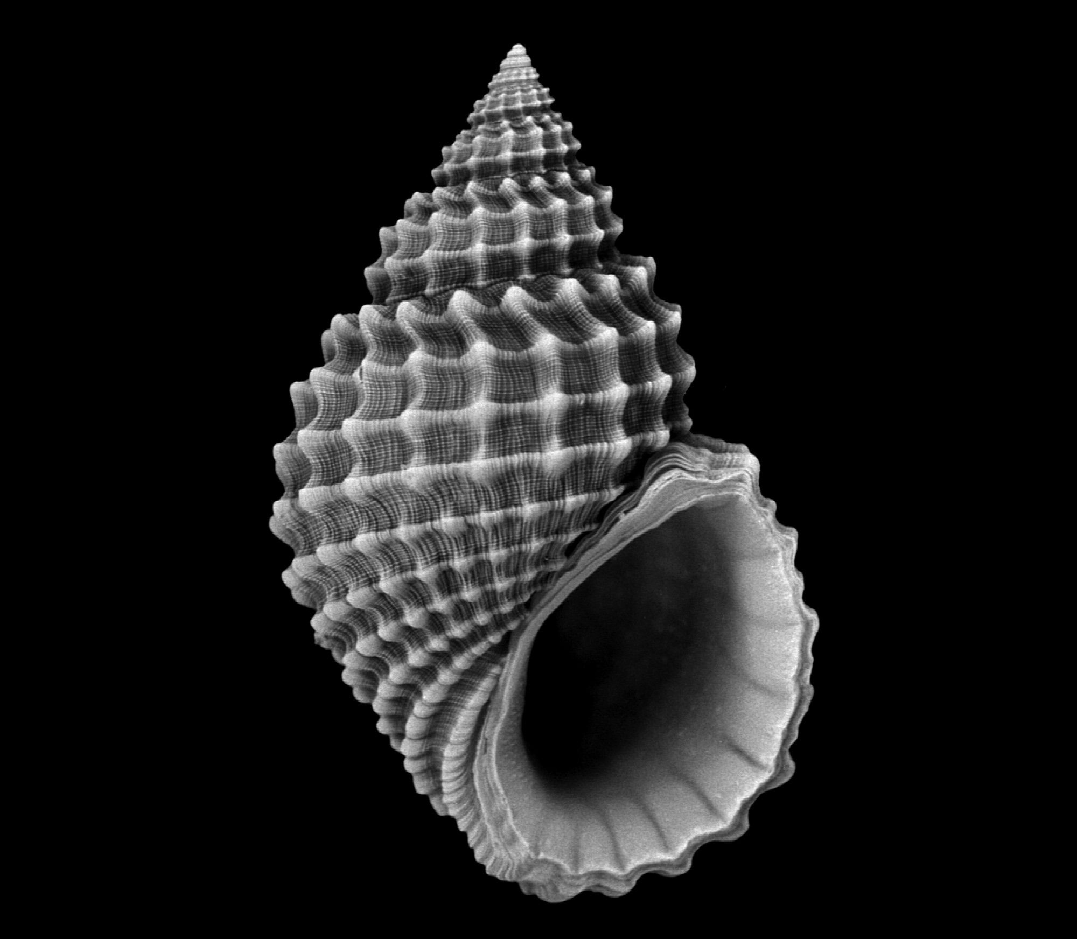
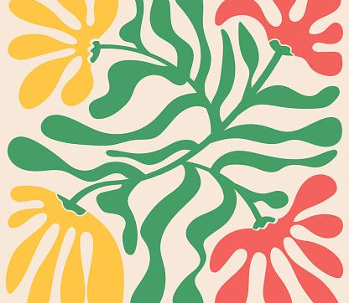
Introduction to Organic Shapes
Organic vs. Geometric Shapes
Characteristics of Organic Shapes
Examples of Organic Shapes
Organic shapes in Fauvist art are free-form and irregular, resembling natural forms. Geometric shapes, on the other hand, are precise and regular, with straight lines and angles.
Organic shapes are free-form and irregular, resembling shapes found in nature, such as leaves, flowers, and clouds.
Organic shapes are prominently featured in Fauvist artworks, reflecting the artists' emphasis on vivid, natural forms.

Slide 6
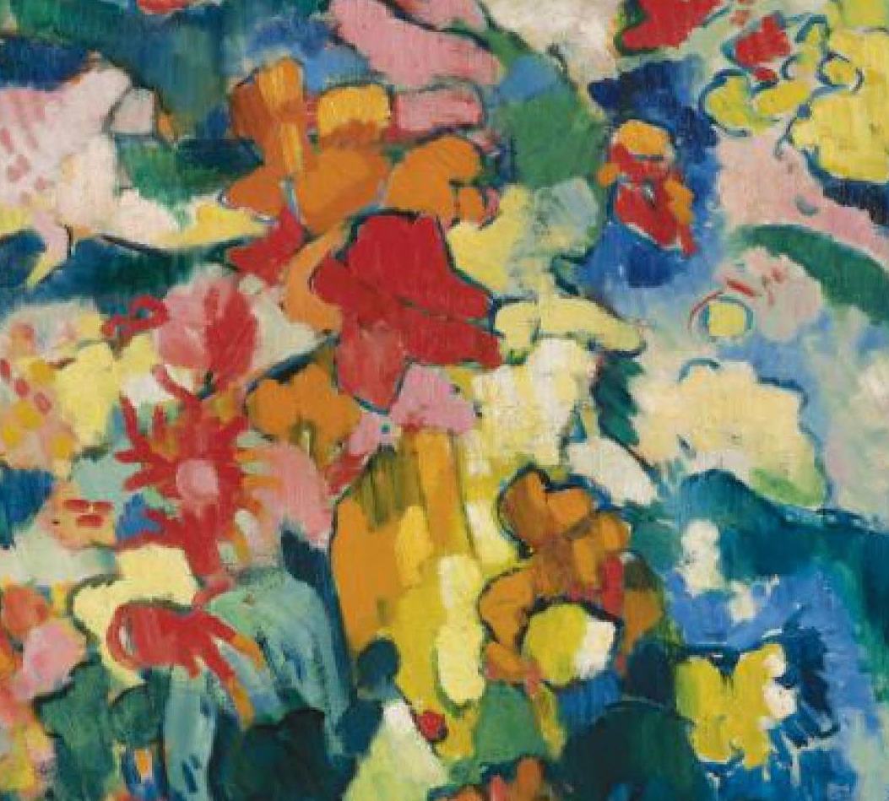
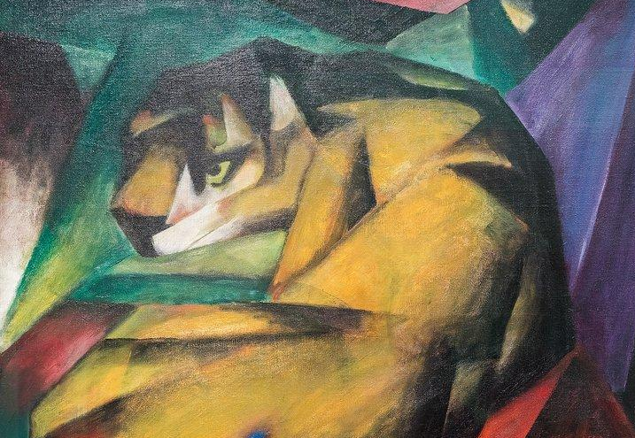
Organic vs Geometric Shapes
Organic Shapes
Geometric Shapes
Found in nature. Free-form and fluid. Irregular and asymmetrical in structure.
Precise and regular shapes. Often man-made. Defined by mathematical rules.

Slide 7
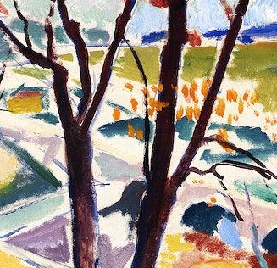
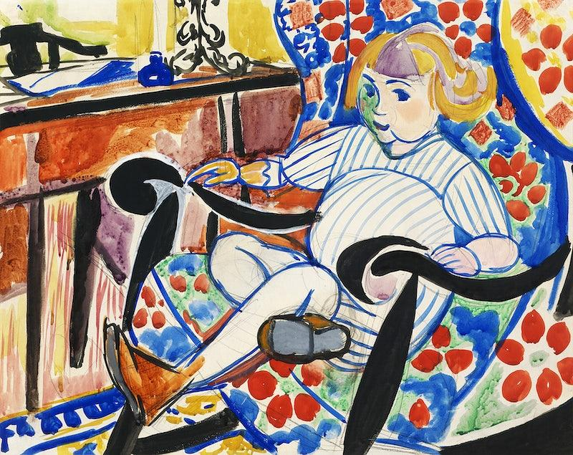
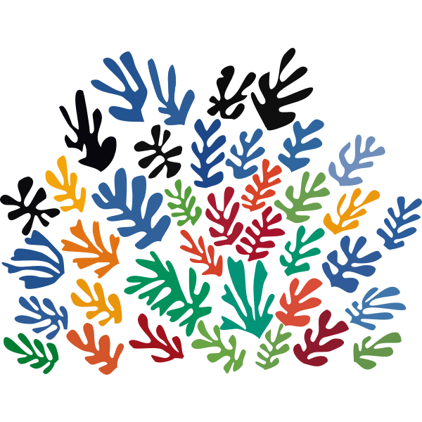
Types of Lines
1. Bold and Unconstrained
2. Sharp and Disjointed
3. Expressive and Colorful
Fauvist art often features bold, thick lines that are drawn with a sense of freedom and spontaneity.
Fauvist artists use sharp, disjointed lines to create dynamic movement and energy in their compositions.
The lines in Fauvist art are highly expressive, often done in vibrant colors to evoke emotional responses.

Slide 8
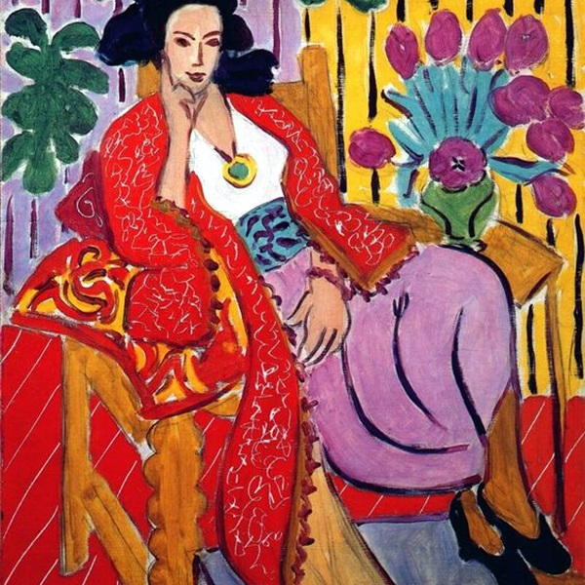
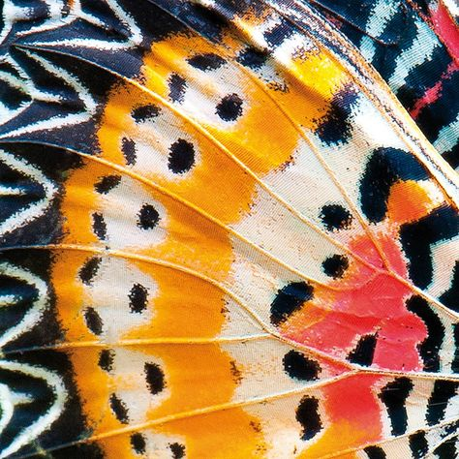
Patterns in Fauvist Artworks
Fauvist Artworks
Example of bold, vibrant patterns and use of organic shapes in Fauvist art.
Natural Forms and Patterns
The use of natural forms and patterns in Fauvist art, showcasing the influence of organic shapes in their work.

Slide 9
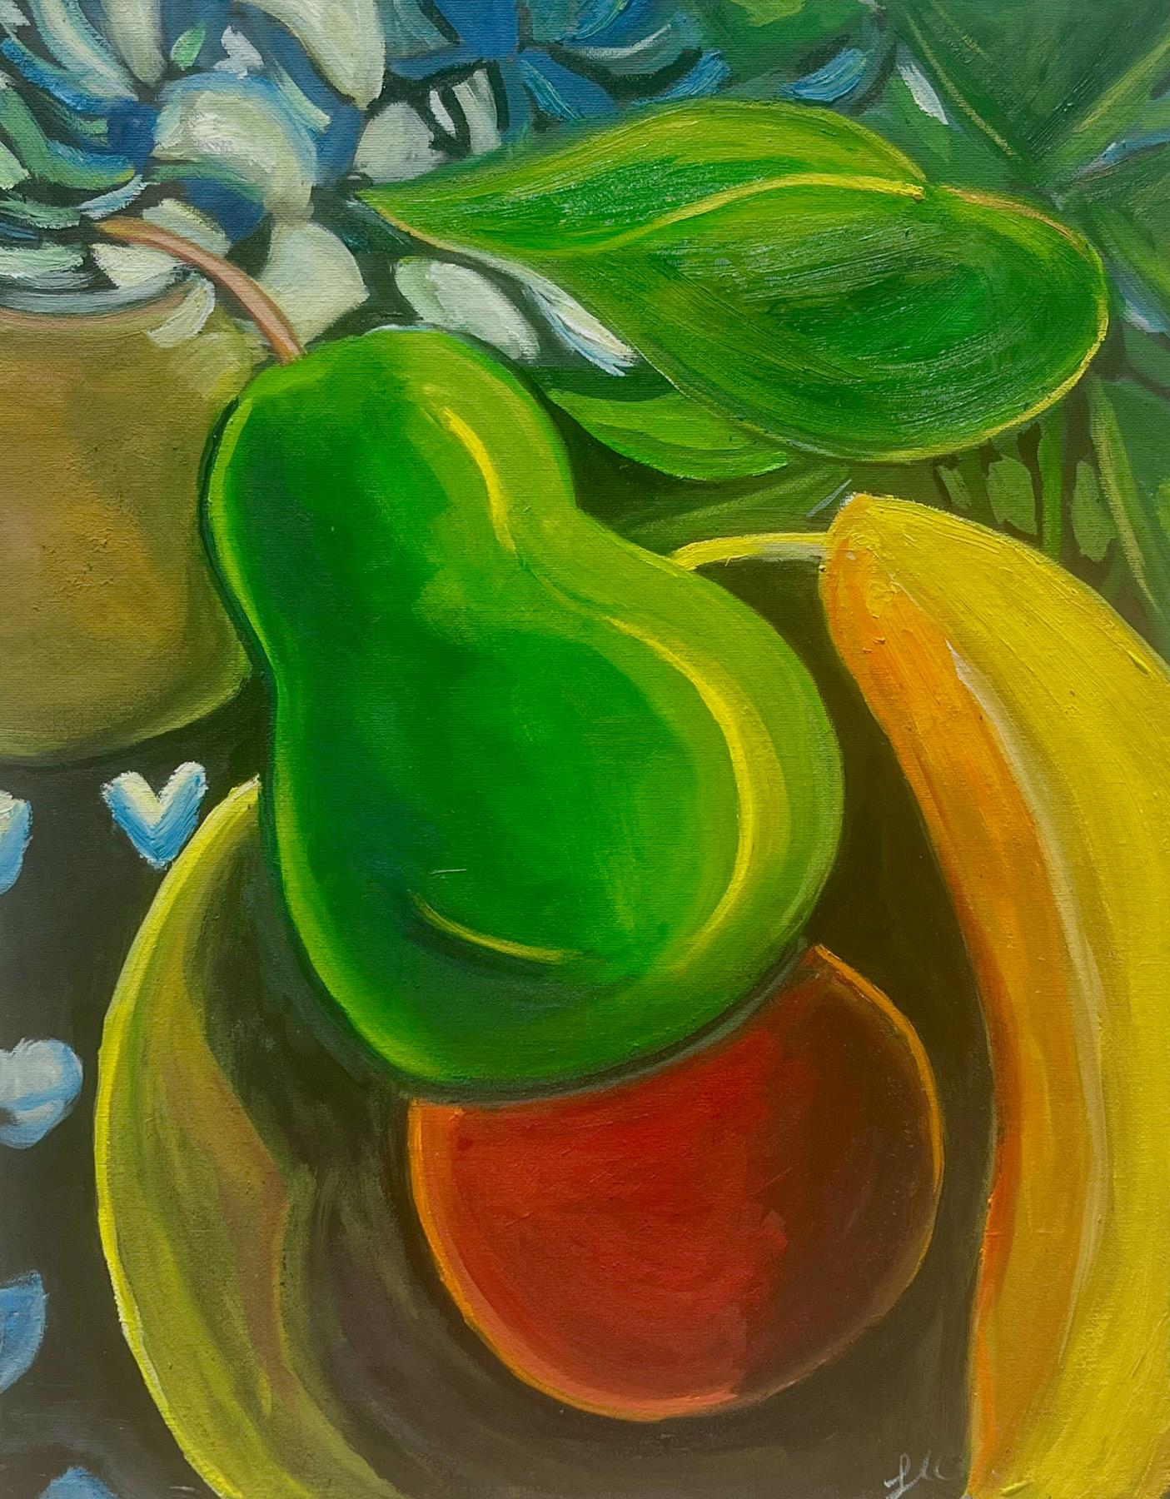
Influence of Organic Shapes in Fauvism
Artistic Freedom and Expression
Fauvist artists favored organic shapes to convey raw emotions and natural forms.
The use of bold, organic shapes in Fauvist art reflected the artists' rejection of traditional artistic constraints.
Organic shapes allowed Fauvist artists to explore the untamed beauty of the natural world, showcasing a unique visual language.

Slide 10
Conclusion: The Importance of Organic Shapes in Fauvism
Organic shapes were a key feature in Fauvist artworks, reflecting the movement's emphasis on emotional expression and natural forms.
The use of organic shapes in Fauvism contributed to the movement's unique aesthetic and distinguished it from other art movements of the time.
Fauvist artists' use of organic shapes demonstrated a radical departure from traditional artistic norms, showcasing the movement's innovative approach to form and color.

