Slide 1
Exploring Fauvism
Discovering Henri Matisse, Franz Marc, & Maurice de Vlaminck

Slide 2
Introduction to Fauvism
Fauvism is an art movement known for its bold use of color and distorted forms
It was a short-lived movement that emerged in the early 20th century, pioneered by artists like Henri Matisse and Andre Derain
The term 'Fauvism' is derived from the French word 'les fauves' which means 'the wild beasts', suggesting the artists' untamed approach to color and form

Slide 3
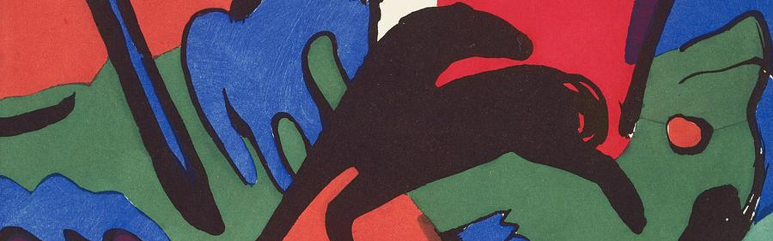
Franz Marc: The Blue Rider
About Franz Marc
Franz Marc was a German artist and one of the key figures of the Fauvist movement.
He was known for his use of bold colors and animal motifs in his artwork.
'The Blue Rider' was one of his famous works, showcasing his unique Fauvist style.

Slide 4
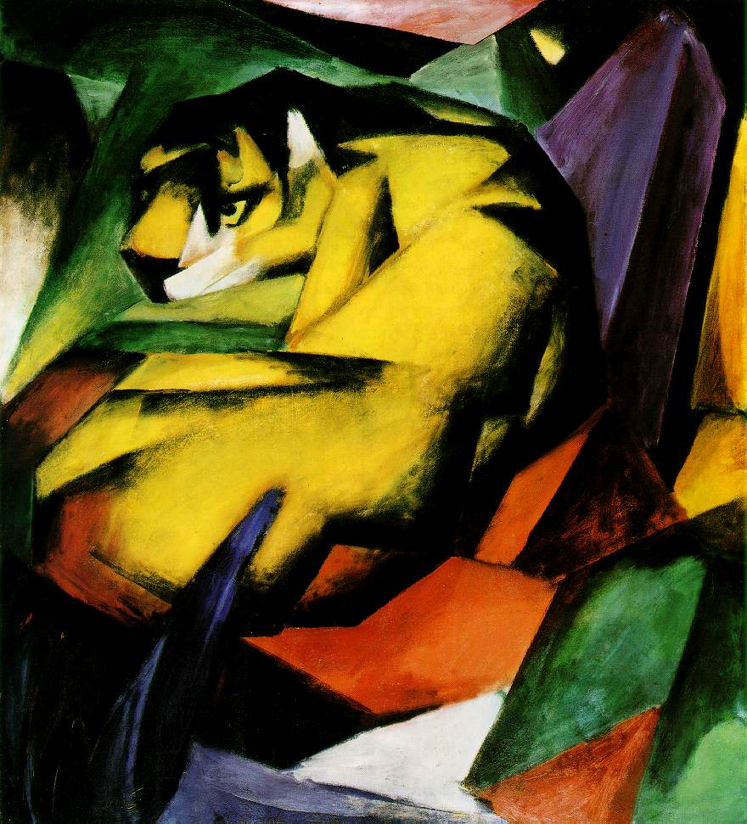
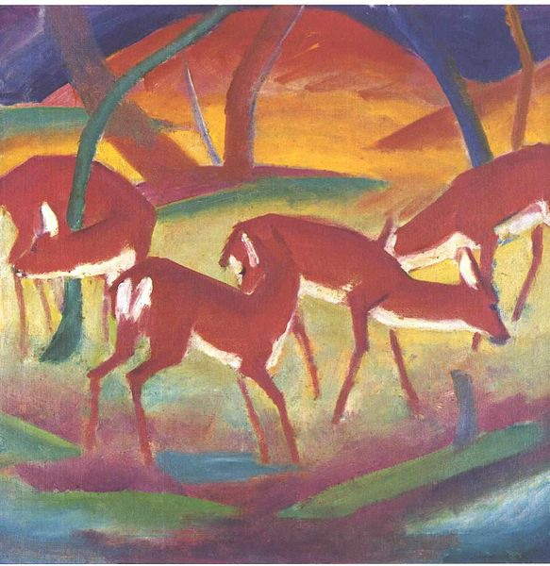
Franz Marc: The Blue Rider
About Franz Marc
Franz Marc, a German artist, was a key figure in the Fauvist movement, known for his use of bold colors and animal motifs in his works.
The Blue Rider Artwork
One of Marc's iconic works is 'The Blue Rider' which showcases his unique style of color usage and symbolic imagery of animals.',

Slide 5
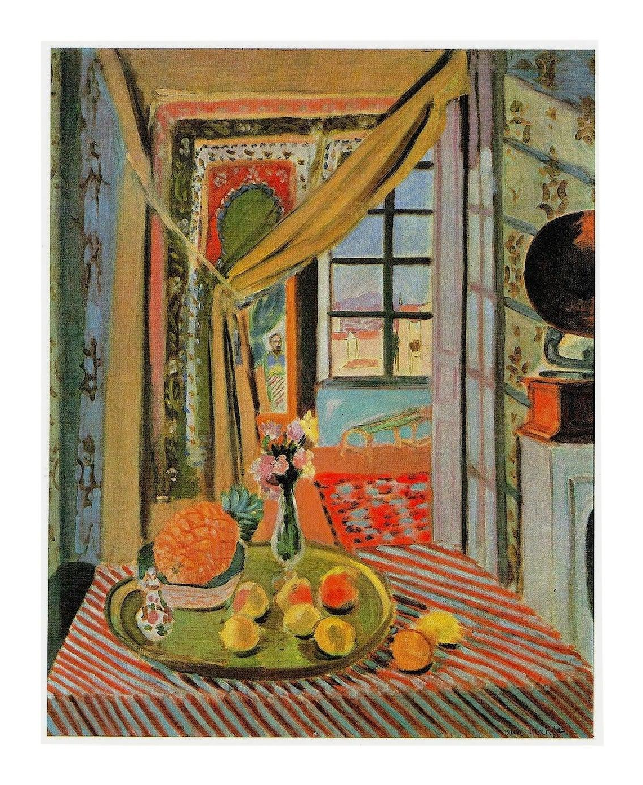
Henri Matisse: The Wild Beast
About Henri Matisse
Henri Matisse was a prominent figure in the Fauvism art movement, known for his use of bold, vivid colors.
He was often referred to as 'The Wild Beast' due to his untamed and expressive artistic style.
Matisse's artwork reflected his unique perspective on the world, emphasizing emotion and feeling over realistic representation.

Slide 6
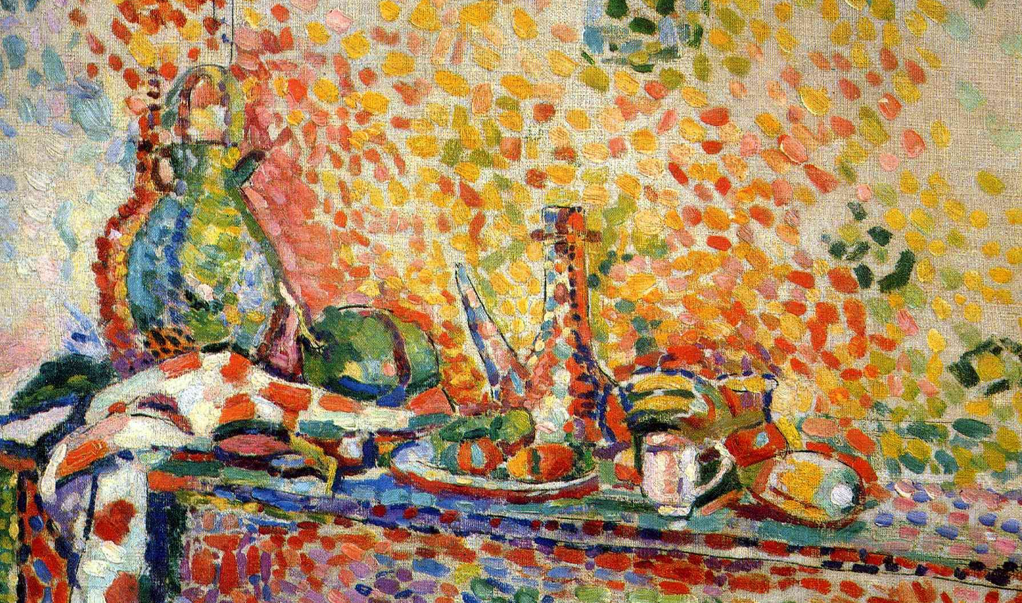
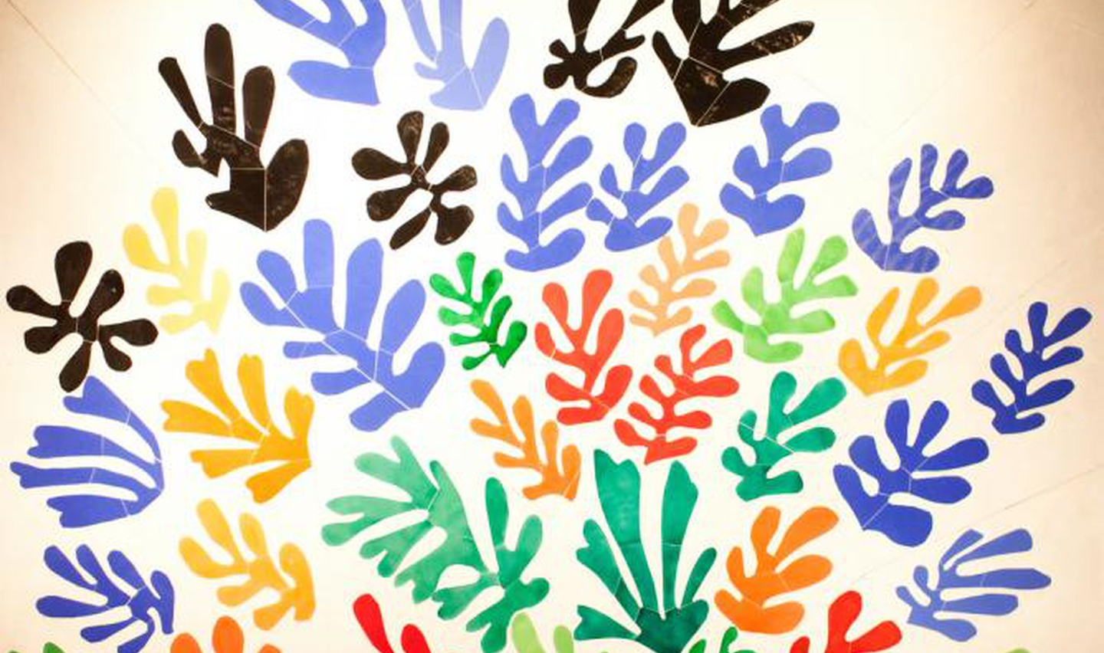
Matisse's Vivid Palette
Master of Color
Matisse was a master of using bold, vibrant colors in his artwork, a key characteristic of Fauvism.
Subject Matter
Matisse often depicted scenes of joy and harmony, using color to convey emotion and energy.

Slide 7
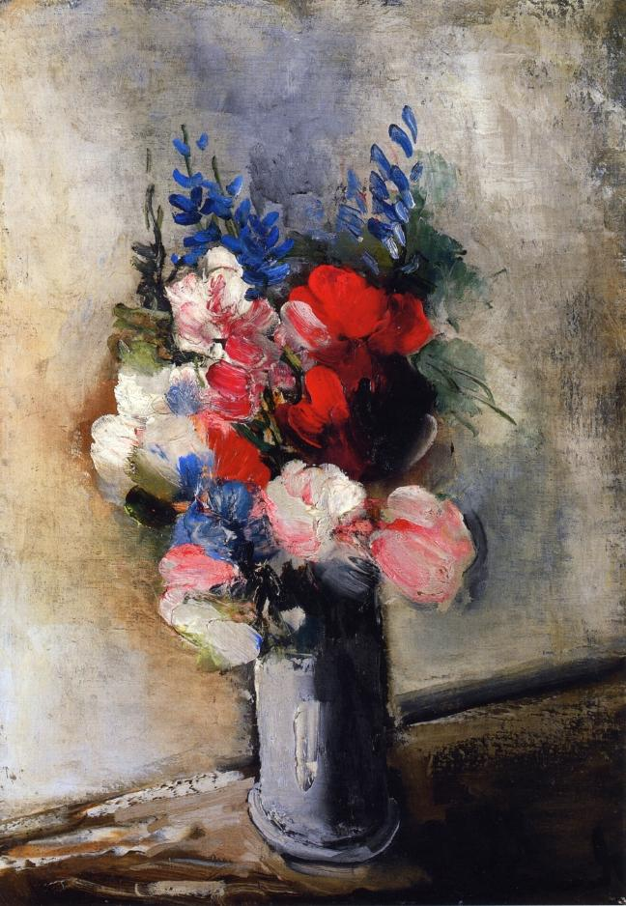
Maurice de Vlaminck: The Impulsive Fauvist
About Maurice de Vlaminck
Maurice de Vlaminck was a French artist and one of the key figures of the Fauvism movement.
He was known for his impulsive and bold use of color, often using colors in ways that didn't reflect the natural world.
Vlaminck's art often conveyed a sense of emotional intensity and raw expression, reflecting his inner feelings rather than outward reality.

Slide 8
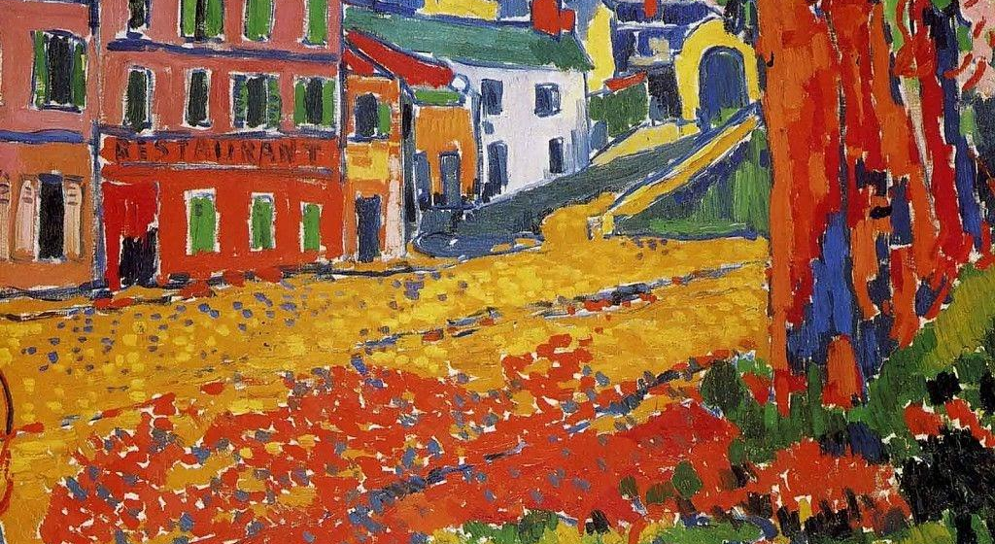
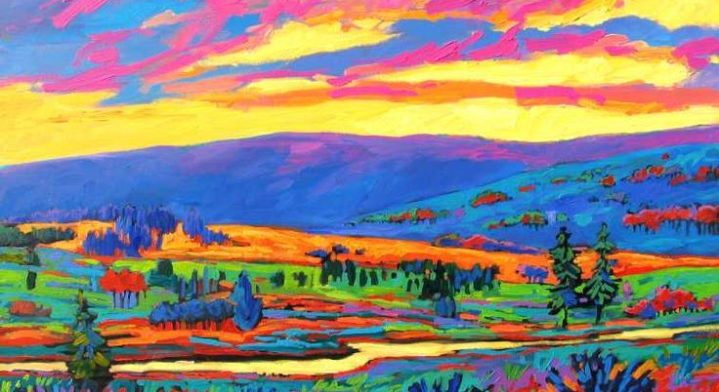
Maurice de Vlaminck: The Impulsive Fauvist
Vlaminck's Artistic Style
Subject Matter
Maurice de Vlaminck was known for his bold, spontaneous use of color and vigorous brushwork.
Vlaminck often painted landscapes and urban scenes, infusing them with intense, non-naturalistic colors.

Slide 9
Color Theory in Fauvism
Vibrant Palette
Fauvist artists used bold, non-representational colors to evoke emotions and set moods, often deviating from natural color schemes.
Emotional Impact
The use of intense colors in Fauvist art aimed to create strong emotional reactions and convey the artists' inner feelings.
Color as Form and Expression
Fauvist artists used color not only to represent forms but also as a means of emotional expression, regardless of natural color conventions.

Slide 10
Shape and Form in Fauvist Art
The Embrace of Organic Forms
Fauvist artists often depicted natural forms with exaggerated and simplified shapes, favoring organic subjects like animals and landscapes.
Liberation of Color over Form
In Fauvist art, color takes precedence over accurate form, with artists using arbitrary and non-representational colors to fill in shapes, disregarding natural color schemes.
Influence of African Art
The bold, simple shapes found in African sculpture and art inspired Fauvist artists, leading to the use of geometric and simplified forms in their work.

Slide 11
The Design Principles of Fauvism
Embracing
Unrestricted
Expressive
Fauvist art prioritizes emotional expression over naturalistic colors. Artists use non-representational hues to evoke feelings.
Fauvist artists show little concern for the accurate depiction of forms. Shapes are simplified and exaggerated for expressive purposes.
The movement values raw emotional expression. Artists' brushwork is often energetic and spontaneous, conveying a sense of freedom and passion.

