Slide 1
Color Schemes
A Guide

Slide 2
Color Schemes
Color Schemes are an important part of art and design.
Colors can help tell a story through mood.
If the colors don’t work together it can cause confusion or tension in an image that wasn’t supposed to be there.
Color schemes are a plan for organizing colors.

Slide 3
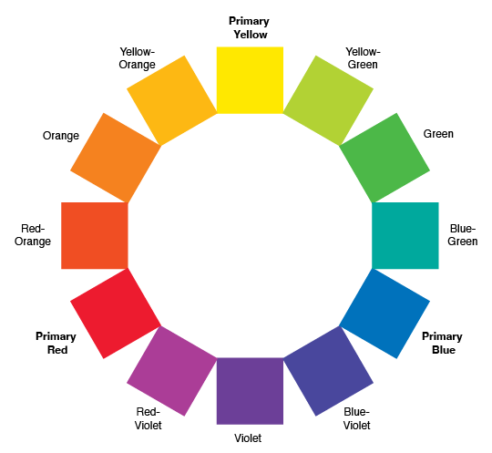
12-Step Color Wheel
The color wheel will be your guide for creating color schemes. A 12-step color wheel will give you primary, secondary, and tertiary colors.

Slide 4
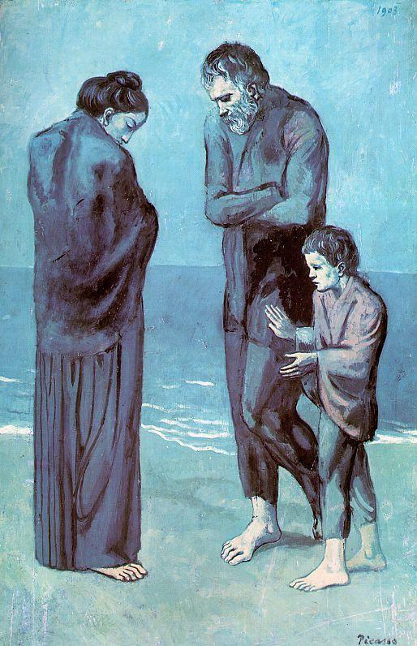

Monochromatic
Monochromatic uses a single hue while adding white and black (tint and shade) to modify the hue.

Slide 5
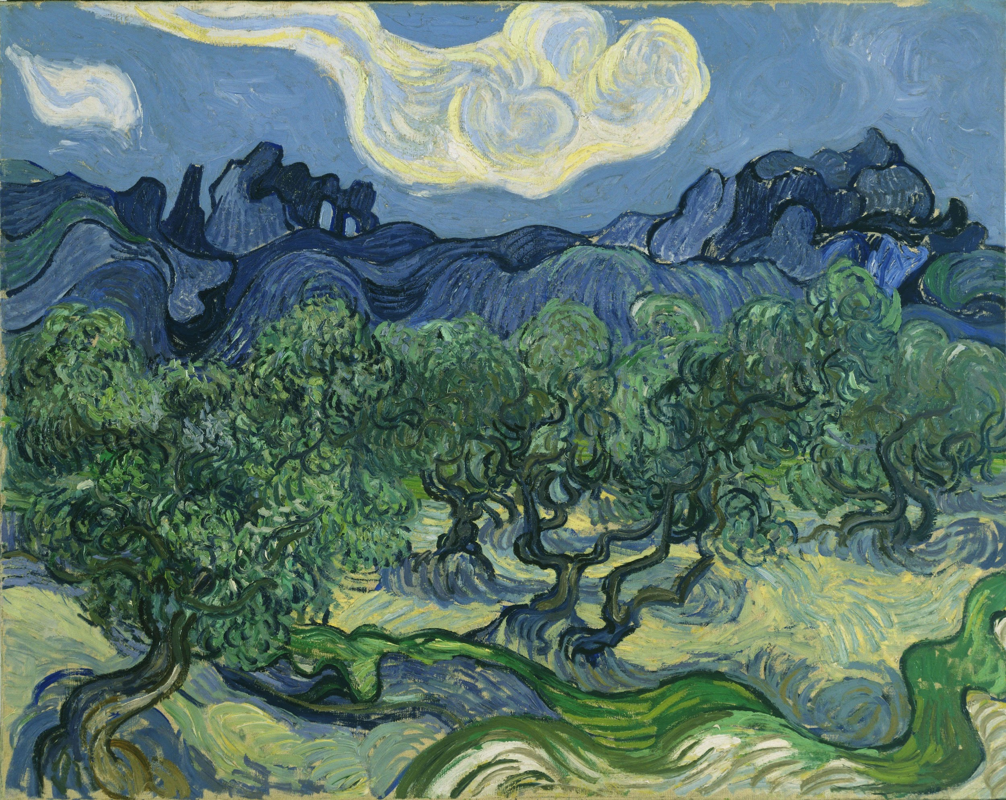


Analogous
Analogous color schemes uses hues that sit next to each other on the color wheel. They can be warm, cool, or a combination of colors as long as they are next to each other.

Slide 6
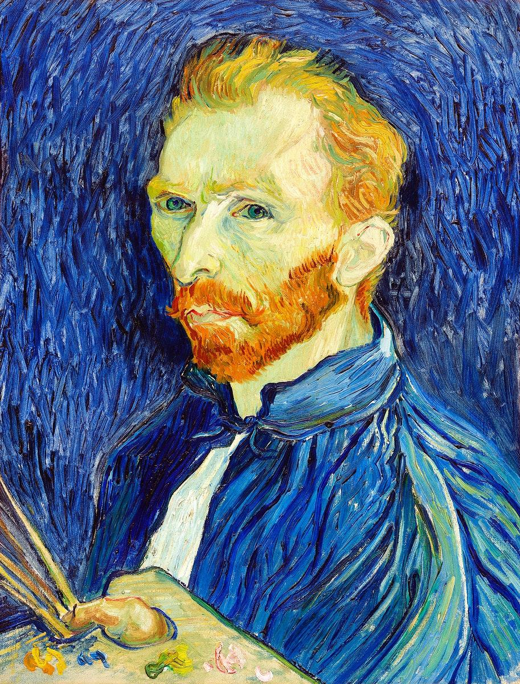

Complementary
Complementary colors are hues that are directly across from each other on the color wheel.

Slide 7
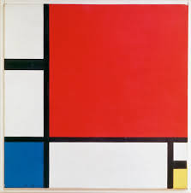

Color Triads
Color triads are groups of 3 colors that are equally distant on the color wheel. For example the primary colors (red, yellow, blue) are a color triad.

Slide 8
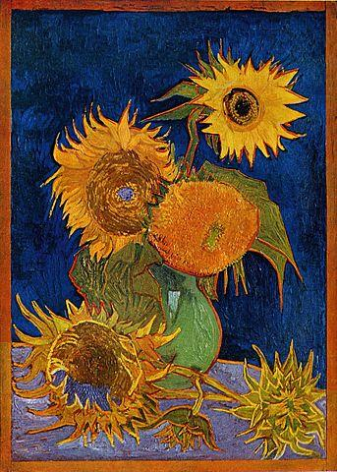

Split Complements
Split complements are one hue and the two hues directly next to its complement. Split complements tend to offer more of a variety of color scheme choices than direct complements.

Slide 9
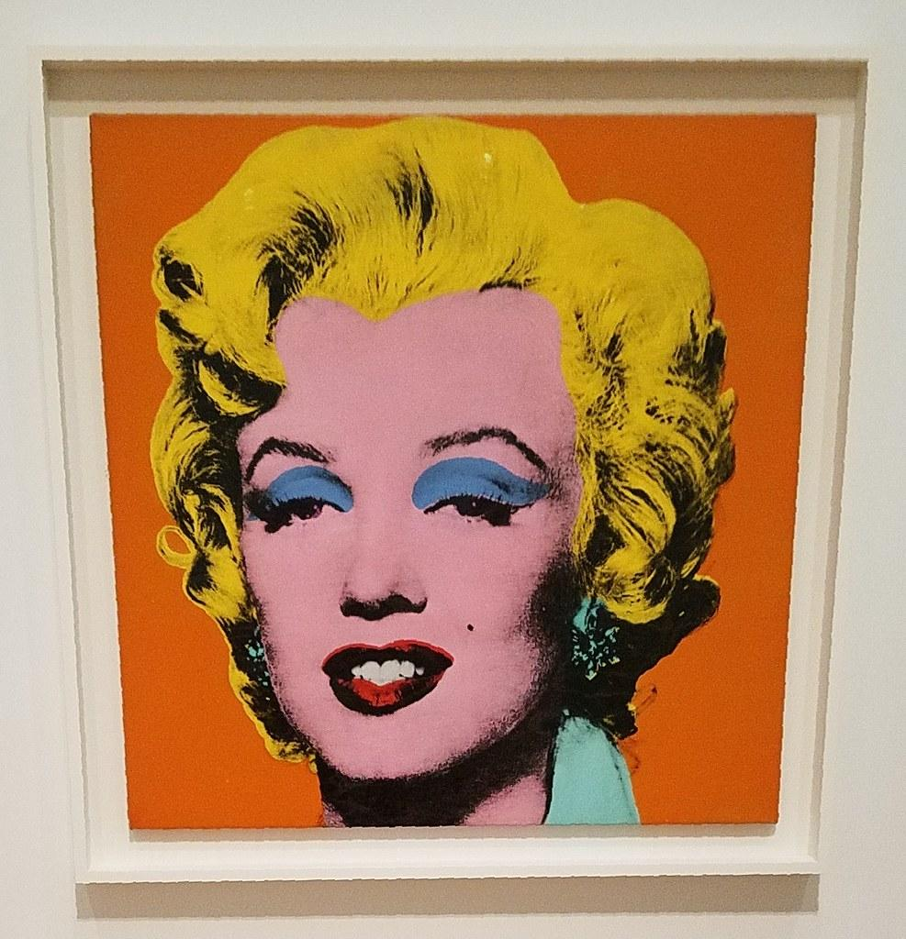
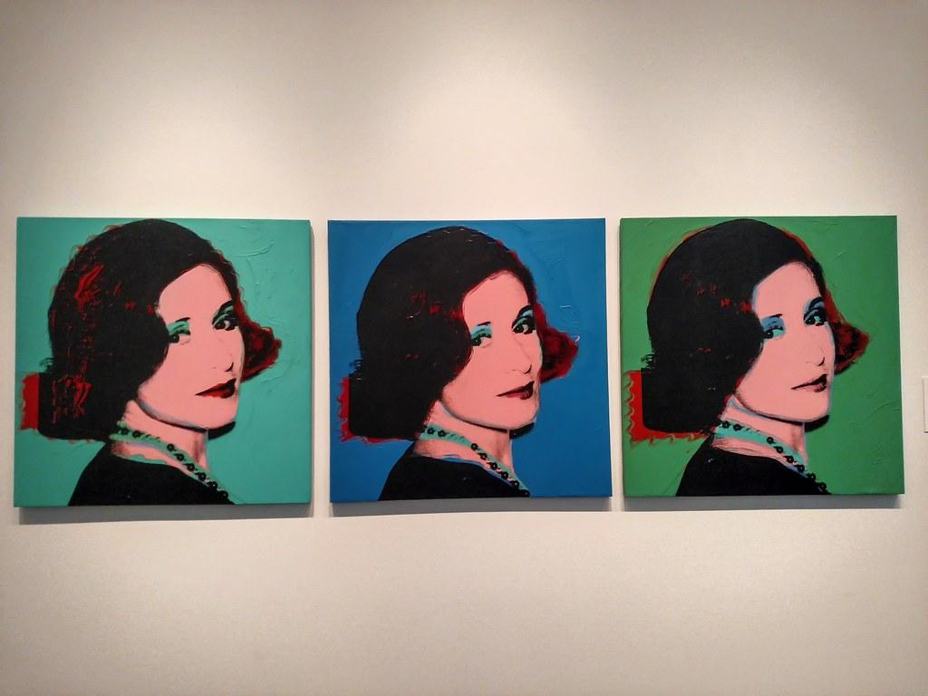
Andy Warhol Portraits

Slide 10

Teacher Example

