Slide 1
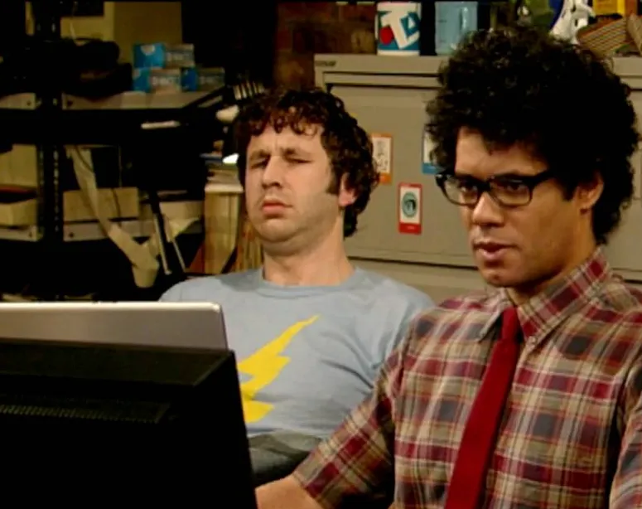
Bug Tracker System
By: Tany Sanchez and Albert Huynh

Slide 2
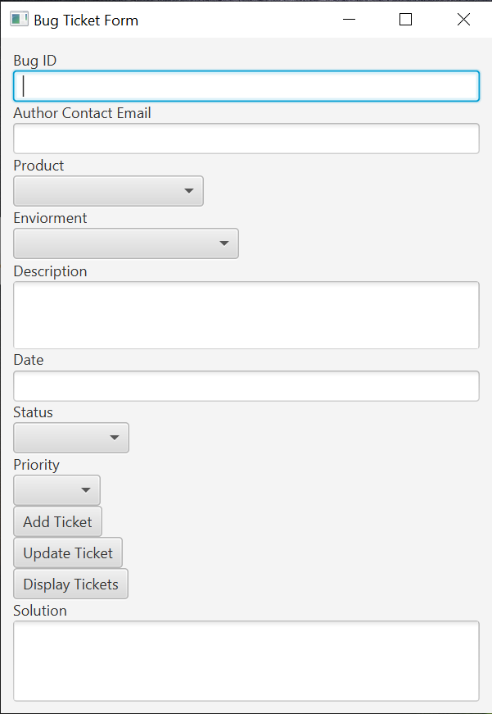

The Product
Bug ticketing system

Slide 3
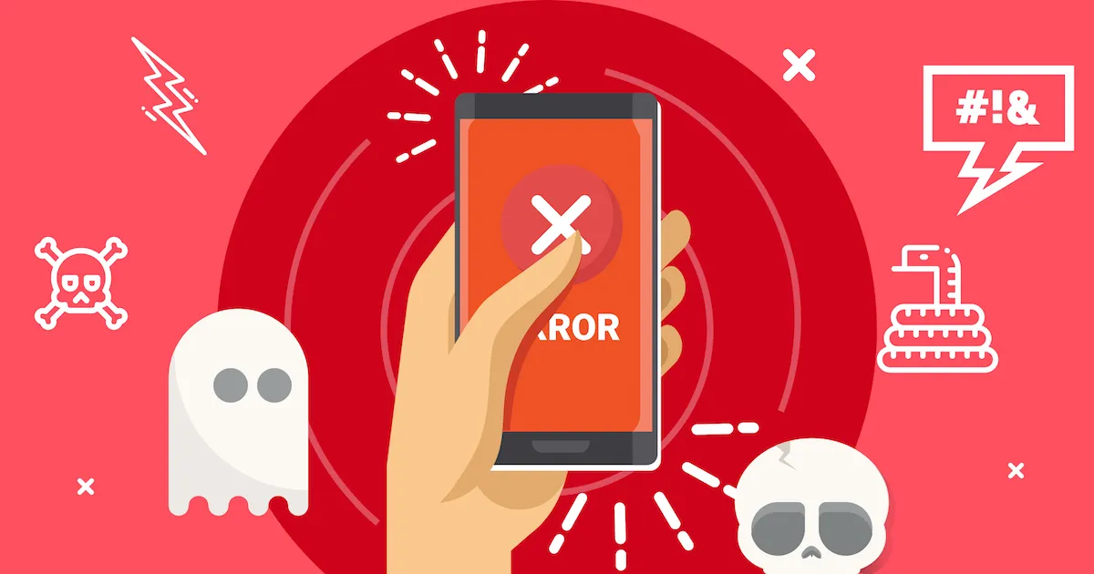
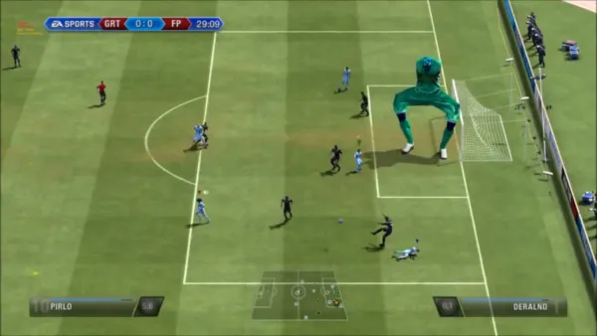
Why?
Stuff has bugs, glitches, and other issues, so this application allows users to report them
Allows the developers of the product to easily resolve the issues

Slide 4
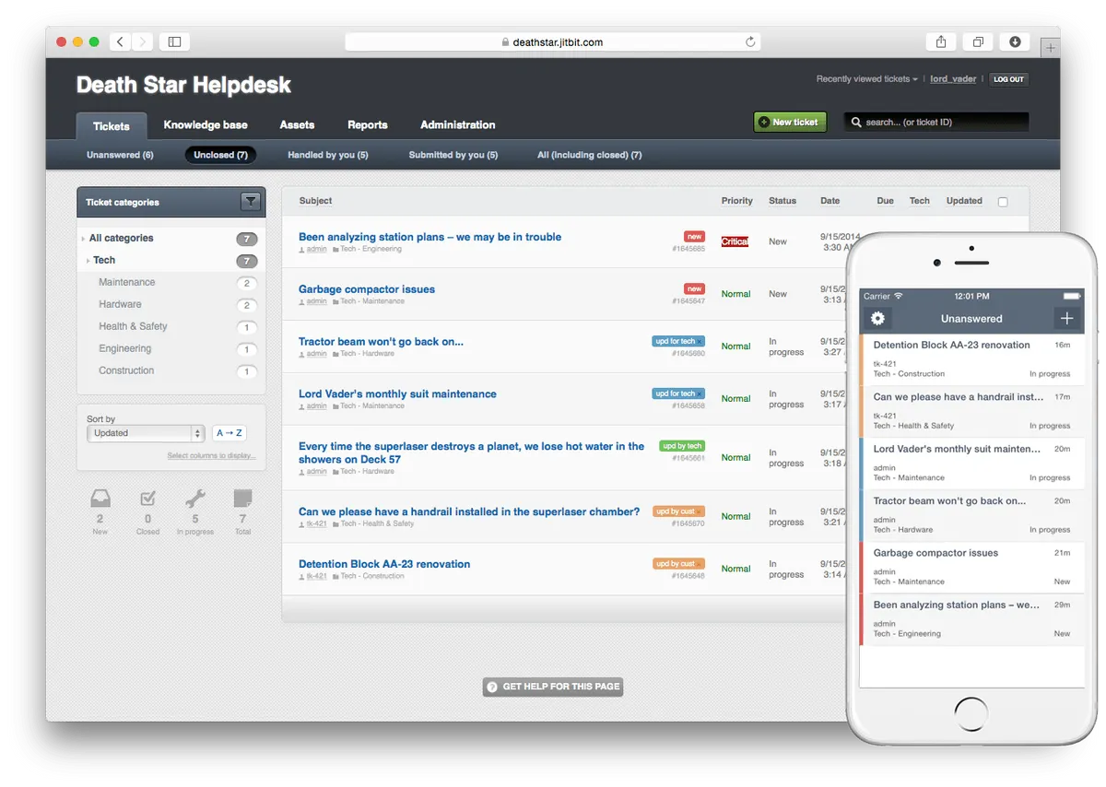







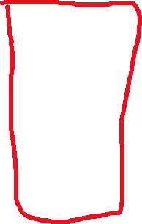
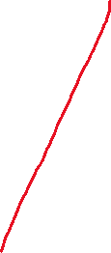
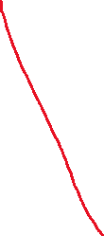

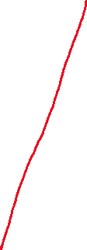

Too Complicated
Too many buttons
Too many selections
Too many confusing colors

Slide 5
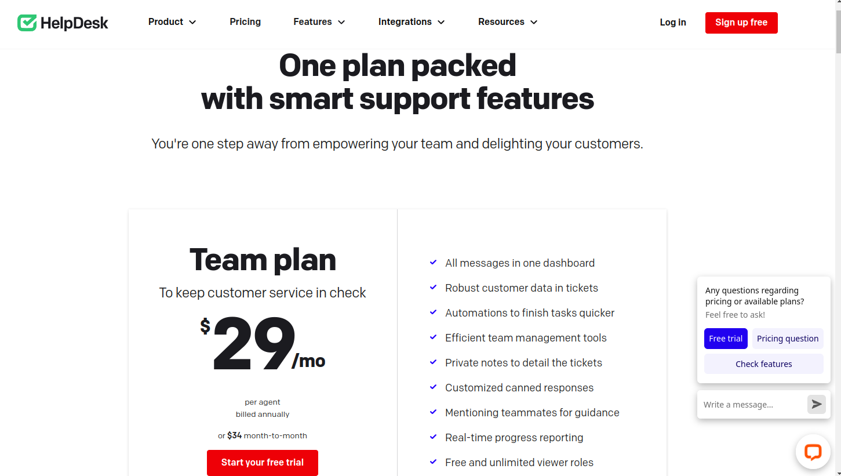

Alternatives Are Too Expensive
~7 Among Us games/month
~18 Tennis balls/month
~10 Live chickens/month
~6 Costco chickens/month

Slide 6
Our Solution
Better Bug Ticketing system
Simple and straightforward
Less confusing colors
Free $0/month

Slide 7
User Input
How the application will get user input

Slide 8
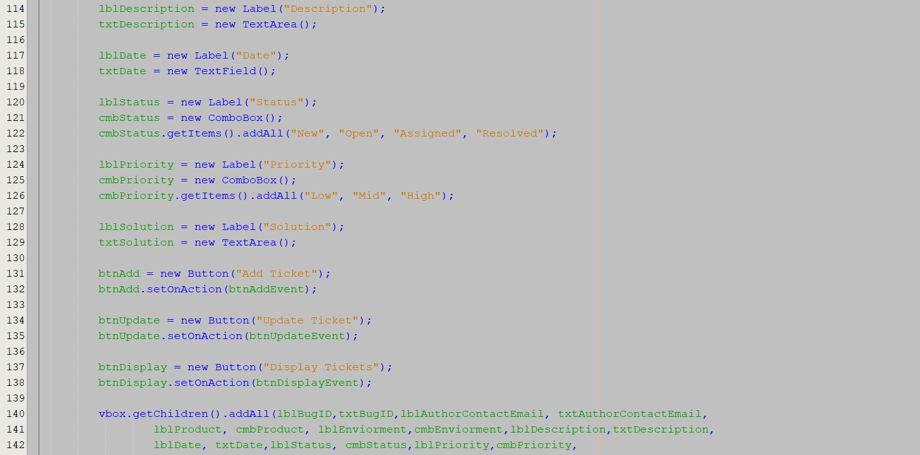

Updating Data
How the data in the table is updated

Slide 9
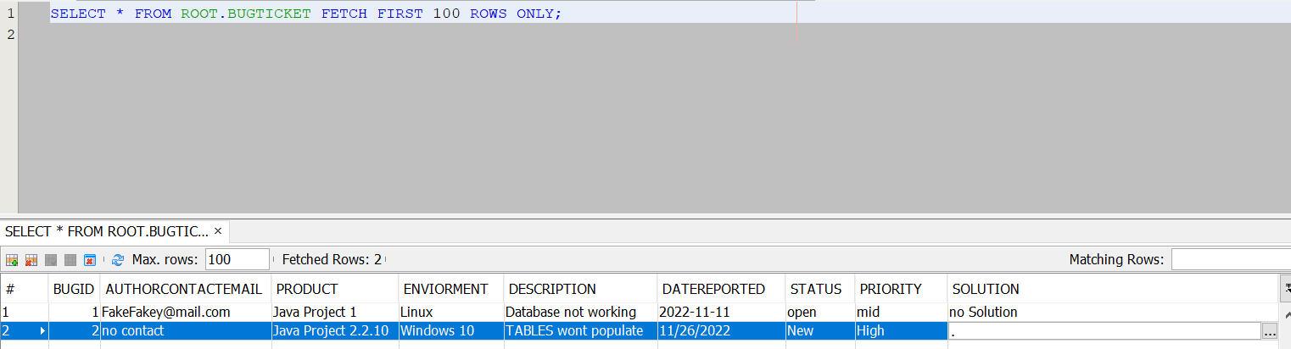
Tickets Table
Where all the tickets are stored

Slide 10
Improvements to be made
Fix mistakes
Populate table directly from database
A search bar to search for all the past tickets
Upgrade the appearance
Link who logged in
GitHub link
Add editable feature to table

