Slide 1

TIC – TAC - TOE
Embedded Systems Design
Rajesh Mallavarapu

Slide 2
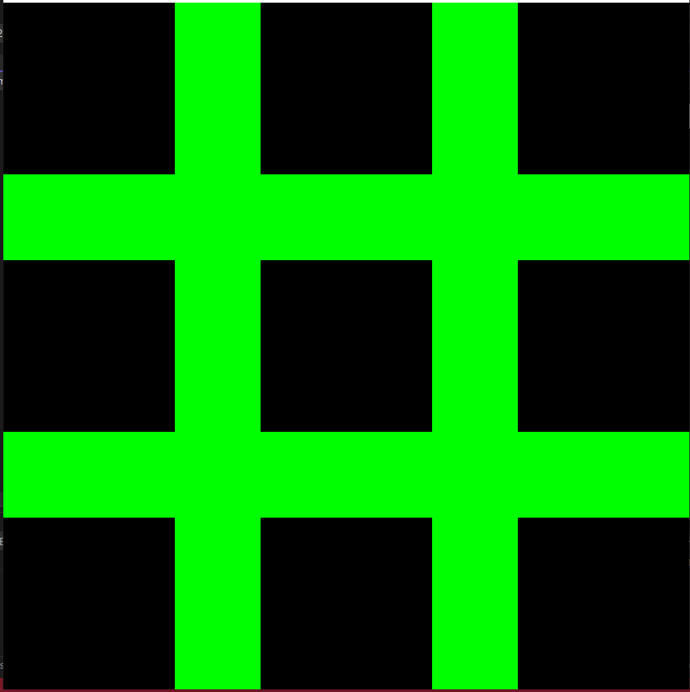
Board Setup
RESOLUTION_X = 8
RESOLUTION_Y = 8
xPad = 0,3,6
yPad = 0,3,6

Slide 3
Move Tile
A Pressed = left
S Pressed = down
W Pressed = up
D Pressed = right
Enter Pressed = set Tile

Slide 4

Player Setup

Slide 5
Game Play
Total chances = 9
Odd - player one - 5 plays
Even - player two - 4 plays
Check winner after 5 plays

Slide 6
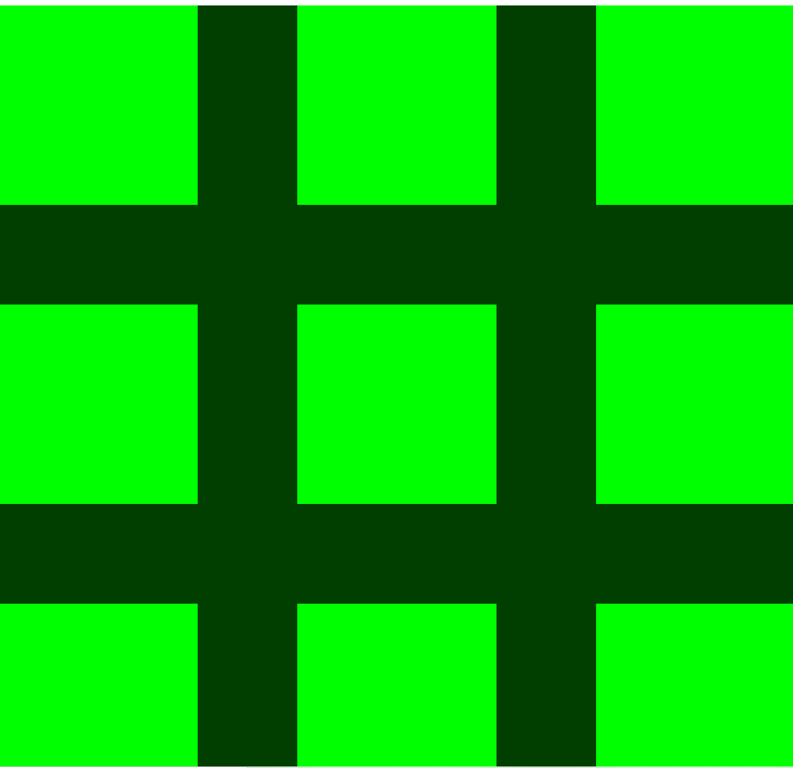

Winner Declaration

