Slide 1
Intake - Outtake
G.M.R. Studios
V.A.R.

Slide 2
Problem & Purpose
As a society we lack the understanding of the immediate link between our food consumption, energy intake, and the associated physical activity needed to meet the energy expenditure.
This lack of understanding has been proven to be detrimental to one's health and wellbeing.
An improved understanding between this relationship will have substantial positive health impacts.
Our purpose is to educate this link to the players, through an immersive experience.

Slide 3
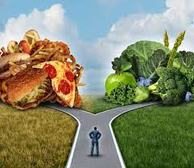
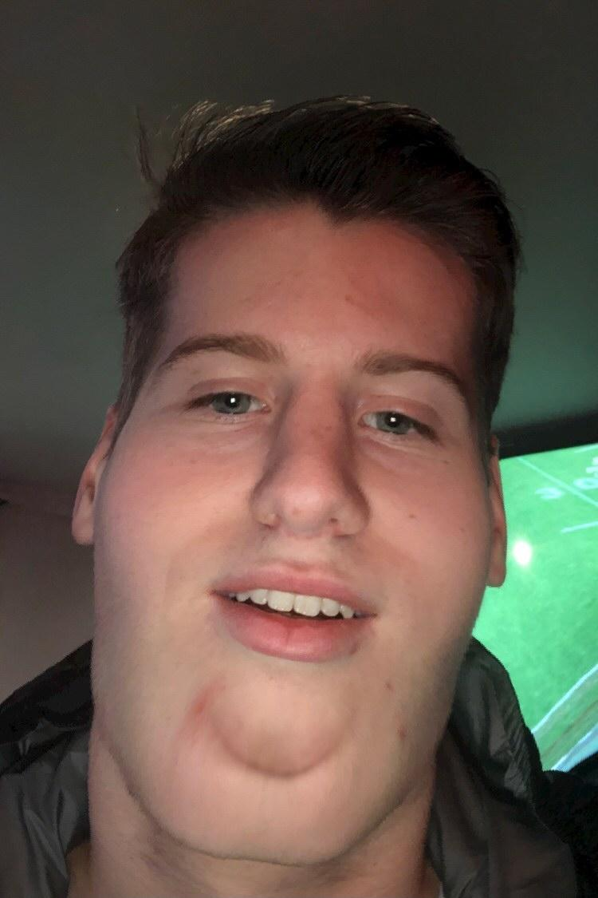
Making Diet Choices
Time, money and education can all affect food choice.
A person may opt for unhealthier more available food.
Unhealthy food options are often more affordable than healthy counterparts.
Consumers can also not have the relevant knowledge to effectively choose healthy foods.
Our game attempts to present these factors to the player to mimic a real-life scenario.

Slide 4
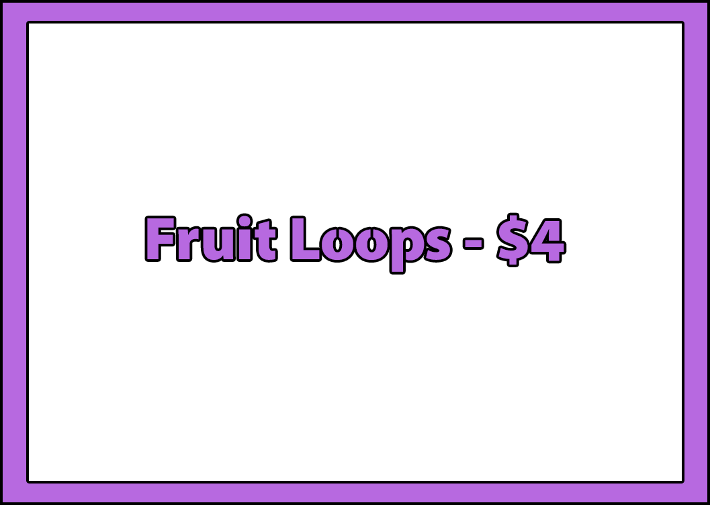
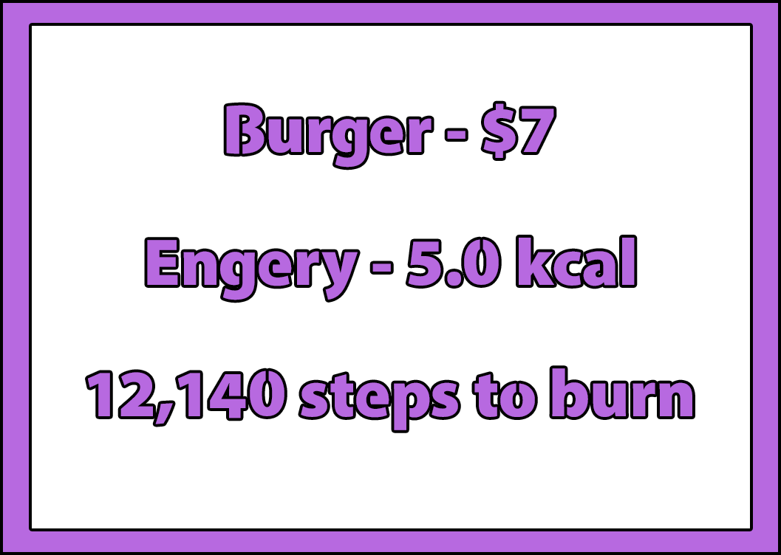
Effective Labelling
When it comes to deciding what to eat, a key factor in guiding our decisions is the food nutritional labelling.
However a number of researches have proven that is not not effective enough.
An alternative that is showing potential is Physical Activity Calories Equivalent.
Our game cycles through a number of labeling methods, with the aim of educating the player about their decisions.

Slide 5

Caloric Intake
Many people do not understand the effects of caloric intake.
Caloric needs are generally understood, however the amount of calories in foods is often massively underestimated.
This causes higher energy intake than energy expenditure.
An imbalanced calorie intake affects both the body and the mind.
Causes weight gain and sluggishness.
Causes poor neuroplasticity, i.e. the brain’s ability to adapt.

Slide 6
Artifact Implementation
Programming & Artwork

Slide 7

Programming / Tools
Oculus Quest series (Standalone VR headset)
Unity (Game Engine)
Oculus Integration (Unity Asset)
Github (Source Control)

Slide 8

Challenges with VR
Build to/with the Oculus Quest.
Establishing the best UI experience for your game.
XR Movement.
Prevention of motion sickness.
Testing and Debugging.
Lighting and baking.
burger vr

Slide 9
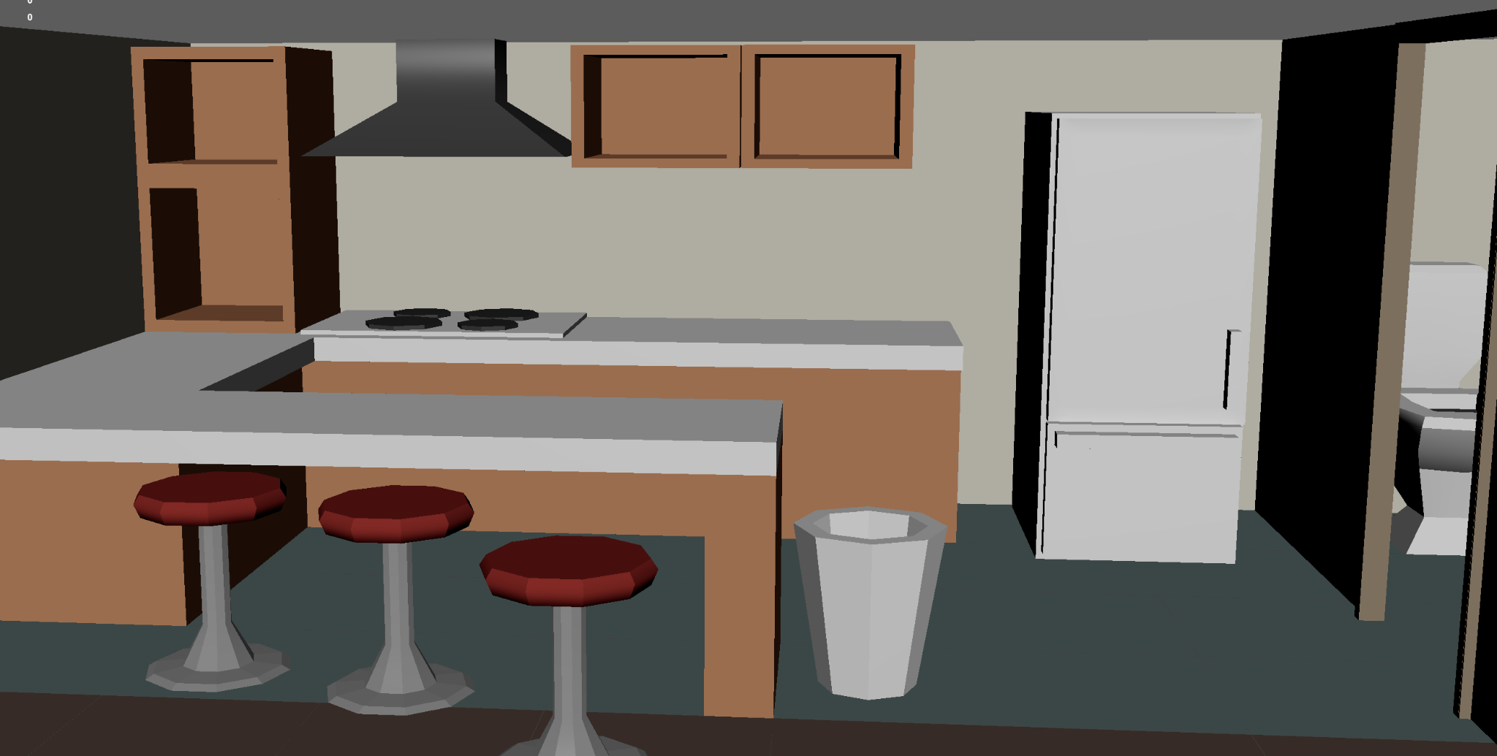
Art Direction
Low poly restrictions when building for the Oculus Quest.
Embraced this artstyle with hardened edges and a focus on silhouettes.
Textures mostly features flat colours to match the simple style.
Colours were chosen to be clearly distinguishable from their surroundings without being hard on the eye.

Slide 10
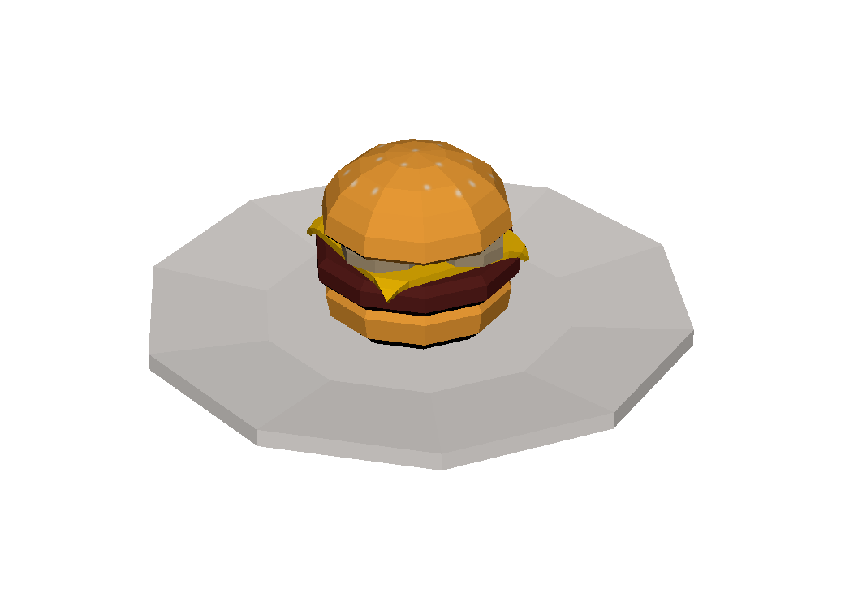
Asset Choices
Each meal has a ‘healthy’ and ‘unhealthy’ option based on calorie intake.
Wanted the player to be able to identify these easily.
Selected recogniseable fast food or sugary options and maintained their real-world allure, i.e. the burger is modelled on an advertisement as opposed to the real thing.
Low calorie options typically feature multiple food groups, one of which being green for the player to associate with being healthy.

Slide 11
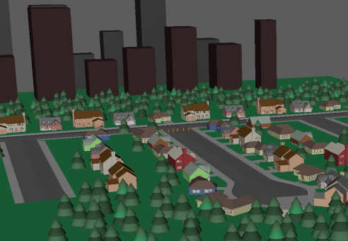
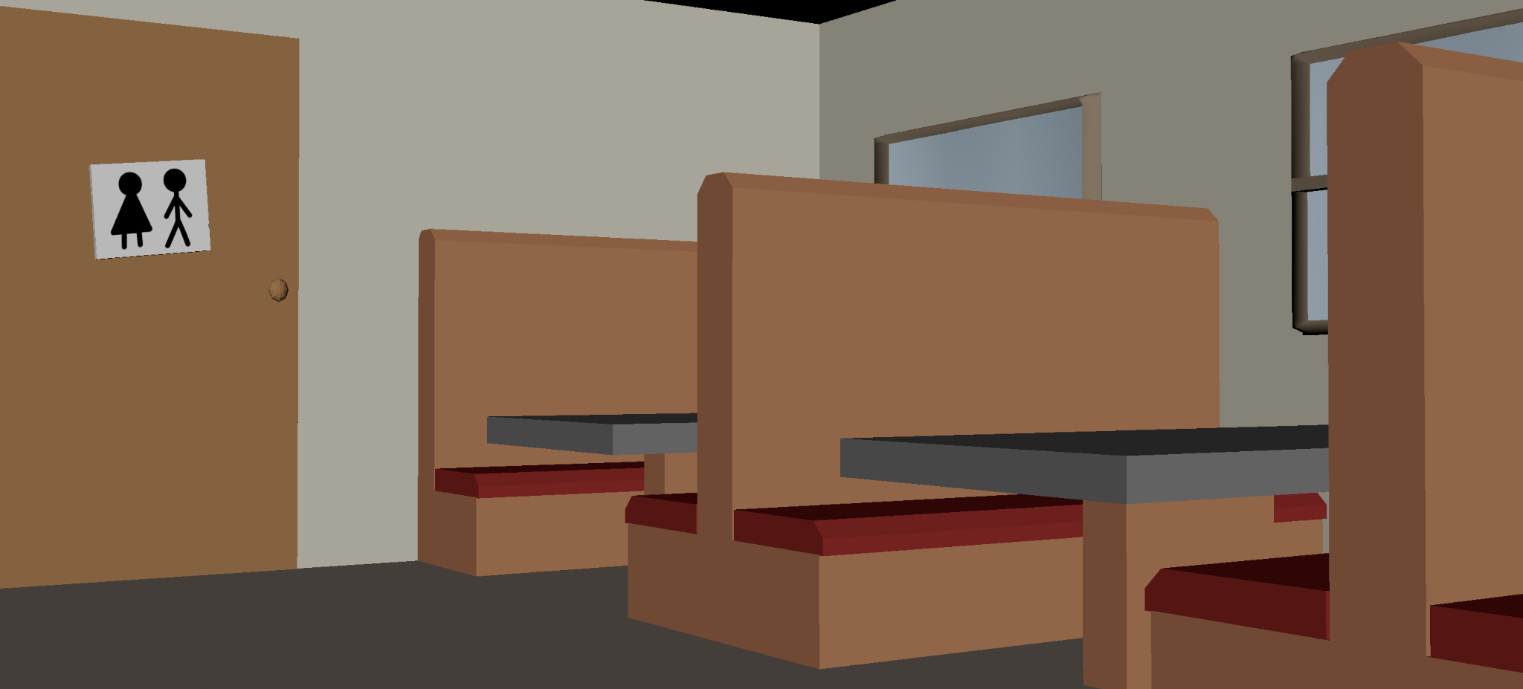
Environment
The scenes are laid out to be orderly and easily comprehensible.
Colours were chosen to mimic buildings in cartoons.
Minimal edges to maintain this clean style.
Rooms layout is designed to ensure accessibility of gameobjects.
Most assets kept modular for reusability during the making of the scenes.

Slide 12
Gameplay Showcase

Slide 13
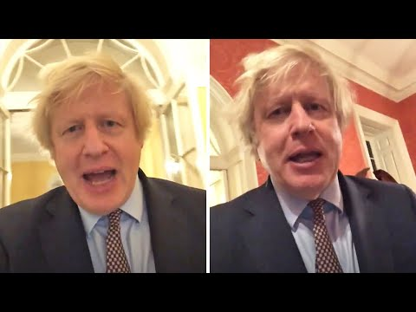
Feedback from Boris

Slide 14
Question Time?

