Slide 1
ESILV
myQLM
Gaëtan Rubez, PhD
Senior expert in Quantum Computing
2022

Slide 2
pyAQASM

Slide 3

pyAQASM – Quantum measurements
One of the postulate of Quantum mechanics provides a means for describing the effects of measurements on quantum systems.
So far, we have been measuring our states in the computational basis.
Meaning that on a single qubit ($\left|ψ> =α\right|0> + β|1>$) we can obtain two possible outcomes with this measurements:
0 with probability $|α|²$
1 with probability ${\left|β\right|}^{2}$
This is acheived by using two measurement operators:
M₀=|0><0| and M₁=|1><1|
Due to p(0) = $<ψ|M_{0}^{†}M0|ψ>$ =$<ψ|M0|ψ>$ = $|α|²$
After measurement, if we obtained 0, the state is $\frac{α}{|α|}|0>$.
Notes:
In this slide :
How to create a Qroutine?
How to call a Qroutine?
The different ways of calling a gate

Slide 4

pyAQASM – Observable
Observable corresponds to a Hermitian operator:
A = $A^{†}$ = A^{T*}
On the QLM we can express an observable as the combination of pauli terms ($σ_{X}$, $σ_{Y}$ and $σ_{Z}$, named X, Y and Z)
The goal in myQLM is to provide to users a framework to efficiently deal with observable sampling.
Notes:
In this slide :
How to create a Qroutine?
How to call a Qroutine?
The different ways of calling a gate

Slide 5
pyAQASM – Observable
from qat.core import Observable, Term
my_observable = Observable(4,
pauli_terms=[
Term(1., "ZZ", [0, 1]),
Term(4., "XZ", [2, 0]),
Term(3., "ZXZX", [0, 1, 2, 3])
],
constant_coeff=23.)
print(my_observable)
Notes:
In this slide :
How to create a Qroutine?
How to call a Qroutine?
The different ways of calling a gate

Slide 6
pyAQASM – Observable
from qat.core import Observable, Term
my_observable = Observable(4,
pauli_terms=[
Term(1., "ZZ", [0, 1]),
Term(4., "XZ", [2, 0]),
Term(3., "ZXZX", [0, 1, 2, 3])
],
constant_coeff=23.)
print(my_observable)
23.0 * I^4 +
1.0 * (ZZ|[0, 1]) +
4.0 * (XZ|[2, 0]) +
3.0 * (ZXZX|[0, 1, 2, 3])
Notes:
In this slide :
How to create a Qroutine?
How to call a Qroutine?
The different ways of calling a gate

Slide 7
pyAQASM – Observable
…
job = circuit.to_job(observable= my_observable)
Results = qpu.submit(job)
…
The sampling of our observable on the final state produced by a quantum circuit.
Notes:
In this slide :
How to create a Qroutine?
How to call a Qroutine?
The different ways of calling a gate

Slide 8

pyAQASM – Parametrized circuit
from qat.lang.AQASM import *
prog = Program()
#Define your variables
theta = prog.new_var(float, "\\theta")
#Apply a gate with a variable
prog.apply(RY(theta), qubits_reg[0])
#Create and display the circuit
circuit = prog.to_circ()
%qatdisplay circuit
q[0]
RY[$θ$]
Notes:
In this slide :
How to create a Qroutine?
How to call a Qroutine?
The different ways of calling a gate

Slide 9

pyAQASM – Parametrized circuit
from qat.lang.AQASM import *
prog = Program()
#Define your variables
theta = prog.new_var(float, "\\theta")
gamma = prog.new_var(float, "\\gamma")
#Apply a gate with a variable
prog.apply(RY(3 * theta * gamma +1), qubits_reg[0])
#Create and display the circuit
circuit_tetha_gamma = prog.to_circ()
%qatdisplay circuit_tetha_gamma
q[0]
RY[$3∗θ∗γ+1$]
Notes:
In this slide :
How to create a Qroutine?
How to call a Qroutine?
The different ways of calling a gate

Slide 10




pyAQASM – Bind variables
new_circuit = circuit.bind_variables({"\\theta": 0.5})
%qatdisplay new_circuit
q[0]
RY[$0.5$]
new_circuit = circuit_tetha_gamma.bind_variables({"\\theta": 0.5})
%qatdisplay new_circuit
q[0]
RY[$3∗0.5∗γ+1$]
new_circuit = new_circuit.bind_variables({"\\gamma": 0.5})
%qatdisplay new_circuit
q[0]
RY[$2.50$]
new_circuit = circuit_tetha_gamma.bind_variables({"\\theta": 0.5, "\\gamma": 0.1})
%qatdisplay new_circuit
q[0]
RY[$1.15$]
Notes:
In this slide :
How to create a Qroutine?
How to call a Qroutine?
The different ways of calling a gate

Slide 11
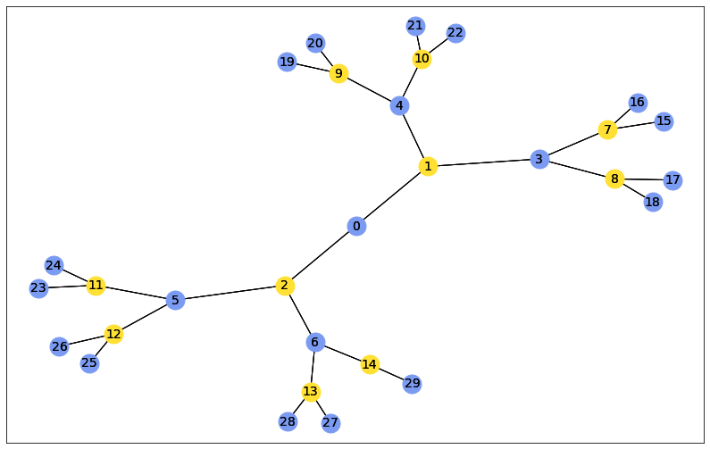
Combinatorial optimization
Usual specification of a combinatorial problem:
$C\left(z\right)=\sum{{α_{i}C}_{i}(z)} argmin_{z} C\left(z\right)$
$z$ is a bitstring
$C$ is the target function (or cost function)
$C_{i}$ are called clauses and are usually $\{0, 1\}$ valued and local
$α_{i}$ are called weights
These problems usually correspond to many yes/no decisions giving a value to the cost function we wish to minimize or maximize.

Slide 12
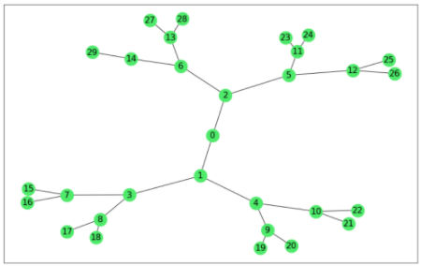
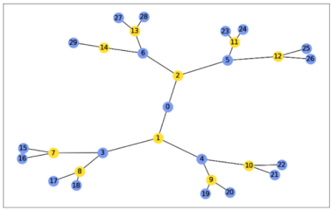
Example: Max Cut
Given an undirected graph G(V, E)
V is a set of vertices
E is a set of edges
The objective of the Max-cut problem is to find two sets from V that maximize the number of edges between these two sets.
H(s₁,… ,s_{N}) = $\sum_{(u,v)∈E}{sisj}$
Notes:
for slow changes of a given parameter, the system will stay in a local minimum of the Hamiltonian

Slide 13
pyAQASM Already implemented combinatorial problems
Unconstrained Graph Problems:
Max cut
Graph Partitioning
Constrained Graph Problems:
Graph Colouring
K-Clique
Vertex Cover
Other problems:
Number Partitioning
Binary Integer Linear Programming
Notes:
In this slide :
How to create a Qroutine?
How to call a Qroutine?
The different ways of calling a gate

Slide 14
pyAQASM – CombinatorialProblem
from qat.opt import CombinatorialProblem
problem = CombinatorialProblem("MyProblem")
# Declare two fresh variables
var1, var2 = problem.new_vars(2)
# Add a new clause : logical AND of the two variables
problem.add_clause(var1 & var2)
# Add a new clause : XOR of the two variables
problem.add_clause(var1 ^ var2)
print(problem)
MyProblem:
2 variables, 2 clauses
Notes:
In this slide :
How to create a Qroutine?
How to call a Qroutine?
The different ways of calling a gate

Slide 15
pyAQASM – CombinatorialProblem
from qat.opt import CombinatorialProblem
problem = CombinatorialProblem("MyProblem")
# Declare two fresh variables
var1, var2 = problem.new_vars(2)
# Add a new clause : logical AND of the two variables
problem.add_clause(var1 & var2, weight=0.5)
print(problem)
MyProblem:
2 variables, 1 clauses
Notes:
In this slide :
How to create a Qroutine?
How to call a Qroutine?
The different ways of calling a gate

Slide 16
pyAQASM – CombinatorialProblem
from qat.opt import CombinatorialProblem
problem = CombinatorialProblem("MyProblem")
# Declare two fresh variables
var1, var2 = problem.new_vars(2)
# Add a new clause : logical AND of the two variables
problem.add_clause(var1 & var2, weight=0.5)
obs = problem.get_observable()
print(obs)
A diagonal Hamiltonian encoding the cost function of the problem can be extracted
0.125 * I^2 +
-0.125 * (Z|[0]) +
0.125 * (ZZ|[0, 1]) +
-0.125 * (Z|[1])
Notes:
In this slide :
How to create a Qroutine?
How to call a Qroutine?
The different ways of calling a gate

Slide 17

pyAQASM – CombinatorialProblem
from qat.opt import CombinatorialProblem
problem = CombinatorialProblem("MyProblem")
# Declare two fresh variables
var1, var2 = problem.new_vars(2)
# Add a new clause : logical AND of the two variables
problem.add_clause(var1 & var2, weight=0.5)
ansatz = problem.qaoa_ansatz(1)
circuit = ansatz.circuit
%qatdisplay circuit
It is possible to directly generate a QAOA ansatz from a CombinatorialProblem
The circuit is accessible from the ansatz
Notes:
In this slide :
How to create a Qroutine?
How to call a Qroutine?
The different ways of calling a gate

Slide 18
pyAQASM – ScipyMinimizePlugin
from qat.qpus import get_default_qpu
from qat.plugins import ScipyMinimizePlugin
qpu = get_default_qpu()
stack = ScipyMinimizePlugin(method="COBYLA",
tol=1e-2,
options={"maxiter":150}) | qpu
result = stack.submit(ansatz)
print("Final energy:", result.value)
Using ScipyMinimizePlugin we can directly minimize our ansatz
Final energy: 7.204089760957932e-05
Notes:
In this slide :
How to create a Qroutine?
How to call a Qroutine?
The different ways of calling a gate

Slide 19
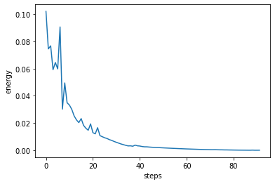
pyAQASM – ScipyMinimizePlugin
import matplotlib.pyplot as plt
plt.plot(eval(result.meta_data["optimization_trace"]))
plt.xlabel("steps")
plt.ylabel("energy")
plt.show()
You can print the trace of the optimization
Notes:
In this slide :
How to create a Qroutine?
How to call a Qroutine?
The different ways of calling a gate

Slide 20
pyAQASM – ScipyMinimizePlugin
from qat.qpus import get_default_qpu
from qat.plugins import ScipyMinimizePlugin
qpu = get_default_qpu()
stack = ScipyMinimizePlugin(method="COBYLA",
tol=1e-2,
options={"maxiter":150}) | qpu
result = stack.submit(ansatz)
print("Final energy:", result.value)
Multiple methods are already available:
Nelder-Mead
Powell
CG
BFGS
Newton-CG
L-BFGS-B
TNC
COBYLA
SLSQP
trust-constr
dogleg
trust-ncg
trust-exact
trust-krylov
Notes:
In this slide :
How to create a Qroutine?
How to call a Qroutine?
The different ways of calling a gate

Slide 21
Plugins
Goal: Simplify the design of applications.
Plugins can:
process circuits (or jobs) on their way to a QPU.
process samples (or values) on their way back.
Plugins API is composed of:
compile for the way in. Take a Batch with HardwareSpecs and return a new Batch.
post_process for the way out. Process BatchResult and return either a BatchResult or a new Batch that should go back to the QPU.
Notes:
In this slide :
How to create a Qroutine?
How to call a Qroutine?
The different ways of calling a gate

Slide 22
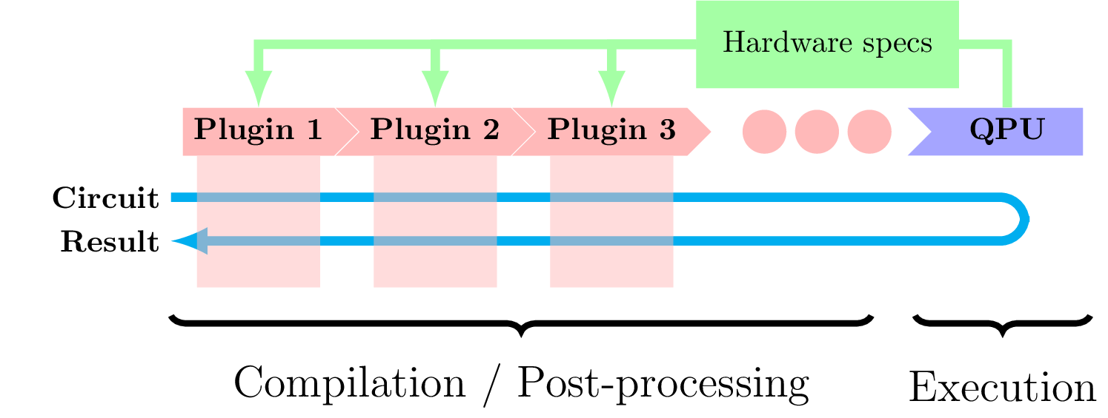
Plugins
Creating a stack using plugins:
my_stack = plugin1 | plugin2 | … | my_qpu
Notes:
Plugins can be used to perform a wide range of transformations.

Slide 23
Writing Plugins
from qat.core.plugins import AbstractPlugin
class MyPlugin(AbstractPlugin):
def compile(self, batch, hardware_specs):
#do something with the batch…
return batch
def post_process(self, batch_result):
#do something with the results…
return batch_result
def do_post_process(self):
return True
MyPlugin()
Notes:
Plugins can be used to perform a wide range of transformations.

Slide 24
Using Plugins
from qat.qpus import LinAlg
my_stack = MyPlugin() | LinAlg()
from qat.lang.AQASM import Program, H
prog = Program()
for qb in prog.qalloc(3):
prof.apply(H, qb)
for sample in my_stack.submit(prog.to_circ().to_job()):
print(sample)
Notes:
Plugins can be used to perform a wide range of transformations.

Slide 25
Using Plugins
from qat.qpus import LinAlg
my_stack = MyPlugin() | LinAlg()
from qat.lang.AQASM import Program, H
prog = Program()
for qb in prog.qalloc(3):
prof.apply(H, qb)
for sample in my_stack.submit(prog.to_circ().to_job()):
print(sample)
Sample(state=|000>, probability=0.1249999, amplitude=(0.35355339+0j), intermediate_measurements=None, err=None)
Sample(state=|100>, probability=0.1249999, amplitude=(0.35355339+0j), intermediate_measurements=None, err=None)
Sample(state=|010>, probability=0.1249999, amplitude=(0.35355339+0j), intermediate_measurements=None, err=None)
Sample(state=|110>, probability=0.1249999, amplitude=(0.35355339+0j), intermediate_measurements=None, err=None)
Sample(state=|001>, probability=0.1249999, amplitude=(0.35355339+0j), intermediate_measurements=None, err=None)
Sample(state=|101>, probability=0.1249999, amplitude=(0.35355339+0j), intermediate_measurements=None, err=None)
Sample(state=|111>, probability=0.1249999, amplitude=(0.35355339+0j), intermediate_measurements=None, err=None)
Sample(state=|011>, probability=0.1249999, amplitude=(0.35355339+0j), intermediate_measurements=None, err=None)
Notes:
Plugins can be used to perform a wide range of transformations.

Slide 26
Example of Plugin
class MyPlugin(AbstractPlugin):
def compile(self, batch, hardware_specs):
for i, job in enumerate(batch.jobs):
print(">> Job #{}".format(i)):
for op in job.circuit.iterate_simple():
print(op)
return batch
def post_process(self, batch_result):
for result in batch_result.results:
print('Result of size', len(result.raw_data))
return batch_result
job = prog.to_circ().to_job()
# Let’s submit 3 times our job in a
# single go
for sample in my_stack.submit([job]*3):
print(sample)

Slide 27
Example of Plugin
class MyPlugin(AbstractPlugin):
def compile(self, batch, hardware_specs):
for i, job in enumerate(batch.jobs):
print(">> Job #{}".format(i)):
for op in job.circuit.iterate_simple():
print(op)
return batch
def post_process(self, batch_result):
for result in batch_result.results:
print('Result of size', len(result.raw_data))
return batch_result
job = prog.to_circ().to_job()
# Let’s submit 3 times our job in a
# single go
for sample in my_stack.submit([job]*3):
print(sample)
>> Job #0
('H', [], [0])
('H', [], [1])
('H', [], [2])
>> Job #1
('H', [], [0])
('H', [], [1])
('H', [], [2])
>>Job #2
('H', [], [0])
('H', [], [1])
('H', [], [2])
Result of size 8
Result of size 8
Result of size 8
Result(raw_data=[Sample(state=|000>, probability=0.1249999999, amplitude=(0.35355339+0j), intermediate_measure…
Result(raw_data=[Sample(state=|100>, probability=0.1249999999, amplitude=(0.35355339+0j), intermediate_measure…
Result(raw_data=[Sample(state=|000>, probability=0.1249999999, amplitude=(0.35355339+0j), intermediate_measure…

Slide 28
List of implemented Plugins
Nnizer: swap insertion plugin
PatternManager: a pattern-based quantum circuit rewriter
Graphopt: pattern & phase polynomial-based circuit optimizer
VariationalOptimizer: a plugin for variational algorithms
ObservableSplitter: turning observable sampling into qubit sampling
CircuitInliner: inlining circuit inside a stack
Display: a console displayer plugin
QuameleonPlugin: emulating hardware constraints via a plugin

Slide 29
Thank you!
For more information please contact: gaetan.rubez@atos.net

