Slide 1
Loan approval prediction model
CREATIVE AND INNOVATIVE PROJECT
Guided by: Dr. Sumalatha and Dr. Lakshmi Harika
Team members:
AmarnaAth M (2018506014)
Roshin farheen (2018506098)
Aditi Narendran (2018506007)
IT7611
TEAM 12
CIP lab

Slide 2
Problem statement
Loan prediction is a very common real-life problem that every retail bank faces in their lending operations. If the loan approval process is automated, it can save a lot of man hours and improve the speed of service to the customers. The increase in customer satisfaction and savings in operational costs are significant. However, the benefits can only be reaped if the bank has a robust model to accurately predict which customer's loan it should approve and which to reject, in order to minimize the risk of loan default.The increase in customer satisfaction and savings in operational costs are significant. However, the benefits can only be reaped if the bank has a robust model to accurately predict which customer's loan it should approve and which to reject, in order to minimize the risk of loan default.

Slide 3

OBJECTIVES
The classification goal is to predict the likelihood of a potential customer buying loans.
To predict whether the loan will likely to default or not, if it is likely to default, then the loan would not be approved, and vice versa.
To develop an user interface that tries to predict the results with most accurate results.
To try different machine learning model that gives the most accurate results.

Slide 4
ABSTRACT
With the enhancement in the banking sector lots of people are applying for bank loans but the bank has its limited assets which it has to grant to limited people only, so finding out to whom the loan can be granted which will be a safer option for the bank is a typical process. So, in this project we try to reduce this risk factor behind selecting the safe person so as to save lots of bank efforts and assets. If the loan approval process is automated, it can save a lot of man hours and improve the speed of service to the customers. The increase in customer satisfaction and savings in operational costs are significant. This is done by mining the Big Data of the previous records of the people to whom the loan was granted before and on the basis of these records/experiences the machine was trained using using the most appropriate machine learning model out of Linear Regression, Decision Tree, Random Forest and XGBoost by choosing the one which gives the most accurate result.

Slide 5
SCOPE OF THE PROJECT
Loan Prediction is very helpful for employee of banks as well as for the applicant also. The aim of this project is to provide quick, immediate and easy way to choose the deserving applicants. It can provide special advantages to the bank and the whole process of prediction is done privately no stakeholders would be able to alter the processing. The Loan Prediction System can automatically calculate the weight of each features taking part in loan processing and on new test data same features are processed with respect to their associated weight. The web-based app makes it easier for the users to check their loan status.The increase in customer satisfaction and savings in operational costs are significant. However, the benefits can only be reaped if the bank has a robust model to accurately predict which customer's loan it should approve and which to reject, in order to minimize the risk of loan default.

Slide 6
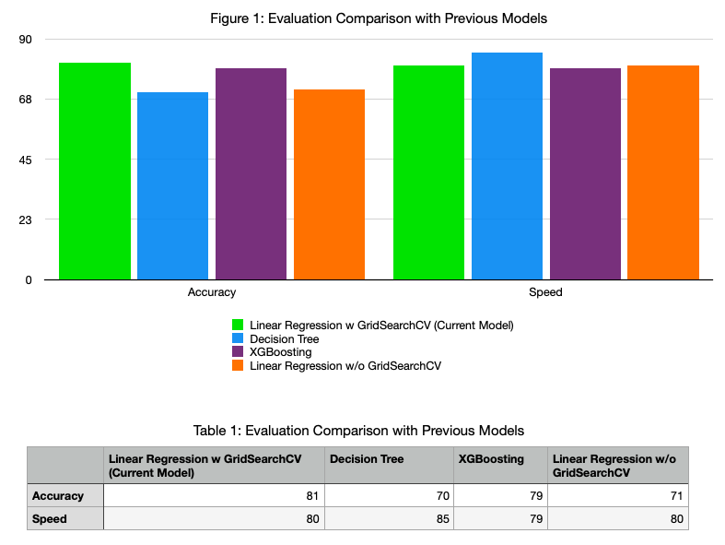
NOVELTY

Slide 7
PROPOSED SYSTEM
Loan prediction is a very common real-life problem that each retail bank faces at least once in its lifetime. If done correctly, it can save a lot of man hours at the end of a retail bank. Customers first apply for a home loan after that company validates the customer eligibility for the loan. The loan eligibility process (real time) can be automated based on customer details provided through for example filling an online application form. These details can be Gender, Marital Status, Education, Number of Dependents, Income, Loan Amount, Credit History etc. Hence the goal is to identify the customer segments that are eligible and in fact germane for loan amounts so that they can be specifically targeted. In this first phase, some preliminary operations were carried out to understand all the features clearly. Visualization of all the variables for example Married, to determine whether the married tend to repay the loans back or the unmarried was done.. All the variables were normalized before plotting and cross checked if it is Normal using graphs. Some of the Bivariate Analysis included Loan Status and Education etc. where loan status is our target variable. Data cleaning includes dealing with missing values Mean (without outliers) and Mode (with Outliers) Replacement Method. Also, Correlation was visualized using Heatmap. In the second phase, we proceeded with data pre-processing and treating missing values and outliers. Next, the plan was to progress further by performing feature engineering and Model Building. Finally, the machine learning model was converted and incorporated onto a Flask deployed webapp.

Slide 8
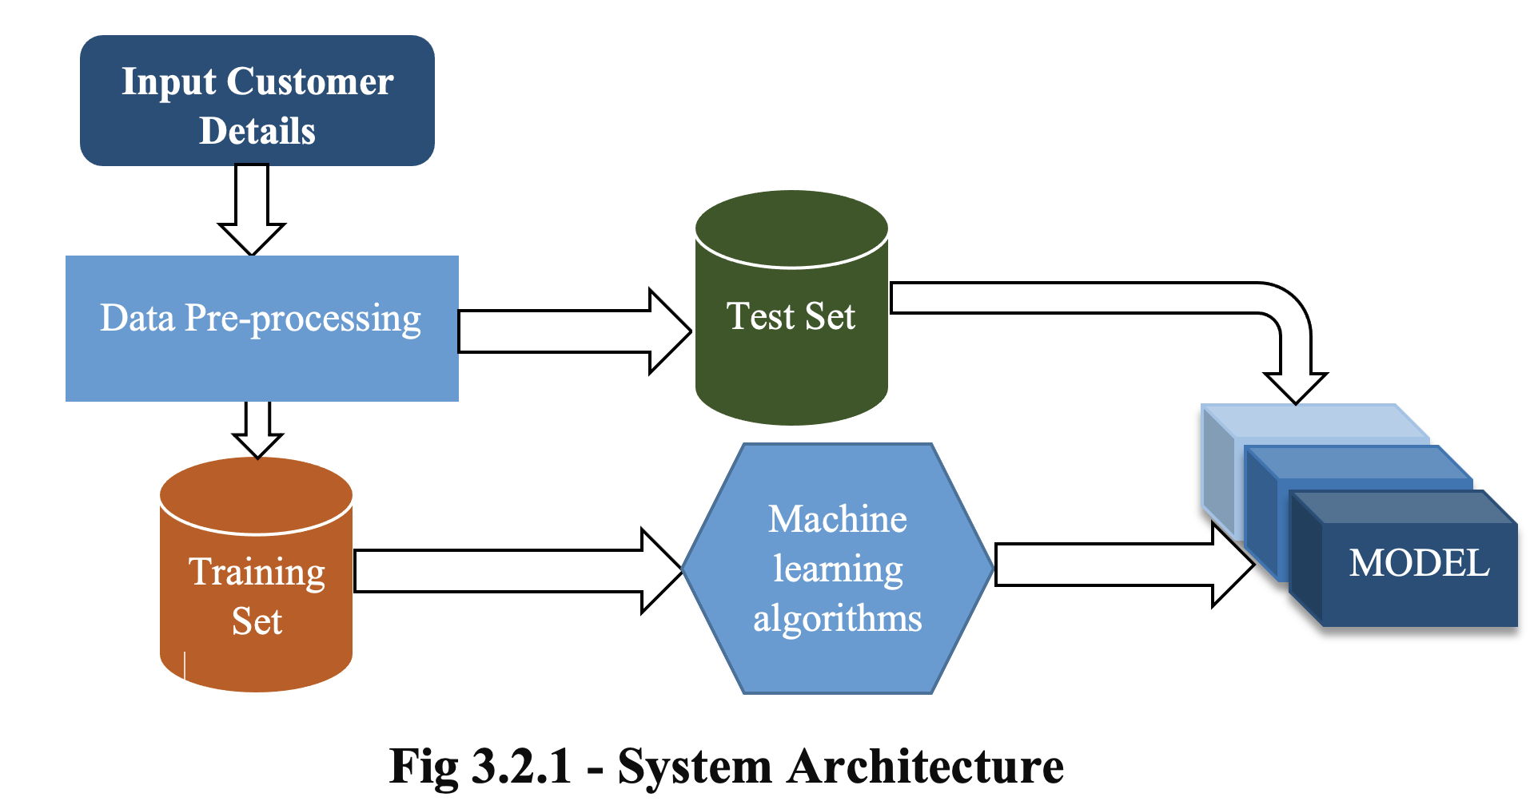
SYSTEM ARCHITECTURE

Slide 9
WORKFLOW OF THE SYSTEM
The 1st part is the Data Collection part. Here, we create a dataset that contains all the necessary attributes in predicting the loan approval of a person. We have collected the data from Kaggle.
After collecting the required data, we go on to filter the data in such a way that there remain no discrepancies in it. This is called the Data Pre-processing Stage.
In this stage, we do the most such that the dataset to be further used has no complications. For example, in our project, some values in certain attributes might be missing. To fill in those, we calculate the median of all the remaining values in that particular attribute and then replace the missing values with this median value.
Now, on finishing the pre-processing stage, we move on further to the data analysis stage. In this stage, we compare each attribute with another and find which has more precedence of them, so that we can use that to predict the condition. On and on and on, we check each attribute with others and form something of a decision tree, wherein the precedence of the most important contributing attribute can be found out, and this can be used in predicting the condition.

Slide 10
WORKFOLW cont
The next process is the Training and the Testing stage. In this stage, we segregate about 80% of the dataset and send it into the Training phase, and the remaining 20% into the Testing phase. We train the data to follow a particular model, and then we use the remaining to test this.
Then, we move on to the Algorithm selection stage. Here, we try and check which algorithm provides the most-highest accuracy for our project. To find this, we apply almost every algorithm possible and find the best possible one.
On finding the most suited algorithm, we then convert it into a model. And feed this model into the Flask web-app.
Now, when the user gives an input through a web form, which we have designed to obtain input, the user details are compared with the values in the database and the prediction is provided.
In the present project work, four models are implemented for loan predictions. They are, (1) Logistic Regression (LR) and Logistic Regression using Stratified K-Folds Cross Validation, (2) Decision Tree (DT) and (3) XGBoost (4) Random Forest (RF) method. The following section deals with the brief description of loan prediction algorithms used in the proposed method

Slide 11

HYPOTHESIS GENERATION
Hypothesis Generation is the process of listing out all the possible factors that can affect the outcome i.e., which of the features will have an impact on whether a loan will be approved or not. It involves understanding of the problem in detail by brainstorming as many factors as possible which can impact the outcome.
Some of the hypotheses are:
Education - Applicants with higher education level i.e., graduate level should have higher chances of loan approval
Income: Applicants with higher income should have more chances of loan approval
Loan amount: If the loan amount is less, the chances of loan approval should be high.
Loan term: Loans with shorter time period should have higher chances of approval.
Previous credit history: Applicants who have repaid their previous debts should have higher chances of loan approval
Monthly instalment amount: If the monthly instalment amount is low, the chances of loan approval should be high
Some of the hypotheses are intuitive. We have tried to validate each of these hypotheses based on the dataset.

Slide 12
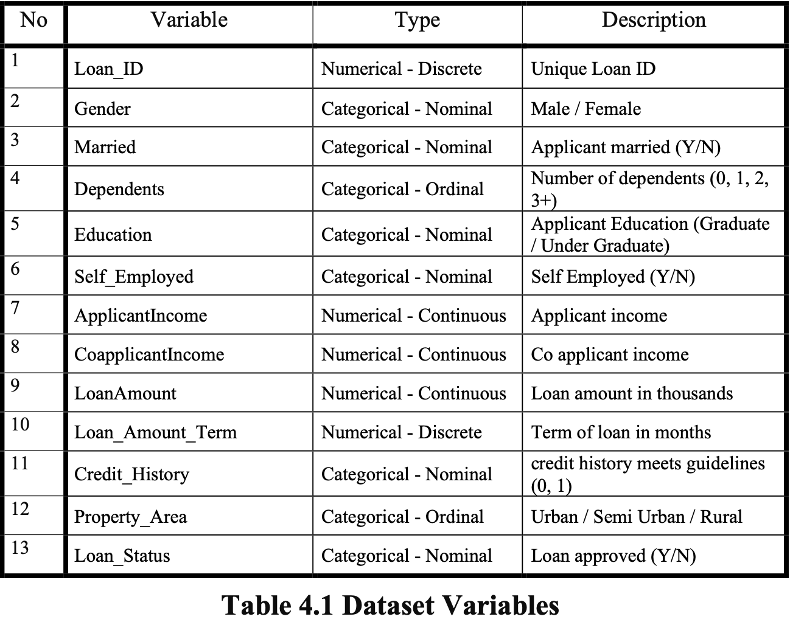
DATA COLLECTION
The data is already labelled in Kaggle. The training set will be used for training the model, i.e., our model will learn from this data. It contains all the independent variables and the target variable. The test set contains all the independent variables, but not the target variable. We apply the model to predict the target variable for the test data. There are 13 columns of features and 614 rows of records in the training set and 12 columns of features and 367 rows of records in the test set. The dataset variables are summarized as below.

Slide 13
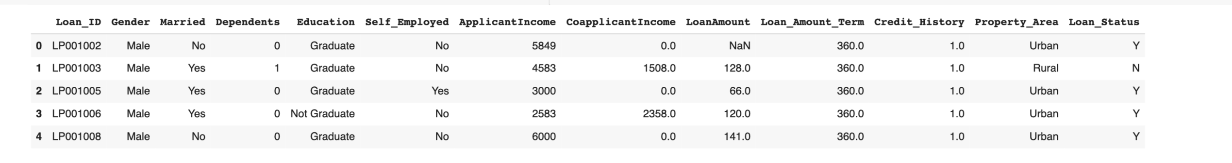
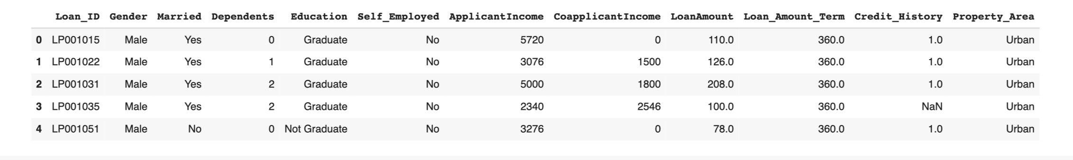
EXPLORATORY DATA ANALYSIS
FIRST FIVE ROWS OF THE TRAIN DATA_SET:
FIRST FIVE ROWS OF THE TEST DATA_SET:

Slide 14
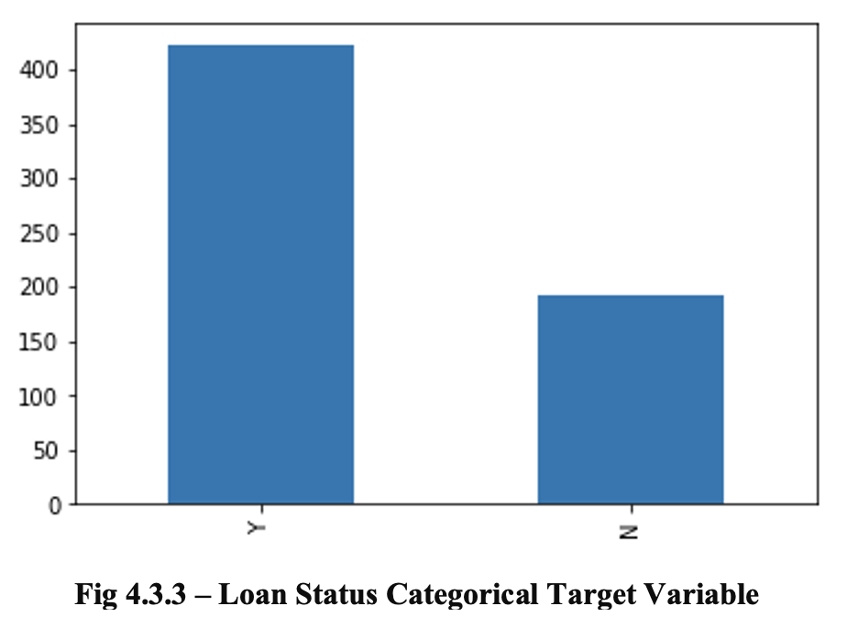
Univariate analysis
Univariate analysis is when we analyse each variable individually. For categorical features we can use frequency table or bar plots which will calculate the number of each category in a particular variable. For numerical features, a histogram or a box-plot can be used to look at the distribution of the variable. With a histogram, you can check the central tendency, variability, modality, and kurtosis of a distribution. But a histogram can’t show you if you have any outliers. This is why we also use box-plots.
NOTE: The loan of 422 (around 69%) people out of 614 was approved. There is no imbalanced classes issue in this dataset, thus accuracy as an evaluation metric should be appropriate. On the other hand, if there are imbalanced or skewed classes, then we might need to use precision and recall as evaluation metrics.

Slide 15
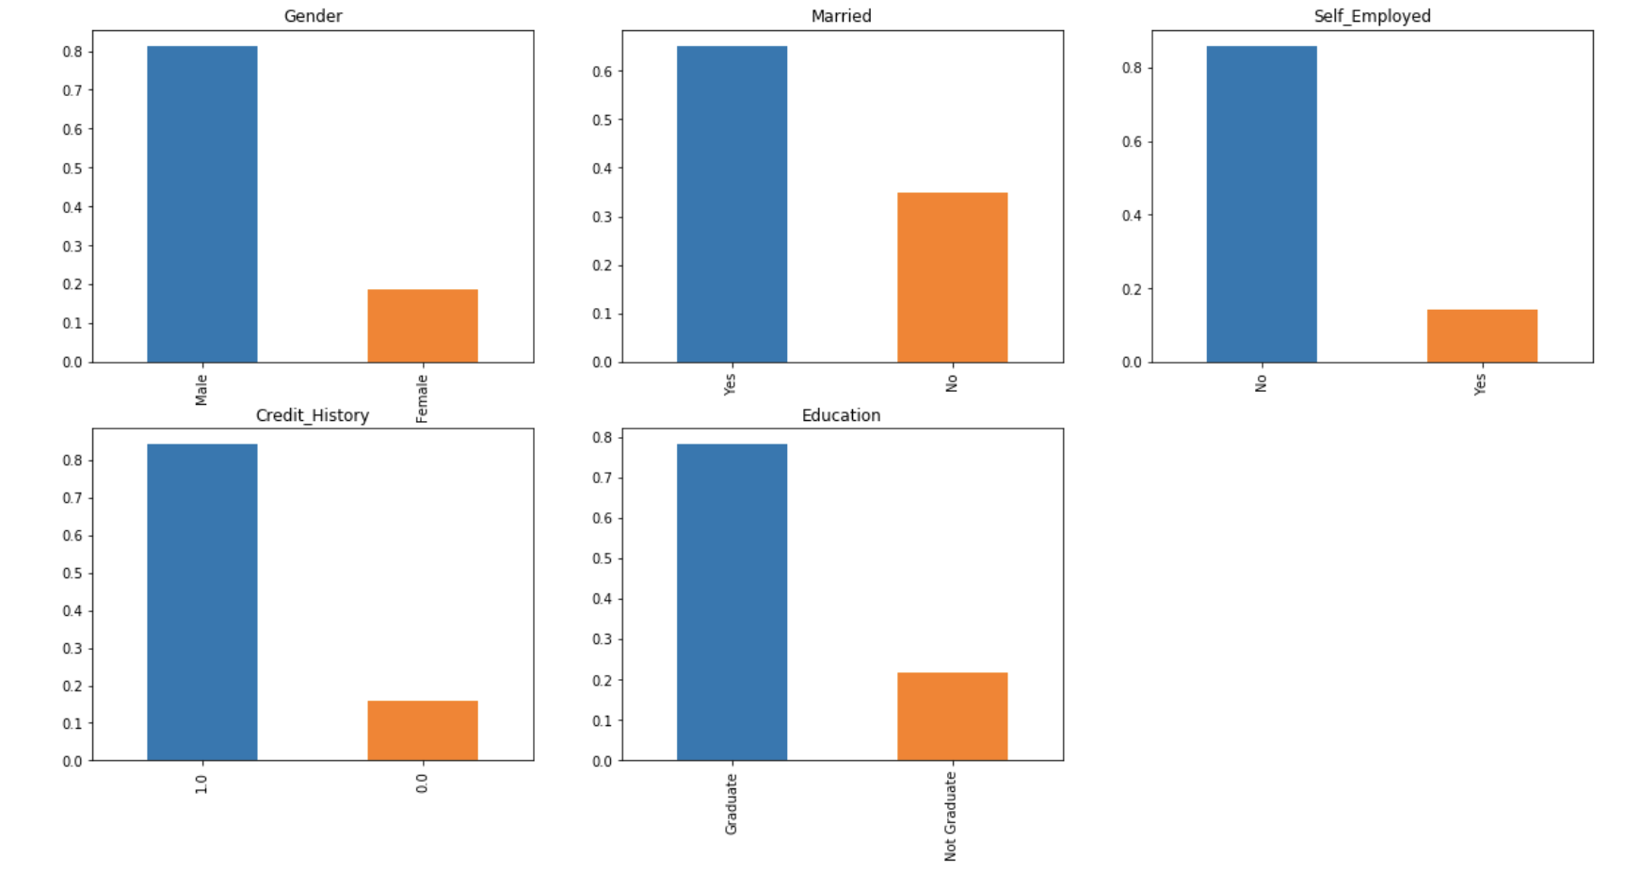
Independent Variable (Categorical)
There are 5 features that are categorical or binary (Gender, Married, Self_Employed, Credit_History, Education)

Slide 16
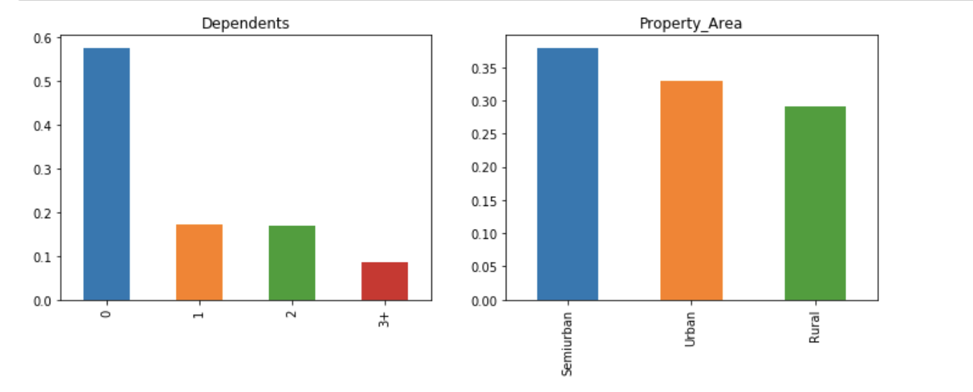
Independent Variable (Ordinal)
There are 2 features that are Ordinal: Variables in categorical features having some order involved (Dependents, Property_Area)

Slide 17
inference from CATEGORICAL VARIABLE ANaLYSIS
80% applicants in the dataset are male.
Around 65% of the applicants in the dataset are married.
Around 15% applicants in the dataset are self employed.
Around 85% applicants have credit history (repaid their debts).
Around 80% of the applicants are Graduate.
inference from ORDINAL VARIABLE ANaLYSIS
More than half of the applicants don’t have any dependents.
Most of the applicants are from semi-urban area.

Slide 18
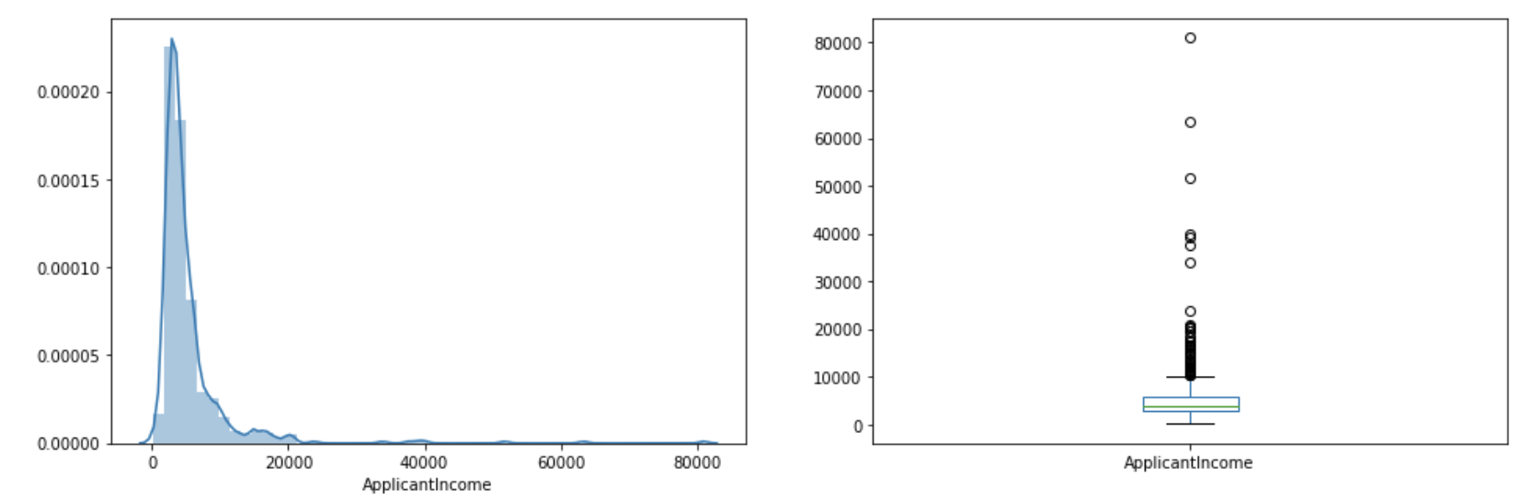
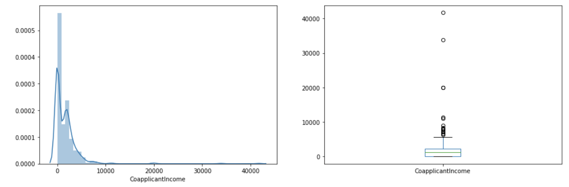
APPLICANTS INCOME DISTRIBUTION

Slide 19
INFERENCES
It can be inferred that most of the data in the distribution of applicant income is towards left which means it is not normally distributed. The distribution is right-skewed (positive skewness). We will try to make it normal in later sections as algorithms works better if the data is normally distributed.
We can see that there are a higher number of graduates with very high incomes, which are appearing to be the outliers.
We see a similar distribution as that of the applicant income. Majority of coapplicant’s income ranges from 0 to 5000. We also see a lot of outliers in the co applicant income and it is not normally distributed.
We see a fairly normal distribution (albeit still slightly right-skewed) for LoanAmount but there are lot of outliers in this variable. We will treat the outliers in later sections.
Around 85% of the loans are 360 months term or 30 years period

Slide 20
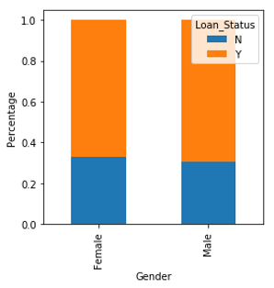
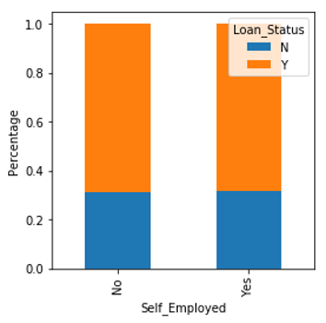
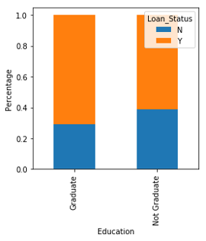
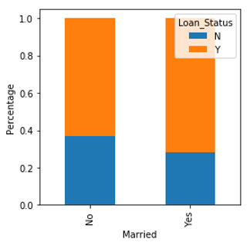
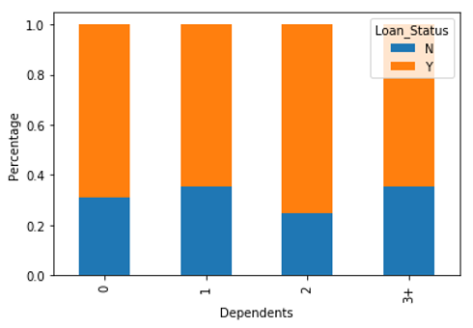
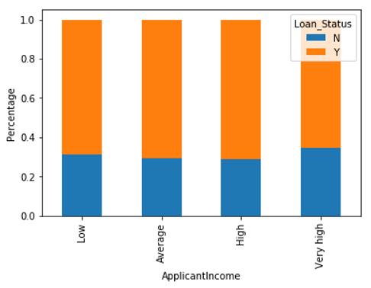
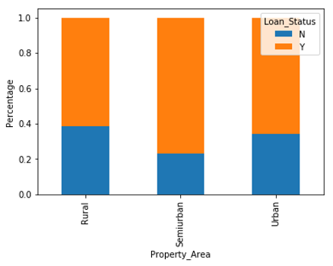
Bivariate Analysis

Slide 21
INFERENCES OF BIVARIATE ANALYSIS
proportion of male and female applicants is more or less same for both approved and unapproved loans
proportion of married applicants is higher for the approved loans
distribution of applicants with 1 or 3+ dependents is similar across both the categories of Loan_Status
there is nothing significant we can infer from Self_Employed vs Loan_Status plot.
proportion of loans getting approved for graduates is higher compared to non-graduates
it seems people with credit history as 1 are more likely to get their loans approved
proportion of loans getting approved in semi urban area is higher as compared to that in rural or urban areas.
It can be seen that the proportion of approved loans is higher for Low and Average Loan Amount as compared to that of High Loan Amount which supports our hypothesis in which we considered that the chances of loan approval will be high when the loan amount is less.

Slide 22
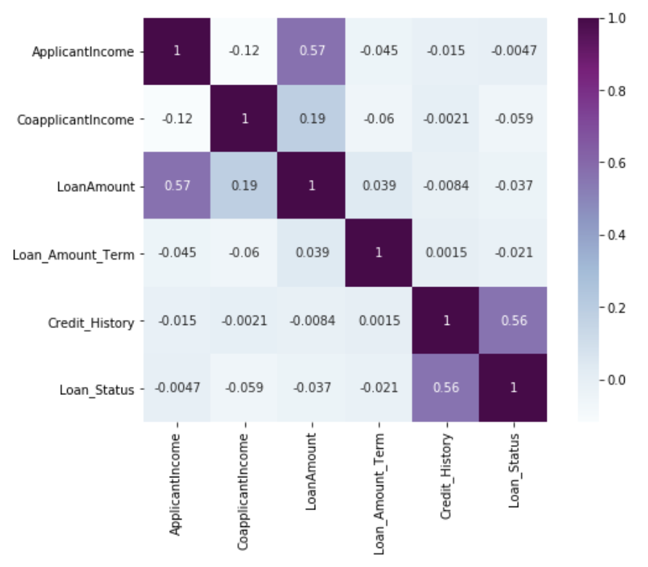
correlation between all the numerical variables
We see that the most correlated variables are:
(ApplicantIncome - LoanAmount) with correlation coefficient of 0.57
(Credit_History - Loan_Status) with correlation coefficient of 0.56
LoanAmount is also correlated with CoapplicantIncome with correlation coefficient of 0.19.

Slide 23
Data Pre-processing
Data pre-processing is a data mining technique that involves transforming raw data into an understandable format. Real-world data is often incomplete, inconsistent, and/or lacking in certain behaviours or trends, and is likely to contain many errors. Data pre-processing is a method of resolving such issues.
Missing value and outlier treatment
There are missing values in Gender, Married, Dependents, Self_Employed, LoanAmount, Loan_Amount_Term and Credit_History features. We will treat the missing values in all the features one by one.
We can consider these methods to fill the missing values:
For numerical variables: imputation using mean or median
For categorical variables: imputation using mode
There are very less missing values in Gender, Married, Dependents, Credit_History and Self_Employed features so we can fill them using the mode of the features. If an independent variable in our dataset has huge amount of missing data e.g. 80% missing values in it, then we would drop the variable from the dataset.

Slide 24
missing values in the test dataset
We need to replace the missing values in Test set using the mode/median/mean of the Training set, not from the Test set. Likewise, if you remove values above some threshold in the test case, make sure that the threshold is derived from the training and not test set. Make sure to calculate the mean (or any other metrics) only on the train data to avoid data leakage to your test set.
OUTLIER TREATMENT
As we saw earlier in univariate analysis, LoanAmount contains outliers so we have to treat them as the presence of outliers affects the distribution of the data. Having outliers in the dataset often has a significant effect on the mean and standard deviation and hence affecting the distribution. We must take steps to remove outliers from our data sets.
Due to these outliers bulk of the data in the loan amount is at the left and the right tail is longer. This is called right skewness (or positive skewness). One way to remove the skewness is by doing the log transformation. As we take the log transformation, it does not affect the smaller values much, but reduces the larger values. So, we get a distribution similar to normal distribution.

Slide 25
Model Development and Evaluation
Model Building : Part I
We will start with logistic regression model and then move over to more complex models like RandomForest and XGBoost. We will build the following models in this section.
Logistic Regression
Decision Tree
Random Forest
XGBoost

Slide 26
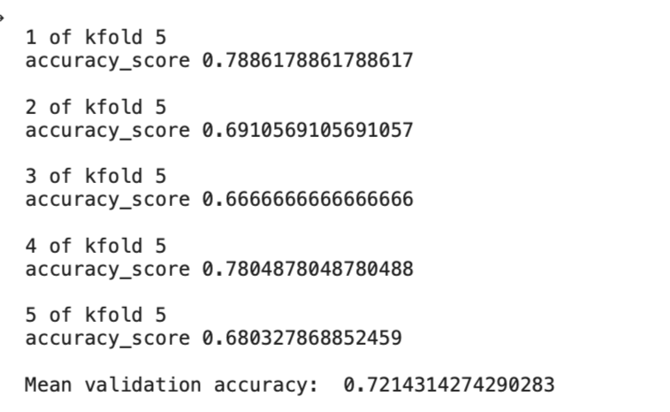
Logistic Regression
Logistic Regression is a classification algorithm. It is used to predict a binary outcome (1 / 0, Yes / No, True / False) given a set of independent variables.
OUTPUT OF THE LOGISTIC Regression model:

Slide 27
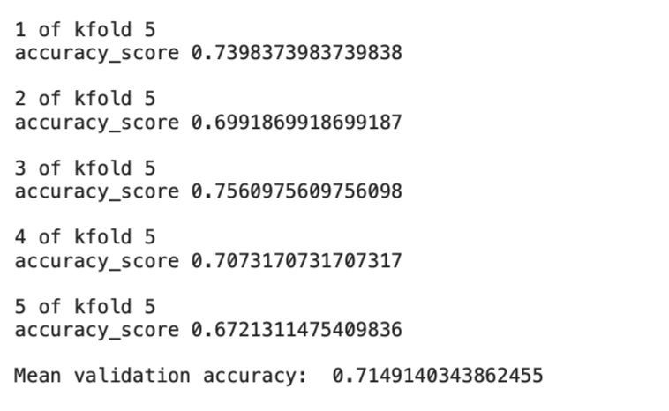
Decision Tree
Decision tree is a type of supervised learning algorithm(having a pre-defined target variable) that is mostly used in classification problems. In this technique, we split the population or sample into two or more homogeneous sets(or sub-populations) based on most significant splitter / differentiator in input variables.
OUTPUT OF THE LOGISTIC DECISION TREE model:

Slide 28
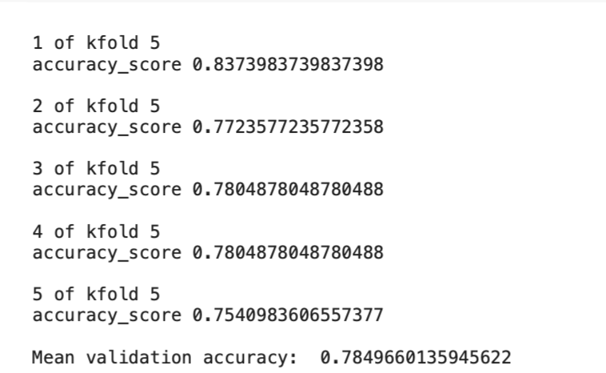
Random Forest
RandomForest is a tree based bootstrapping algorithm wherein a certain no. of weak learners (decision trees) are combined to make a powerful prediction model.
For every individual learner, a random sample of rows and a few randomly chosen variables are used to build a decision tree model.
Final prediction can be a function of all the predictions made by the individual learners.
In case of regression problem, the final prediction can be mean of all the predictions.

Slide 29
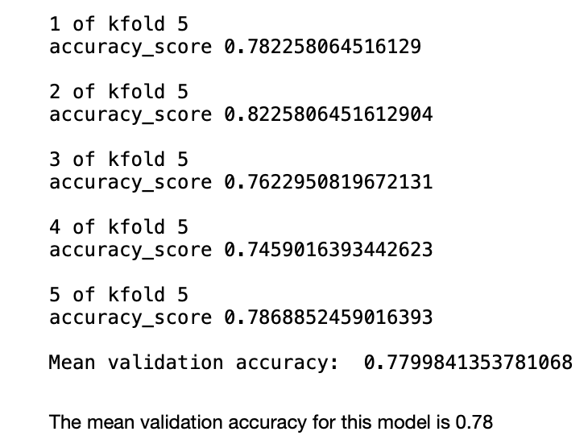
XGBoost
XGBoost is an implementation of gradient boosted decision trees designed for speed and performance.XGBoost is a scalable and accurate implementation of gradient boosting machines and it has proven to push the limits of computing power for boosted trees algorithms as it was built and developed for the sole purpose of model performance and computational speed.
OUTPUT OF THE XGBOOST model:

Slide 30
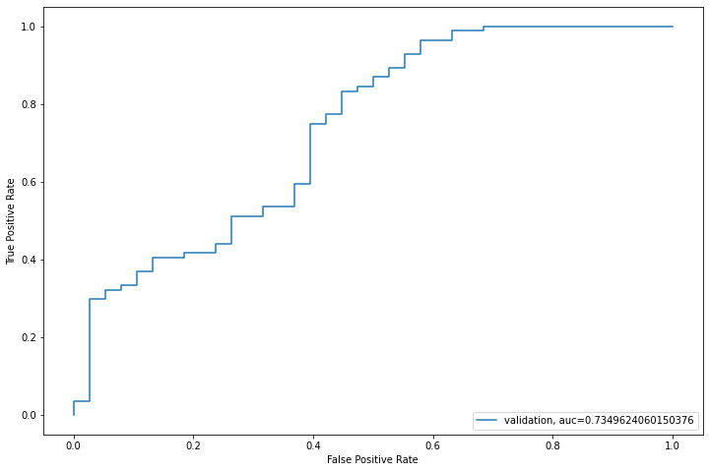
Area Under Curve

Slide 31
FEATURE ENGINEERING
Based on the domain knowledge, we can come up with new features that might affect the target variable. We will create the following three new features:
Total Income - As discussed during bivariate analysis we will combine the Applicant Income and Coapplicant Income. If the total income is high, chances of loan approval might also be high.
Equated Monthly Installment - EMI is the monthly amount to be paid by the applicant to repay the loan. Idea behind making this variable is that people who have high EMI’s might find it difficult to pay back the loan. We can calculate the EMI by taking the ratio of loan amount with respect to loan amount term.
Balance Income - This is the income left after the EMI has been paid. Idea behind creating this variable is that if this value is high, the chances are high that a person will repay the loan and hence increasing the chances of loan approval.

Slide 32
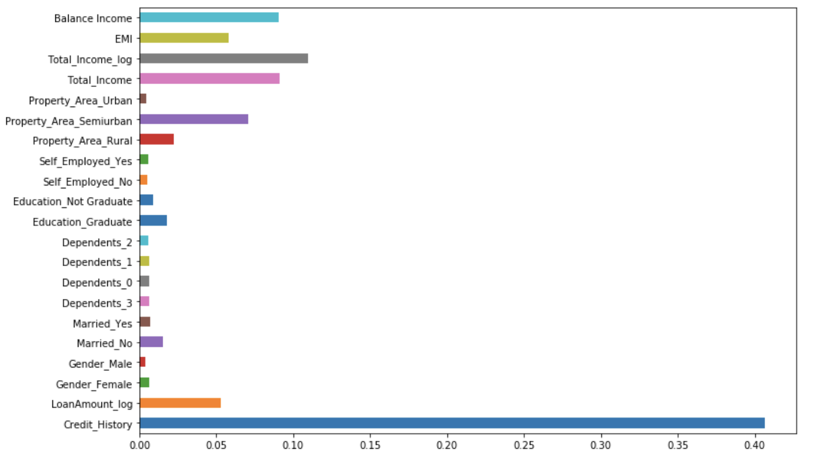
GridSearch CV
We will try to improve the accuracy by tuning the hyperparameters for this model. We will use grid search to get the optimized values of hyper parameters. GridSearch is a way to select the best of a family of hyper parameters, parametrized by a grid of parameters.
FEATURE IMPORTANCE

Slide 33
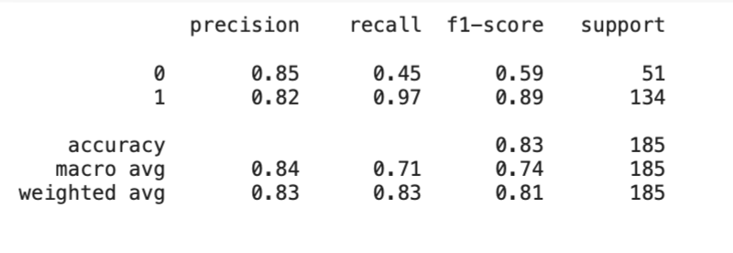
COMBINING ALL THESE RESULTS AND CREATING THE BEST MODEL
Logistic Regression using stratified k-fold cross validation

Slide 34
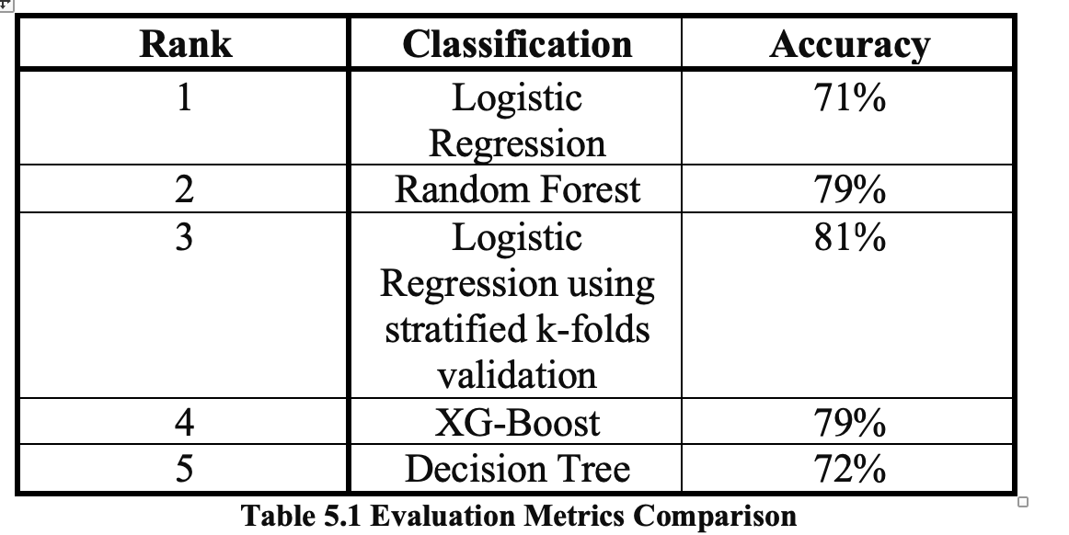
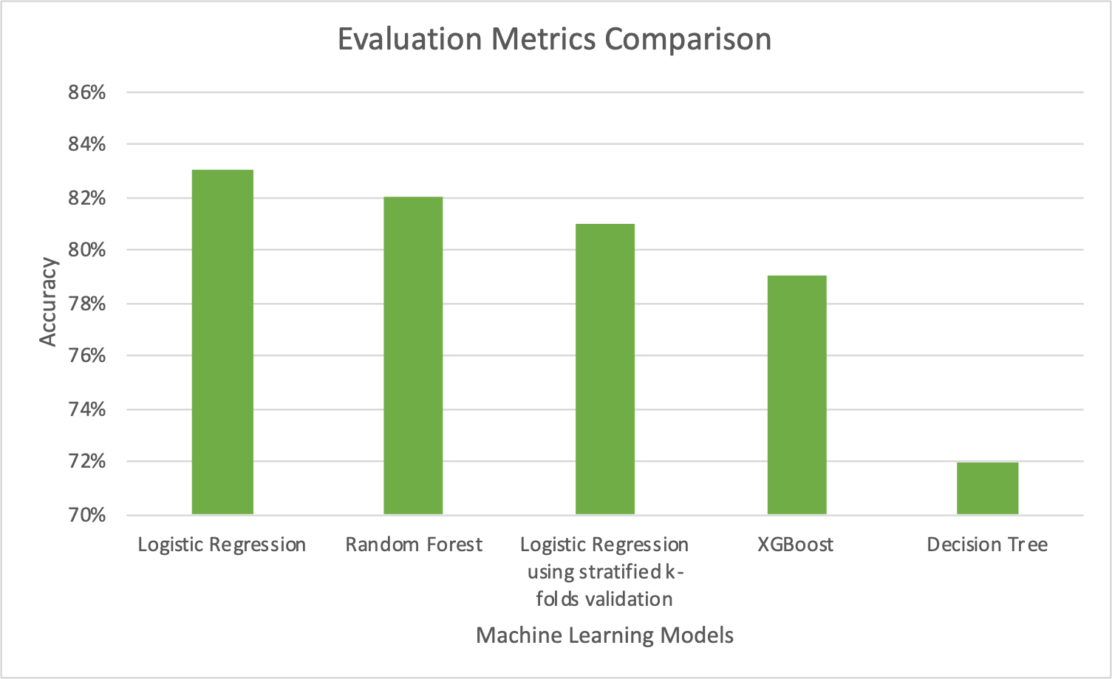
SUMMARY
We can conclude that Logistic Regression has the highest accuracy while predicting Loan Status for the given dataset.

Slide 35
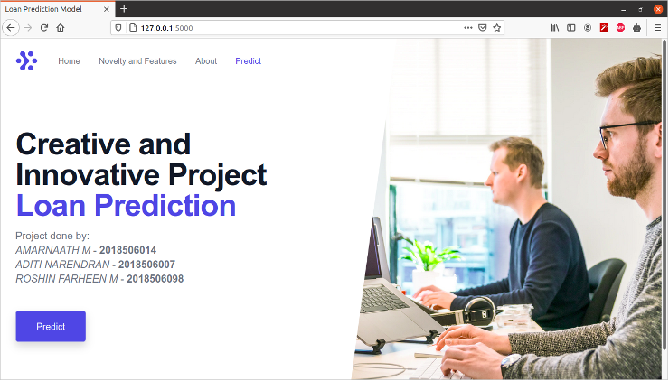
DEPLOYMENT OF THE SAVED MODEL AND TESTING THE MODEL

Slide 36
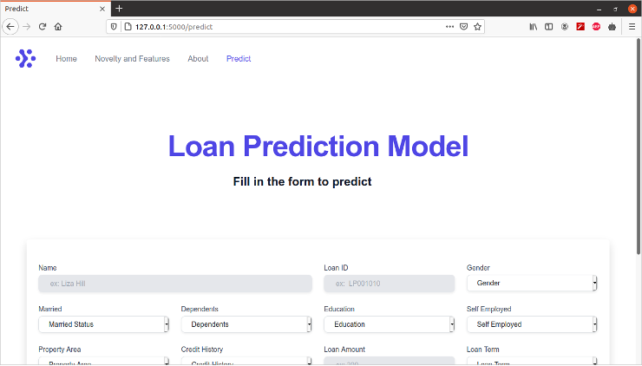

Slide 37
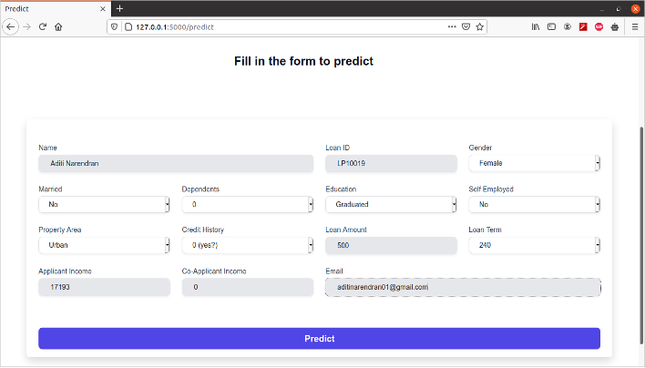

Slide 38
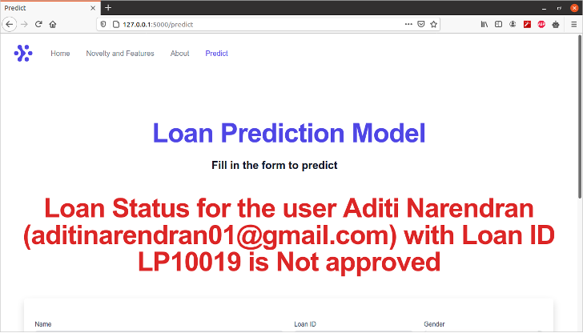
MODEL PREDICTION

Slide 39
CONCLUSION
After trying and testing 4 different algorithms, the best accuracy on the model is achieved by Logistic Regression (0.81), followed by RandomForest (0.7778) and XGBoost (0.7778), and Decision Tree performed the worst (0.6458). While new features created via feature engineering helped in predicting the target variable, it did not improve the overall model accuracy much. Compared to using default parameter values, GridSearchCV helped improved the model's mean validation accuracy by providing the optimized values for the model's hyper parameters. On the whole, a logistic regression classifier provides the best result in terms of accuracy for the given dataset, without any feature engineering needed. Because of its simplicity and the fact that it can be implemented relatively easy and quick, Logistic Regression is often a good baseline that data scientists can use to measure the performance of other more complex algorithms. In this case, however, a basic Logistic Regression has already outperformed other more complex algorithms like Random Forest and XGBoost, for the given dataset.

Slide 40
THANK YOU

