Slide 1
Taekwon
~ App by Ahana

Slide 2
Introduction
My dream for this app is for it to be a virtual interface where many can learn Taekwondo and improve their skills. Taekwondo is a form of martial art, albeit very different from others. Unlike other arts, Taekwondo is one meant to be used to put an end to fights. It aims to create a more peaceful world.
Why this app?
I wished to create an app in a field I relate to. Being a black belt in Taekwondo myself, I wished for other people, especially people with little-to-no access to Taekwondo learning facilities, to be able to learn this wonderful martial art, and to also be able to protect themselves from any dangers.

Slide 3
Features I wish to include
Home Screen giving an introduction on Taekwondo (already made)
Sessions Screen with buttons leading to the syllabus for each belt and showing progress in last session
When clicked, it will redirect you to the portion for that belt, and allow you to resume you last session in the form of a video + theory sheet + test
Test will be practical and theoretical. A.I. camera can be implemented for the practical test to track movements of user
Poomsae will be divided according to level of difficulty for each belt
Settings Screen will let you access your profile + dark theme + check your progress + logout + (additional feature not yet decided upon).

Slide 4
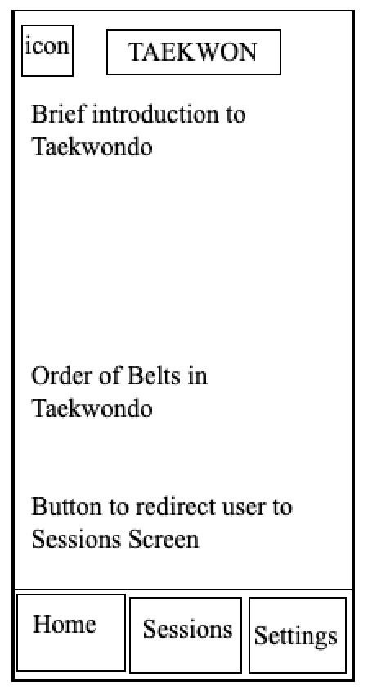
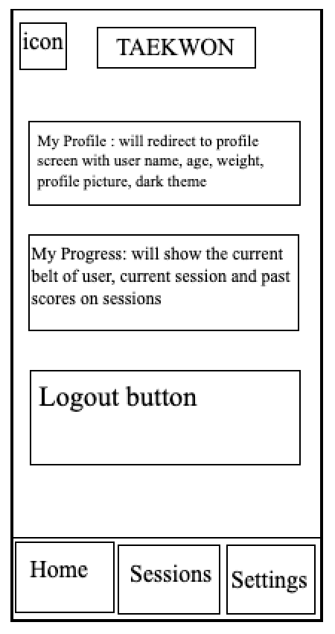
Home Screen
Settings Screen

Slide 5
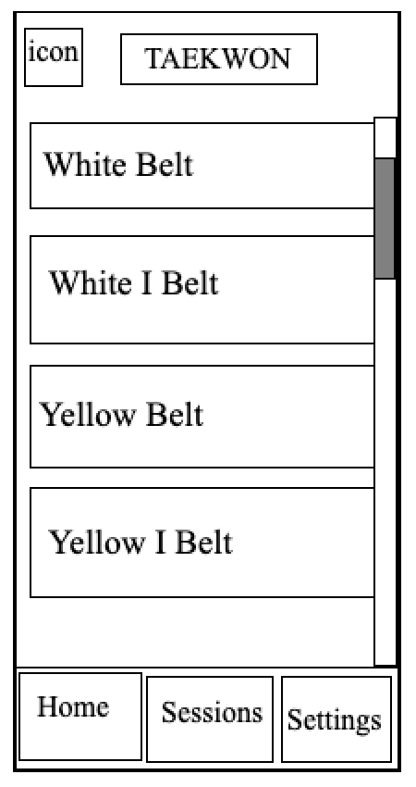
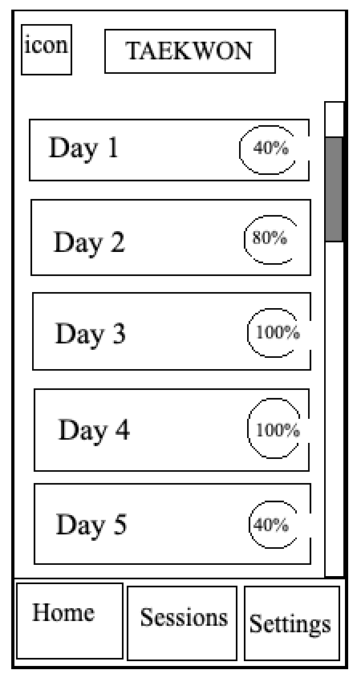
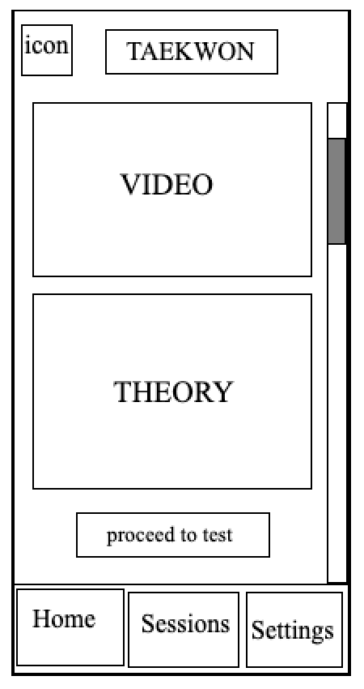
Sessions Screen
Upon clicking on one of the belts
Upon clicking on a session
40% - video, 40% - theory sheet, 20% - test

Slide 6
THANK YOU

