Slide 1
ADVANCED COMPUTER VISION FINAL PROJECT
Picture to Recipe
Identification Model
Xander Deanhardt · Lily Kendall · Ken Lew · Payton Stewart
August 17, 2026

Slide 2
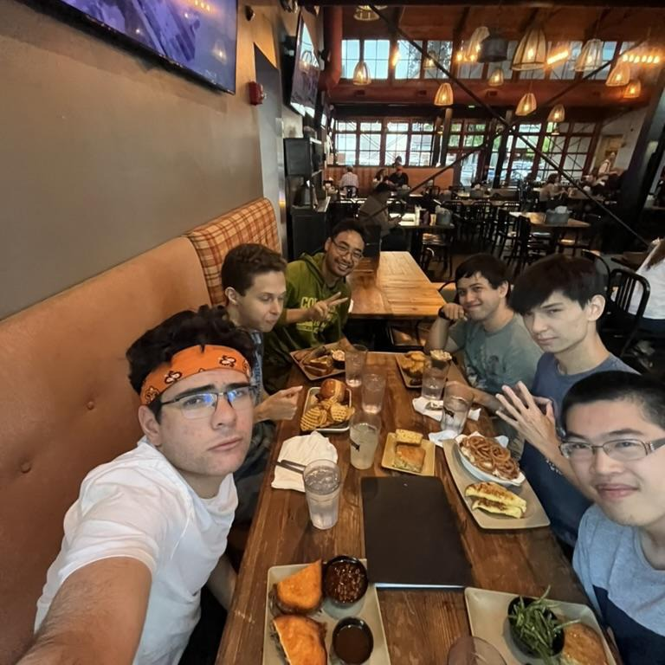
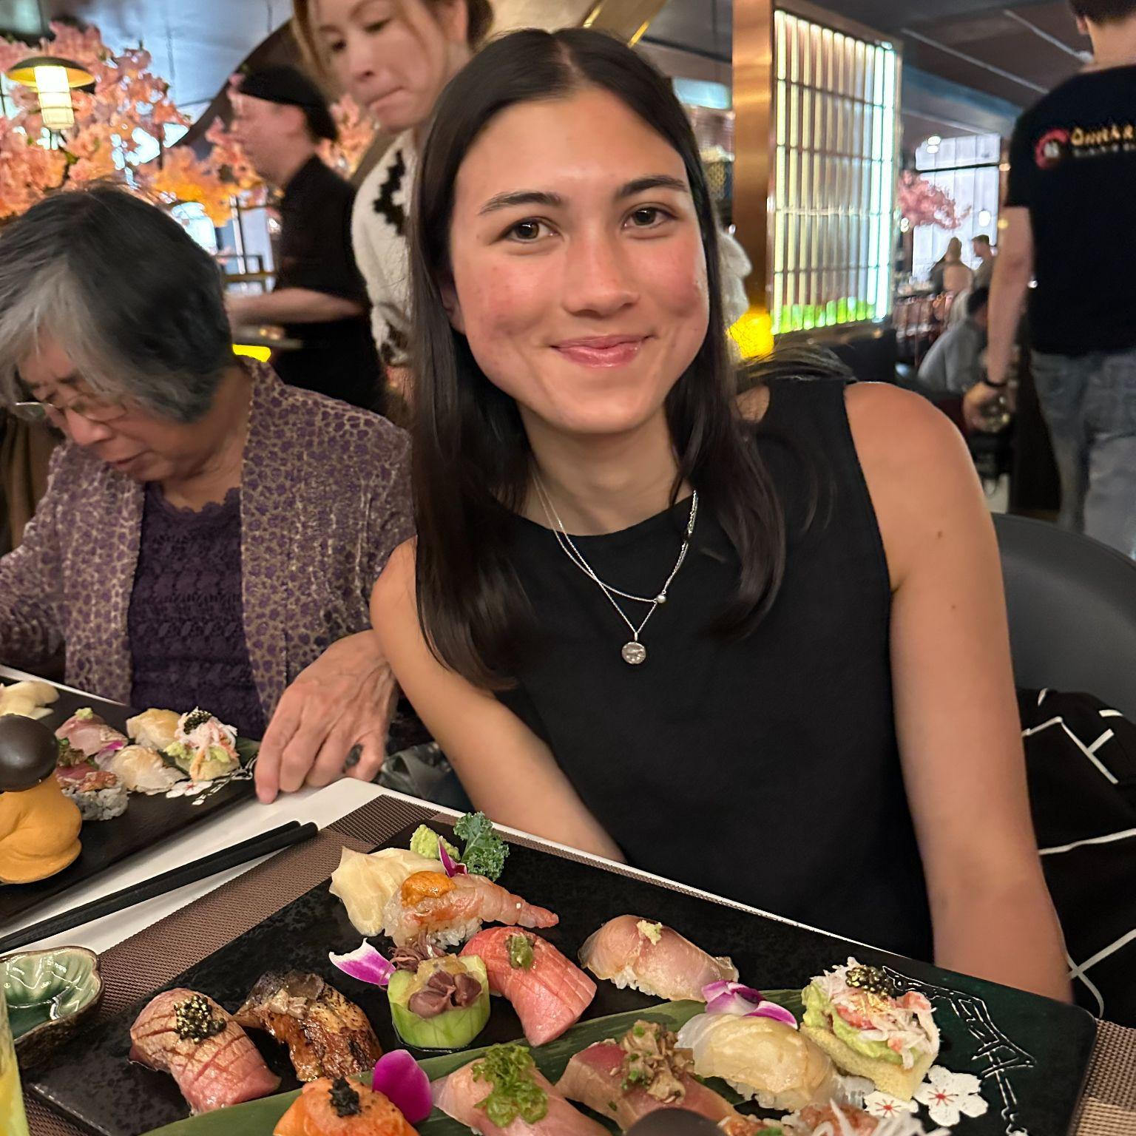
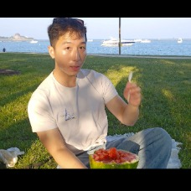
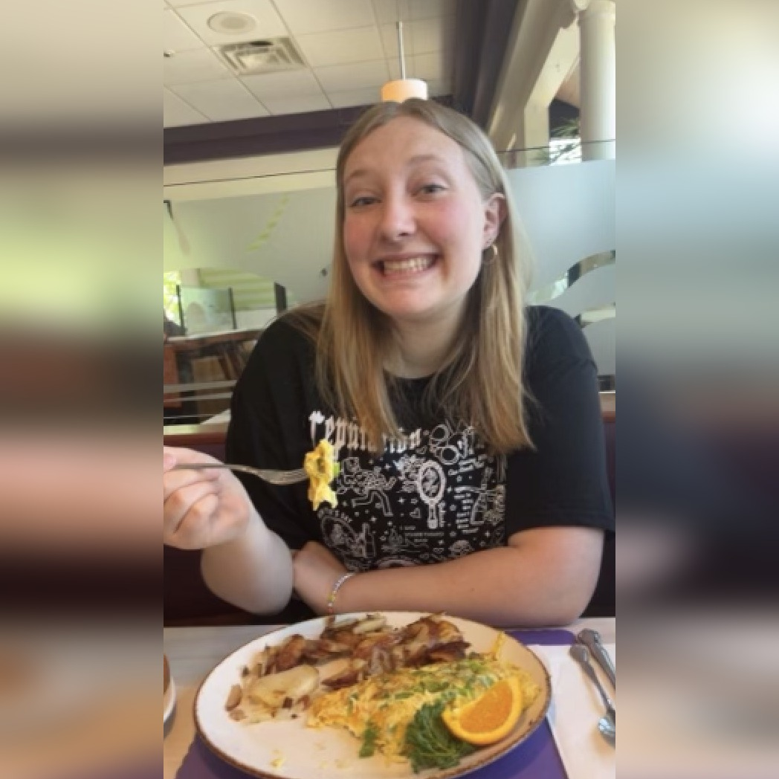
THE TEAM
Team Introductions
Xander Deanhardt
Lily Kendall
Recipe Matching — Integration Lead
Faster R-CNN — Modeling & UI Lead
Ken Lew
Payton Stewart
Recipe Matching — Feature Engineer
YOLO — Modeling Lead
02

Slide 3
OVERVIEW
Table of Contents
01
What is the Goal?
Solving ‘What can I cook right now?’ by converting photos into recipes
02
Exploratory Data Analysis
Analyzing 13,500+ recipes & 280,000+ food images
03
Problem 1: Ingredient Detection
Comparing real-time YOLOv8s against Faster R-CNN
04
Problem 2: Recipe Recommendation
Evaluating Jaccard keyword matching vs. Qwen3 LLM embeddings
05
Deployment & MLOps
Deployment architecture and maintenance
06
Conclusion & Future Vision
Key takeaways, limitations, and roadmap
03

Slide 4
THE IDEA
From a Photo to a Recipe
Snap & Scan
Match & Cook
Real-life problem: people often have ingredients on hand but don’t know what dish they can make without missing key items.
A user points their phone camera at the counter; computer vision localizes food items instantly.
Predicted ingredient labels feed a retrieval engine that scores 13,500+ recipes by what you actually have.
Resilient fallback: a fine-tuned embedding model steps in when labels are noisy or use regional variants.
04

Slide 5
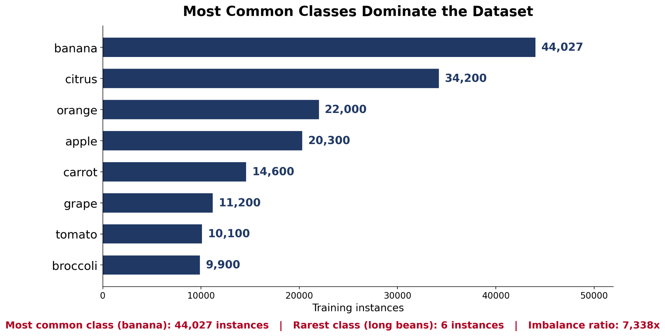
EXPLORATORY DATA ANALYSIS
Food Images
Dataset | Images | Boxes | Classes
FV40 | 17,459 | 282,794 | 62
FOOD-INGREDIENTS | 9,734 | 22,843 | 120
Merged (unified) | 27,193 | 305,637 | 148
Cleaning
Limitations
Merged inconsistent class names across sources; fixed labeling errors.
Rebuilt train/val/test splits from scratch to prevent duplicate leakage.
Most common class (banana) has 7,300x more examples than the rarest (long beans).
Dataset skews toward produce, with too few protein and spice examples.
05

Slide 6
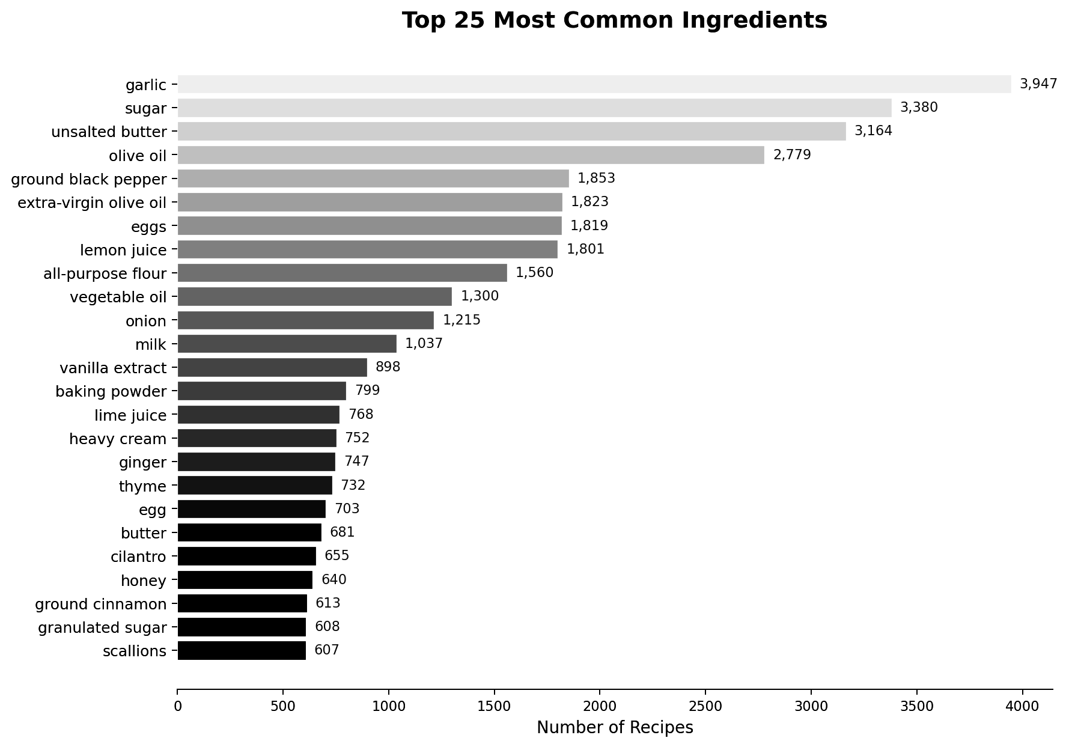
EXPLORATORY DATA ANALYSIS
Recipe Images
SOURCE
CLEANING
Cleaned and merged 13,509 recipes (13,319 unique dish names) from Epicurious and the Spoonacular API.
Stripped measurements, quantities, and prep verbs to produce 25,337 clean ingredient tokens.
INGREDIENT COUNT DISTRIBUTION
DIVERSITY
Recipes average 10.6 ingredients (median 10), providing multi-ingredient matching context.
Pairwise ingredient overlap between random recipes is only 0.50 shared items.
06

Slide 7
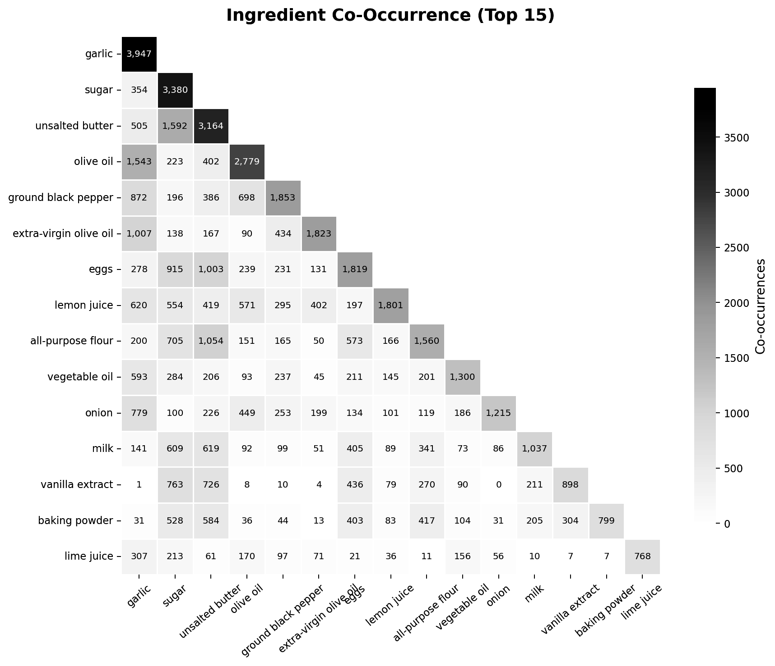
EXPLORATORY DATA ANALYSIS
Flavor Profiles
GLOBAL CUISINE MAPPING
COMPLEXITY & RATING PROXY
Dish complexity is scored from technique verbs (braise, sauté, caramelize) and ingredient counts.
Asian
16.8%
Italian
9.9%
Indian
7.7%
NATURAL INGREDIENT PAIRINGS
High co-occurrence clusters: garlic + onion, olive oil + tomato, soy sauce + ginger.
American
4.7%
MATCHING IMPLICATION
Exact token matching handles common staples easily; complex dishes benefit from semantic embeddings.
07

Slide 8
PROBLEM 1
Detecting Ingredients in Photos
Objective: locate and classify all food items visible on a user’s counter.
This is object detection, not classification: recipe matching needs what and roughly how many, so bounding boxes matter — not just “this photo contains an apple.”
YOLOv8
Faster R-CNN
TYPE
TYPE
Single-stage detector
Two-stage detector (region proposal → classification)
WHY CHOSEN
WHY CHOSEN
Fast inference — suits a live, counter-photo app experience
Strong, accuracy-oriented classic baseline
TRADEOFF
TRADEOFF
Speed-optimized
Accuracy-optimized
08

Slide 9
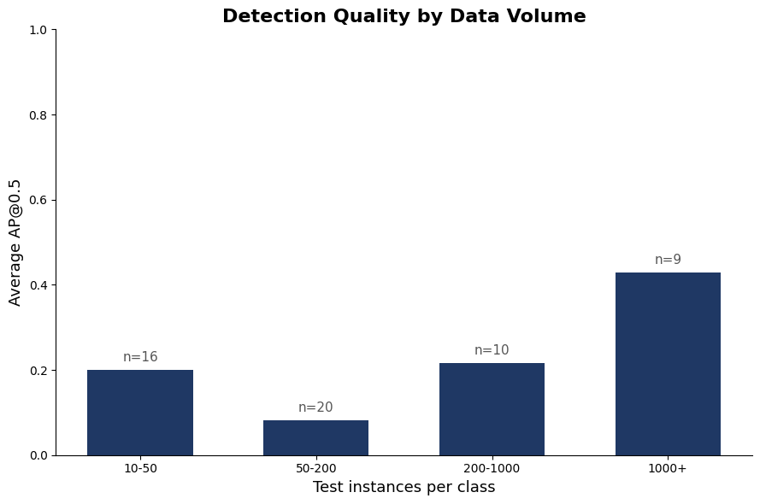
PROBLEM 1 · RESULTS
YOLOv8 Results
YOLOv8s, 30 epochs, trained on the full ~23K images
0.247
0.146
0.440
0.277
mAP@50
mAP@50-95
Precision
Recall
Detection quality is highest with abundant data, though mid-range classes show more variance — likely reflecting which specific ingredients fall in that range rather than data volume alone.
09

Slide 10
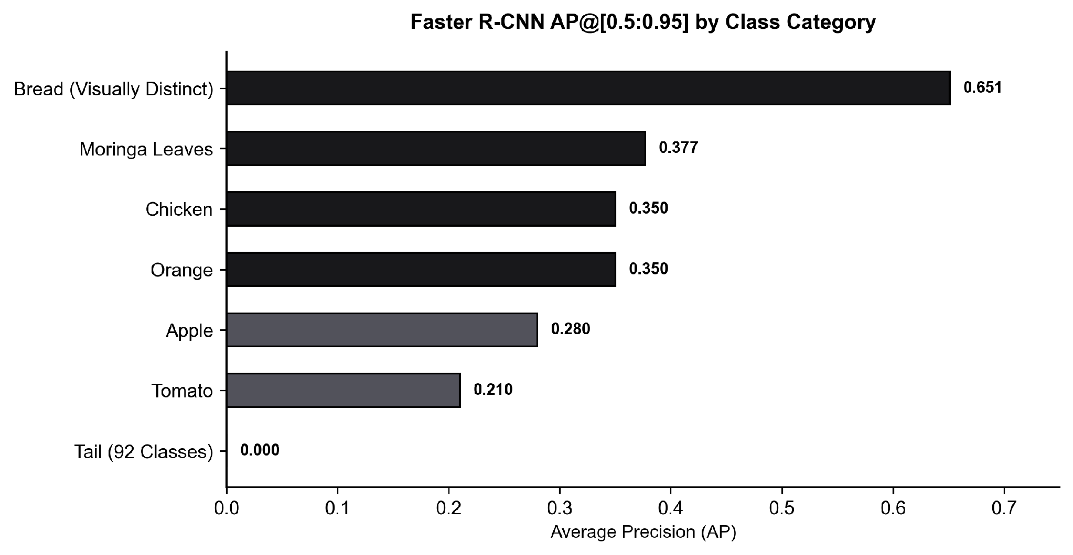
PROBLEM 1 · RESULTS
Faster R-CNN
30%
Due to time and GPU limitations, the model was trained on a 30% subset of the full training dataset, reducing performance overall compared to a full-dataset run.
of the full training dataset
10

Slide 11
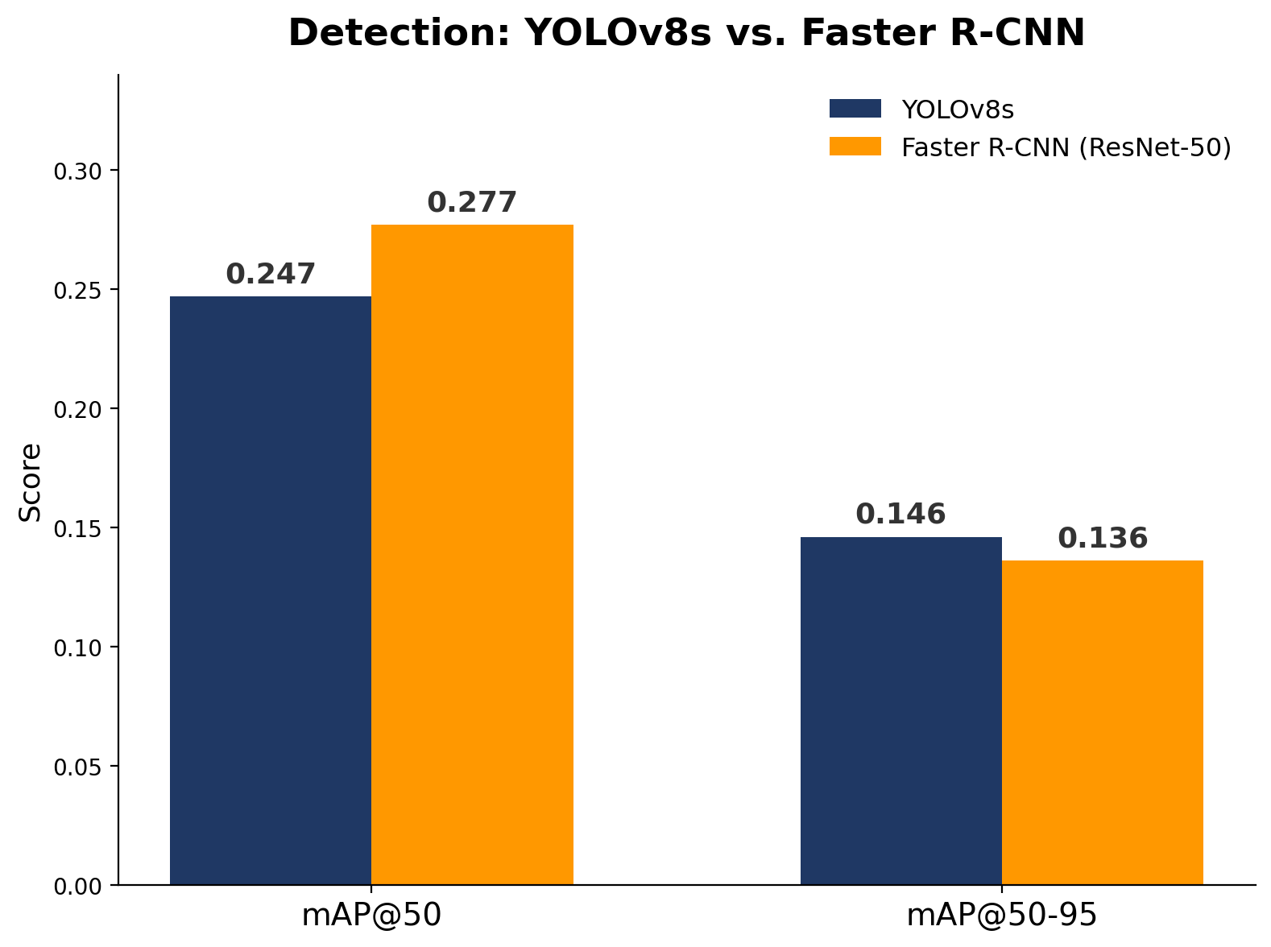
PROBLEM 1 · VERDICT
Choosing the Best
Winner: YOLOv8s
Only model trained on the full ~23K-image dataset (Faster R-CNN’s comparable run used a 30% stratified subset for compute-time reasons).
Comparable mAP@50-95 (0.146 vs. 0.136) despite that data-volume gap — a stronger result than the raw numbers alone suggest.
Faster inference matters directly for a live, phone-camera app experience.
Faster R-CNN (ResNet-50) edges ahead on mAP@50 (0.277 vs. 0.247), but YOLOv8s is the better fit once training-data scope and deployment speed are both weighed in.
11

Slide 12
PROBLEM 2
Matching Images to Recipes
Objective: take the ingredients the model saw and recommend a recipe.
Example query — detected ingredients: Carrots, Celery, Tomatoes, Onions
Jaccard Similarity
Fine-Tuned Qwen-0.6B
TYPE
TYPE
Keyword matching — shared-ingredient overlap
Embedding model — cosine similarity
WHY CHOSEN
WHY CHOSEN
Fast; highest accuracy when tokens are predictable
Understands meaning and combinations; reliable in edge cases
TRADEOFF
TRADEOFF
Speed and accuracy — optimized
Versatility — optimized
12

Slide 13
PROBLEM 2 · RESULTS
Lightning-Fast Keyword Matching Results
98.7%
0.941
98.4%
<10ms
Jaccard Hit Rate @10
Jaccard MRR @10
Ingredient Coverage
CPU Inference / Query
Top-K | Jaccard HR | Cosine HR | Jaccard MRR | Cosine MRR | Jaccard Cov. | Cosine Cov.
K = 1 | 91.2% | 74.3% | 0.912 | 0.743 | 98.4% | 88.4%
K = 3 | 96.7% | 84.6% | 0.937 | 0.790 | 98.4% | 88.4%
K = 5 | 97.8% | 88.4% | 0.939 | 0.798 | 98.4% | 88.4%
K = 10 | 98.7% | 92.2% | 0.941 | 0.804 | 98.4% | 88.4%
K = 20 | 99.4% | 95.2% | 0.941 | 0.806 | 98.4% | 88.4%
13

Slide 14
PROBLEM 2 · METHOD
Smart Synonym LLM (Qwen3-Embedding)
Anchor
Positive
Negative
Dish name + ingredient list
→
Shares 2+ ingredients with anchor
→
Shares 0 ingredients with anchor
Positive and negative pairs teach the embedding model to place similar-ingredient dishes close together, and dissimilar dishes far apart, in embedding space.
14

Slide 15
PROBLEM 2 · RESULTS
Model Comparison Results
Key finding: Qwen fine-tuned with only ingredients beats every other model (K = 10, 96.6%), and is the only one to beat the baseline.
Using dish names always provides a weak and misleading signal — ingredients let the model learn.
Top-K | Baseline HR | Setup 1 HR | Setup 2 HR | Setup 3 HR | Setup 4 HR
K = 1 | 85.6% | 72.4% | 73.1% | 74.3% | 90.6%
K = 3 | 91.9% | 81.8% | 82.4% | 82.7% | 95.3%
K = 5 | 92.9% | 84.9% | 85.3% | 86.1% | 96.0%
K = 10 | 95.1% | 88.3% | 90.2% | 89.5% | 96.6%
K = 20 | 97.2% | 91.9% | 93.4% | 91.7% | 98.0%
15

Slide 16
PROBLEM 2 · VERDICT
Head-to-Head & Hybrid Recipe Retrieval
Why Jaccard Wins — more accurate: 91.2% Hit Rate@1 and 0.912 MRR beats the fine-tuned LLM on every metric.
Near-instant: under 1ms on CPU.
No GPU needed: Qwen3 requires ~1GB of model weights for a measurably worse answer.
Synonyms solved: a 148-entry vocabulary bridge maps detector classes to recipe text.
Top-K | Jaccard HR | Qwen HR | Jaccard MRR | Qwen MRR
K = 1 | 91.2% | 90.6% | 0.912 | 0.906
K = 5 | 97.8% | 96.0% | 0.939 | 0.929
K = 10 | 98.7% | 96.6% | 0.941 | 0.930
K = 50 | 99.9% | 98.7% | 0.941 | 0.931
16

Slide 17
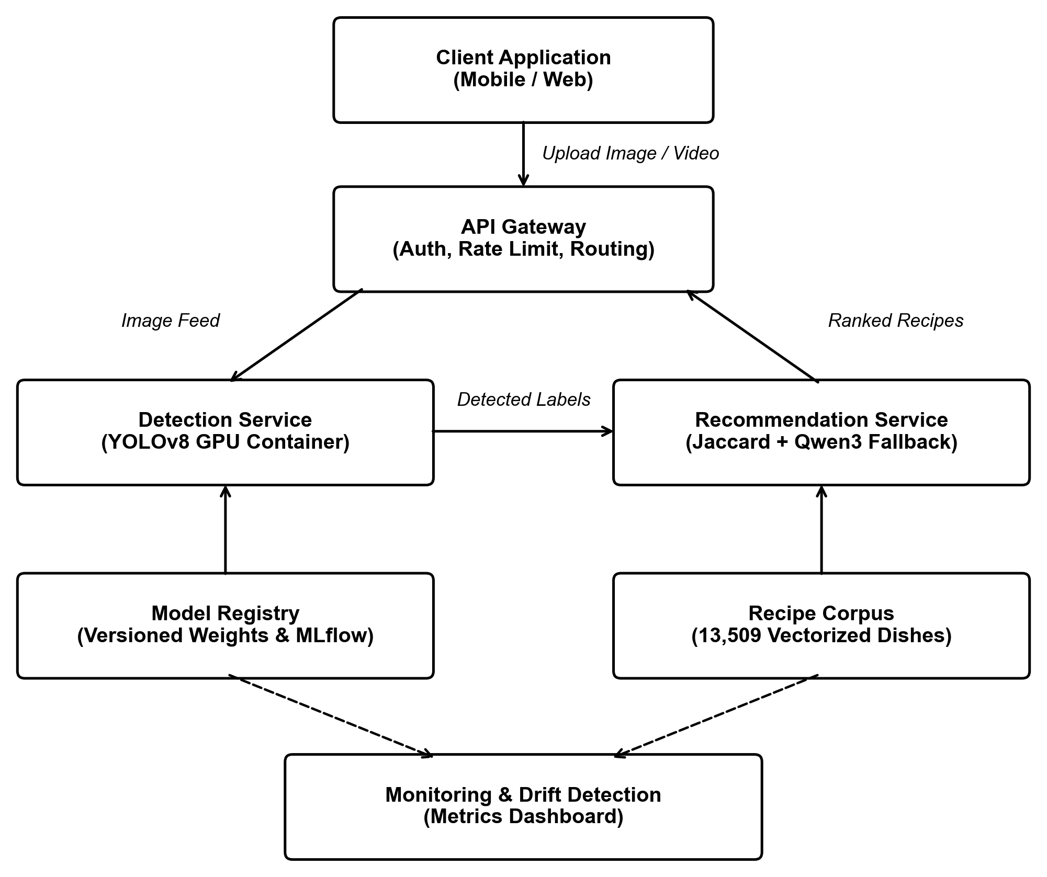
DEPLOYMENT & MLOPS
Deployment Architecture
17

Slide 18
LIVE WALKTHROUGH
Demo
18

Slide 19
WRAPPING UP
Conclusion and Future Impact
Project Accomplishments
Roadmap & Future Impact
End-to-end working app: upload a photo, detect ingredients, get ranked recipes.
YOLOv8s won the detection comparison — faster, more accurate, and the only model trained on the full dataset; deployed with tiled inference.
Jaccard beat the fine-tuned LLM: simpler, faster, and higher accuracy on every retrieval metric.
Expand the ingredient taxonomy (meats, dairy, grains) to unlock full recipe matching.
Close the small-object gap — recall on small items is 0.405 vs. 0.736 for large.
LLM fallback for edge cases: Qwen3 embeddings could handle regional synonyms (e.g. aubergine vs. eggplant) the taxonomy doesn’t yet cover.
19

Slide 20
Thank You
We will take questions at this time.
20

Slide 21
APPENDIX
References & Sources
GitHub repository with full source code and app deployment.
Ultralytics YOLOv8 documentation — docs.ultralytics.com
torchvision Faster R-CNN (fasterrcnn_resnet50_fpn_v2, fasterrcnn_mobilenet_v3_large_fpn) — pytorch.org/vision
Qwen3-Embedding-0.6B — Hugging Face Hub
FV40 and FOOD-INGREDIENTS datasets (Roboflow / COCO-format sources)
Epicurious and Spoonacular recipe data
TA Session 4 (Object Detection & Segmentation) — course-provided workshop notebook, YOLOv8 training conventions
21

Slide 22
APPENDIX
Abstract
This project builds an end-to-end pipeline that turns a photo of a kitchen counter into ranked recipe suggestions. Two problems are solved in sequence: object detection (identifying which ingredients are visible, and roughly how many) and retrieval (matching detected ingredients against a 13,509-recipe corpus). For detection, we compared YOLOv8s against a Faster R-CNN champion-challenger pair (ResNet-50 vs. MobileNetV3 backbones), training on a merged 27,193-image, 148-class dataset built from FV40 and FOOD-INGREDIENTS. YOLOv8s achieved mAP@50 = 0.247 on the full training set; for retrieval, a simple Jaccard keyword-matching baseline outperformed a fine-tuned Qwen3 embedding model across every metric tested (91.2% Hit Rate@1 vs. 90.6%), a finding that shaped our final deployment choice. The result is a working FastAPI-served pipeline: photo in, ranked recipes out.
22

Slide 23
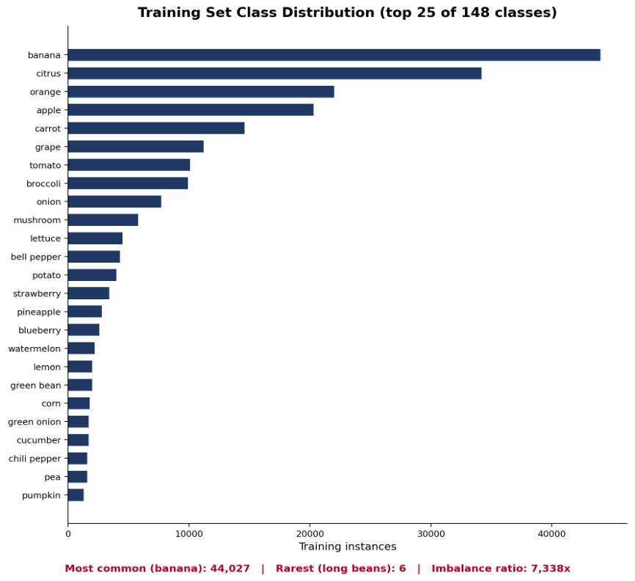
APPENDIX
Food Image Data: Full EDA
Schema, cleaning steps, and the top 25 of 148 training classes
Dataset | Format | Images | Boxes | Classes
FV40 | COCO | 17,459 | 282,794 | 62
FOOD-INGREDIENTS | YOLO | 9,734 | 22,843 | 120
Merged (unified) | — | 27,193 | 305,637 | 148
Unified class taxonomy across sources — resolved case differences and translated-name normalization, reviewed manually before merge.
Fixed split leakage: 8.8% of FOOD-INGREDIENTS photos had augmented copies scattered across splits; reassigned by majority vote to a single split.
Built a fresh stratified 80/10/10 split for FV40, which had none originally.
23

Slide 24
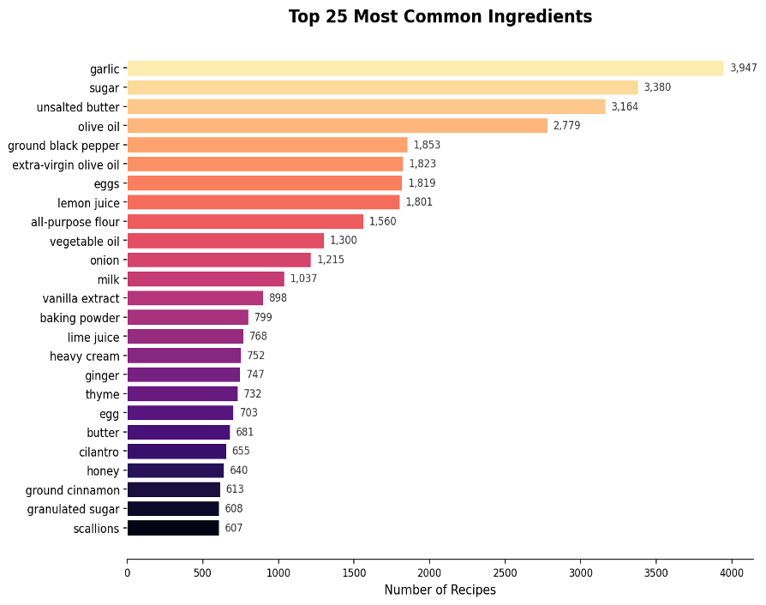
APPENDIX
Recipe Data: EDA
13,509 recipes merged from Epicurious & Spoonacular
Metric | Value
Total recipes | 13,509
Unique dish names | 13,319
Avg / median ingredients | 10.6 / 10
Std dev / min / max ingredients | 4.8 / 0 / 51
Missing / unparseable lists | 7 recipes (0.05%)
24

Slide 25
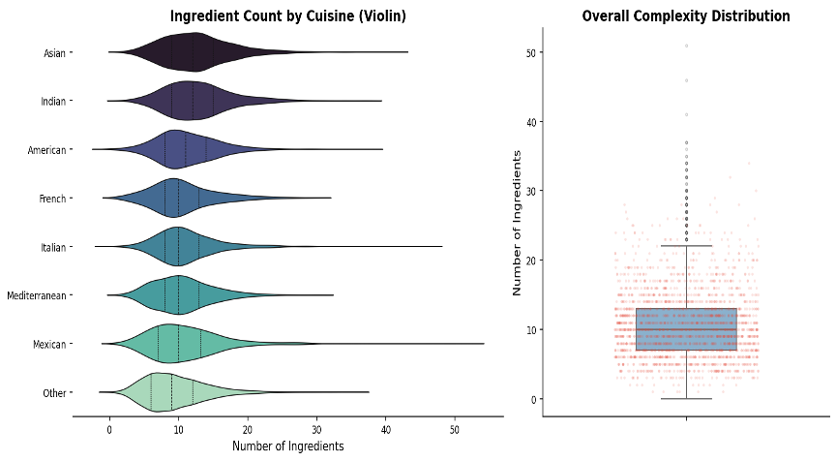
APPENDIX
Recipe Data: Ingredient Co-occurrence & Complexity
8–15
Univariate / violin analysis: most recipes use 8–15 ingredients, with a heavy right tail toward complex dishes.
ingredients per recipe, typical range
25

Slide 26
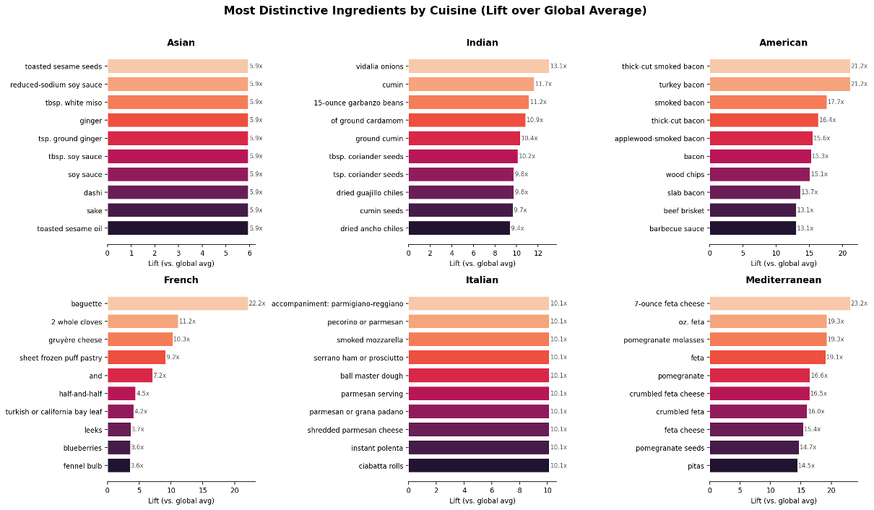
APPENDIX
Recipe Data: Bivariate Analysis
Bivariate relationship between recipe complexity and cuisine / rating variables, explored to understand what drives multi-ingredient dishes.
26

Slide 27
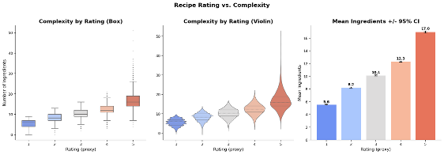
APPENDIX
Recipe Data: Bivariate Analysis (Cuisine & Rating)
21x
23x
5.6 → 17.0
Bacon vs. average — American cuisine signature ingredient
Feta vs. average — Mediterranean cuisine signature ingredient
Avg. ingredients, rating 1 → rating 5
Lift measures how much more often an ingredient appears in a cuisine vs. the global average.
Rating (proxy) vs. complexity shows a strong positive relationship — more ingredients, higher rating.
27

Slide 28
APPENDIX
Problem 1: YOLOv8 Full Results
Metric | Value
mAP@50 | 0.247
mAP@50-95 | 0.146
Precision | 0.440
Recall | 0.277
Model / epochs | YOLOv8s, 30 epochs
Config | conf=0.25, iou=0.45, patience=10
Evaluated classes | 102 of 148 (46 had zero test instances)
YOLOv8 is a single-stage, anchor-free detector: predicts boxes and classes in one pass, favoring inference speed over the region-proposal precision of two-stage detectors. Well suited to a live, counter-photo app experience.
28

Slide 29
APPENDIX
Problem 1: Faster R-CNN Backbone Comparison
ResNet-50 FPN v2 vs. MobileNetV3-Large FPN, everything else held constant
ResNet-50
MobileNetV3
MAP@50
MAP@50
0.277
0.232
MAP@50-95
MAP@50-95
0.136
0.122
LATENCY
LATENCY
34.7 img/s
40.1 img/s
PARAMS
PARAMS
43.7M
19.4M
29

Slide 30
APPENDIX
Faster R-CNN: Methodology Notes & Limits
What this comparison establishes, and what it doesn’t
Held constant across both arms: same 7,578-image stratified training subset, splits, taxonomy, seed, resolution, batch size, LR, optimizer, schedule, class-balanced sampler, and augmentation.
Not tuned per-backbone: learning rate was shared rather than individually tuned — the cleaner control for isolating “which backbone,” at the cost of neither number being that backbone’s best achievable result.
Scope: this uses a 30% stratified subset, not the full dataset YOLOv8 trained on — absolute mAP isn’t directly comparable to the YOLO numbers, though ResNet-50 vs. MobileNet is valid.
Latency measured single-stream on one GPU class; MobileNet’s speed advantage is typically larger on CPU/edge hardware, not captured here.
30

Slide 31
APPENDIX
Problem 1: YOLOv8 vs. Faster R-CNN Head-to-Head
Metric | YOLOv8s | Faster R-CNN (ResNet-50)
mAP@50 | 0.247 | 0.277
mAP@50-95 | 0.146 | 0.136
Training data | Full ~23K images | 7,578-image subset
Architecture | Single-stage, anchor-free | Two-stage (region proposal + classify)
Design intent | Speed-optimized | Accuracy-oriented baseline
Caveat: mAP@50-95 (the stricter, standard benchmark metric) is close between the two despite the data-volume gap — not a clean “winner,” a genuine architecture/data-budget tradeoff.
31

Slide 32
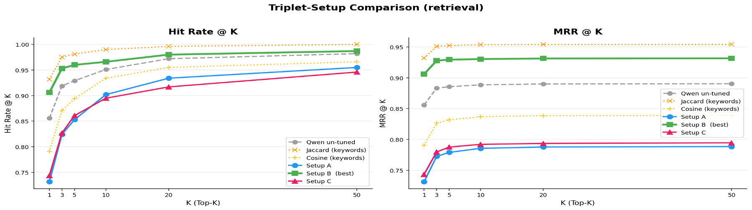
APPENDIX
Problem 2: Jaccard vs. Qwen Embeddings
Four fine-tuning triplet setups vs. a keyword-matching baseline
Model | HR@1 | MRR@1 | HR@50
Jaccard (keyword) | 93.3% | 0.933 | 100.0%
Qwen, un-tuned | 85.6% | 0.856 | 98.2%
Setup B (ingr→ingr, best tuned) | 90.6% | 0.906 | 98.7%
Setup C (dish→dish name) | 74.3% | 0.743 | 94.6%
Setup A (dish→ingr) | 73.1% | 0.731 | 95.5%
32

Slide 33
APPENDIX
Problem 2: Finding & Algorithm Analysis
Key finding: simple keyword matching beat every embedding variant, tuned or not, at every K.
Jaccard Similarity
Qwen3 Embeddings
PROS
PROS
Fast, deterministic, no training required — naturally suited to set overlap between ingredient lists.
Can in principle capture semantic and synonym relationships Jaccard can’t.
CONS
CONS
No semantic understanding — can’t match “scallion” to “green onion” unless literally the same token.
Underperformed the simpler baseline across all four triplet strategies tested — semantic capacity wasn’t the limiting factor.
33

Slide 34
APPENDIX
Model Operations
Deployment mechanism and maintenance plan
Deployment
Maintenance
YOLOv8 exported to ONNX (dynamic input shape) for framework-agnostic serving.
Detected ingredient labels feed a Jaccard retrieval engine against the 13,509-recipe corpus.
Served via a FastAPI endpoint: image in, ranked recipe list out.
Checkpoint-and-resume training pipeline: every epoch’s weights persist to durable storage, so retraining resumes rather than restarts.
Per-class AP monitoring flags exactly which ingredient classes need more training data.
Sample-size toggle allows fast validation of any pipeline change before a full retrain.
34

Slide 35
APPENDIX
Conclusion: Limitations & Future Work
Limitations
Future Work
Severe class imbalance: 7,338x gap between the most and least common classes (banana vs. long beans).
46 of 148 classes have zero test-set instances — a consequence of non-class-stratified splitting.
Dataset skews heavily toward produce; protein and spice classes lack sufficient training examples.
YOLOv8 (full dataset) and Faster R-CNN (stratified subset) aren’t trained on identical data volumes.
Class-stratified splitting to guarantee test coverage across all classes.
Targeted data collection for underrepresented protein/spice/staple classes.
35

