Slide 1
Sample code of Angular Framework
-- Li Li 11/7/2019

Slide 2
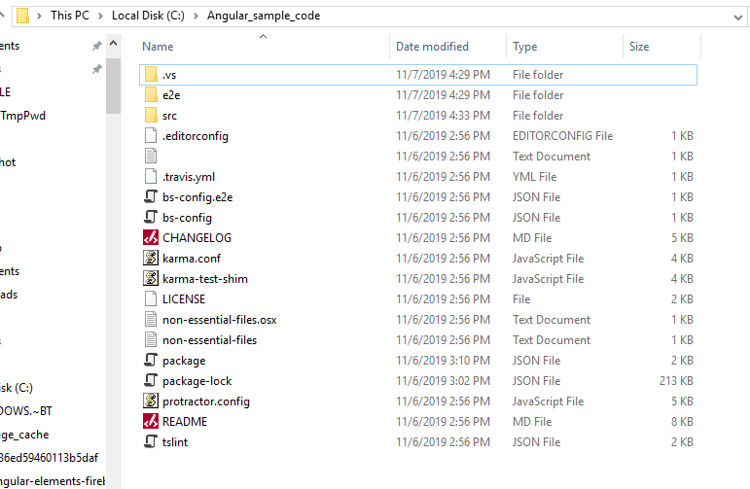
Configuration:
Download the Angular_sample_code.zip package and unzip to local folder.
Go to C:\Angular_sample_code and launch the command prompt.

Slide 3
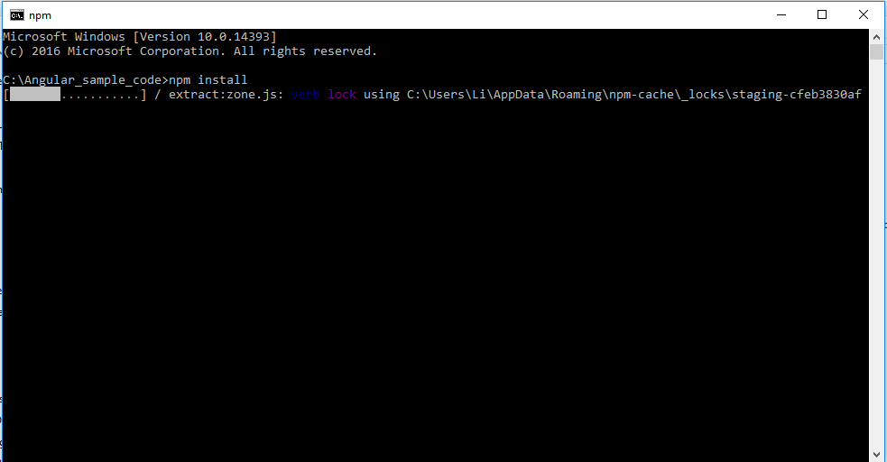
3. Type command: npm install

Slide 4
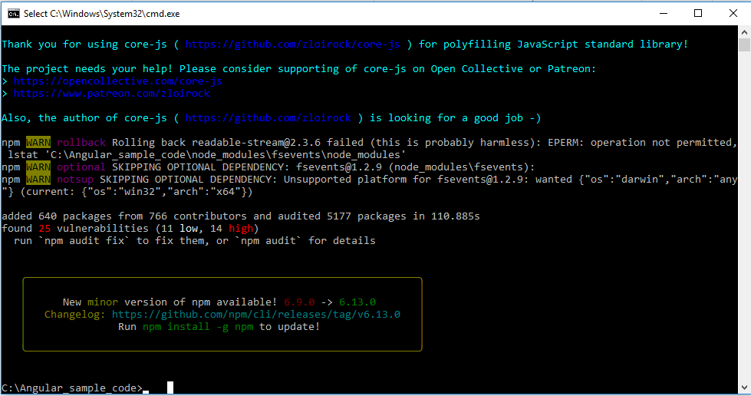
4.Run command: npm audit fix

Slide 5
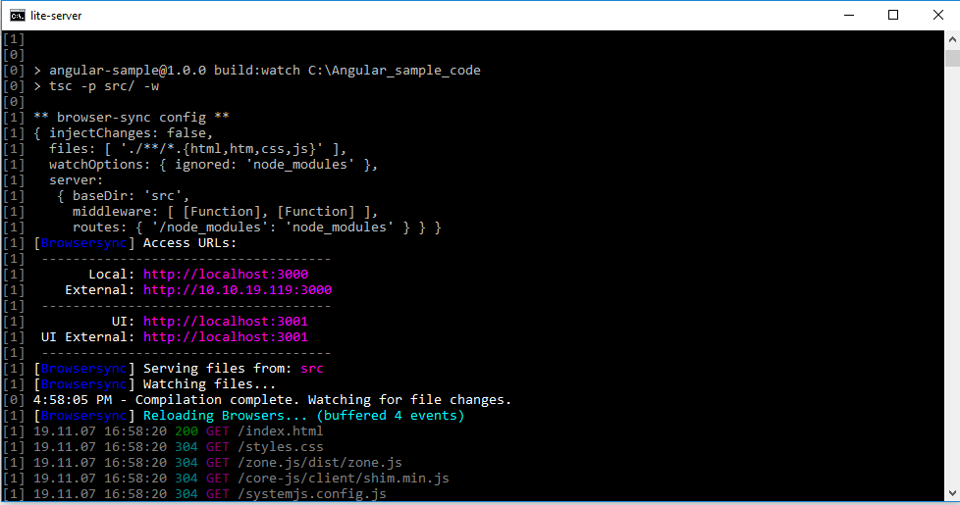
5. Run command: npm start, then launch the website by http://localhost:3000 in google chrome browser.

Slide 6
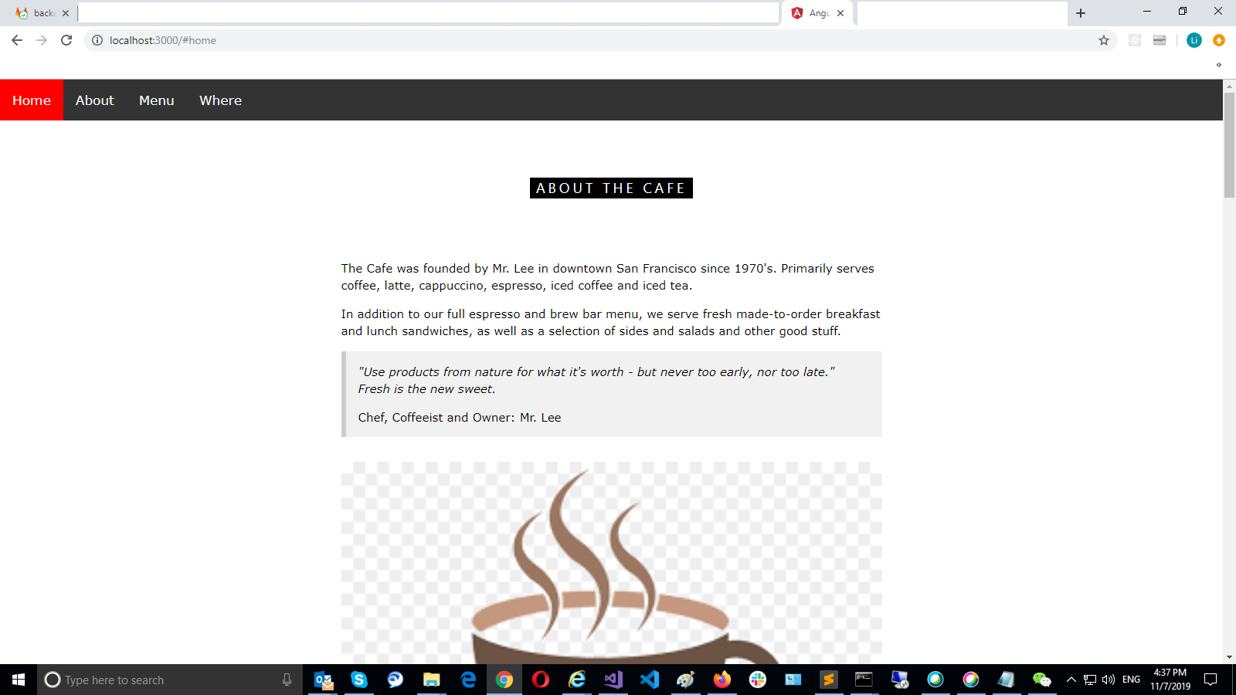

Slide 7


Slide 8
