Slide 1

Evangelia Maragkou Ntinti

Slide 2

About me
Evangelia (Lily) Maragkou Ntinti,
BSc Physics
MSc Computational Physics
Integration Development
Cloud services

Slide 3
Contents
Database creation on AWS
Testing the database
Building the API calls on Postman
EC2 Instances
Connecting to EC2 Instances
S3 Bucket
Deploying the project on EC2 Instances
Load Balancer
Suggestions for improvement

Slide 4

Database creation on AWS
pfizersacchondb
SQL Server Express Edition
us-east-2

Slide 5
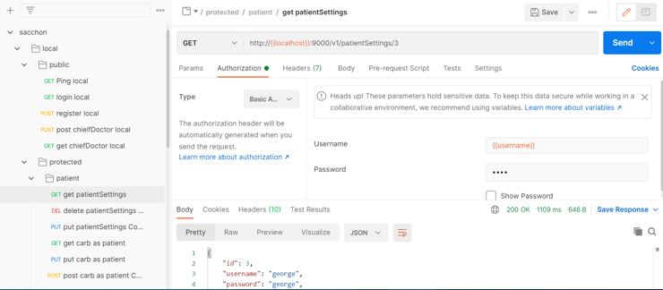
Testing the database
Update code according to db configuration
Deploy project
Test db connection locally
Populate the tables with data
Create Postman collection

Slide 6
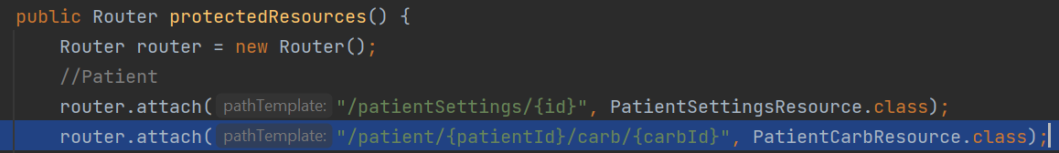
Building the API calls on Postman
Endpoints – CustomRouter class
Methods & authentication – resource classes
Request body – representation classes

Slide 7
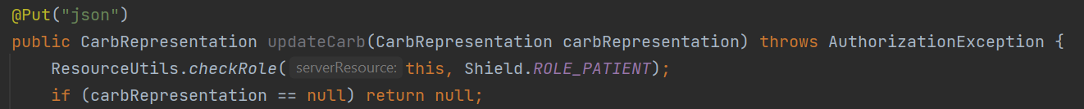
Building the API calls on Postman
Endpoints – CustomRouter class
Methods & authentication – resource classes
Request body – representation classes

Slide 8
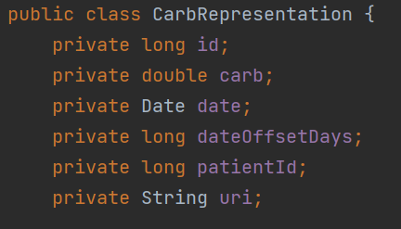
Building the API calls on Postman
Endpoints – CustomRouter class
Methods & authentication – resource classes
Request body – representation classes

Slide 9

EC2 Instances
Characteristics
Amazon Linux / Ubuntu
us-east-2
List of instances
http://ec2-3-141-5-248.us-east-2.compute.amazonaws.com:9000/v1/ping
http://ec2-3-142-97-210.us-east-2.compute.amazonaws.com:9000/v1/ping
http://ec2-3-141-106-21.us-east-2.compute.amazonaws.com:9000/v1/ping

Slide 10

Connecting to EC2 Instances
First method
Locally
SSH client
AWS key pairs
Second method
AWS Console
Access jar file
S3 Bucket

Slide 11
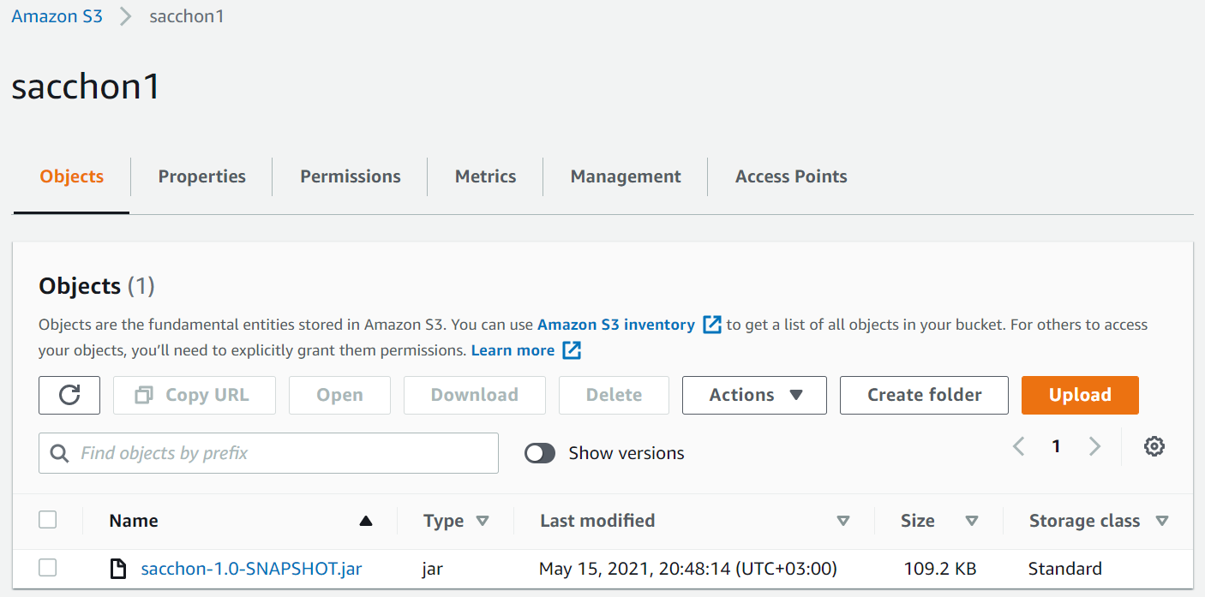

S3 Bucket

Slide 12
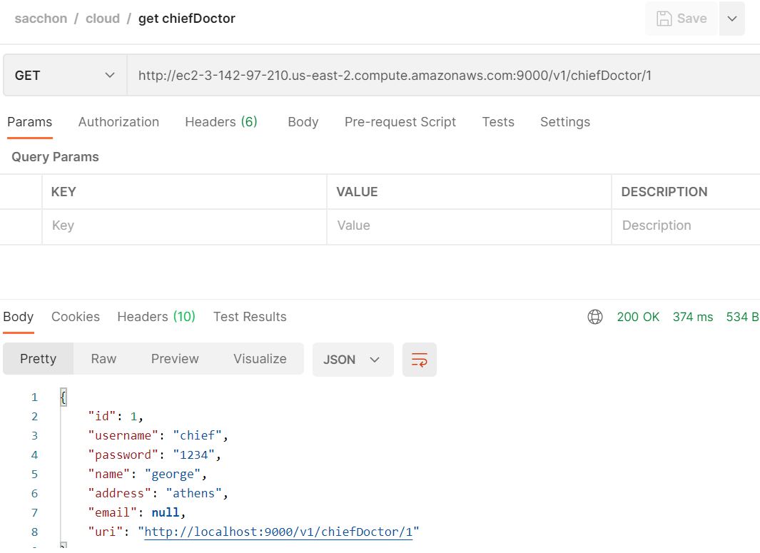
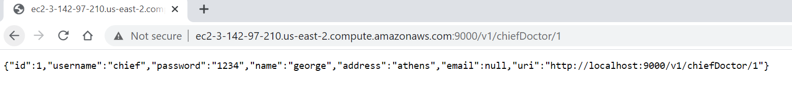
Deploying the project on EC2 Instances

Slide 13
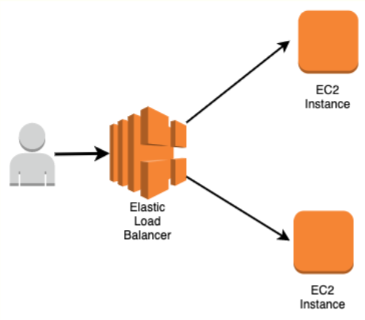
Load Balancer
Split traffic
Register targets
Health checks
http://sacchon-726d3dc3d938b2bd.elb.us-east-2.amazonaws.com:9000/v1/ping

Slide 14
Suggestions for improvement
Name validation upon doctor / patient registration
Password validation
Error handling

Slide 15

Thank you for your time

Slide 16
Backup slides

Slide 17
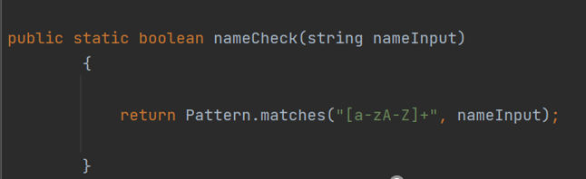
Suggestions for improvement
Name validation upon doctor / patient registration

Slide 18
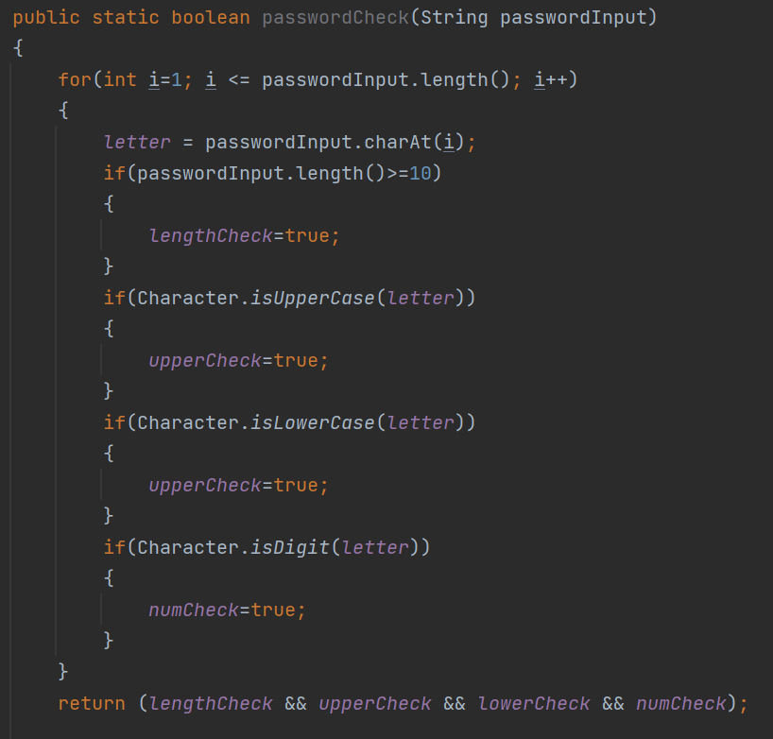
Suggestions for improvement
Username validation
assuring that the user sets
a strong password

Slide 19
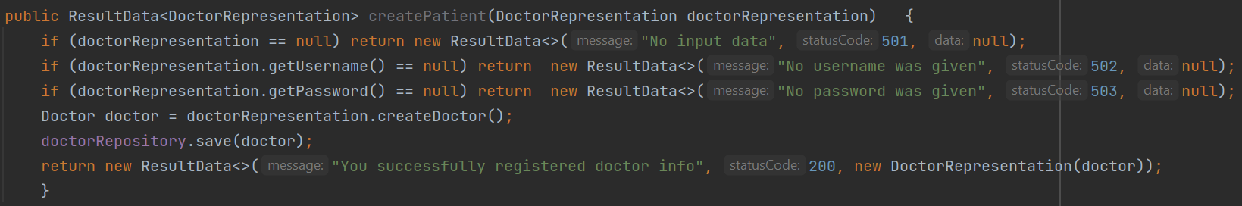
Suggestions for improvement
Error handling
Produce an error message in case of null input

