Slide 1
Managing With Analytics IPM652

Slide 2
Used Cars
- Lily Sunil karmakar

Slide 3
Overview
Introduction-George
Data- Karthik
Methodology-Karthik
Findings- George
Recommendations-Mason
Ethical Considerations-Ashley
Conclusion-Lily

Slide 4
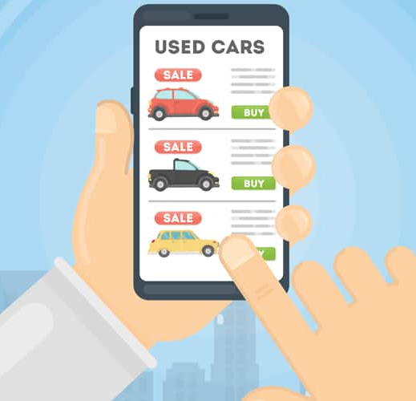

Introduction
Kaggle – Craigslist used car listing data pull
Analysis is from the seller's perspective.
Recommendations are focused towards Carvana

Slide 5
Data & Methodology
The data was scraped from craigslist by a Kaggle user in two-month intervals from October 2018 to March 2020.
The dataset contains every used car listed on craigslist in the United States in that time period.
The unclean data contained 25 columns of car descriptions (listing price, odometer readings, make, model, manufacture year, geographic latitude and longitude etc.) for nearly 10 million car listings.
Unnecessary columns such as – craigslist urls, VIN numbers, etc, were removed
Listings with incomplete dimension descriptions were removed.

Slide 6
Data & Methodology
The unclean data was filtered to match Carvana's listing criteria. Cars with more than 100,000 odometer miles, cars which were manufactured before year 2000 and cars with salvage/rebuilt titles were removed from the dataset.
All the cleansing mentioned above bought the size of the dataset from 1.1GB to around 100 MB.
The data was then analyzed in tableau to form recommendations for the target company.

Slide 7
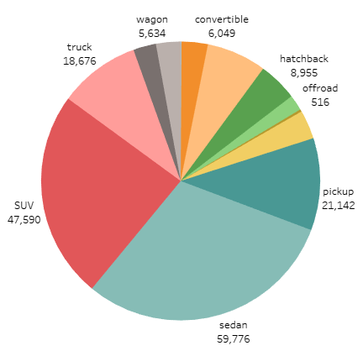
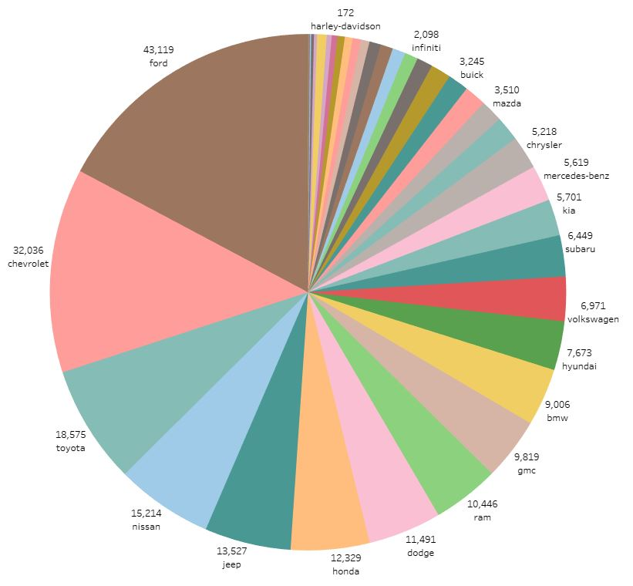
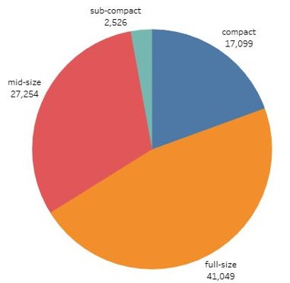
Our Findings – Popularity
Type
Size
Manufacturer

Slide 8
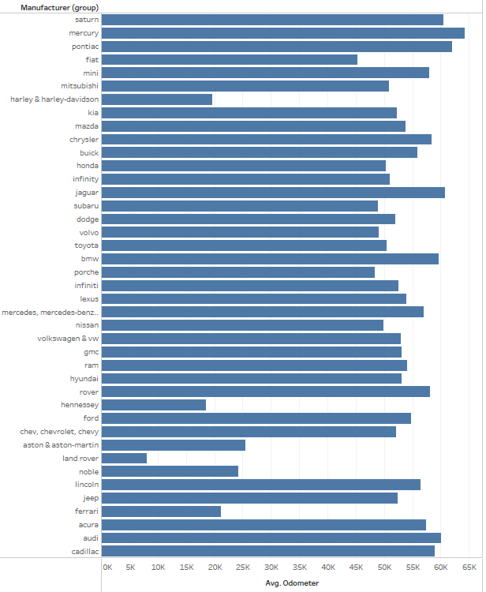
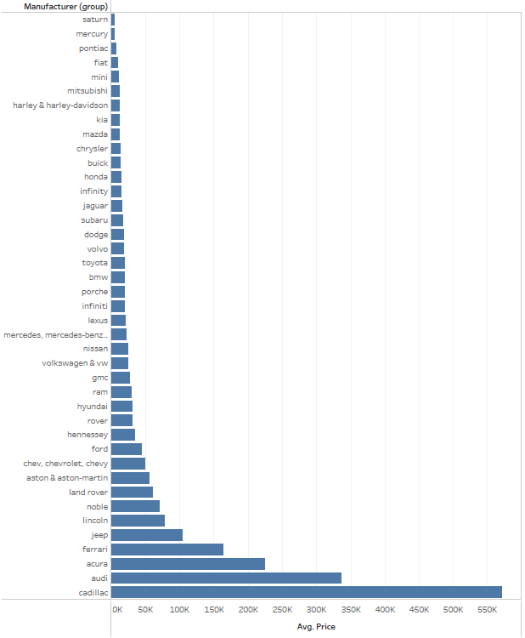

Slide 9
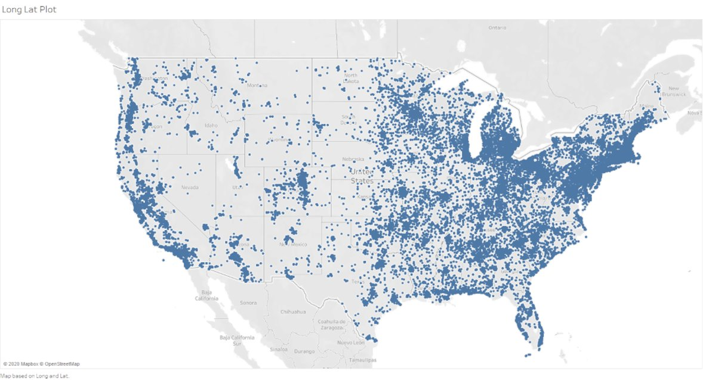
Our Findings – US Listings

Slide 10
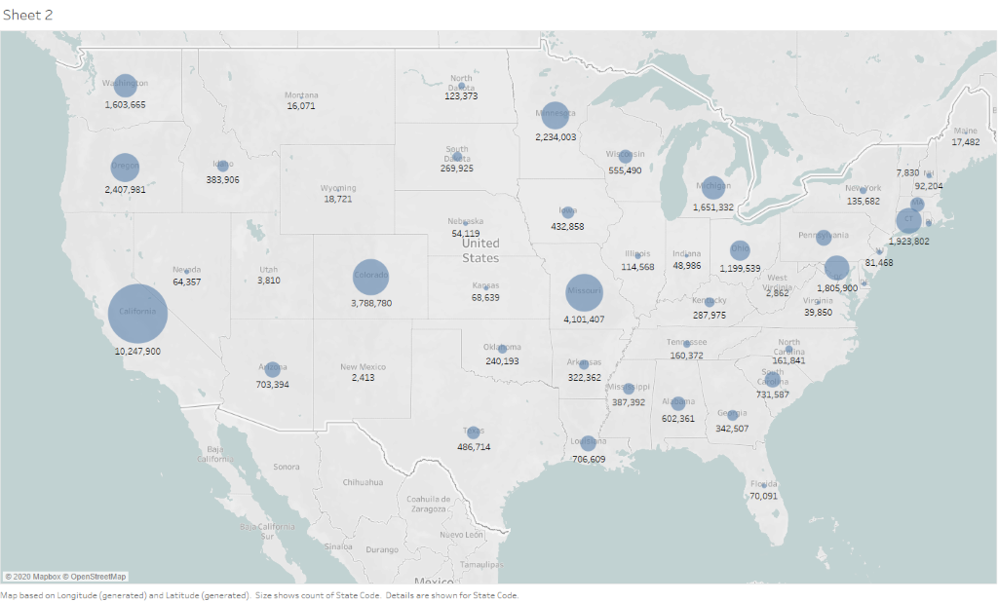
Our Findings – US Listings​
1 Million +:
CA
CO
MO
MD
MN
OH
WA
OR
MI

Slide 11




Operations recommendations
Local Partner-Maximize Customer experience
Partner with local dealership and mechanics for vehicle inspection and delivery
The customer could drop the vehicle at a partnering dealership for instant cash offer
Enable a "drop off- inspect- go" car shopping procedure for trade in customer

Slide 12
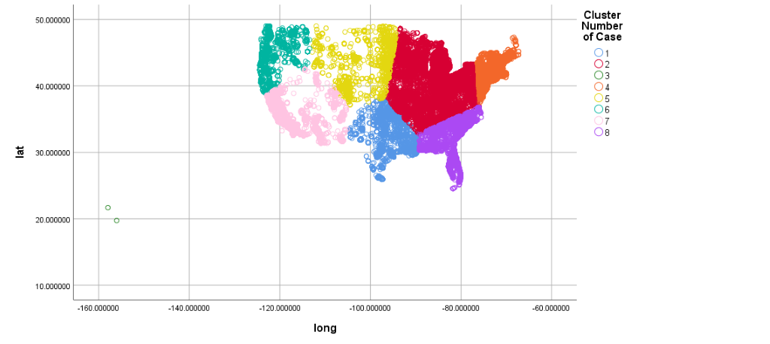
Operations recommendations Operation districts- Minimizing transportation cost
District Number | Percent of Cars | Regions Included
1 | 2% | TX, OK, LA, KS
2 | 17% | Midwest, VA, West PA, South state NY
3 | 12% | ME, VT, NH, MA, CT, RI, NJ, NYC and Up State NY, DE, East PA
4 | 10% | MT, ND, SD, West WI, NE, CO, WY
5 | 14% | WA, OR, ID, North CA
6 | 34% | South CA, AZ, NM, UT
7 | 12% | NC, SC, GA, AL, FL

Slide 13
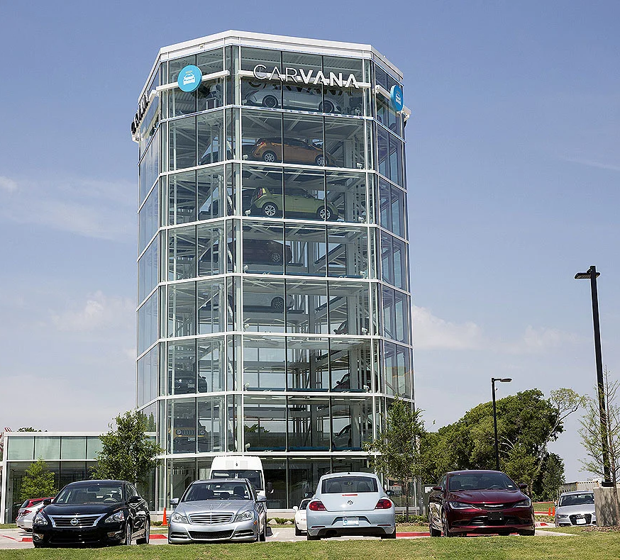
Advertising/Marketing recommendations Offline advertising
Place car vending machine or billboard in major highway in CA, CO, MO, MD, MN, OH, WA, OR

Slide 14
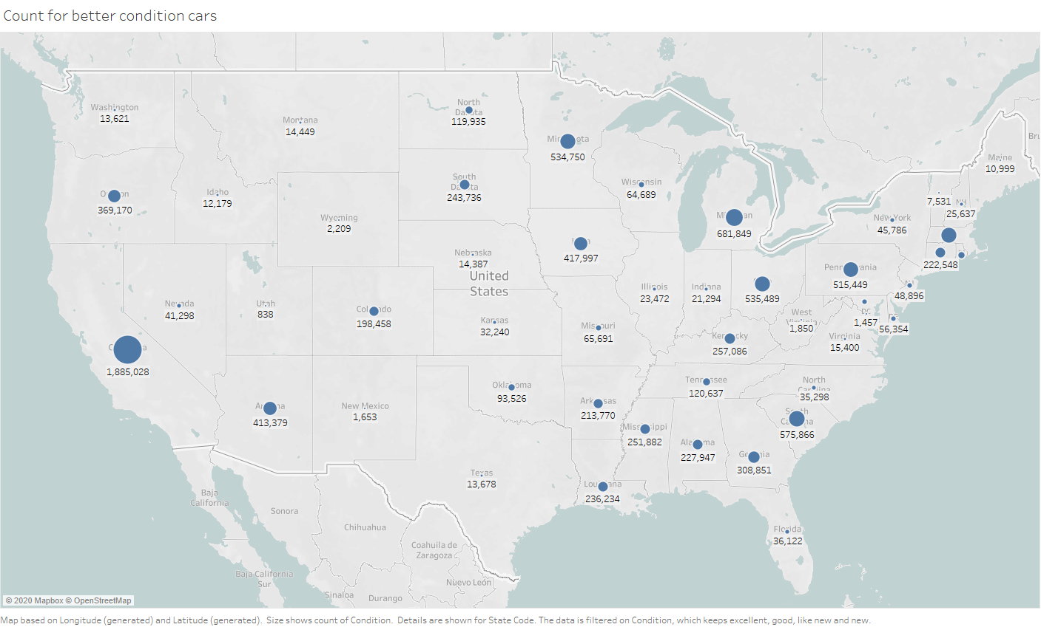
Advertising/Marketing recommendations Online advertising
Draft "We will buy your car" email campaign to select sellers
Manufacturer: Ford, Chevy, Toyota and Honda
Type: Sedan, SUV, Pickup
Tittle: Clean, Lien
Color: Black, White, Gray
State: CA,MI SC,MA,OH,MN,PA
They are more likely to have car in better(as new, excellent, very good) conditions and their car could be easier to sell

Slide 15
Ethics
Potential for privacy issues
Potential for discrimination
Manufacturers
Customers
Location
Reliability
Sourcing

Slide 16
Conclusion
Used car data set and factors and its importance
Manufacturers Ford, Chevy, Toyota or Honda.
Color – Black, White, Gray
Odometers – Low Mileage
Recommend to add more factors like Hybrid and Electric car options
Discount provisions -Negotiation
Improve the accuracy of choice

Slide 17
Questions

