Slide 1
Top 10 populated countries
CAPSTONE PROJECT
Presented By:
Lily Rajan K
9513- Jayaraj Annapackiam CSI College of Engineering
B.E Mechanical Engineering

Slide 2
OUTLINE
Problem Statement
Proposed System/Solution
System Development Approach
Algorithm & Deployment
Result
Conclusion
Future Scope
References

Slide 3
Problem Statement
The Titanic disaster, one of the most infamous maritime tragedies in history, occurred on April 15, 1912, when the RMS Titanic, a British passenger liner, struck an iceberg during its maiden voyage from Southampton to New York City. The collision resulted in the sinking of the Titanic, leading to the deaths of over 1,500 passengers and crew.
The problem statement surrounding the Titanic disaster typically involves analyzing various aspects of the event, such as:
Survival prediction: Using machine learning techniques to predict which passengers were likely to survive based on factors such as age, sex, passenger class, and presence of family members.
Demographic analysis: Examining the demographics of the passengers aboard the Titanic, including age, gender, socio-economic status, and how these factors influenced survival rates.
Impact of passenger class: Investigating the correlation between passenger class (first, second, or third class) and survival rates, considering factors such as access to lifeboats and priority during evacuation.
Family relationships: Exploring how the presence of family members affected the likelihood of survival, such as whether traveling with a spouse, parent, or child increased the chances of survival.
Crew survival: Analyzing the survival rates among the crew members of the Titanic and identifying any factors that may have influenced their chances of survival.

Slide 4
Proposed Solution
While the Titanic disaster cannot be undone, several proposed solutions have emerged over the years to address the issues that contributed to the tragedy and improve maritime safety. Here are some potential solutions based on the lessons learned from the Titanic disaster:
Improved Ship Design:
Enhance hull construction and compartmentalization to make ships more resilient to damage.
Implement stricter standards for watertight compartments and bulkhead design to prevent flooding in the event of a breach.
Advanced Navigation Technology:
Develop and deploy more sophisticated navigation systems to detect hazards such as icebergs and other vessels at greater distances.
Integrate real-time weather monitoring and forecasting capabilities to assist in route planning and hazard avoidance.
Enhanced Safety Measures:
Mandate the installation of sufficient lifeboats and life rafts on all passenger ships, ensuring that there are enough for all passengers and crew.
Require regular and comprehensive lifeboat drills and crew training to improve readiness and response during emergencies.

Slide 5
System Approach
A system approach to the Titanic disaster involves examining the event from a holistic perspective, considering various interconnected components and their interactions. Here's how you could approach it:
System Identification
System Boundaries
Inputs and Outputs
Interactions and Relationships
Feedback Loops
Complexity and Emergent Properties
System Dynamics and Resilience

Slide 6
Algorithm & Deployment
Deploying an algorithm related to the Titanic disaster could involve creating a predictive model to estimate the likelihood of survival for passengers based on various factors such as age, gender, passenger class, and presence of family members. Here's a step-by-step guide to deploying such an algorithm:
Data Collection and Preprocessing:
Gather a dataset containing information about Titanic passengers, including features such as age, gender, passenger class, number of and whether they survived or not.
Preprocess the data by handling missing values, encoding categorical variables, and scaling numerical features as necessary.
Deployment:
Choose a deployment environment for the algorithm, such as a web application, mobile app, or cloud-based service.
Implement the algorithm into the chosen environment, ensuring compatibility with the programming languages and frameworks used for deployment.
Testing and Validation:
Conduct thorough testing of the deployed algorithm to verify its functionality, performance, and reliability under different scenarios and inputs.
Validate the algorithm's predictions against known outcomes from the Titanic dataset to ensure consistency and accuracy.

Slide 7
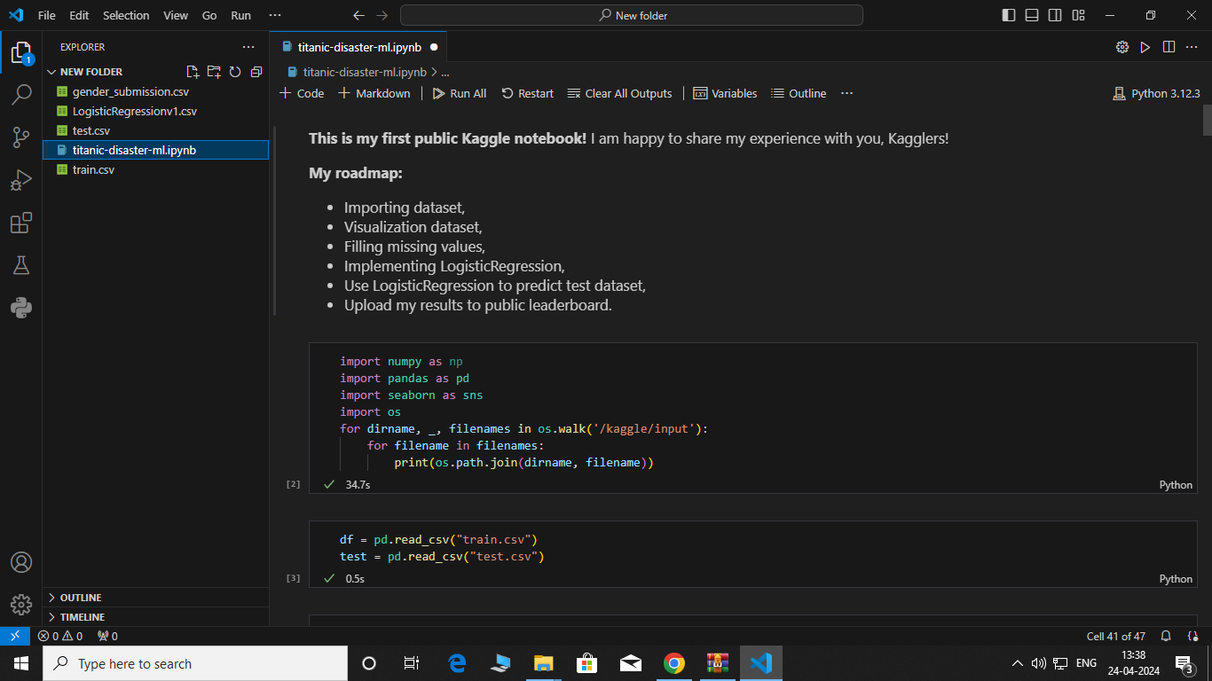
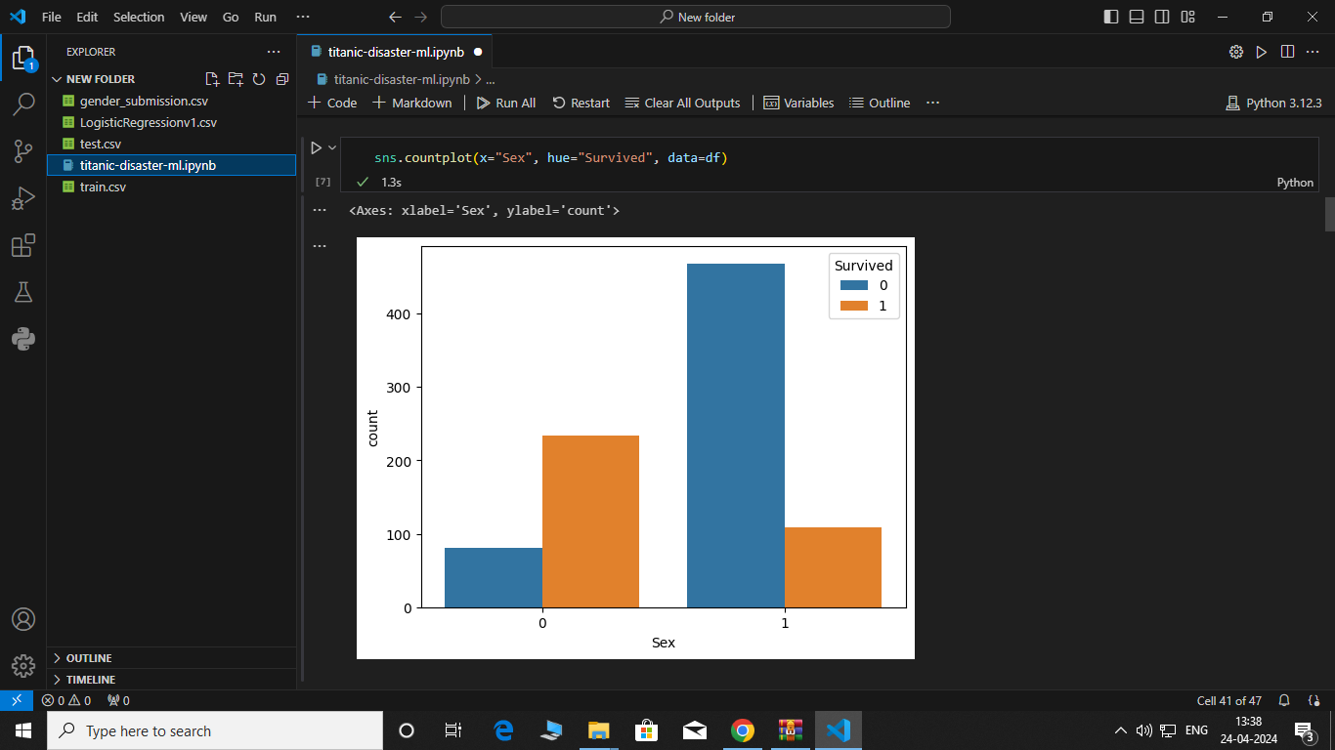
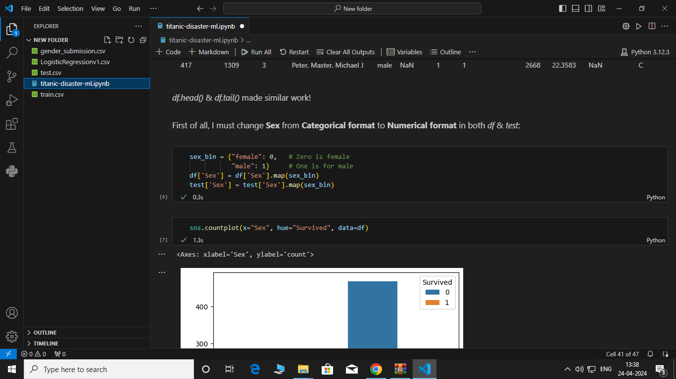
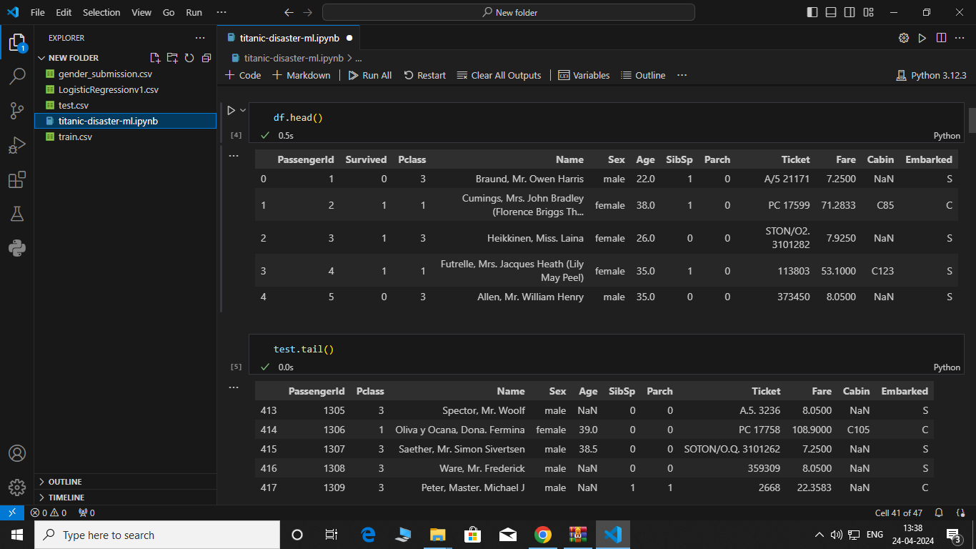
Result

Slide 8
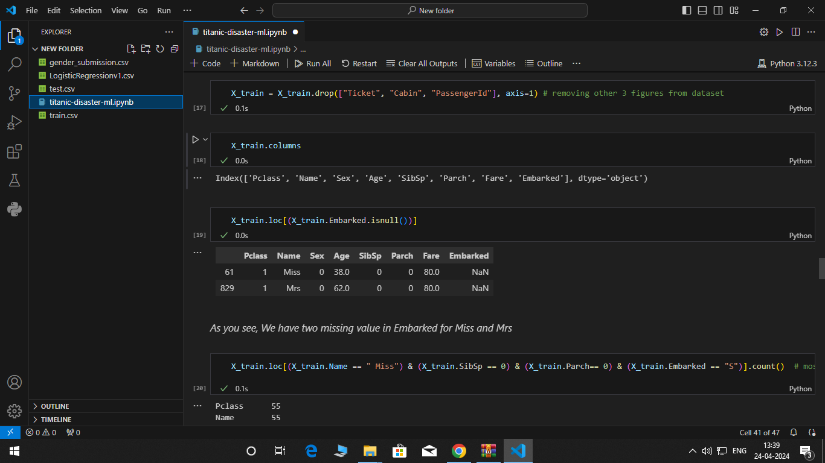
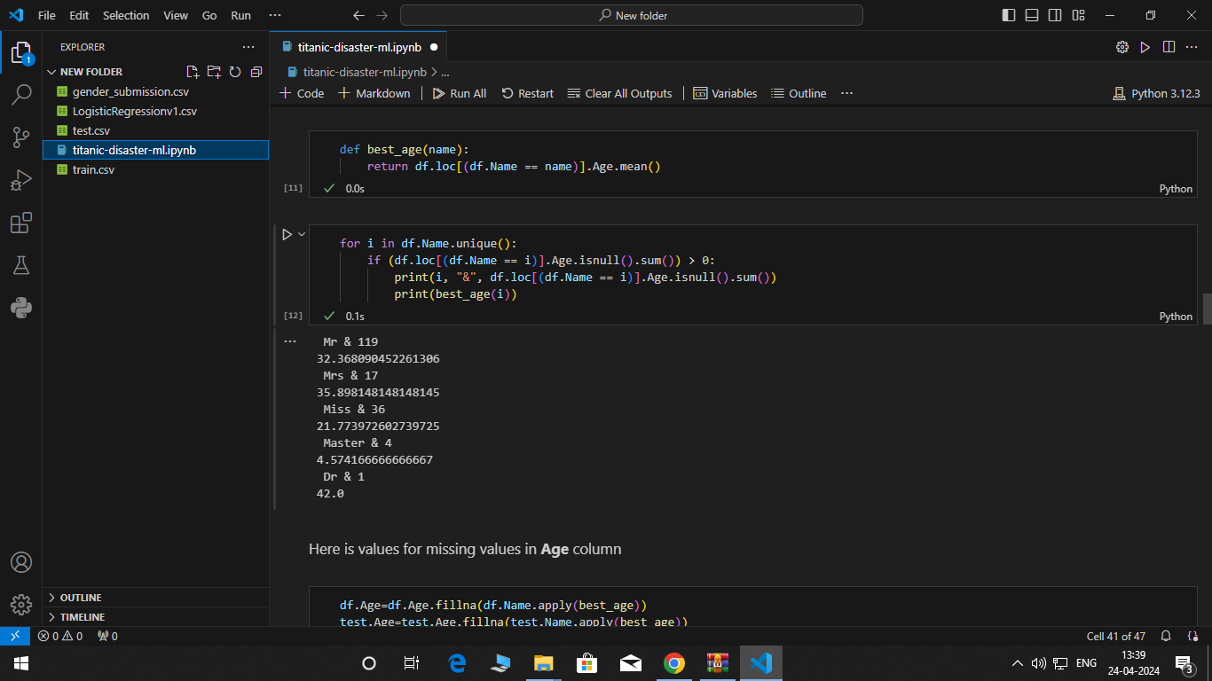
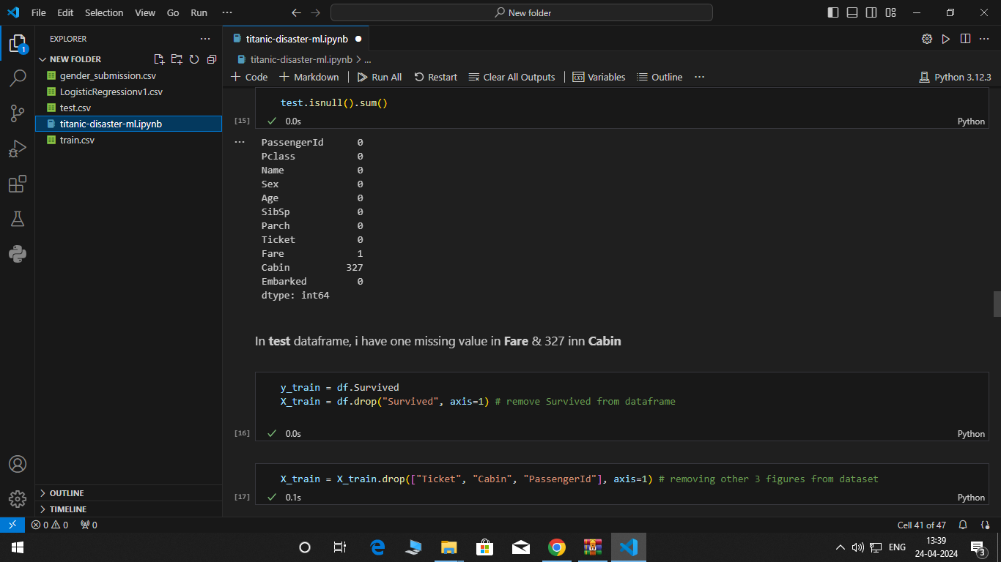
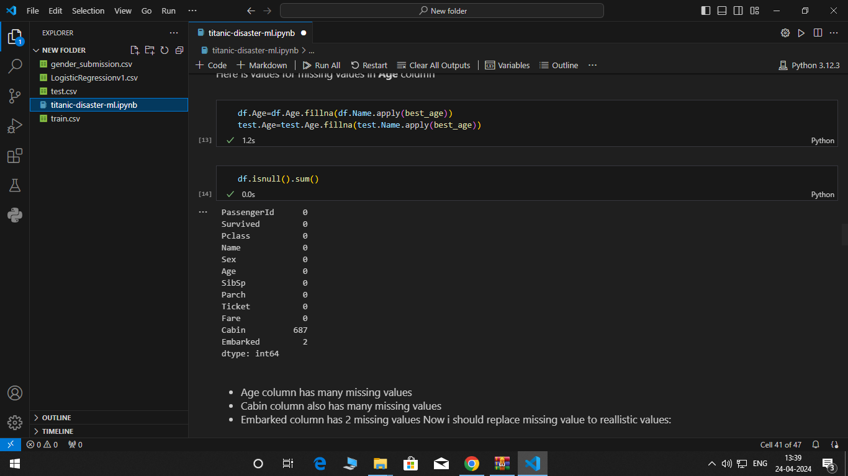
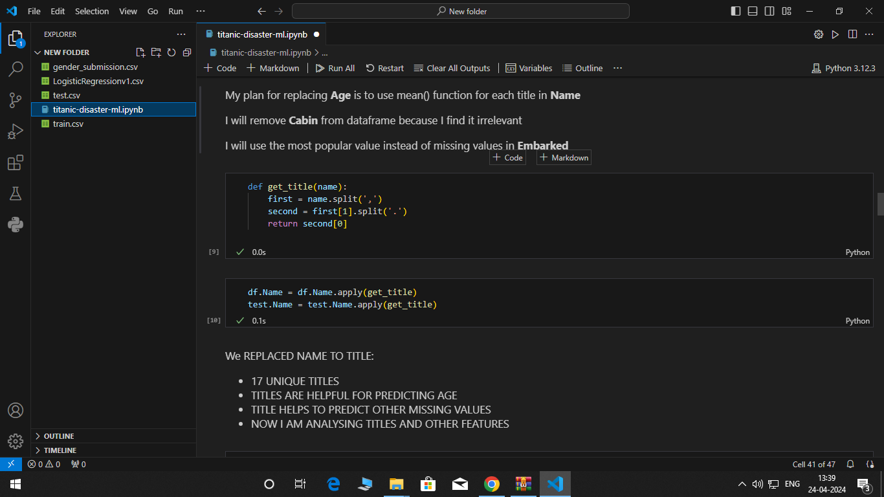
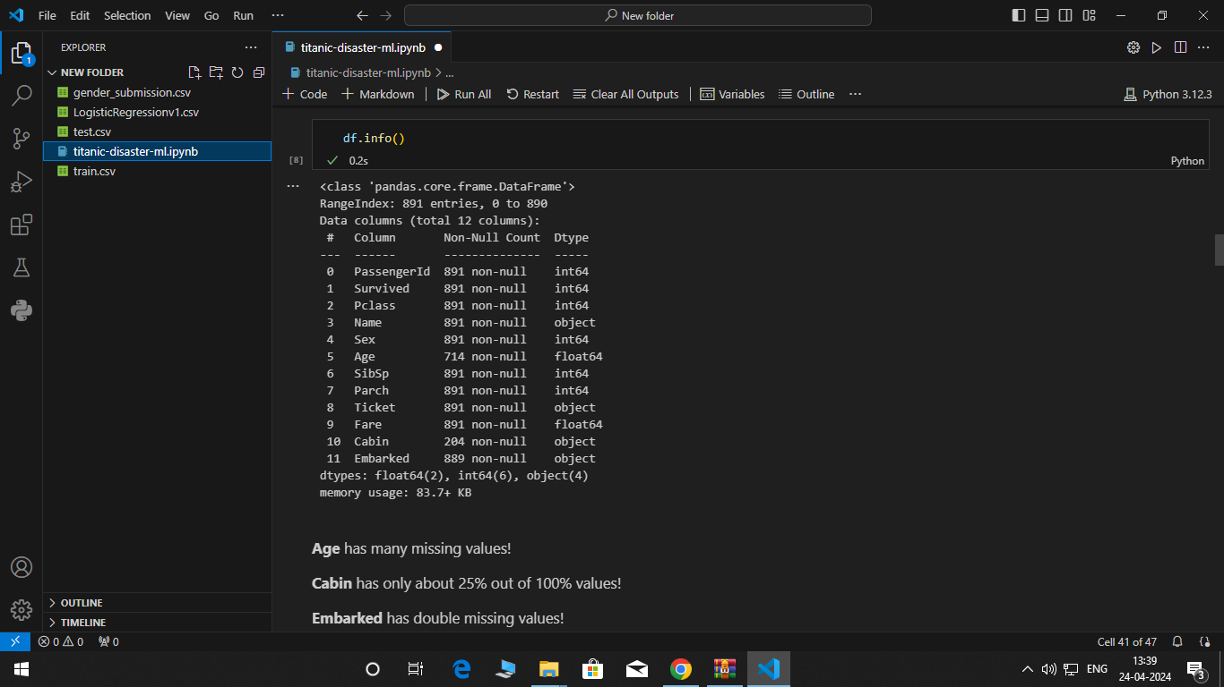

Slide 9
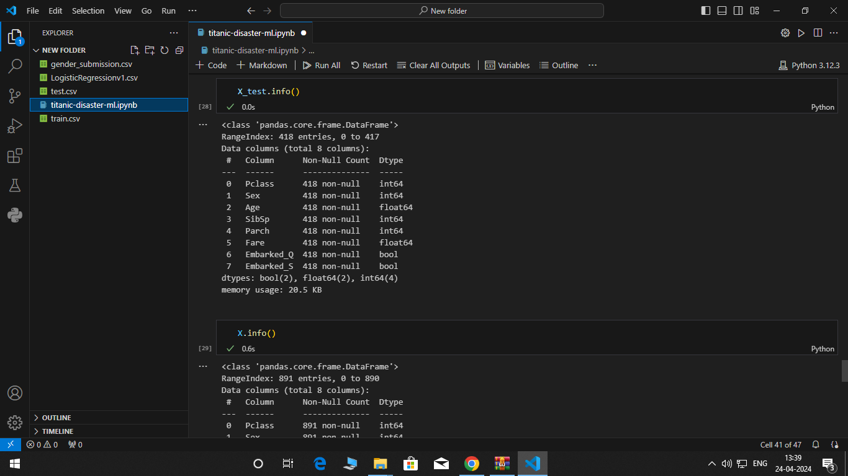
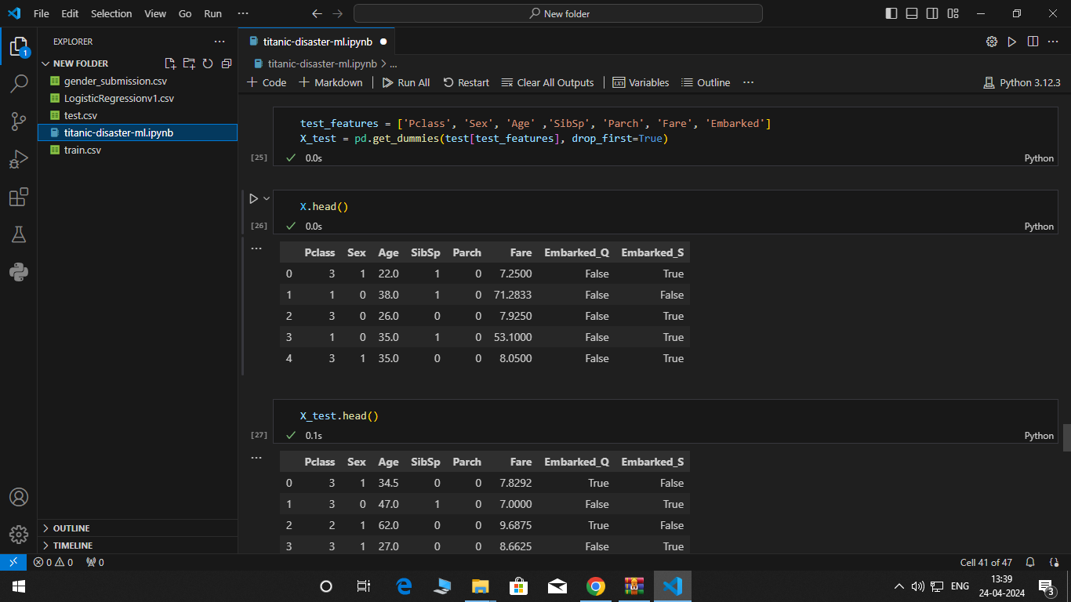
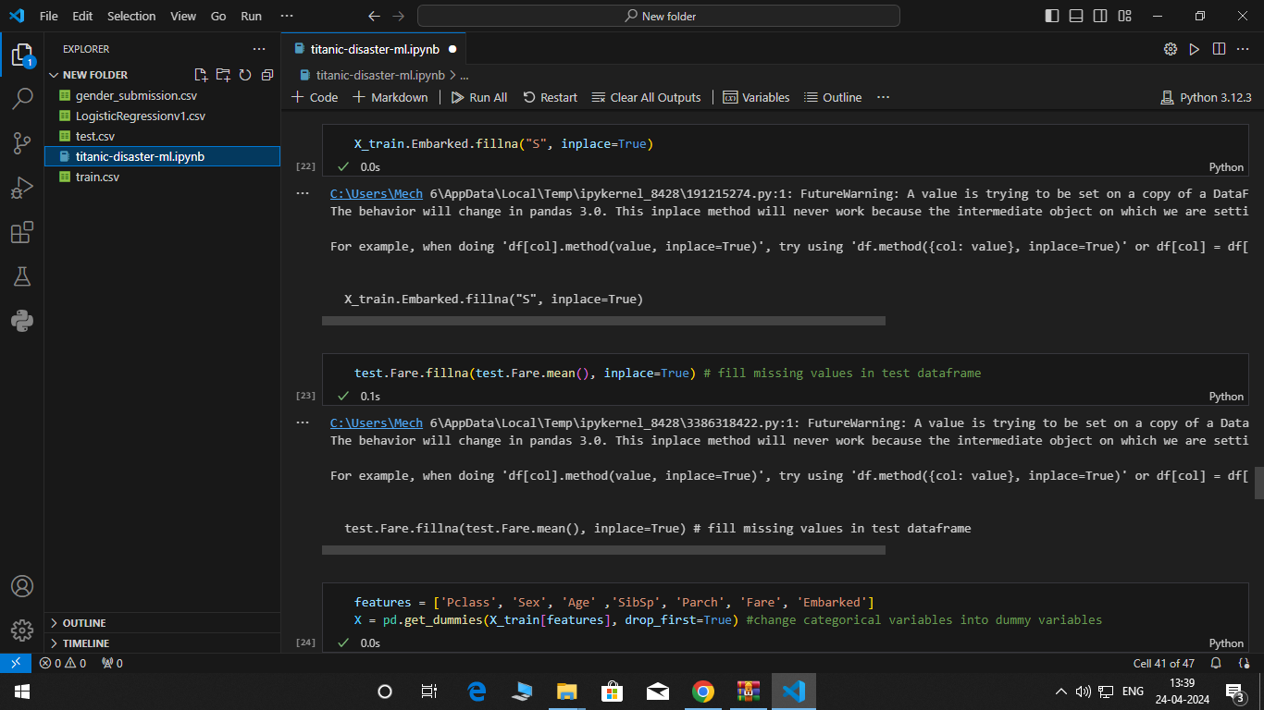
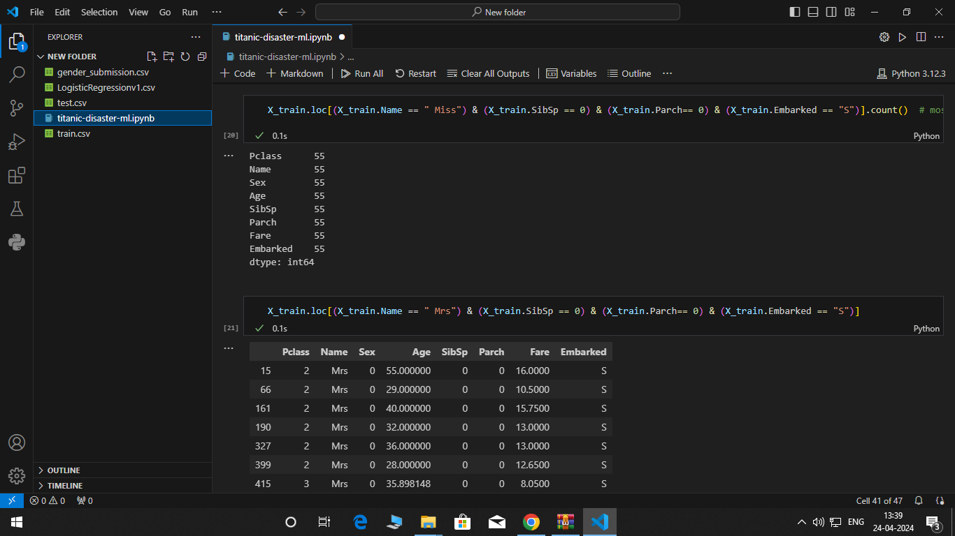
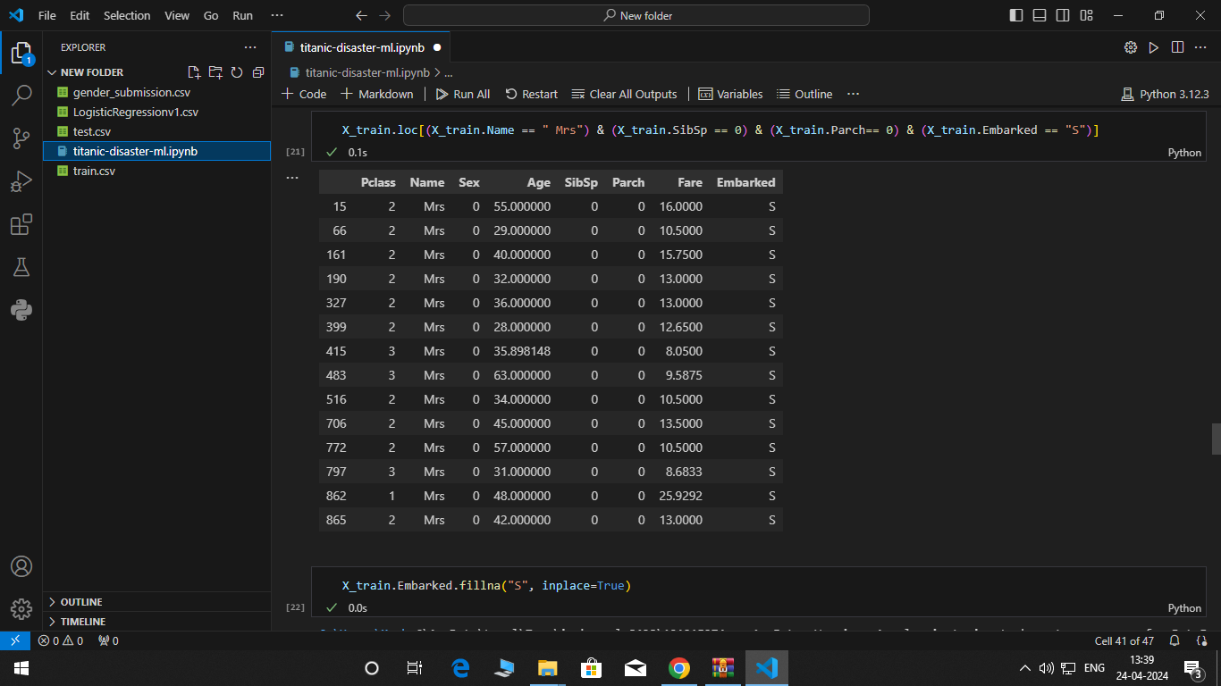

Slide 10
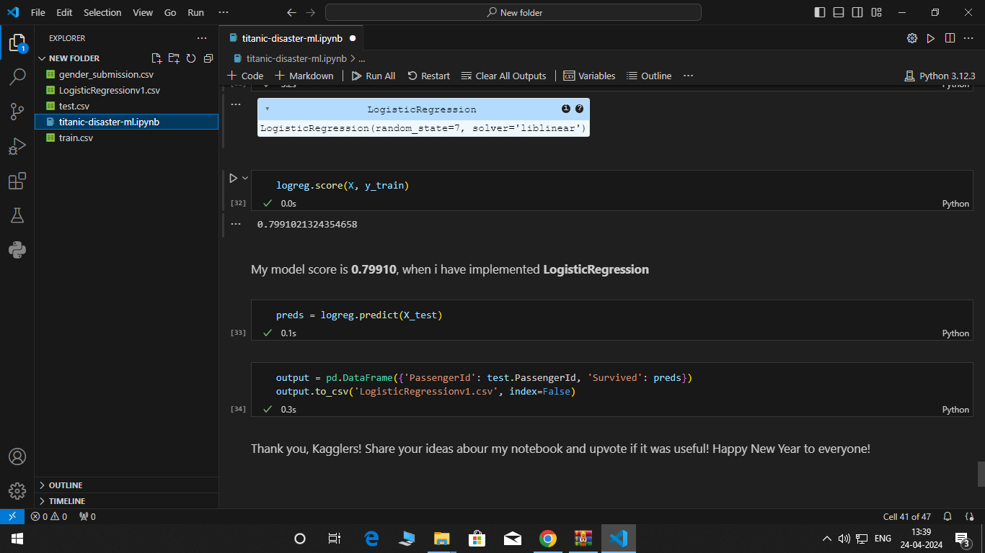
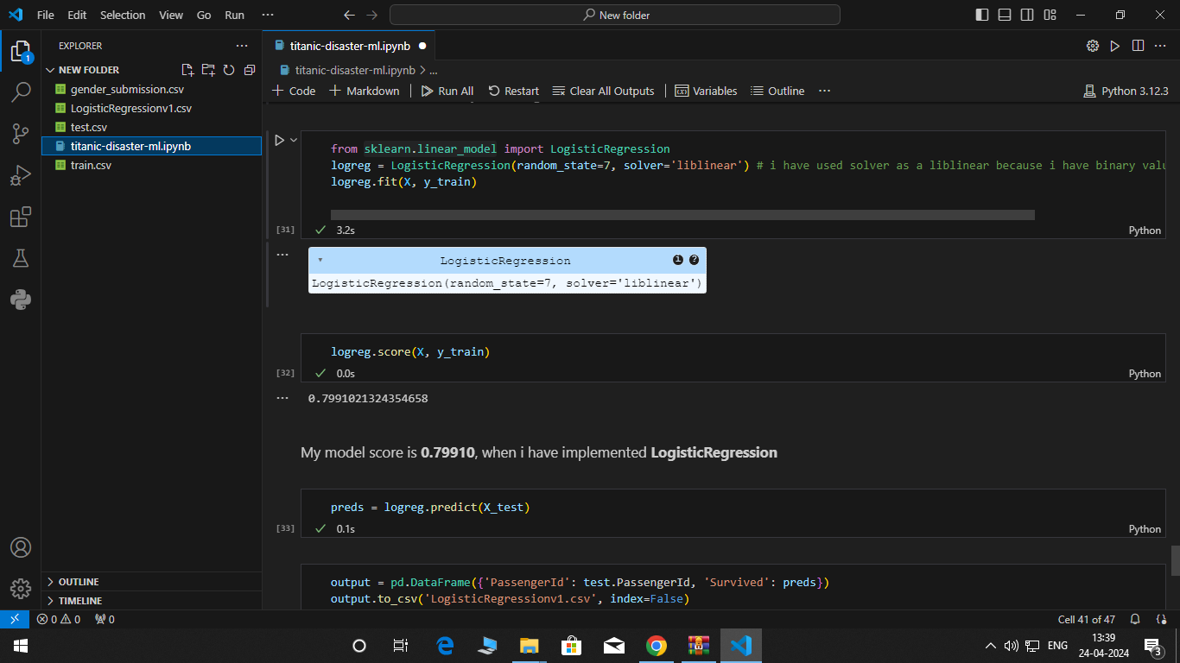
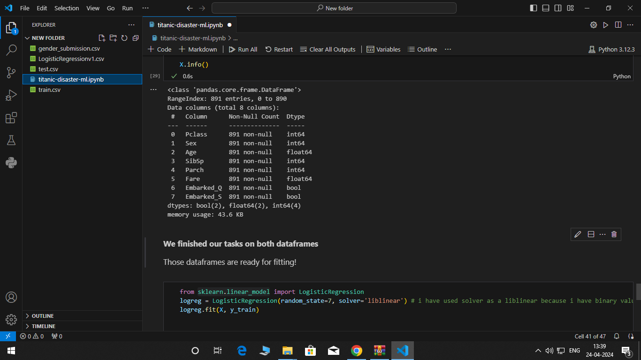

Slide 11
Conclusion
The Titanic disaster stands as a tragic reminder of the perils of human hubris, technological overconfidence, and systemic failures. Despite being hailed as "unsinkable," the RMS Titanic met its demise on April 15, 1912, when it struck an iceberg during its maiden voyage from Southampton to New York City. The catastrophic sinking claimed the lives of over 1,500 passengers and crew, leaving an indelible mark on maritime history and popular culture.
Safety and Preparedness: The Titanic disaster underscored the importance of robust safety measures, comprehensive emergency preparedness, and effective risk management in maritime operations. Inadequate lifeboat capacity, insufficient crew training, and a lack of proactive measures to mitigate iceberg risks contributed to the high casualty count.
Social Inequities: The Titanic disaster exposed social hierarchies and disparities in access to life-saving resources, with first-class passengers receiving preferential treatment during the evacuation process. This inequality served as a poignant reminder of broader societal divisions and injustices.
Regulatory Reforms: In the aftermath of the Titanic disaster, significant regulatory reforms were enacted to improve maritime safety standards, including requirements for sufficient lifeboat capacity, enhanced navigation protocols, and stricter oversight of passenger ship operations. These reforms aimed to prevent similar tragedies from occurring in the future.
Cultural Impact: The Titanic disaster left an enduring cultural legacy, inspiring numerous books, films, documentaries, and artistic interpretations that continue to captivate audiences worldwide. The story of the Titanic has become synonymous with themes of tragedy, heroism, sacrifice, and the fragility of human endeavors.

Slide 12
Future scope
Advanced Data Analysis:
Continued analysis of the Titanic dataset using advanced machine learning and statistical techniques to uncover deeper insights into factors influencing survival rates.
Exploration of more complex models and feature engineering methods to improve prediction accuracy and interpretability.
Integration of New Data:
Incorporation of additional historical data sources, survivor testimonies, and archival records to enrich existing datasets and provide a more comprehensive understanding of the events leading up to and following the Titanic disaster.
Integration of modern technologies such as natural language processing (NLP) to analyze survivor accounts and newspaper articles for qualitative insights.
Simulation and Visualization:
Development of interactive simulations and visualizations to recreate the Titanic disaster and explore hypothetical scenarios, allowing researchers and enthusiasts to gain a deeper understanding of the sequence of events and decision-making processes.
Creation of immersive virtual reality (VR) experiences to engage audiences and educate them about the Titanic disaster in a compelling and interactive manner.
Interdisciplinary Research:
Collaboration between historians, maritime experts, data scientists, and psychologists to explore interdisciplinary aspects of the Titanic disaster, including human behavior during emergencies, societal attitudes towards risk, and the cultural impact of the tragedy.
Investigation of broader historical and socio-economic contexts surrounding the Titanic disaster, such as the Gilded Age, immigration trends, and the development of transatlantic travel.
Educational Initiatives:
Development of educational materials, curriculum modules, and online courses to teach students about the Titanic disaster and its relevance to fields such as history, engineering, maritime studies, and data science.
Organization of public exhibitions, museum displays, and commemorative events to raise awareness about the Titanic disaster and its enduring significance in popular culture and collective memory.

Slide 13
References
Here are some references related to the Titanic disaster:
Ballard, Robert D. "The Discovery of the Titanic." National Geographic, September 1985.
Eaton, John P., and Haas, Charles A. Titanic: Triumph and Tragedy. W.W. Norton & Company, 1995.
Lord, Walter. A Night to Remember. Holt Paperbacks, 2005.
Lynch, Don, and Marschall, Ken. Titanic: An Illustrated History. Hyperion, 1992.
National Archives and Records Administration (NARA). Records of the National Transportation Safety Board, Record Group 237, Washington, D.C.
National Geographic Society. "Titanic: 100-Year Anniversary Edition." National Geographic, April 2012.
Titanic Historical Society. "Titanic Commutator" (Journal). Available online at: https://www.titanichistoricalsociety.org/commutator
Titanic Inquiry Project. Online database of primary sources related to the Titanic disaster. Available online at: https://www.titanicinquiry.org/
United States Senate. "Titanic Disaster: Hearings before a Subcommittee of the Committee on Commerce, United States Senate, Sixty-Second Congress." Government Printing Office, 1912.
Wreck Site. Online database of information and research about shipwrecks, including the Titanic. Available online at: https://www.wrecksite.eu/

Slide 14
THANK YOU

