Slide 1
NeuroFoot
Smart Plantar Pressure Monitoring for Diabetic Neuropathy
BME 555a — USC Viterbi School of Engineering — Spring 2026
Team Cardinal
Pouya Behdinan
Ava Rathenberg
Lily Wu
Nwachukwu Anene

Slide 2



Clinical Need & Use Cases
Section 1.1a — Stakeholder Use-Case Scenarios
Unaware Patient
Real-Time Alert
Clinical Review
A patient with loss of protective sensation walks for hours with dangerous pressure concentrated under the metatarsal heads. Without feedback, tissue damage develops silently.
The NeuroFoot detects sustained overload and sends a WARN alert to the patient's smartphone. The patient offloads pressure before injury occurs.
During a follow-up visit, the clinician reviews weeks of pressure trend data, identifies high-risk zones, and adjusts the patient's care plan accordingly.
Lily Wu
NeuroFoot | Team Cardinal | BME 555a
Notes:
Before I go into the technical design, I want to explain the clinical need and how NeuroFoot is used.
First is the unaware patient. Some patients, especially those with diabetic neuropathy, lose feeling in their feet. That means they can walk for a long time with high pressure in certain areas without noticing it. A common area is under the metatarsal heads. Since they don’t feel pain, tissue damage can develop without warning.
The second use case is real time alert. NeuroFoot monitors pressure continuously. When it detects high pressure for too long, it sends a warning to the patient’s phone. This helps the patient adjust or stop before damage happens.
The third use case is clinical review. The system records pressure and gait data over time. During a follow up visit, the clinician can look at the data, find high pressure areas, and adjust the treatment plan.
So the goal of NeuroFoot is to give feedback to the patient in the moment, and also provide useful data for clinicians later.

Slide 3



Stakeholder Analysis & Priority
Section 1.1a — Who the device serves and why
SH-01
Neuropathic Patient
Primary alert recipient; daily wear and charging
Direct risk of harm — highest priority per ISO 14971
SH-02
Caregiver
Secondary alert recipient; assists with offloading
ADA identifies caregivers as essential in high-risk populations
SH-03
Clinician
Reviews longitudinal data; modifies care plan
IWGDF 2023 recommends periodic pressure monitoring
SH-04
FDA CDRH
Regulatory reviewer for premarket submission
Defines constraints: 21 CFR 890.5575, Class II
Lily Wu
NeuroFoot | Team Cardinal | BME 555a
Notes:
The primary stakeholder is the neuropathic patient (IWGDF Risk 2-3), who bears the direct risk of harm from device failure and cannot compensate for lost sensation through any other means. Secondary stakeholders include caregivers who assist with offloading and device maintenance, clinicians who review longitudinal data during clinical encounters, and the FDA's CDRH, which serves as the regulatory reviewer for premarket submissions.

Slide 4




MVP Features Priority Ranking
Section 1.1a — Features derived from stakeholder needs
1
16-Zone Plantar Pressure Sensing
Critical
FSR array across toes, metatarsal heads, midfoot, heel — core clinical function
2
Real-Time Threshold Alerting
Critical
WARN >600 ADC, CRITICAL >850 ADC — behavioral offloading prompt
3
BLE Wireless to iOS App
Critical
nRF52840 BLE 5.0 to companion app — <1s alert latency
4
6-Axis IMU Gait Analysis
High
BMI270 accel/gyro at 50 Hz — step count, cadence, stance timing
5
Ambient Environmental Monitoring
Medium
HS300x temp (±0.25°C) and humidity (±3.5% RH) — skin maceration context
6
Data Logging for Clinician Review
Medium
Longitudinal pressure trends stored for clinical follow-up
Pouya Behdinan
NeuroFoot | Team Cardinal | BME 555a

Slide 5
MVP Specifications Linked to Features
Section 1.1b — Measurable performance requirements
Feature | Specification | Verification Method
16-zone pressure sensing | ≥16 zones, 50 Hz, 0–400 kPa, R² > 0.90 | Calibrated weight test, MuxPressureTest MODE 1
Threshold alerting | WARN >600 ADC within 1s, CRITICAL >850 within 1s, clear <2s | Controlled load, measure response time
BLE communication | Advertise <3s, connect <10s, 4 characteristics at rate | Power-on to app data display <15s
IMU gait analysis | ±1g (±0.05g) accel, <±0.5 dps gyro bias | 6-position static cal, zero-rate bias test
Environmental sensing | Temp ±0.5°C vs reference, humidity ±5% RH | Side-by-side with calibrated instruments
Pouya Behdinan
NeuroFoot | Team Cardinal | BME 555a

Slide 6

Regulatory: Intended Use & Predicate Device
Section 1.1c — 21 CFR 890.5575, Product Code IRN, Class II
SmartStep (K060150)
NeuroFoot (Proposed)
Predicate Device — Andante Medical Devices
Team Cardinal — USC BME 555a
Flexible pressure-sensing insole
Belt-worn Control Unit + PC Software
Threshold-based overload alarm
Rehabilitation / partial weight-bearing
Prescription Use under physician supervision
Cleared Feb 23, 2006 (Class II)
16-zone FSR array in sandal form factor
Arduino Nano 33 BLE + iOS companion app
Graded alerts: OK / WARN / CRITICAL
Continuous daily ambulatory monitoring
Prescription Use under clinician supervision
510(k) pathway via K060150 predicate
Ava Rathenberg
NeuroFoot | Team Cardinal | BME 555a

Slide 7
Substantial Equivalence & Clinical Alignment
Section 1.1c — Key SE comparisons and guideline reconciliation
Feature | SmartStep | NeuroFoot | Equivalence
Sensor | Resistive insole | 16-zone FSR via mux | Same modality
Pressure | Single threshold | 16-zone 50 Hz + PTI | Enhanced resolution
Alerts | Audible/visual alarm | OK/WARN/CRITICAL + haptic | Same core function
Wireless | Control Unit to PC | BLE 5.0 to iOS | Both wireless
Form Factor | Insole + belt unit | Sandal + embedded MCU | Both wearable
Safety Std | IEC 60601-1, ISO 14971 | Same + IEC 62304 | Same core standards
Clinical Guideline Alignment
IWGDF 2023: Pressure offloading for neuropathic patients • ADA 2024: Comprehensive foot exams + early intervention • APMA: Wearable pressure-offloading technologies
Ava Rathenberg
NeuroFoot | Team Cardinal | BME 555a
Notes:
Our predicate is the SmartStep system by Andante Medical Devices, cleared in 2006 as a Class II device under product code IRN. SmartStep uses a resistive pressure insole with threshold-based alarms — same core function as NeuroFoot. Our differences are in form factor and connectivity, not intended use, which keeps us firmly in 510(k) territory.

Slide 8
Bill of Materials Overview
Section 1.2a — Key components and specifications
Component | Part Number / Description | Key Specification | Qty
Microcontroller | Arduino Nano 33 BLE Sense Rev2 (ABX00070) | nRF52840, BLE 5.0, BMI270, HS300x | 1
Multiplexer | CD74HC4067 (16-ch analog) | Break-before-make, 100µs settle | 1
FSR Insole | In-house developed 16-zone sensor | Resistance varies 10kΩ | 1
Pull-down Resistors | 10kΩ | Voltage divider for FSR channels | 16
Sandal | EVA foam, two-layer construction | Board housed between layers | 1 pair
Ava Rathenberg
NeuroFoot | Team Cardinal | BME 555a

Slide 9
Hardware Block Diagram
Section 1.2a — System architecture and signal flow
Digital Signal
Arduino Nano 33
BLE Sense Rev2
iOS
App
Analog Signal
Wireless
FSR Insole
(16 zones)
CD74HC4067
Multiplexer
BMI270
HS300x
BLE 5.0
nRF52840
ADC
10kΩ ×16
Nwachukwu Anene
NeuroFoot | Team Cardinal | BME 555a
Notes:
16 traces (C0-C15) → multiplexer → 4 traces out (S0-S3)
BMI270 → IMU
HS300x → Humidty sensor
nRF52840 → Bluetooth module
ADC → Analog to digital converter

Slide 10
Software Decision Logic & App Workflow
Section 1.2a — Firmware thresholds and iOS companion app
Firmware Decision Logic
iOS Companion App
Read 16 FSR channels (50 Hz scan)
Real-time 16-zone pressure heatmap
Zone bar charts with threshold markers
Duration each zone spends within a threshold recorded
Gait metrics: steps, cadence, stance
Ambient temperature & humidity display
WARN/CRITICAL alert banners + haptic
Connection status & battery monitoring
SwiftUI + CoreBluetooth framework
Check each zone against thresholds
< 600: OK
600–849: WARN
≥ 850: CRIT
Record duration each zone spends within thresholds
Transmit via BLE to iOS app
Transmit via BLE to iOS app
Nwachukwu Anene
NeuroFoot | Team Cardinal | BME 555a

Slide 11
Acceptance Criteria
Section 1.2b — Per-component and integrated system verification
Component | Test | Pass Criteria | Result
Arduino Nano 33 BLE | Power-on self-test | Board ID + BLE MAC within 5s | ✓ Pass
CD74HC4067 Mux | Channel isolation | <5 ADC unloaded, no cross-talk | ✓ Pass
FSR Array (16 zones) | Response linearity | Monotonic, R² > 0.90 | ✓ To Be Tested
BMI270 Accel | 6-position static cal | ±1g (±0.05g) | ✓ Pass
BMI270 Gyro | Zero-rate bias | <±0.5 dps stationary 30s | ✓ Pass
HS300x Temp | Reference comparison | ±0.5°C vs calibrated | ✓ Pass
BLE Link | Connection test | Connect <10s | ✓ Pass
Alert System | Threshold trigger | WARN <1s, CRITICAL <1s | ✓ Pass
Full System | 2-min walk test | Continuous data, no dropouts | ✓ To Be Tested/Improved
BMM150 Magneto | I2C read | Valid axis readings | ✗ Not Included
Pouya Behdinan
NeuroFoot | Team Cardinal | BME 555a

Slide 12
Test Plan & Calibration Methods
Section 1.2b — Verification sequence and calibration approach
Integration Verification
Calibration Methods
Stage 1 — Breadboard
Tested Arduino - IMU (accel and gyro), Temp, and Humidty
Arduino + MUX + FSR on breadboard. MuxPressureTest sketch confirms 16 independent channels with 10kΩ pull-downs. NeuroFoot_BLE sketch verifies iOS app receives all 4 BLE characteristics.
Stage 2 — Sandal Assembly
Transfer to sandal form factor. Arduino secured between EVA layers. FPC breakout connected via ribbon cable. Full walk test verifies no signal degradation, loose connections, or BLE range issues.
FSR: Calibrated weights (0, 5, 10, 20, 40 kg) on rigid surface, ADC vs load curve
IMU Accel: 6-position static test, 100 samples per orientation, mean per axis
IMU Gyro: Stationary 30s, 3000 samples at 100 Hz, compute zero-rate bias
Temp: Side-by-side with NIST-traceable thermometer, 5-min stabilization
Humidity: Side-by-side with calibrated hygrometer, 5-min stabilization
BLE: Power-on to app data display timing, repeated 10× for consistency
Nwachukwu Anene
NeuroFoot | Team Cardinal | BME 555a

Slide 13

Traceability & Components to Avoid
Section 1.2c — Breadboard → Altium → PCB, and lessons learned
Design
Requirement
BOM
Component
Breadboard
Validation
Altium
Schematic
PCB
Vendor
Components & Configurations to AVOID
100kΩ pull-downs — compressed ADC range to ~270 counts; use 10kΩ instead
Piezoelectric sensors — no sustained reading under static load; unsuitable for plantar monitoring
BMM150 magnetometer — not accessible on Rev2 Wire1 bus; excluded from design
Wire.begin() in firmware — corrupts onboard I2C bus (HS300x, BMI270 fail)
APDS9960 init before other I2C — causes bus conflicts; must initialize last
Pouya Behdinan
NeuroFoot | Team Cardinal | BME 555a

Slide 14
Manufacturing Process Flow
Section 1.2d — Repeatable assembly recipe
1
Populate 16 × 10kΩ pull-downs on breadboard/PCB
2
Mount CD74HC4067 mux; wire S0–S3 to Arduino digital pins
3
Connect FPC breakout board; attach insole ribbon cable
4
Wire mux SIG → Arduino A0; VCC/GND connections
5
Flash firmware (NeuroFoot_BLE sketch); verify serial output
6
Run MuxPressureTest — validate all 16 channels
7
Cut sandal in half; seat Arduino + PCB between layers; glue
8
Route FPC cable; verify no pinch points; close sandal
9
Full system walk test — confirm no signal degradation
Nwachukwu Anene
NeuroFoot | Team Cardinal | BME 555a

Slide 15
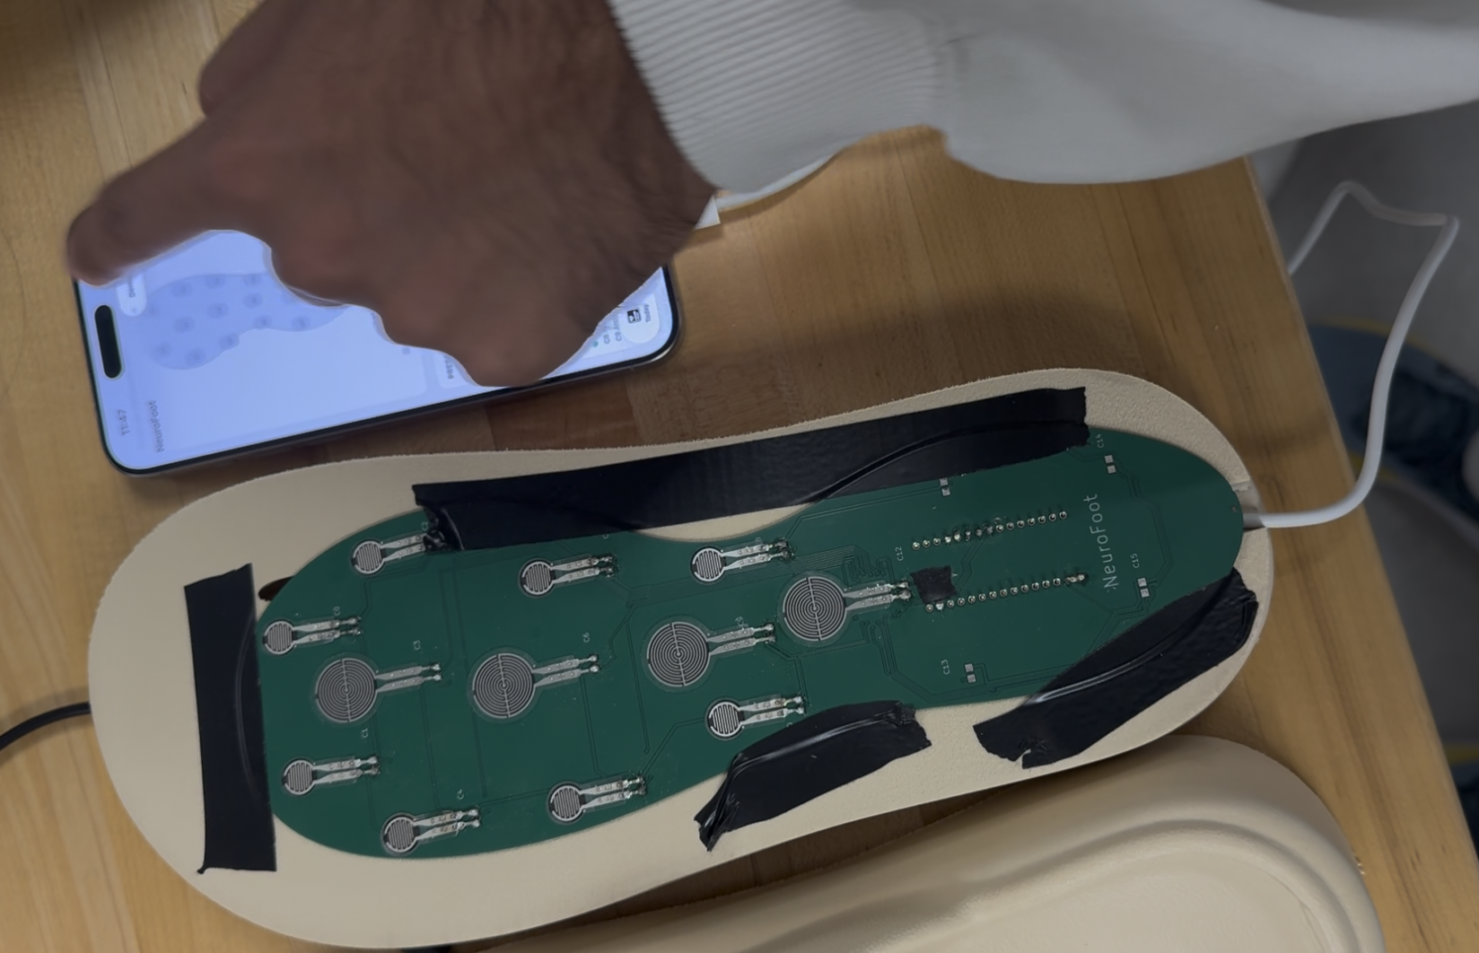
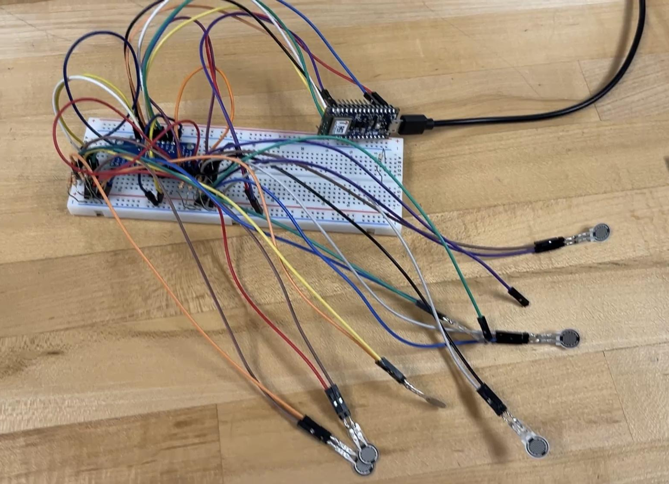
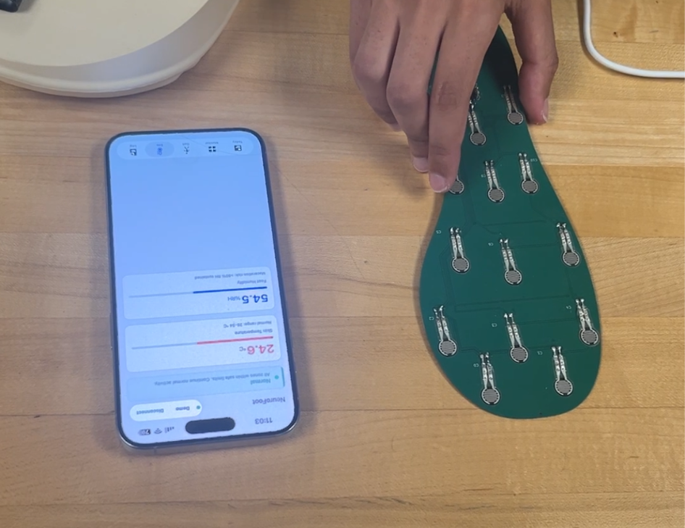
Prototype Verification & Testing
Section 1.2e — Assembly images and verification results
Verification Summary
9/10 components passed acceptance testing. BMM150 magnetometer rejected (I2C inaccessible on Rev2). Integration verified in two stages: breadboard validation followed by sandal assembly walk test. All pressure channels, IMU axes, environmental sensors, BLE link, and alert thresholds confirmed operational.
Pouya Behdinan
NeuroFoot | Team Cardinal | BME 555a

Slide 16
Identified Failure Modes
Section 2.1 — Six failure modes across five categories
Failure Mode | Category | Clinical Impact | Source
FSR adhesive delamination | Mechanical Wear | Underreported pressure → missed alerts | Anticipated
60 Hz electromagnetic interference | Environmental | False threshold crossings → alert fatigue | Observed
Moisture ingress / corrosion | Environmental | Short circuits, signal degradation | Anticipated
BLE disconnection | Wireless | No alerts reach patient during overload | Anticipated
User forgets to charge | User Error | Device dies mid-use, all monitoring stops | Anticipated
HS300x cold-boot zero read | Firmware | Erroneous 0.0 values, reduced confidence | Observed
2 of 6 failure modes were directly observed and resolved during prototype development. The remaining 4 are anticipated based on the device's mechanical and electrical design.
Pouya Behdinan
NeuroFoot | Team Cardinal | BME 555a

Slide 17
FMEA Identified Failure Modes
Section 2.1 — Six failure modes across five categories
FM-01 · Mechanical
FM-02 · Environmental
FM-03 · Environmental
FSR adhesive delamination
60 Hz EMI on analog lines
Moisture ingress / corrosion
Underreported pressure; missed alerts during sustained overload
False alerts from noise; patient ignores legitimate warnings
Short circuits; silent monitoring loss during wear
Source: Anticipated
Source: Anticipated
Source: Anticipated
FM-04 · Wireless
FM-05 · User Error
FM-06 · Firmware
BLE disconnection
User forgets to charge
HS300x cold-boot zero read
No alerts reach patient during dangerous loading
Complete monitoring loss for unknown duration
Erroneous 0.0 values on first read; no alert impact
Source: Observed
Source: Anticipated
Source: Observed
Pouya Behdinan
NeuroFoot | Team Cardinal | BME 555a

Slide 18
Risk Analysis — Severity Scale (S)
Section 2.2a — Worst-case consequence if failure reaches patient undetected
Score | Level | Clinical Context
1–3 | Minor | Function slightly degraded; patient self-corrects; no safety impact
4–6 | Moderate | Accuracy reduced or alert frequency affected; no direct tissue injury
7–8 | Serious | Core monitoring fails; patient exposed to sustained overload without warning
9–10 | Critical | Direct physical injury or complete silent failure; patient believes device works
Scoring Rationale
Scores reflect consequences for the NeuroFoot intended use population: adults with diabetic peripheral neuropathy and loss of protective sensation (LOPS). A score of 7+ means the patient cannot independently detect the failure.
Lily Wu
NeuroFoot | Team Cardinal | BME 555a
Notes:
Severity looks at the worst case outcome if a failure reaches the patient without being detected.
A score from 1 to 3 is minor. The system might not work perfectly, but the patient can adjust and there is no safety impact.
A score from 4 to 6 is moderate. The system may lose some accuracy or alerts may be affected, but it does not directly cause injury.
A score from 7 to 8 is serious. This means the main monitoring function fails, and the patient may be exposed to high pressure without any warning.
A score from 9 to 10 is critical. This is the worst case, where there could be direct injury or a complete silent failure, and the patient believes the device is working.

Slide 19
Risk Analysis — Occurrence Scale (O)
Section 2.2a — Estimated probability of failure during expected device lifetime
Score | Frequency | Basis
1–2 | Remote (<1 in 10,000) | Component spec provides very high reliability assurance
3–4 | Low (~1 in 1,000) | Component meets spec; failure possible but infrequent
5–6 | Moderate (~1 in 100) | Known failure mechanism in literature; design partially mitigates
7–8 | High (~1 in 10) | Failure mechanism dominant; current design does not address
9–10 | Very High (>1 in 2) | Failure expected under normal use without corrective action
Estimates based on available evidence at PDR stage: datasheet specs, published literature, and prototype test observations.
Lily Wu
NeuroFoot | Team Cardinal | BME 555a
Notes:
Occurrence looks at how likely a failure is to happen over the lifetime of the device.
A score of 1 to 2 means the failure is very unlikely. This is based on strong component reliability from datasheets.
A score of 3 to 4 is low. The component meets specifications, and failure is possible but not common.
A score of 5 to 6 is moderate. There is a known failure mechanism, and the design only partially reduces the risk.
A score of 7 to 8 is high. The failure is likely, and the current design does not fully address it.
A score of 9 to 10 is very high. The failure is expected during normal use if nothing is changed.
These estimates are based on datasheets, published information, and what we observed during prototyping.

Slide 20
Risk Analysis — Detection Scale (D)
Section 2.2a — Ability of design controls to identify failure before patient impact
Score | Detectability | Mechanism
1–2 | Almost Certain | Firmware/hardware auto-detects; visible alert before patient impact
3–4 | High | Patient would likely notice anomalous behavior within one session
5–6 | Moderate | Requires active inspection or app review; not self-evident during use
7–8 | Low | Gradual or latent failure; patient unlikely to notice without monitoring
9–10 | Remote | Silent failure; device gives no indication of malfunction
Higher score = lower probability of detection. A score of 10 means the device gives no indication of failure — the patient cannot distinguish operational from non-operational.
Lily Wu
NeuroFoot | Team Cardinal | BME 555a
Notes:
Detection looks at how likely it is that the system or the patient will notice a failure before it causes harm.A score of 1 to 2 means the failure is almost certain to be detected. The system can catch it automatically and alert the user.
A score of 3 to 4 is high. The patient would likely notice something is wrong during use.
A score of 5 to 6 is moderate. The issue is not obvious and may only be found by checking the app or data.
A score of 7 to 8 is low. The failure develops slowly, and the patient is unlikely to notice it on their own.
A score of 9 to 10 is the worst case. This is a silent failure, where the device gives no sign that something is wrong.
So a higher detection score actually means it is harder to detect the failure.

Slide 21
Risk Acceptance Criteria
Section 2.2a — RPN-based classification and required actions
200–1000
Corrective action required before Design Verification
HIGH
Revised RPN must fall below 200 after controls implemented
100–199
Risk reduction recommended
MEDIUM
Actions documented and addressed in Design Verification plan
1–99
Acceptable with existing controls
LOW
Monitor and reassess if design changes are made
Lily Wu
NeuroFoot | Team Cardinal | BME 555a
Notes:
If the RPN is between 200 and 1000, it is considered high risk. In this case, corrective action is required before design verification. After changes are made, the RPN needs to be reduced below 200.
If the RPN is between 100 and 199, it is medium risk. Risk reduction is recommended, and the actions should be documented and included in the design verification plan.
If the RPN is below 100, it is low risk. These risks are acceptable with the current design, but they should still be monitored in case anything changes.
So this scale helps us decide which risks need immediate fixes and which ones can be managed.

Slide 22
Risk Analysis — RPN Scoring
Section 2.2 — Severity x Occurrence x Detection
S (Severity) O (Occurrence) D (Detection) RPN = S x O x D
ID | Failure Mode | S | O | D | RPN | Risk
FM-01 | FSR adhesive delamination | 9 | 5 | 7 | 315 | HIGH
FM-02 | 60 Hz EMI false alerts | 5 | 4 | 6 | 120 | MEDIUM
FM-03 | Moisture ingress / short circuit | 7 | 5 | 7 | 245 | HIGH
FM-04 | BLE disconnection | 7 | 4 | 6 | 168 | MEDIUM
FM-05 | Battery depletion / user failure | 7 | 5 | 5 | 175 | MEDIUM
FM-06 | HS300x cold-boot init failure | 2 | 4 | 3 | 24 | LOW
FDA & ISO Risk Management Alignment
ISO 14971: RPN >=200 (FM-01, FM-03) require mandatory design controls. ISO 13485 7.1: All risk controls documented and verified. FDA 21 CFR 820.30(g): Design validation must address identified risk scenarios.
Lily Wu
NeuroFoot | Team Cardinal | BME 555a
Notes:
RPN stands for severity, occurrence, and detection. Each failure mode is given a score in these three categories, and then we multiply them to get the final RPN value.
Severity is how serious the impact is. Occurrence is how likely it is to happen. Detection is how likely we are to catch it before it causes harm.
From the table, the highest risks are FSR adhesive delamination and moisture ingress, with RPN values above 200. These are considered high risk and need design controls.
The other failure modes fall into medium risk. They affect system reliability, like false alerts, BLE disconnection, or battery issues, but are less likely to directly cause harm.
The HS300x startup issue is low risk since it only affects the first reading and does not impact alerts.
At the bottom, we connect this to standards. ISO 14971 says high RPN risks need to be addressed, and ISO 13485 and FDA guidelines require that these risks are documented and validated in the design.

Slide 23
Risk Mitigation & Design Controls
Section 2.3 — Risk reduction strategies and residual RPN
FM-01 · Adhesive Delamination
FM-02 · 60 Hz EMI
FM-03 · Moisture Ingress
RPN: 315 -> 54
RPN: 120 -> 20
RPN: 245 -> 42
Medical-grade adhesive + recessed midsole channel + firmware self-test
10k pull-downs (confirmed) + PCB ground plane + 3-sample debounce
Conformal coating + IP44 enclosure + sealed FPC connector
FM-04 · BLE Disconnection
FM-05 · Battery Depletion
FM-06 · HS300x Init Failure
RPN: 168 -> 24
RPN: 175 -> 42
RPN: 24 -> 8
Onboard buzzer for CRITICAL + auto-reconnect every 5s + visible LED
Audible low-battery alarm + caregiver push notification + wireless charging
Firmware retry loop (3x, 500ms delay) — already deployed in prototype
Nwachukwu Anene
NeuroFoot | Team Cardinal | BME 555a

Slide 24
Mitigations & Design Controls
Section 2.3 — Risk reduction strategies per failure mode
Failure Mode | Risk Control Measure | Type
Adhesive delamination | Snap-fit insole mount; medical-grade adhesive; peel-strength test | Design
60 Hz EMI | 10k pull-downs; 100nF bypass caps; shielded PCB traces | Design
Moisture ingress | Conformal coating; sealed FPC connector; hydrophobic liner | Design
BLE disconnection | Onboard buzzer + LED; app auto-reconnect; BLE loss alert | Firmware
User charging failure | Audible low-battery alarm; app notification; USB-C quick charge | Design + UX
HS300x cold-boot | Firmware retry loop (3x, 100ms delay); validated in prototype | Firmware
Ava Rathenberg
NeuroFoot | Team Cardinal | BME 555a

Slide 25
Summary & Fall 2026 Handoff
Team Cardinal · NeuroFoot System · April 27, 2026
WHAT WAS BUILT & VERIFIED
FALL 2026 — NEXT TEAM CHECKLIST
✓ 16-zone FSR insole + CD74HC4067 mux — all channels verified
IMMEDIATE
→ Implement FMEA mitigations
✓ BLE 5.0: pressure (50 Hz), IMU (50 Hz), environmental (0.5 Hz)
PCB DESIGN
✓ Graded alerts (OK/WARN/CRITICAL) — <200 ms latency
→ Translate to Altium (see traceability)
✓ HS300x temp (+-0.5C) and humidity (+-5% RH) verified
→ No 100k pull-downs. No Wire.begin(). No BMM150.
✓ IMU 6-position accel cal and gyro zero-rate bias confirmed
VALIDATION
→ Dynamic force cal with reference plate
✓ Sandal assembly — 2-min walk test, no BLE dropouts
→ IEC 60601-1-2 EMC testing
✓ Predicate: SmartStep (K060150) — SE documented
→ Human walking trials (5-30 subjects)
✓ ISO 13485-compliant DFM documentation
REGULATORY
→ File 510(k) with K060150 predicate
Pouya Behdinan
Team Cardinal · BME 555A Spring 2026

Slide 26

Thank You
Questions?

Slide 27
FMEA — Identified Failure Modes (≥5)
Section 3.1 · Presenter: Pouya Behdinan
FM-01 · Mechanical Wear · Pressure Sensing
FM-02 · Environmental · Pressure Sensing (ADC)
FSR signal degradation from adhesive delamination
60 Hz electromagnetic interference on analog signal line
System underreports actual plantar loading. Patient with LOPS cannot independently verify accuracy. Missed alerts during sustained overload — highest risk failure.
False WARN/CRITICAL alerts from EMI noise → alert fatigue → patient ignores legitimate future alerts.
Source: Anticipated
Source: Observed in prototype
FM-03 · Environmental · Electronics / Assembly
FM-04 · Wireless Communication · BLE Radio / iOS App
Moisture ingress causing short circuit or corrosion
BLE disconnection during ambulatory use
Intermittent or complete device failure. Silent monitoring loss — patient unaware while walking unmonitored.
Silent monitoring interruption. Patient experiences no alerts during potentially dangerous plantar loading.
Source: Anticipated
Source: Anticipated
FM-05 · User Error · Power Management
User fails to charge device before daily use
Complete monitoring loss for unknown duration during daily wear. Patient may walk for hours without any alerts.
Source: Anticipated

Slide 28
Risk Analysis
Severity Scale (S) Severity describes the worst-case consequence of a failure mode reaching the patient, assuming the failure is not detected or corrected. Scores reflect the clinical consequences specific to the NeuroFoot intended use population: adults with diabetic peripheral neuropathy and loss of protective sensation
Score Range | Description | NeuroFoot Clinical Context
1 to 3 | Minor | Device function slightly degraded; no patient safety impact; patient or clinician would notice and self-correct without consequence
4 to 6 | Moderate | Monitoring accuracy reduced or alert frequency affected; potential for user inconvenience or alert fatigue; no direct tissue injury expected
7 to 8 | Serious | Core alert or monitoring function fails; patient is exposed to sustained plantar mechanical overload without warning; clinically meaningful DFU risk elevation
9 to 10 | Critical | Device causes direct physical injury (e.g., electrical shock, skin damage from hardware failure); or complete silent failure with patient believing device is operational

Slide 29
Risk Analysis
Occurrence Scale (O)
Occurrence reflects the estimated probability that the identified failure cause will produce the failure mode during the expected device lifetime, based on available evidence at PDR stage.
Score | Frequency Estimate | Basis
1 to 2 | Remote: fewer than 1 in 10,000 operating cycles | Component-level specification provides very high reliability assurance
3 to 4 | Low: approximately 1 in 1,000 cycles | Component meets specification; failure possible but infrequent under normal use
5 to 6 | Moderate: approximately 1 in 100 cycles | Known failure mechanism documented in literature or datasheet; design partially mitigates
7 to 8 | High: approximately 1 in 10 cycles | Failure mechanism is dominant and current design does not adequately address it
9 to 10 | Very High: greater than 1 in 2 cycles | Failure is expected under normal use without corrective design action

Slide 30
Risk Analysis
Detection Scale (D)
Detection reflects the ability of existing design controls to identify the failure mode before it reaches the patient without correction. A higher score indicates a lower probability of detection; a score of 10 represents a complete inability to detect the failure.
Score | Detectability | Mechanism
1 to 2 | Almost certain | Automatic detection by device firmware or hardware; failure triggers visible or audible alert before patient impact
3 to 4 | High | Patient or user would likely notice anomalous device behavior within one use session
5 to 6 | Moderate | Detection requires active inspection, calibration check, or app review; not self-evident during routine use
7 to 8 | Low | Failure is gradual or latent; patient is unlikely to notice degraded performance without dedicated monitoring
9 to 10 | Remote | Silent failure; device gives no indication of malfunction; patient cannot distinguish operational from non-operational states

Slide 31
Risk Acceptance Criteria
RPN Range | Risk Level | Required Action
200 to 1000 | High | Corrective action required before Design Verification. Revised RPN must fall below 200 following implementation of recommended controls.
100 to 199 | Medium | Risk reduction recommended. Recommended actions documented and addressed in the Design Verification plan.
1 to 99 | Low | Risk acceptable with existing controls. Monitor and reassess if design changes are made.

Slide 32
Risk Analysis – RPN
Section 3.2 · Presenter: Lily Wu
S (Severity)
O (Occurrence)
D (Detection)
RPN = S × O × D
ID | Failure Mode | S | O | D | RPN | Risk Level | Clinical Risk Justification
FM-01 | FSR Adhesive Delamination | 9 | 5 | 7 | 315 | HIGH | Patient cannot verify accuracy; silent overload missed; loss of protective warning
FM-02 | 60 Hz EMI False Alerts | 5 | 4 | 6 | 120 | MEDIUM | Alert fatigue → patient ignores legitimate warnings; behavioral desensitization
FM-03 | Moisture Ingress / Short Circuit | 7 | 5 | 7 | 245 | HIGH | Intermittent or complete device failure; silent monitoring loss during wear
FM-04 | BLE Disconnection (ambulatory) | 7 | 4 | 6 | 168 | MEDIUM | No alerts delivered during potentially dangerous loading; LED indicator not visible
FM-05 | Battery Depletion / User Failure | 7 | 5 | 5 | 175 | MEDIUM | Complete monitoring loss unknown to patient; extended unmonitored wear
FM-06 | HS300x Cold Boot Init Failure | 2 | 4 | 3 | 24 | LOW | Incorrect environmental data on first read; firmware retry loop resolves; no alert impact
FDA & ISO RISK MANAGEMENT ALIGNMENT
ISO 14971: Risk acceptability criteria applied — RPN ≥200 (FM-01, FM-03) require mandatory design controls before commercialization. ISO 13485 §7.1: All risk controls must be documented and verified. FDA 21 CFR 820.30(g): Design validation must address identified risk scenarios. Risk-benefit analysis: for LOPS patient population, monitoring benefit substantially outweighs residual risks when design controls implemented.
Notes:
This slide shows the risk analysis using RPN, which stands for severity, occurrence, and detection.
Each failure mode is scored in these three categories, and then multiplied to get the RPN value. Higher RPN means higher risk.
The highest risks are FSR adhesive delamination and moisture ingress, with RPN values of 315 and 245. These are high because they can lead to loss of pressure data, which means the system may miss dangerous loading without the patient knowing.
There are several medium risks, like EMI causing false alerts, BLE disconnection, and battery depletion. These don’t always stop the system completely, but they can reduce reliability or cause the patient to ignore alerts.
The lowest risk is the HS300x cold boot issue. It only affects the first reading and does not impact alerts, so it is considered low.
At the bottom, we relate this to FDA and ISO standards. Risks with RPN above 200 require design controls before use. Overall, the system is acceptable as long as these higher risks are addressed and mitigated.

Slide 33
Risk Mitigation, Design Controls & Quantified Risk Reduction
Section 3.3 · Presenters: Nwachukwu Anene / Ava Rathenberg
FM-01 · FSR Adhesive Delamination
RPN: 315 → Target ≤50
FM-02 · 60 Hz EMI False Alerts
RPN: 120 → Target ≤40
→ Medical-grade pressure-sensitive adhesive (e.g., 3M 9919 or equivalent)
→ 10kΩ pull-down resistors (confirmed in prototype — mandatory in production)
→ Mechanical retention: recessed channel in sandal midsole to constrain insole lateral movement
→ PCB ground plane shielding beneath FSR signal traces
→ Periodic self-test: firmware detects implausible all-zero or all-max readings → alerts user to inspect device
→ Debounce algorithm: alert only triggers if threshold exceeded for ≥3 consecutive samples (60 ms window)
Adhesive qualification test + mechanical retention reduces O from 5→2; self-test improves D from 7→3. Residual RPN: 9×2×3 = 54.
PCB ground plane + debounce reduces O from 4→2 and D from 6→2. Residual RPN: 5×2×2 = 20.
FM-03 · Moisture Ingress
RPN: 245 → Target ≤63
FM-04 · BLE Disconnection
RPN: 168 → Target ≤56
→ Conformal coating on PCB (acrylic or silicone — select based on IEC 60601-1 compliance)
→ Onboard audible buzzer: sounds during CRITICAL state independent of BLE connection
→ IP44 minimum ingress protection rating for final enclosure design
→ Automatic BLE reconnection attempt every 5 seconds when disconnected
→ FPC connector with moisture-sealed housing or potting compound at entry point
→ LED indicator accessible during wear (relocate to visible ankle position)
Conformal coating + IP44 enclosure reduces O from 5→2 and D from 7→3. Residual RPN: 7×2×3 = 42. Alternate: conservative estimate with O→3 gives 63.
Onboard buzzer reduces patient risk during disconnection (S effectively 3 for patient with active local alert); D from 6→2. Residual RPN: 3×4×2 = 24.
FM-05 · Battery Depletion
RPN: 175 → Target ≤49
FM-06 · HS300x Init Failure
RPN: 24 → Already Acceptable
→ Onboard audible low-battery alarm at ≤20% charge (independent of iOS app)
→ Firmware retry loop implemented in prototype (current fix — already deployed)
→ Caregiver push notification when battery falls below 15%
→ 3-attempt retry with 500 ms delay before logging initialization error
→ Wireless charging dock with visual confirmation LED
→ Status characteristic reports sensor health status to iOS app
Onboard alarm reduces D from 5→2; caregiver notification reduces O from 5→3 (assisted monitoring). Residual RPN: 7×3×2 = 42.
Retry loop reduces D from 3→1. Residual RPN: 2×4×1 = 8. Already below acceptable threshold — no additional controls required.

Slide 34
Mitigations & Design Controls
Section 2.3 — Risk reduction strategies per failure mode
Failure Mode | Risk Control Measure | Control Type
Adhesive delamination | Mechanical snap-fit insole mount; medical-grade adhesive with peel-strength testing | Design
60 Hz EMI | 10kΩ pull-downs on all channels; 100nF bypass caps; shielded traces on PCB | Design
Moisture ingress | Conformal coating on PCB; sealed FPC connector; hydrophobic sandal liner | Design
BLE disconnection | Firmware local monitoring + onboard LED; app auto-reconnect; BLE connection-loss alert | Firmware
User charging failure | Independent audible low-battery alarm; app persistent notification; USB-C quick charge | Design + UX
HS300x cold-boot | Firmware retry loop with 100ms delays on initialization; validated in prototype | Firmware
Nwachukwu Anene / Ava Rathenberg
NeuroFoot | Team Cardinal | BME 555a

Slide 35
Summary & Fall 2026 Handoff Notes
Team Cardinal · NeuroFoot System · April 27, 2026
WHAT WAS BUILT & VERIFIED
FALL 2026 — NEXT TEAM CHECKLIST
✓ 16-zone FSR insole integrated with CD74HC4067 mux — all channels verified
IMMEDIATE
✓ BLE 5.0 streaming: pressure (50 Hz), IMU (50 Hz), environmental (0.5 Hz)
→ Implement FMEA mitigations: conformal coating, onboard buzzer, reconnect logic
✓ Graded alert system (OK/WARN/CRITICAL) — <200 ms measured latency
PCB DESIGN
✓ HS300x temperature (±0.5°C) and humidity (±5% RH) verified
→ Translate breadboard design to Altium — use traceability matrix (Slide 14)
→ 10kΩ pull-down array, mux proximity to FPC, antenna 5mm exclusion zone
✓ IMU 6-position accel calibration and gyro zero-rate bias confirmed
→ Do NOT use 100kΩ pull-downs. Do NOT initialize Wire bus. Avoid BMM150.
✓ Sandal assembly — successful 2-minute walk test with no BLE dropouts
VALIDATION
✓ Predicate device: SmartStep System (K060150) — substantial equivalence documented
→ Complete dynamic force calibration with reference force plate (correlation ≥0.90)
✓ ISO 13485-compliant DFM documentation — designed for MS-level team handoff
→ Perform IEC 60601-1-2 EMC testing in lab environment
→ Human walking trials: 5–30 subjects, Bland-Altman vs reference system
REGULATORY
→ File 510(k) with FDA predicate K060150 (SmartStep System)
→ Target IEC 60601-1, ISO 14971, IEC 62304 compliance documentation
Pouya Behdinan · Ava Rathenberg · Lily Wu · Nwachukwu Anene · Team Cardinal · BME 555A Spring 2026 · ISO 13485-Compliant Documentation

