Slide 1
Lily YANG Weekly Report
Week rept 30
Project Name : Adapting High-Speed I/O System for EDA Cloud Computing Platform
Project Leader: Alvin Chan
Subject : Progress Week of 21
Objective this week
Solve the Sampling Rate Problem and Write a Basic CA-CFAR Specification.
1.1 Ran the simulation to generate threshold waveform and compare with CFAR model output.
1.2 Tuning the training cell numbers and PFA to optimize.
Planned Tasks next week
Keep supporting the project.
1

Slide 2
Lily YANG Weekly Report
Week rept 30
Project Name : Adapting High-Speed I/O System for EDA Cloud Computing Platform
Project Leader: Alvin Chan
Subject : Progress Week of 22
Objective this week
Solve the Sampling Rate Problem and Write a Basic CA-CFAR Specification.
1.1 Change the input to double data and remove square law module.
1.2 Generate the hdl code and run behavioral simulation.
Planned Tasks next week
Keep supporting the project.
2

Slide 3
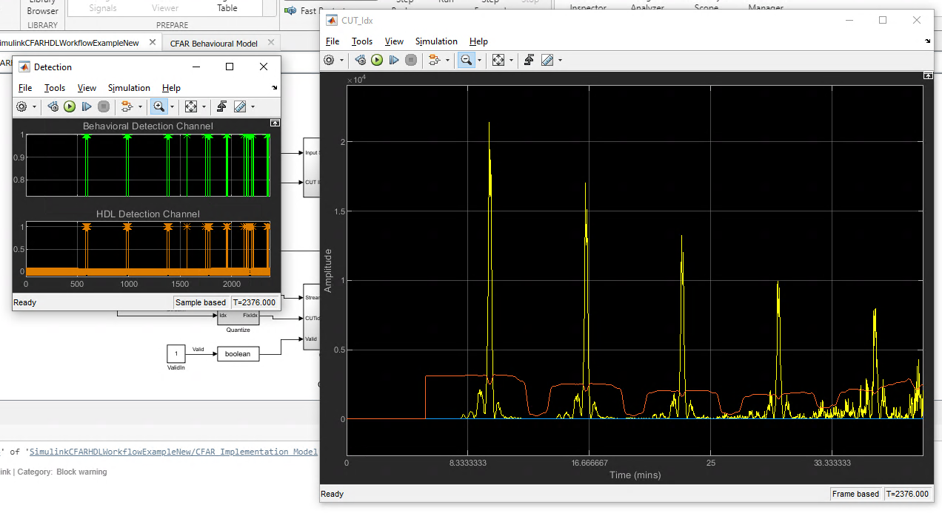
CA-CFAR Threshold Waveform
Here shows the CA-CFAR threshold waveform. According to the simulation result, the HDL detection output is same a behavioural detection output.

Slide 4
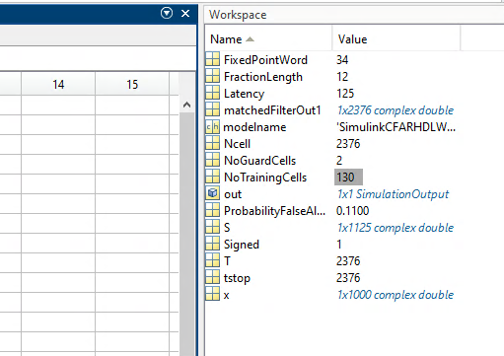
CA-CFAR Specification
To get better performance, I tuned the training cells number and PFA. Here shows the Simulink model parameters compare with matlab model specification.
Spec Item | Spec Value
Method | 'CA'
NumGuardCells | 1*2
NumTrainingCells | 500*2
ThresholdFactor | 'Auto'
ProbabilityFalseAlarm | 0.17
OutputFormat | 'CUT result'

Slide 5
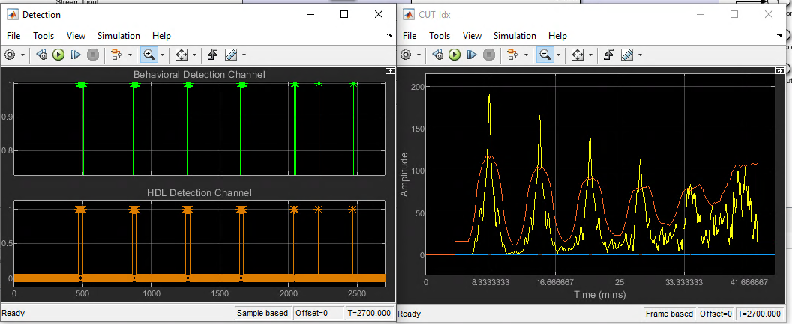
CA-CFAR Threshold Waveform
Because the input data change to double format, the square law module is no longer need. Here shows the threshold Waveform and Detection result.

Slide 6
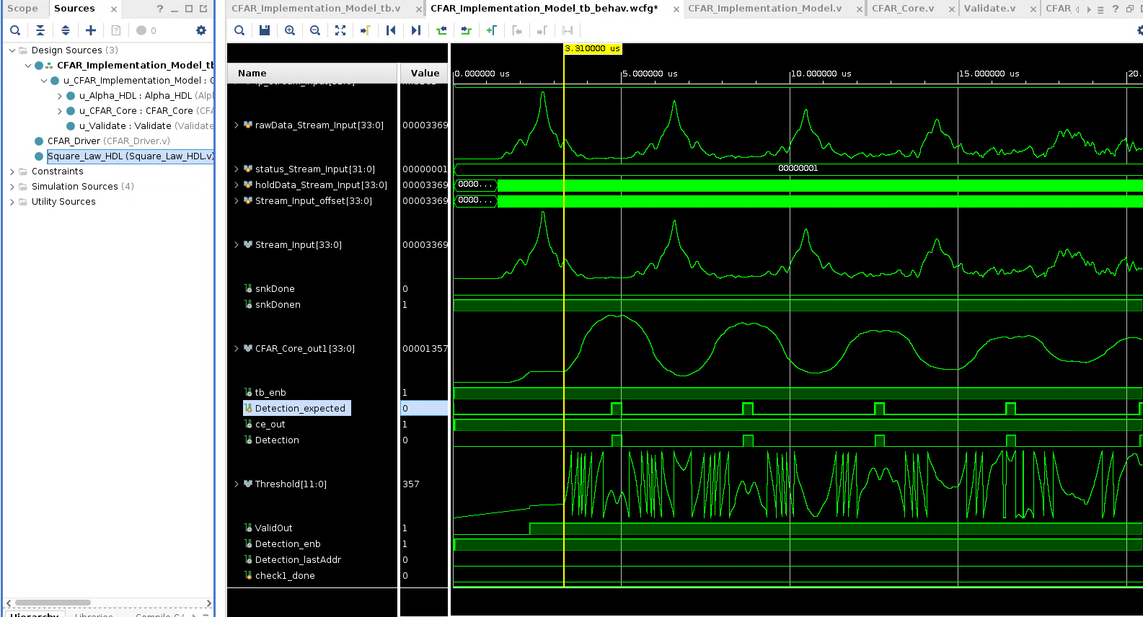
CA-CFAR HDL Code
The hdl code generated by using hdl coder of Simulink. Here shows the Stream Input and CFAR Threshold waveform.

