Slide 1
Gaming Platform Based on Blockchain and Crypto Technology

Slide 2
structure
01
05
Project Information
Social Responsibility
02
Idea and Concepts
06
Timeline
03
Business Model and Strategy
04
Creativity and Innovation

Slide 3
Project Information

Slide 4
Project Idea
Applying blockchain technology to build a gaming platform using crypto tokens for cross-game value transfer
Aims of the Project:
Achieving cross game assets transfer to benefit player’s gaming consumption experience
Dropping gaming company’s operation risk
Reducing payment platform’s service fee costed from gaming company
Lowering player losing rate of the games

Slide 5
Background and Project Abstract
Background
Gaming industry is growing in a rapid pace, the improvement of technology elevates players’ entertainment experience within games. Free to play and pay to win are the major business strategies deployed by the gaming companies in the market, players are induced to consume money to buy the gaming products and equipment for powering up their gaming characters.
If you have the experience of playing a game with money, you will be aware that all your investments in the game are bound to the game account. If one day you abandon the game, your gaming properties are left in the account, and the crucial fact is that they cannot be traded in for any valuable thing.
Project Abstract
We would apply blockchain technology to develop a gaming platform to issue crypto token for games. Gaming companies would be invited to join our platform to use our crypto token as the gaming currency. Users’ crypto wallets are the gaming wallets. Bitcoin will be used to purchase our platform’s crypto tokens for game stores’ consumption. As all the games share the common wallet and gaming currency, once the player abandons the game, he can trade-in his equipment and gaming products to other players for crypto tokens which can be used in other games. Gaming companies can earn players’ crypto tokens through selling gaming products in their game stores and imposing tax to the transactions between players. They can exchange the crypto tokens gained from the players to bitcoin through smart contracts as their income.

Slide 6



Our Team
Tsang Chin Fung
Blockchain developer and Marketing officer
Yang Yuening
Blockchain developer
He Huanchen
Blockchain developer
Undergraduate student at the University of Hong Kong with Computer Science and Finance major
Award winner in Samsung Solve for Tomorrow Competition 2019 (application development competition)
Good at software development and financial modelling
Great at administration work, as the Public Relations Officer of Politic and Public Administration Association in the University of Hong Kong
Working experience: Bank of China Hong Kong Fintech placement (2020-2021) Pearson Educational Limited Programmer (2020) China Development Bank Summer Analyst (2019) 91 Technology Limited Company Assistant Engineer (2018)
Undergraduate student at the University of Hong Kong with Computer Science major and Finance minor
Good at software development of both front- and back-end
Familiar with the blockchain and blockchain-related implementation knowledge and skills
Working experience: Tencent Video, iOS developer (2020) Tencent Cloud - Tencent Blockchain as a Service TBaaS, backend developer (2019)) Weizhi take-over, web developer (2019)
Undergraduate student at the University of Hong Kong with Computer Science major and Finance minor
Familiar with the blockchain and blockchain-related implementation knowledge and skills.
Working experience: China Construction Bank Fintech (2020) Zhong Zhao United (2019)

Slide 7
Idea and Concepts

Slide 8



Blockchain Gaming platform’s concept (1)
Blockchain’s membership
Qualification to join the platform
The gaming companies are the members in our permissioned blockchain, these companies will commonly use our platform’s crypto token as the virtual gaming currency in their games.
We will have strict control on our platform games’ quality, the games with low-quality will be refused to join the permissioned blockchain and issue games on our platform.
The games in our platform should support the in-game player transaction function, so that players can freely transact their gaming properties in the game.
Game A
Game C
The games should call our platform’s crypto wallet’s interface to use the crypto tokens issued by our platform as the gaming currency. Players can use the crypto tokens in the crypto wallet to buy gaming products in the game stores and transact with other players in the game.
Game B
Game D
Joining our platform
Our blockchain platform (ERC20 crypto token will be issued for gaming consumption purpose)

Slide 9
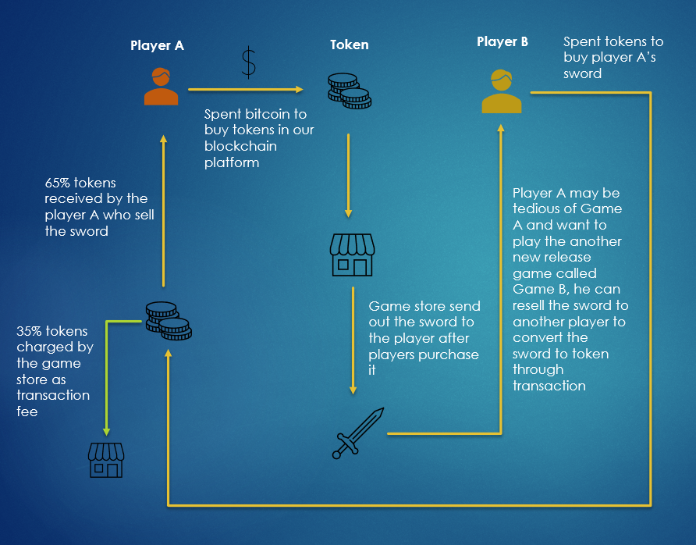
Blockchain Gaming Platform’s Concept (2)
In-game transaction
Our platform’s nature is to provide payment and transaction services. Just like other application platform like App Store and Google Play, however our payment and transaction services are based on the blockchain technology.
Platform’s token transaction mechanism:
Users’ crypto wallets will be the gaming wallets.
Players spend bitcoin to purchase our platform’s crypto tokens for game stores’ consumption.
Player can resell their gaming properties to other players for crypto tokens which can be used in all of the games on the platform
Transaction tax is imposed on the transactions between players, the transaction tax will be 35% of the token amount.

Slide 10
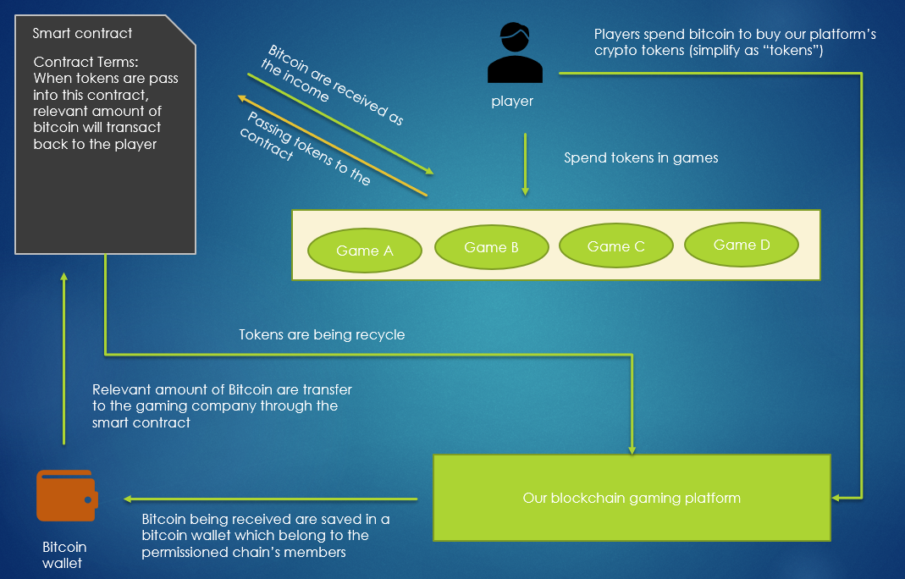
Blockchain Gaming Platform’s Concept (3)
Token-Bitcoin conversion
Our platform’s token is just a gaming currency, they are valueless outside the gaming world. We would provide smart contract for the gaming companies to convert the valueless token to Bitcoin as their income.
Token-Bitcoin conversion mechanism:
Players spend bitcoin to buy crypto token of our platform for in-game consumption
The bitcoin being received will be saved in a bitcoin wallet (*The bitcoin wallet would have strict access control, smart contract is the only way to access the bitcoin wallet)
The gaming company can gain tokens from gaming products selling in the game store and the taxation received from transaction among players.
Gaming companies can convert the tokens they gained to Bitcoin as their income.

Slide 11




Problems Solved by Our Project (1)
Problem: Gaming properties are not value conversable
Achieve cross game value transfer
Players’ investments in the game are bound to the game account. When they abandon the game, all the gaming properties are left in the account. They are not value conversable.
Crypto tokens will be used as a general gaming currency, so all the games share the common wallet and gaming currency. Once the player abandons the game, he can trade-in his equipment and gaming products to other players for crypto token which can be used in other games.
Problem: Gaming companies facing high operation cost
Reducing gaming company’s operation cost
Gaming companies rely on gaming platforms’ payment service to support their business for gaming products selling; However all gaming platform’s service fee are extremely high. They charge for more than 30% of the game’s revenue.
Our gaming platform is a decentralized application which involved with less agency organizations. Beside, our platform is specified in gaming, therefore it has less business requirements compared to other general application payment platforms like (Appstore and Google Play). These two factors allow our platform to keep low operation and maintenance cost, so our platform’s service fee will lower than other general payment platforms by 50%, only 15% of the gaming company’s revenue will be charged as platform service fee.
Problem: Gaming company having high operation risk
Dropping gaming company’s operation risk
Hackers are common to attack the gaming server to generate counterfeit currency. Counterfeit currency will disrupt the economy in the game and bring operation risk to the gaming companies.
Blockchain‘s immutable and traceable features guarantee no people can illegally generate unofficial gaming currency; It drops gaming company’s operation risk.

Slide 12

Problems Solved by Our Project (2)
Problem: Players are in high losing rate
Lowering the player losing rate of the game
Gaming is a competitive industries, chunk of games are issued everyday. Gaming company are always vexed at the player drain problem, as parts of the players will be run off from the old games to the new games.
As players are not able to refund the crypto tokens, the crypto tokens gained from equipment trade-in will be spent in other games on our platform. It ensures players of the games on our platform less likely losing to the external games outside our platform, the games on our platform are player active.

Slide 13
Business Model & Strategy

Slide 14

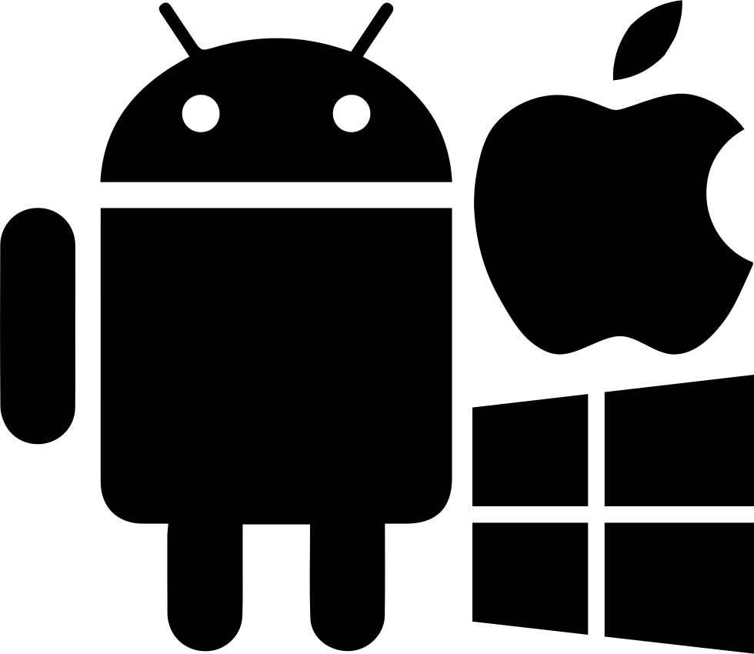
Platform Revenue
The revenue of this platform mainly comes from advertising fees and platform service fees
Advertising Fees
Platform Service Fees
Our platform‘s operation cost
In order to maintain our platform in a productive state, we need to carry out node maintenance and monitor hardware’s consumption.
Besides, we would continue to optimize the underlying implementation of our platform's blockchain and business services to improve the quality of the platform to achieve high stability, high security and high concurrency requirements.
Demand on advertising service
The games on the platform will compete on attracting platform users. They can increase the popularity of the game through advertising in our platform.
Platform fees charging
We would adjust the advertising fees based on the demand and supply of the advertising service.
Advertising fields will be set up on the platform web pages for game companies to place their company's game advertisements
Platform fees charging
We would tentatively charge 15% of the game companies’ income as the platform fee. The platform fee collection will be realized by smart contracts.
Corresponding platform fees will be charged from the game companies in proportion to their income.
85%
15%

Slide 15
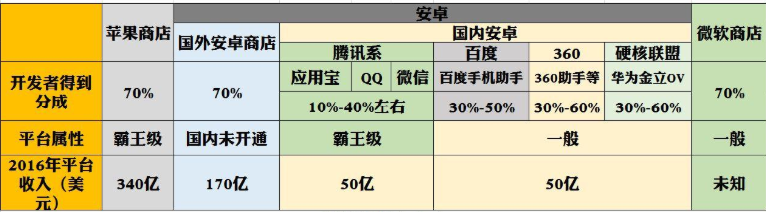
Marketing strategy
30%
Preferential platform fees
We hope to attract game companies to publish games on our platform with a lower platform fee to expand our market share of the game platform. Only 15% of the game revenue will be charged.
Platform fees comparison
As the figure below, all the mainstream application platforms’ commission rates is higher than 30%. The high expense decreases the profits of game companies. As mentioned above, our platform only charges 15% as the platform service fee, which is more than 50% cheaper than existing game platforms that support players to consume.
15%
Our platform
15%
>30%

Slide 16
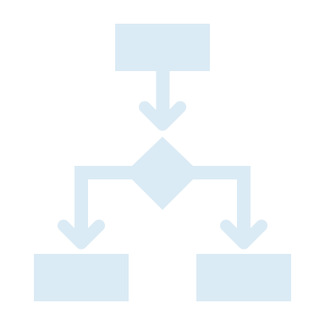

Strategy to Promote Platform Token Exchange
We have set out explicit development direction to initial and mid-development state. In the initial state, we would focus on the proof of concept work and business model evaluation. In the mid development state, we would launch measure to push the companies using platform general token instead of company tokens comprehensively.
Company token vs platform general token
The difference between platform token and game company token is that the former can be circulated in different games of different companies, while the latter can only be circulated in different games of the same company.
Rationale for us to provide the company token option
Initial state
Mid-development state
This plan is to give the game companies a transition period to test the impact of using a common game token on their revenue.
Using company token as the game currency will reduce the risk of players transferring their assets to other companies’ games, which will be easier to be accepted by gaming companies, increasing their willingness to participate in our platform.
Provide two token options for game company to use
Increase platform fees for the games using company tokens
Strategy to push the companies switching from company token to general platform tokens
We will increase the platform fees for the games using company token from the original 15% to 20%
In the initial stage, game companies can choose to use platform’s general token or issue their own company's crypto token on this platform as the game currency to participate in this platform.
In the middle stage, we would aim at promoting the use of common platform token as game currency for game companies. The platform fees will be increased for the company tokens’ transactions, it pushes the company to participate in the use of platform with lower platform fee

Slide 17
Technique Review

Slide 18
Permissioned Blockchain’s Features and Advantages
Decentralization
Authorization control
The blockchain platform is controlled by all the gaming companies who joined our platform instead of us. The game companies would trust on our platform, as the decentralized application prohibits us to takes all money away. The bitcoin wallet can only access by the Token-Bitcoin conversion smart contract.
The permissioned blockchain allows our platform doing authorization control. For example, the players are not allowed to convert tokens to bitcoin, so only the gaming companies will be granted with the right to call the smart contract for Token-Bitcoin conversion.
Features
High concurrency and low latency
Immutability
In-game transactions are high frequency, these transaction required real time update on the data. Compared to public blockchain, permissioned blockchain technology will have better performance with higher concurrent capacity and lower transaction latency.
The immutability feature ensure all trading records are traceable, so no people can illegally generate unofficial gaming currency, it lowers gaming company’s operation risk.

Slide 19
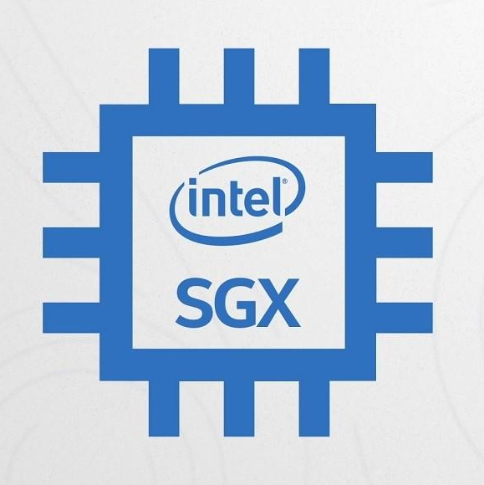
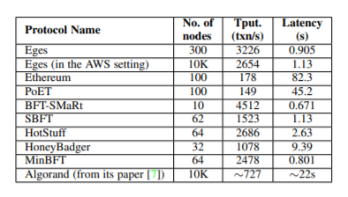
DOS Resistant Consensus
We will apply a DOS-resistant consensus called EGES for our blockchain. EGES utilizes Intel SGX hardware to guarantee of the blockchain’s security and efficiency.
Intel® Software Guard Extensions (Intel® SGX) official description
A set of instructions that increases the security of application code and data, giving them more protection from disclosure or modification. Developers can partition sensitive information into enclaves, which are areas of execution in memory with more security protection. (from https://software.intel.com/content/www/us/en/develop/topics/software-guard-extensions.html)
Intel SGX’s function:
SGX itself can ensure the code logic will not be tampered with and also the privacy of user data, and EGES does the DOS-resistant part and has an improvement in transaction rates.
EGES’s features and performance
Intel SGX provides a secure environment for the smart contract execution, so no people can manipulate the transaction results.
Besides, Intel SGX enable our blockchain platform recognizing the malicious, therefore it can filter out them to prevent DOS attacks.
In the performance perspective, EGES having low latency, high concurrent capacity and excellent scalability compared to other consensus. With amazon cloud setting, the blockchain can scale to 10K nodes, it can achieve 2650 transaction per second with just 1.13 second latency.

Slide 20
Social Responsibility

Slide 21

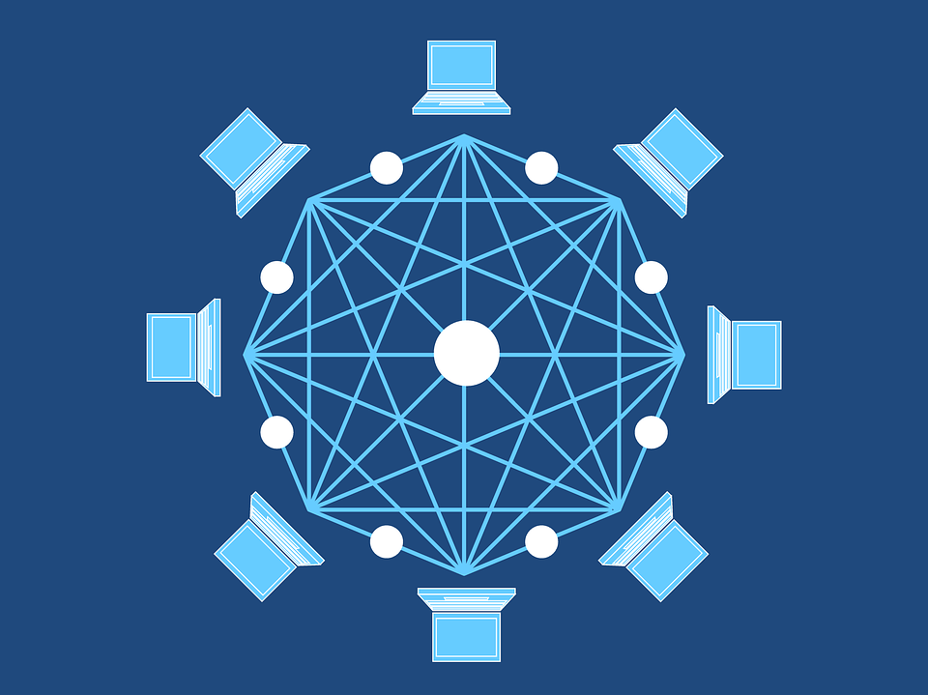

Social Responsibility
Popularizing blockchain decentralized application and technology
We believe that our blockchain gaming platform will benefit many gaming players. Through using our gaming platform, they can experience the advantages brought by blockchain technology, so our blockchain gaming platform can spread the blockchain knowledge to the general public.
Increasing blockchain developer’s job opportunities
The gaming companies using our platforms need to hire blockchain developers to integrate our crypto wallet interface to their games. Increasing in blockchain developer positions will turn out to facilitate blockchain experts’ breeding as more IT people will dedicate themself to the blockchain development field.

Slide 22
Timeline
Develop the frontend of our web-based gaming platform.
Write smart contracts to fulfill our business requirements.
Design on the system's architecture.
2020 Sept
2020 Nov
2021 Jan
2020 Oct
2020 Dec
2021 Feb
Develop the permissioned blockchain as the low-level implementation to support our gaming platform development. The blockchain platform will integrate with the intel SGX hardware to guarantee our blockchain platform's security and efficiency.
Connect the frontend of the gaming platform to our blockchain system, so interacting with UI to transact through the blockchain is available.
Test on our system's stability.
Write API document for our system to guide the gaming companies to integrate their games to our blockchain system.
Write and delivering white paper to show our idea and concept.
Release our gaming platform.

