Slide 1


FGP Loyalty Program: Customer Analytics for Retention and Value Management
LILY LEI Z5620411
SONGYUN ZHANG Z5620255
ZHE YANG Z5459640
YINGYING ZHANG Z5521377
ZICHENG ZHAO Z5706210

Slide 2

Managerial Problem
Customers differ significantly in value, engagement and churn risk
Limited retention resources make uniform strategies inefficient
Research Objectives
Identify customer segments using behavioural data
Examine drivers of customer value and loyalty
Use CLV and churn analysis to guide retention priorities
Analytical Approach
RFM-based segmentation (PAM clustering)
Regression analysis
CLV and churn prediction analysis
Purpose
Support targeted, efficient and financially justified customer retention strategies.
INTRODUCTION

Slide 3

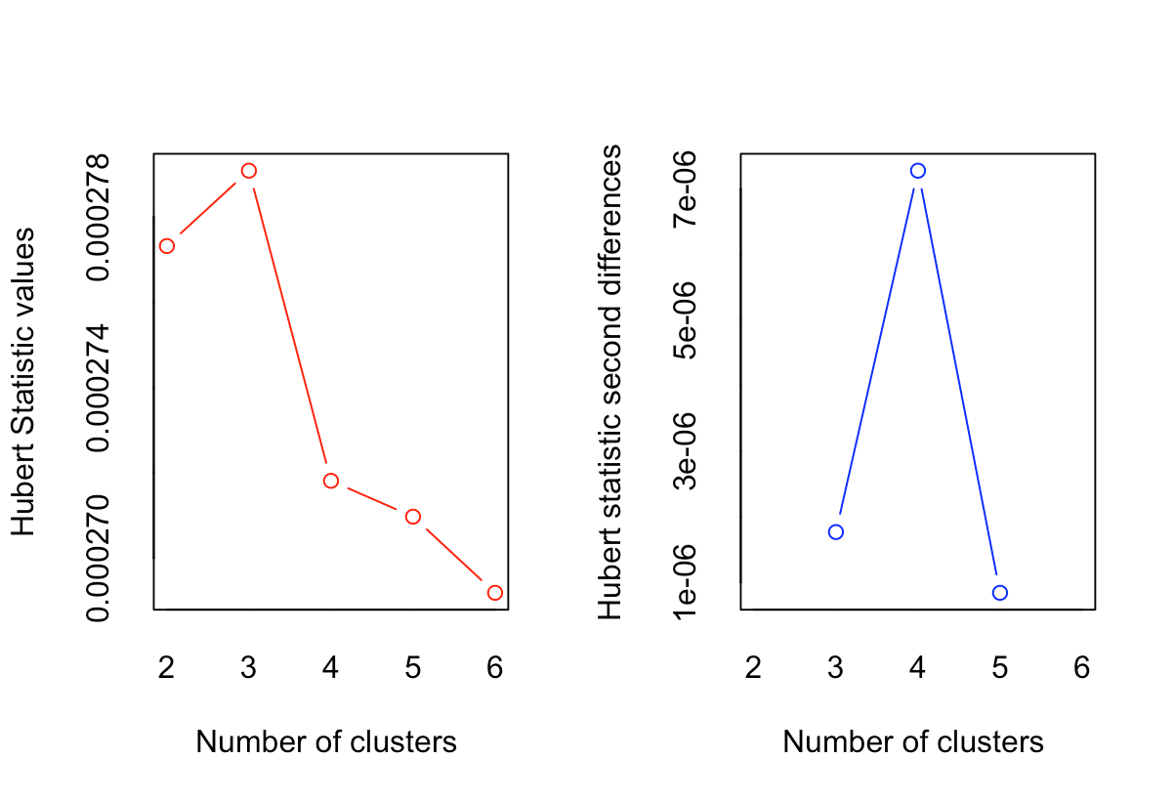
RQ1 · ANALYTICAL APPROACH
What Customer Segments Exist?
MANAGERIAL PROBLEM
How can FGP identify distinct customer groups to improve retention and maximise value? RQ1 is the foundation — without clear segments, downstream profiling and value estimation have nothing to build on.
Our approach — three deliberate choices
Choosing k = 3
1
RFM variables
NbClust aggregates 23 indices → majority rule selects k = 3; confirmed by Hubert and D-index.
Recency, Frequency, Monetary from 2018 transactions — practical behavioural indicators of customer value.
2
2018 only
Clean temporal separation — RFM from 2018, churn observed in 2019, so no information leakage.
3
PAM clustering
Robust alternative to K-means — less sensitive to instability from heavy-spender outliers.
Hubert index — clear structural break at k = 3

Slide 4
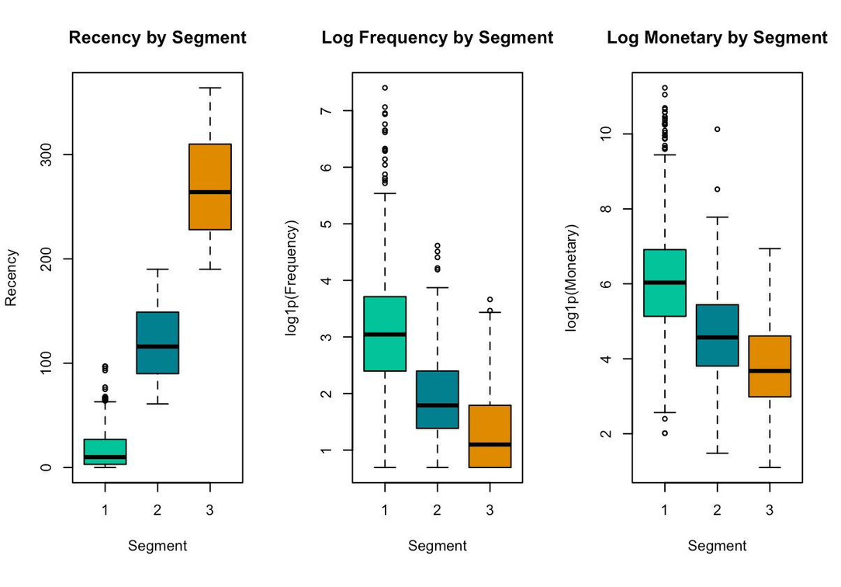
RQ1 · DESCRIPTIVE STATISTICS
Substantial Heterogeneity in Customer Behaviour
Table 1. 2018 RFM distribution (N = 3,214)
Figure 1. RFM distribution across the three segments
Statistic | Recency (days) | Frequency (txn) | Monetary ($)
Min. | 0 | 1 | 2.0
1st Qu. | 7 | 4 | 71.6
Median | 34 | 11 | 219.1
Mean | 78.04 | 24.81 | 794.5
3rd Qu. | 123 | 27 | 648.6
Max. | 364 | 1,641 | 75,439.8
Highly right-skewed — small group drives most activity
Mean Monetary is $794 vs median $219. Mean Frequency is 24.8 vs median 11. A small share of customers accounts for a disproportionate share of spending — motivating clustering rather than averages.
Clear behavioural gradient: Segment 1 is the most engaged, Segment 3 the least — on every RFM dimension.

Slide 5
RQ1 · §2.3 SEGMENTATION RESULTS
Three Distinct Customer Segments
Seg | Label | n | Share | Avg Recency | Avg Freq. | Avg Spend ($) | 2019 Churn
1 | High-Value Customers | 1,968 | 61.2% | 17.2 days | 36.3 | 1,181 | 7.9%
2 | At-Risk Customers | 789 | 24.5% | 120 days | 8.1 | 234 | 38.1%
3 | Dormant Customers | 457 | 14.2% | 268 days | 4.1 | 98 | 71.1%
Segment 1 — High-Value (61.2%)
Segment 2 — At-Risk (24.5%)
Segment 3 — Dormant (14.2%)
The core active base. Purchased recently and frequently, highest spending, low churn. The program's financial backbone.
Activity clearly lower than Segment 1 — longer inactivity, lower spend. 38% already churning; retention efforts here can make the most difference.
Long inactivity, minimal spending, 71% churn. Heavy retention investment unlikely to be effective for this group.
Churn rises from 7.9% → 38.1% → 71.1% — 2018 behaviour already foreshadows 2019 retention outcomes.
Notes:
The PAM clustering produced three clearly distinct segments.
Segment 1, High-Value, is the biggest — 61% of the base. They buy recently, frequently, and with the highest spending. Churn is just 7.9%. This is the program's core active base.
Segment 2, At-Risk, is 25%. Activity is clearly lower, many haven't purchased in months, and 38% are churning. This is the group where retention work can make the biggest difference.
Segment 3, Dormant, is 14%. Long inactivity, minimal spending, and 71% churn. Most are effectively gone.
The bottom strip shows the most important pattern: segment-level churn rises from 8% to 38% to 71% — essentially five-fold at each step. So our 2018 behavioural segmentation already predicts 2019 retention very strongly. This is our external validation that the segments are managerially meaningful — not just statistically different.
3

Slide 6
RQ1 ANSWERED · TO RQ2 & RQ3
What We've Answered — and What Comes Next
RQ1 — ANSWERED
Three behaviourally distinct segments exist in the FGP programme.
High-Value (61%) · At-Risk (25%) · Dormant (14%) — statistically robust, cleanly separated, and already strongly predictive of 2019 churn at the segment level.
Segment-level findings raise two deeper questions:
RQ2
RQ3
How do segments differ in who the customers are?
How do value and individual churn risk differ?
Beyond RFM — do demographics, satisfaction, and advocacy differ systematically? What drives high-value membership and NPS?
Segment-level churn is a start — individual CLV and logistic churn probabilities turn the segmentation into a concrete priority matrix.
Next: customer profiling via regression
Next: CLV estimation & priority matrix

Slide 7
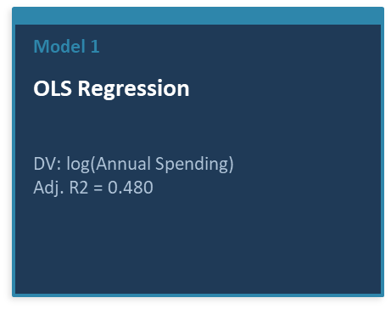
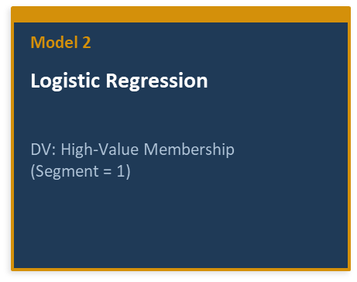
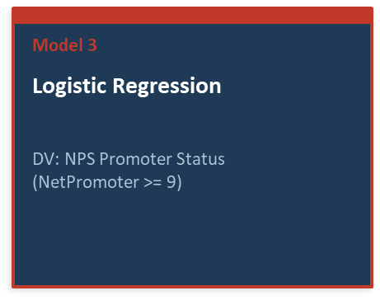
RQ2: SEGMENT PROFILING VIA REGRESSION ANALYSIS
UNDERSTANDING WHAT DRIVES CUSTOMER SPENDING, HIGH-VALUE MEMBERSHIP, AND NPS ADVOCACY
Data: 3,214 FGP loyalty program members | IVs: 4-dimensional satisfaction + demographics | Period: 2018-2019
SEGMENT 1: HIGH-VALUE
n = 1,968 (61.2%)
SEGMENT 2: AT-RISK
n = 789 (24.5%)
SEGMENT 3: DORMANT
n = 457 (14.2%)

Slide 8
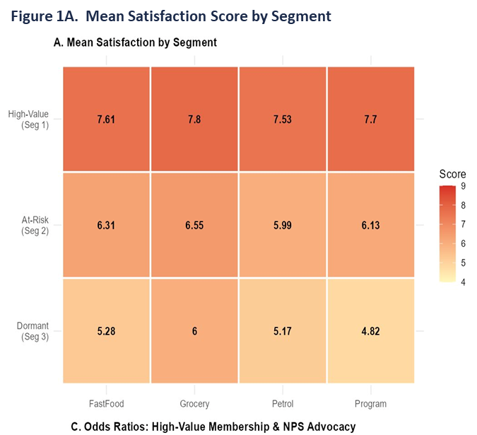
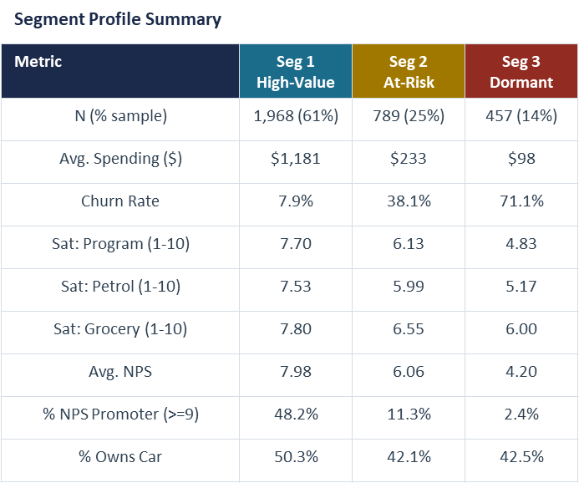
THREE DISTINCT SEGMENTS: SATISFACTION AND KEY METRICS DIVERGE SIGNIFICANTLY (ANOVA P < 0.001)
HIGH-VALUE CUSTOMERS SPEND 12X MORE AND CHURN 9X LESS THAN DORMANT CUSTOMERS — ALL SATISFACTION GAPS ARE HIGHLY SIGNIFICANT ACROSS SEGMENTS

Slide 9
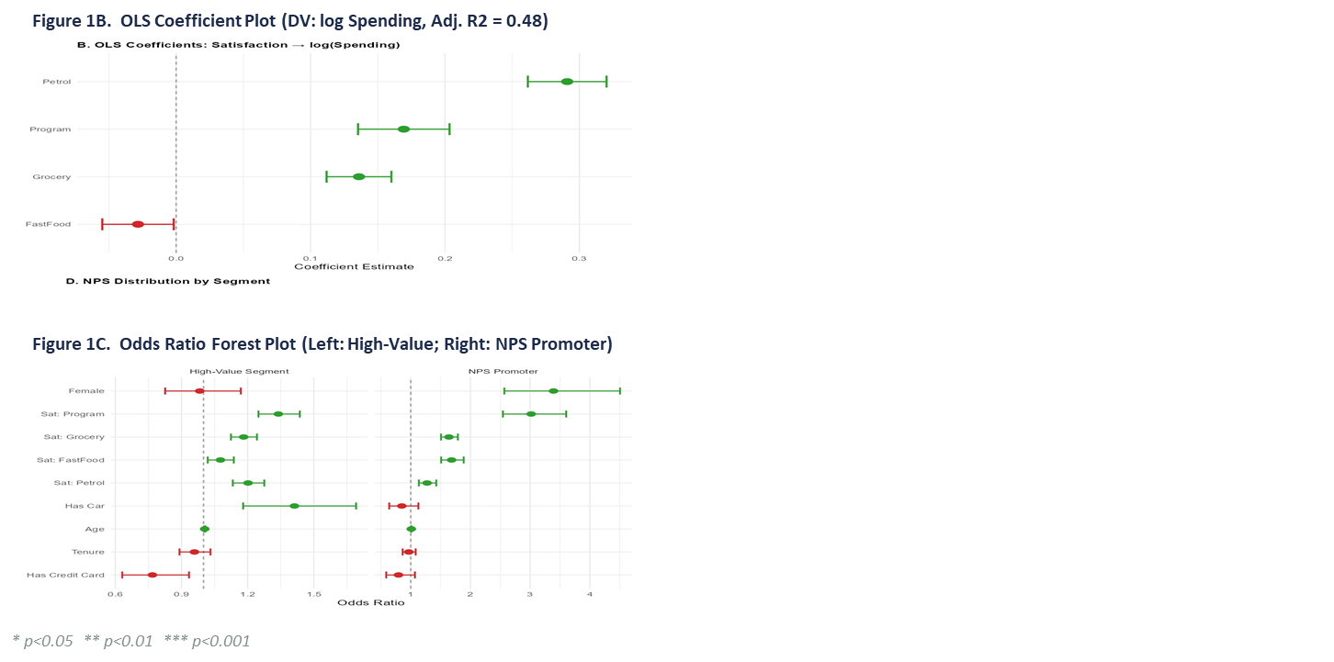
REGRESSION RESULTS: HOW DO SATISFACTION AND DEMOGRAPHICS PREDICT CUSTOMER SPENDING AND VALUE?
MODEL 1 KEY FINDINGS (OLS)
Petrol satisfaction is the strongest spending driver (b = 0.291***) — each +1pt adds ~34% in spending
Program (0.169***) and grocery satisfaction (0.136***) are also positive and significant
FastFood satisfaction has a small negative effect (-0.028*) — likely channel substitution
Car owners spend 21% more (0.193***); longer tenure is associated with lower spending (-0.080***)
MODEL 2 & 3 KEY FINDINGS (LOGISTIC)
Program satisfaction is the strongest predictor of high-value membership (OR = 1.34***)
Car owners are 41% more likely to be high-value customers (OR = 1.41***)
Credit card holders are less likely to be high-value (OR = 0.77**) — possibly multi-program spending
Program satisfaction dominates NPS advocacy (OR = 3.02***); female customers are 3.4x more likely to be Promoters (OR = 3.39***)

Slide 10
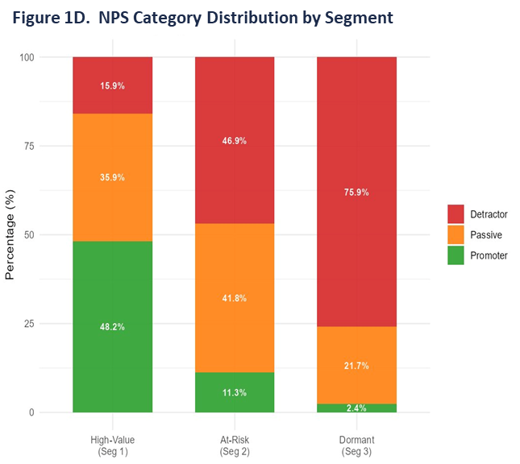
FROM INSIGHT TO ACTION: THREE MANAGERIAL RECOMMENDATIONS
PRIORITISE PETROL & PROGRAM SATISFACTION
Petrol satisfaction is the top spending driver (b = 0.291***) and program satisfaction governs both high-value membership and NPS advocacy. Improve petrol service quality to lift transaction volume, and strengthen the coalition's overall value proposition.
TARGET CAR OWNERS AS A PRIORITY ACQUISITION SEGMENT
Car owners are 41% more likely to be high-value (OR = 1.41***) and spend 21% more. Use OwnCar = Y as a targeting criterion in recruitment campaigns, and consider bundled petrol-point offers to onboard new members.
ACTIVATE FEMALE PROMOTERS FOR LOW-COST GROWTH
Female customers are 3.4x more likely to be NPS Promoters (OR = 3.39***) — the largest single-variable effect in the study. Design female-targeted referral programmes to leverage word-of-mouth as a low-cost acquisition channel.
SATISFIED CUSTOMERS DON'T JUST STAY, THEY RECRUIT. PROGRAM SATISFACTION (OR = 3.02) IS THE SINGLE MOST POWERFUL LEVER FOR TURNING CUSTOMERS INTO GROWTH ASSETS.

Slide 11

RQ3 CUSTOMER VALUE & CHURN:
WHO TO KEEP AND WHERE TO ACT?
• Not all customers contribute equally
• Retention budget is limited
• Need to prioritise based on value + risk

Slide 12
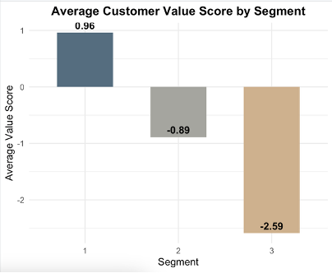
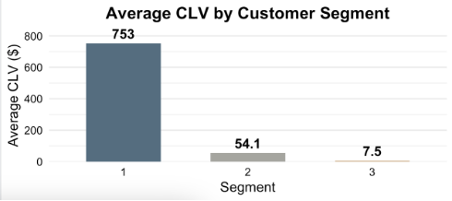
5.1 CUSTOMER VALUE（CLV）
SEGMENT 1: HIGHEST CLV (~$753)
SEGMENT 3: VERY LOW CLV (~$7.5)
VALUE IS HIGHLY UNEVEN ACROSS CUSTOMERS

Slide 13
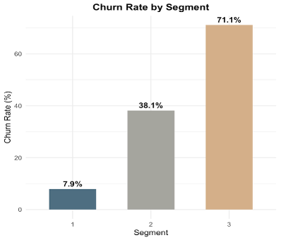
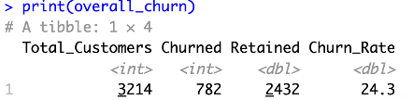
5.2 CHURN RISK
CHURN RISK IS BEHAVIOUR-DRIVEN
OVERALL CHURN: ~24%
SEGMENT 2: HIGHEST CHURN RISK
BEHAVIOUR STRONGLY PREDICTS CHURN

Slide 14
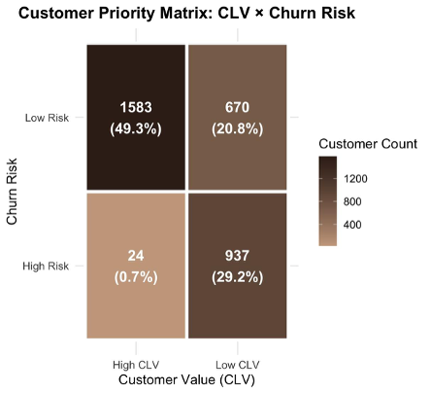
5.2 CHURN RISK
WHERE SHOULD JENNIFER FOCUS?
HIGH CLV + HIGH RISK → PRIORITY
HIGH CLV + LOW RISK → PROTECT
LOW CLV + LOW RISK → GROW
LOW CLV + HIGH RISK → LOW PRIORITY
Only 24 customers are high-value & high-risk
• CLV based on assumptions (10% margin, discount)
• Model uses one-year data
• Near-perfect separation affects generalisability
5.3 LIMITATION

Slide 15
Managerial Recommendations
Retain High-Value At-Risk Customers
Use personalised rewards and targeted engagement
Prioritise retention investment by CLV and churn risk
Develop Under-Engaged Customers
Apply cross-merchant promotions and tailored incentives
Improve satisfaction to strengthen loyalty
Limit Investment in Dormant Customers
Use low-cost reactivation only
Focus resources on higher-return segments
Embed Predictive Analytics
Update churn models regularly
Use CLV and risk-based targeting
Strategic Implication
Shift from uniform retention spending to value-based resource allocation.
MANAGERIAL RECOMMENDATIONS

Slide 16
Key Findings
Three distinct customer segments were identified
Customer value and churn risk differ substantially across segments
Satisfaction is a key driver of spending, loyalty and advocacy
Managerial Implications
Prioritise high-value customers at risk of churn
Use lower-cost activation for under-engaged customers
Limit intensive investment in low-value dormant customers
CONCLUSION

Slide 17
REFERENCES
Ali, N. and Shabn, O.S. (2024) ‘Customer lifetime value (CLV) insights for strategic marketing success and its impact on organizational financial performance’, Cogent Business & Management, 11(1), 2361321. doi:10.1080/23311975.2024.2361321.
Curiskis, S., Dong, X., Jiang, F. and Scarr, M. (2023) ‘A novel approach to predicting customer lifetime value in B2B SaaS companies’, Journal of Marketing Analytics, 11, pp. 587–601. doi:10.1057/s41270-023-00234-6.
Gayam, S.R. (2022) ‘Enhancing customer retention in e-commerce with AI: Techniques for predictive analytics, personalization, and loyalty programs’, Australian Journal of Machine Learning Research & Applications, 2(1), pp. 45–61. Available at: https://www.sydneyacademics.com/index.php/ajmlra/article/view/121 (Accessed: 18 April 2026).
Maldonado, S., Ríos, J., Mora, E. and Castillo, P. (2025) ‘A predictive analytics approach to improve telecom’s customer retention’, Frontiers in Artificial Intelligence, 8, 1600357. doi:10.3389/frai.2025.1600357.

Slide 18
THANK YOU

