Slide 1
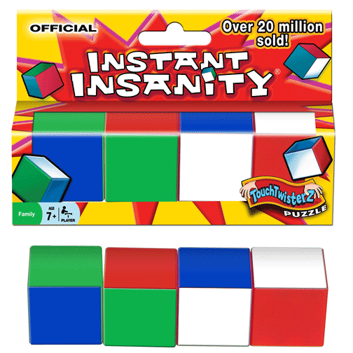
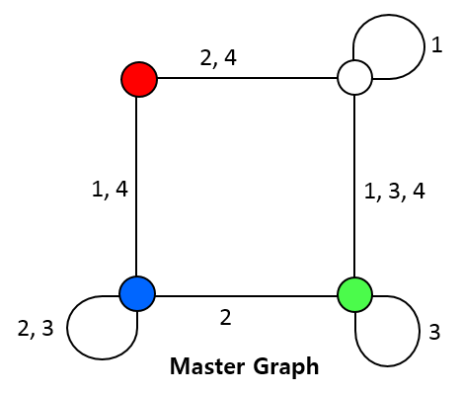
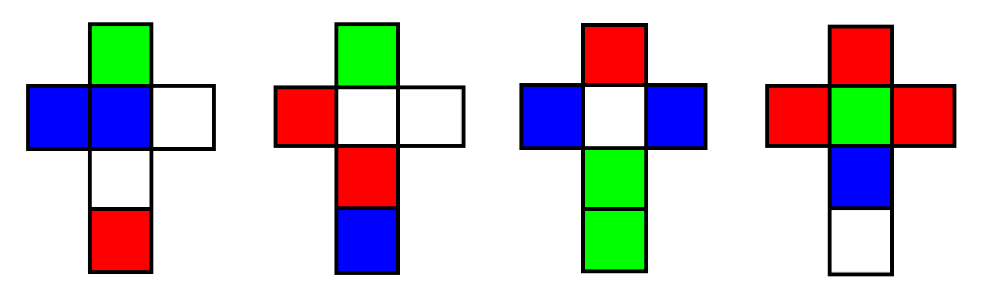
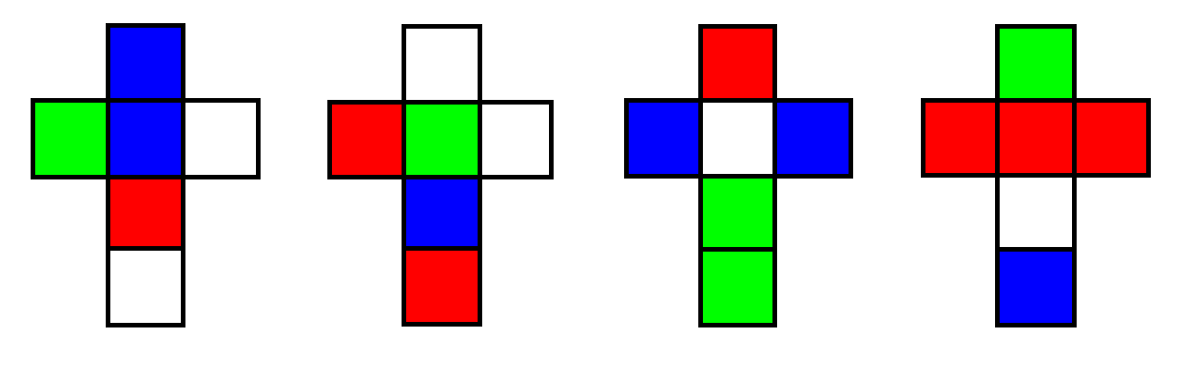
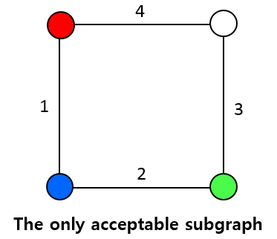
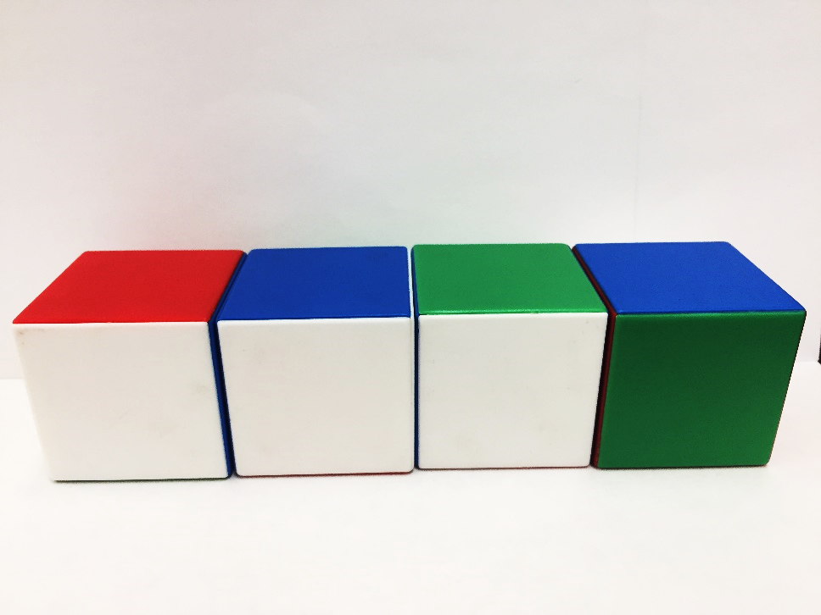
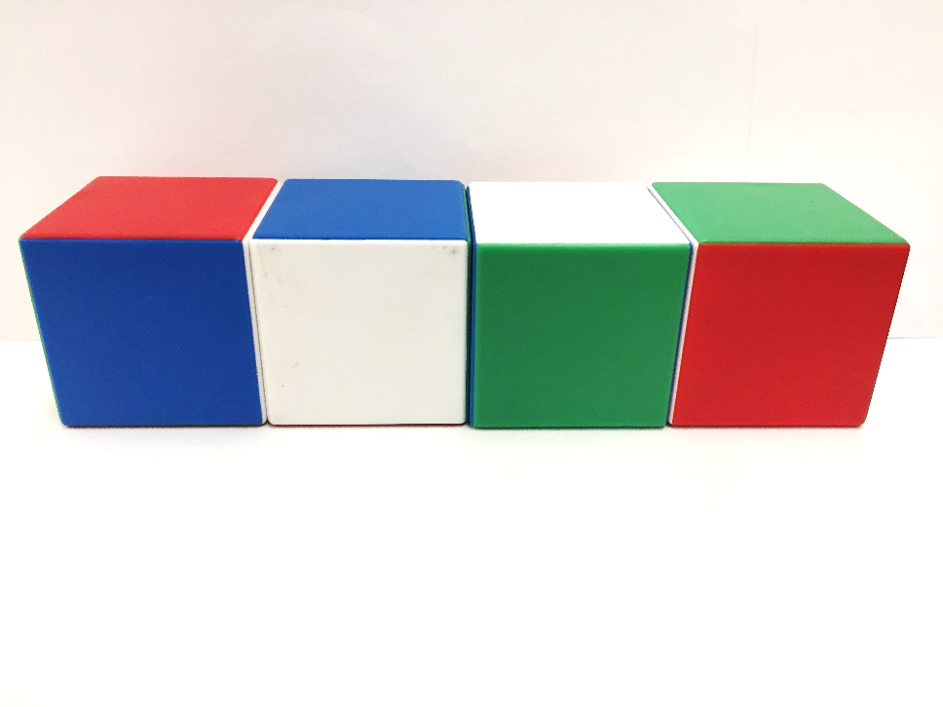
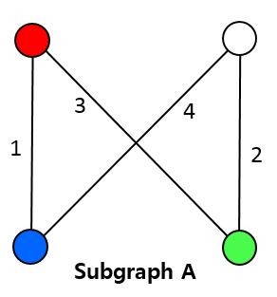
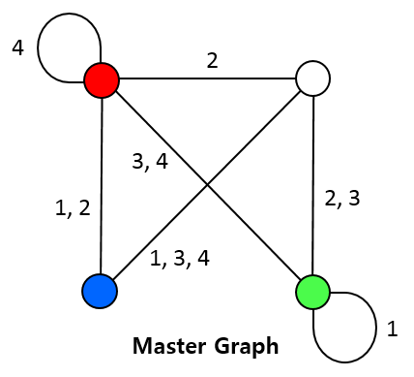
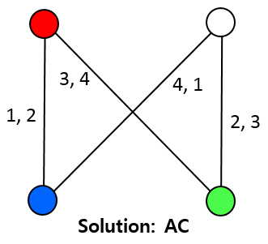
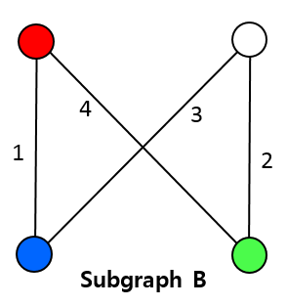
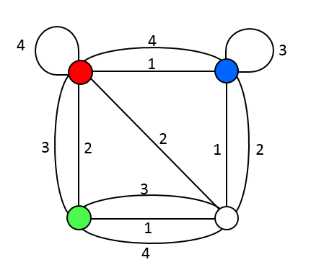
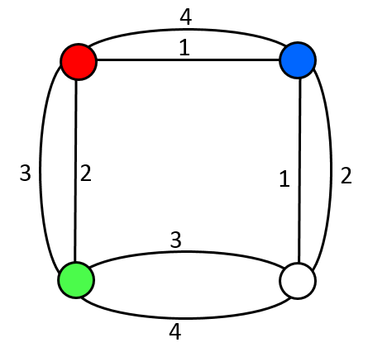
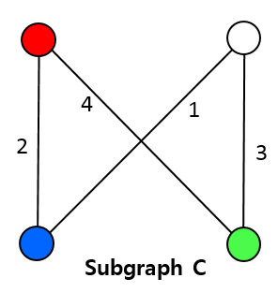
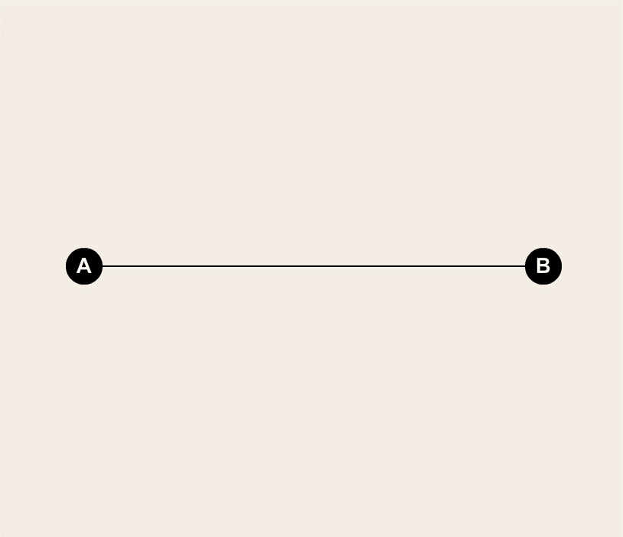
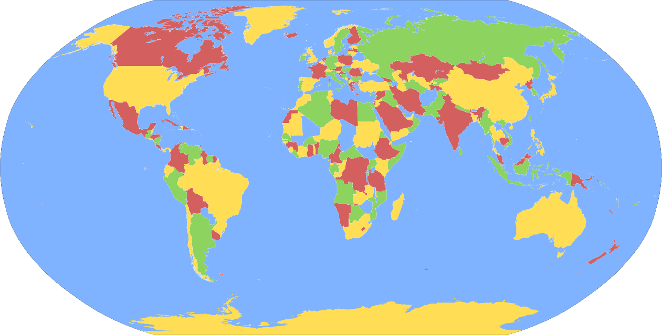

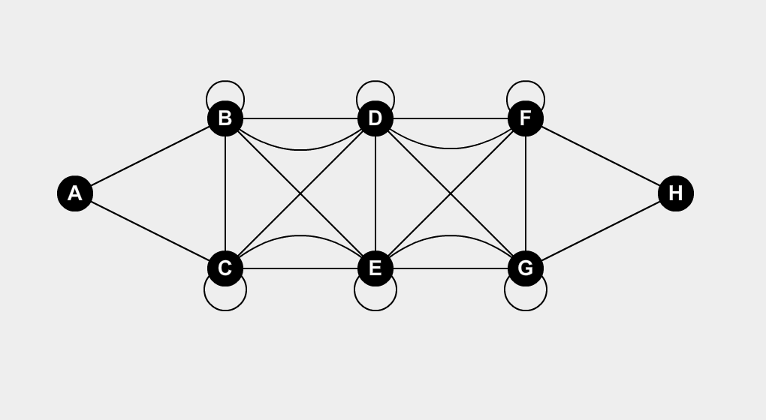
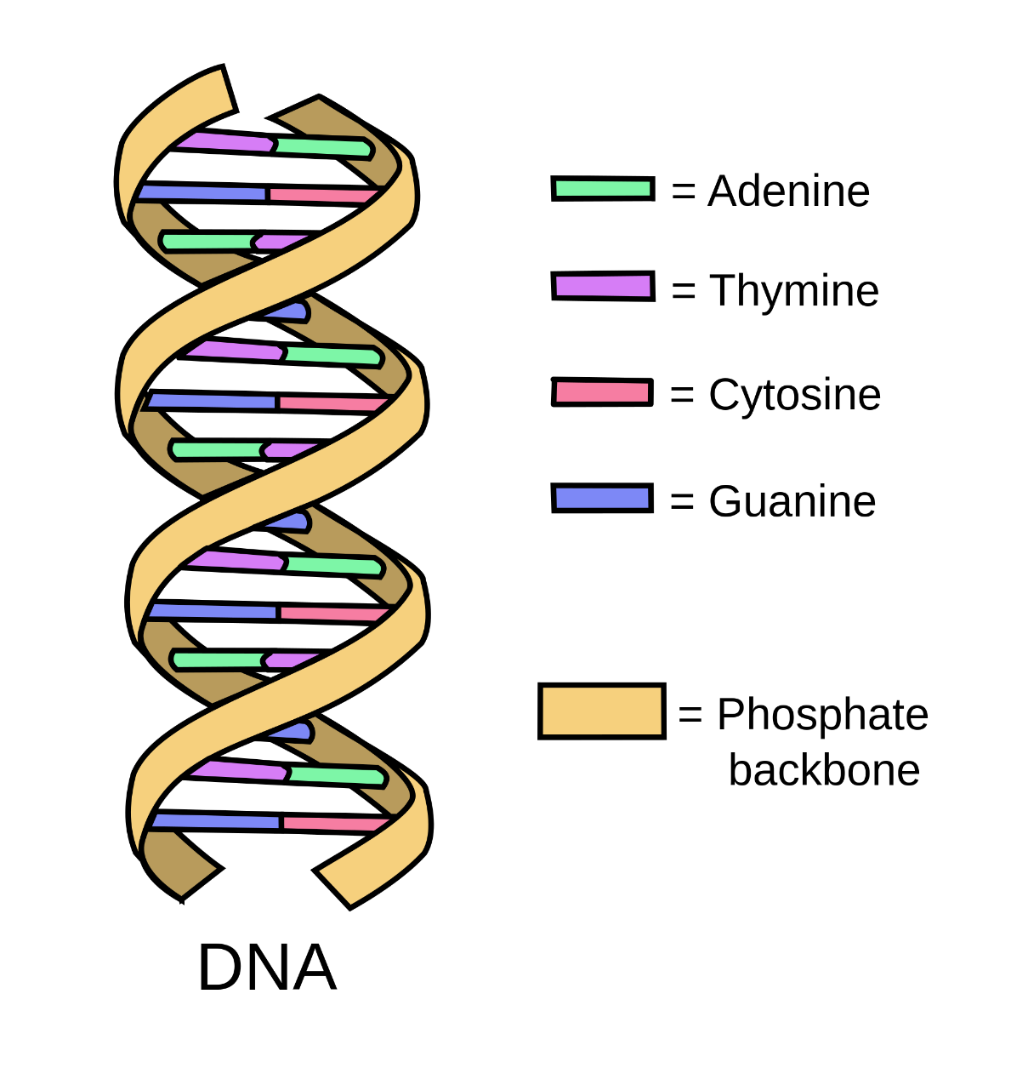
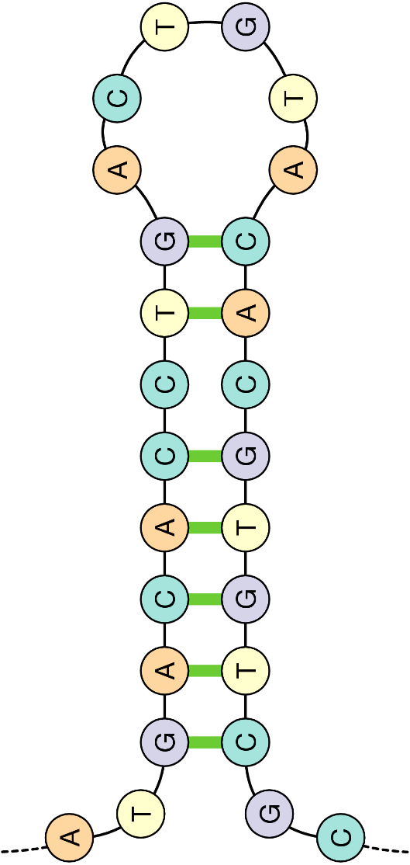
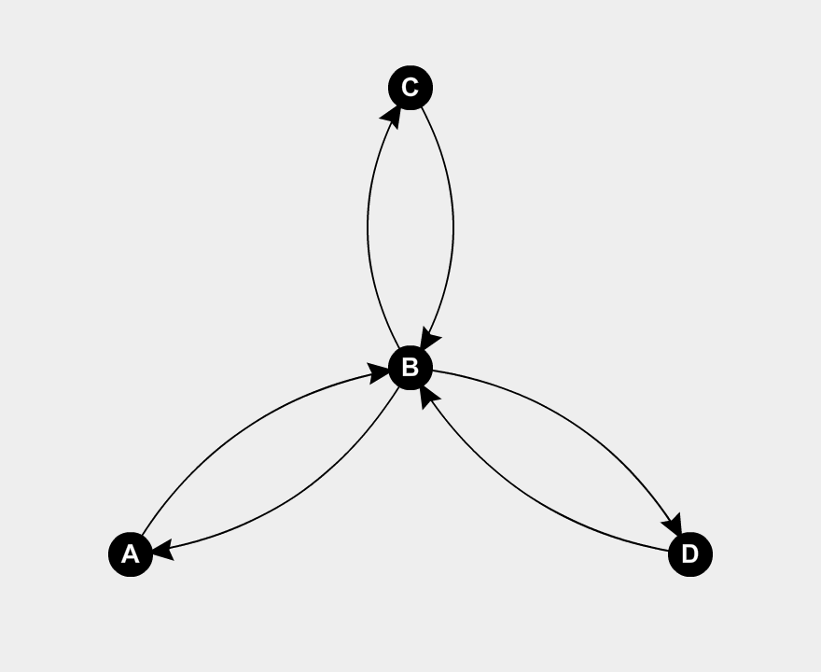
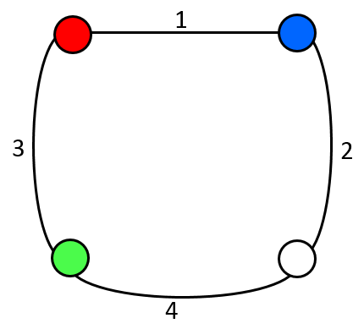
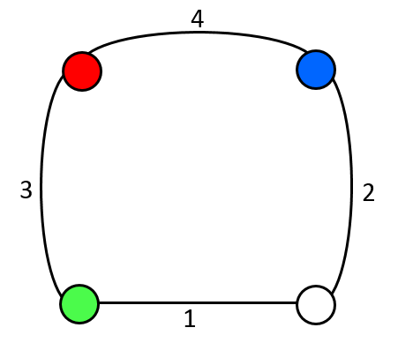
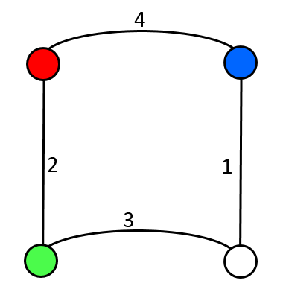
A Tantalizing Twist with Cubes
Nicholas Brandt – Thoa Ta – Yi Yi (Lily) Zhang
Faculty Mentor: Satyanand Singh, Ph.D.
Division of Computer Science – College of Professional Studies
SUMMARY OF THE PUZZLE
PROCEDURE
MORE EXAMPLES
We start with 4 cubes, and each face on a given cube is shaded one of the 4 colors (R, W, B, G). The goal is to arrange the cubes into a rectangular log so that each long side of the log has one and only one occurrence of each color.
41,472 possible arrangements if done by hand! Is there a more efficient way?
The procedure here features the set of cubes in the commercially sold “Instant Insanity.”
An example that does not work:
An example that works (Arlinghaus, 1991):
UNSOLVED
SOLVED
NO
SOLUTION
Unsolved state
Solved state
ONE
SOLUTION
OVERVIEW - GRAPH THEORY
Graphs help represent a set of data, and any relationships inherent within that set, in a more intuitive way.
Master Graph
The only solution: A-C combined
Vertices: A, B
Edge: the line connecting A and B
Degree of a vertex: number of edges that touch that vertex
Simple graph: unweighted, undirected, no loops or multiple edges
Loop: an “edge” which joins a vertex to itself
Complex graph: with loops and multiple edges
Directed graph: edges have directions
← This is an example of an Euler cycle (visits every edge exactly once)
APPLICATIONS - GRAPH THEORY
Acceptable subgraphs: subgraphs with degree-2
METHOD
REFERENCES
A graph with 4 vertices labelled R, B, W, G.
To describe the relationship between two opposite faces, an edge is drawn between the vertex(es) corresponding to their color(s).
Arlinghaus, W. C. 1991. “The Tantalizing Four Cubes.” In John G. Michaels and Kenneth H. Rosen, editors, Applications of Discrete Mathematics, chapter 16. McGraw-Hill Higher Education.
A
B
C

