Slide 1

POOR MONEY MANAGEMENT
is one of the top reason that cause bankrupt

Slide 2


The earlier a child or teenage learn about finance, the better money manager they will become

Slide 3

But
there are few
CHALLENGE

Slide 4


They are hard to understand that the money is earned
instead of taking from parent

Slide 5


They are hard to understand the
VALUE OF MONEY

Slide 6


Lack of
MOTIVATION

Slide 7


Real world
economic
environment
Hard to explain

Slide 8


Hard to deliver
FINANCE MESSAGE
to them

Slide 9


How to
Overcome
these challenge

Slide 10
Introducing
A gamification solution that make a better education way by connecting youth with parent and social media
littleWallet

Slide 11


Here is
HOW IT WORK

Slide 12
First
Child/teen login with bank account
LOGIN

Slide 13
Parent bank account
Hobby / interested thing
Setup their profile
Finance goal
Social media account

Slide 14

Parent login and verify their child account

Slide 15
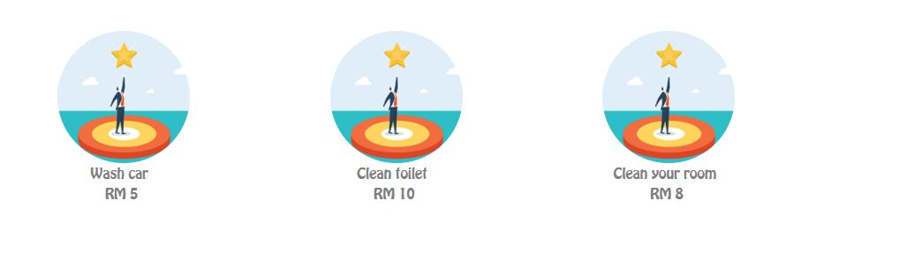
Parent create task with
amount of money

Slide 16

Once child/teen is complete the task
Parent click on complete button and
money will transfer to their account

Slide 17
It teach youth to understand that
THE VALUE OF MONEY
THE REAL WORLD ECONOMIC
MONEY IS EARNED

Slide 18
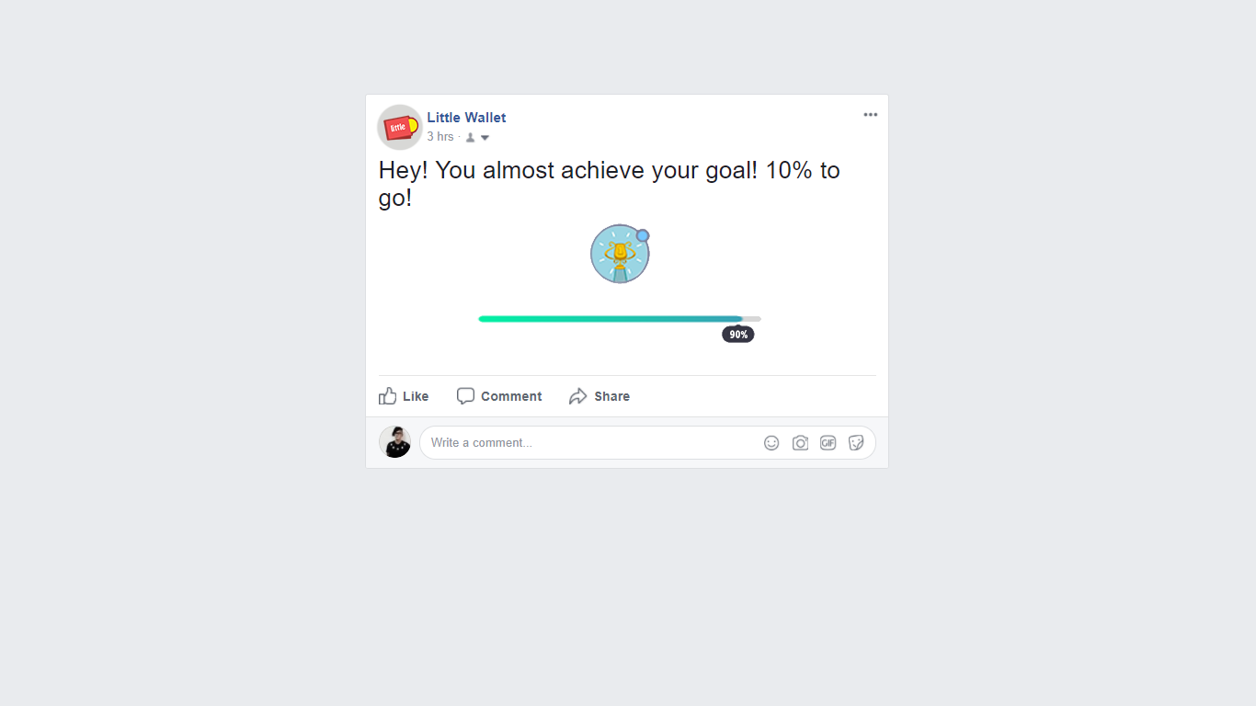
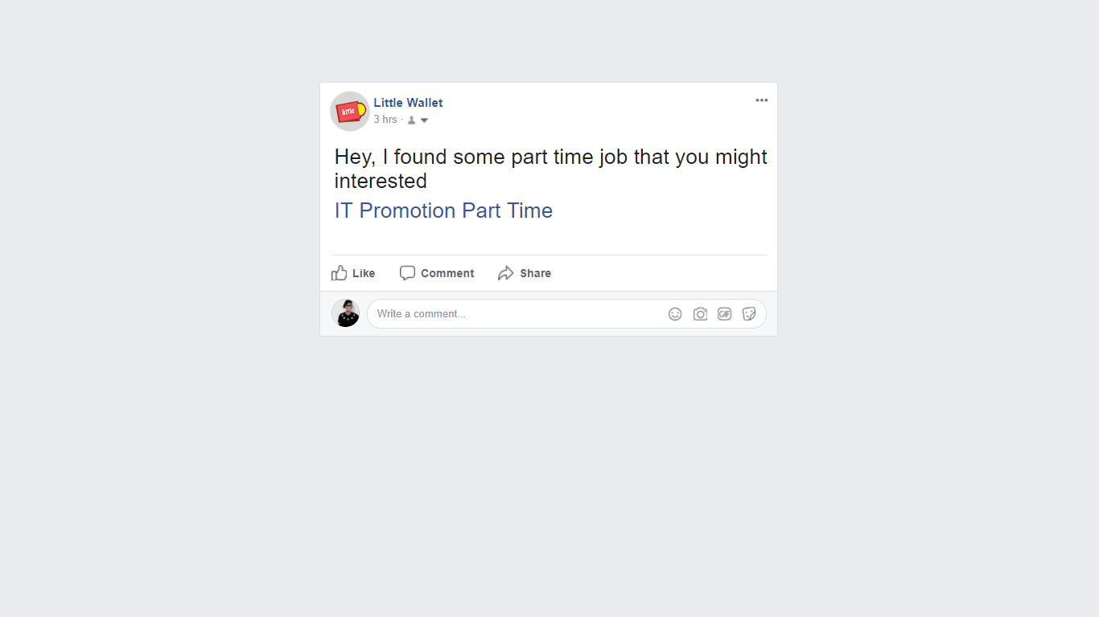
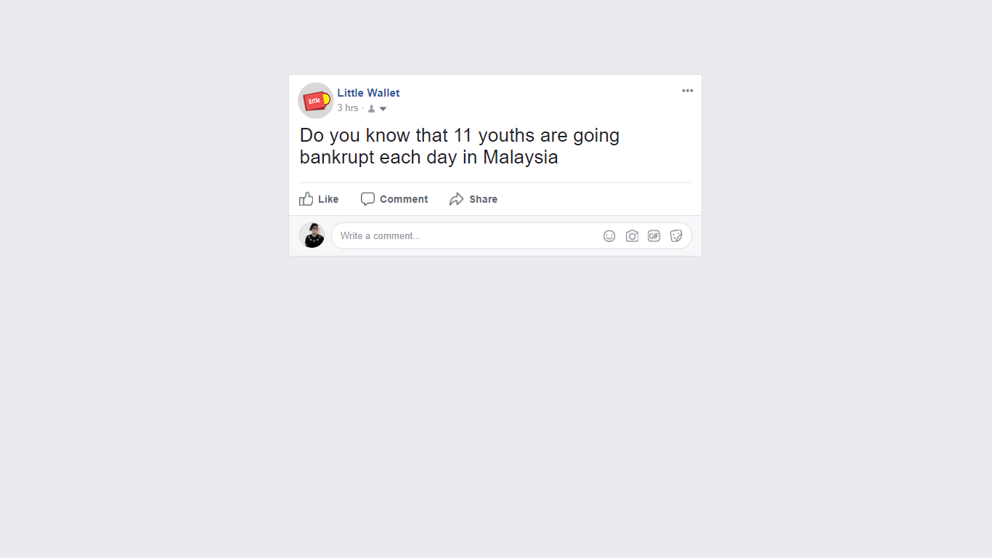
social media bot will post
Finance message
privately
to the user
Job
Status

Slide 19

Teenage access social media app
average 8 times per day
Social media is best place to deliver message

Slide 20

Lastly
Parent can check their child spending behave and money management prediction model based on their spending data

Slide 21
littleWallet
better way to educate youth

