Slide 1

Predicting Solar Power Generation
Jungju Lim, Tracy Strycharski, Robert Thomas III, Aaron Wong

Slide 2


Data Overview
Dataset contains information from two solar power plants in India over a 34-day period in May-June 2020
Composed of four separate csv files
Power generated by each inverter in a 15-minute period (2)
Corresponding weather data (2)
Combined the four files into one complete dataset before starting analysis
Shape: (143616, 9)
Notes:
Data collected at the inverter level
Changes applied to the dataset: created one master csv by joining the weather data with the power generation data from each plant

Slide 3
Data Overview
Field Name | Description
NEW_PLANT_ID | Indicates if the reading came from Plant 1 or Plant 2
NEW_SOURCE_KEY | Identifies the unique inverter in each observation
AMBIENT_TEMPERATURE | Ambient temperature at the plant at the time of the observation (Celsius)
MODULE_TEMPERATURE | Temperature of the module (solar panel) at the time of the observation (Celsius)
IRRADIATION | Total solar irradiation over each 15-minute interval
DC_POWER | Amount of DC power generated in the 15-minute interval
AC_POWER | Amount of AC power generated in the 15-minute interval
DATE | The date of the observation
TIME | The time of the observation
Notes:
Initial source keys were long strings, converted these to integers
Irradiation levels will be 0 overnight and grow throughout the day

Slide 4
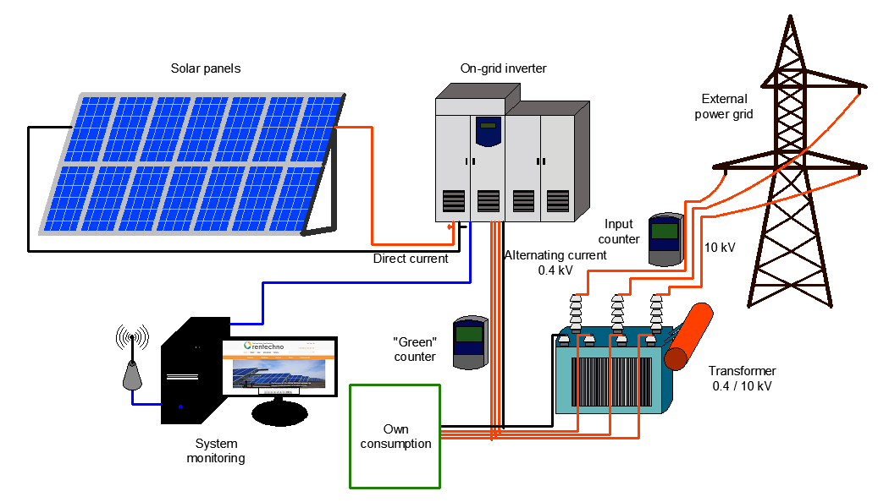
Data Overview
Each plant collected data at the inverter level
Inverters are used to convert the DC power generated by solar panels into AC power
Notes:
Each plant has 22 inverters

Slide 5
Business Objectives
Optimize the plant’s energy output through the following measures:
Predictive model to forecast power based on weather data
Identify underperforming inverters
Compare the output of both plants to identify improvement opportunities
Notes:
More companies are turning toward green energy sources such as solar, which makes it a timely topic
Also has as number of business applications
Essential to be able to forecast energy production in order to meet demand

Slide 6
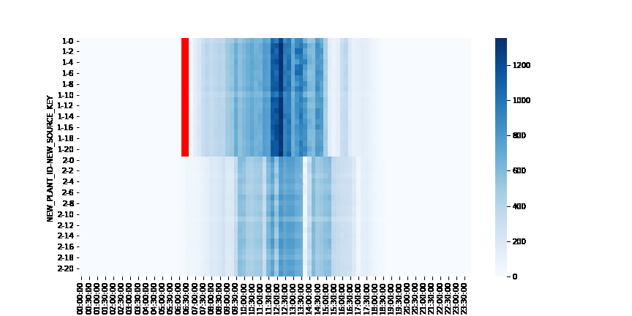
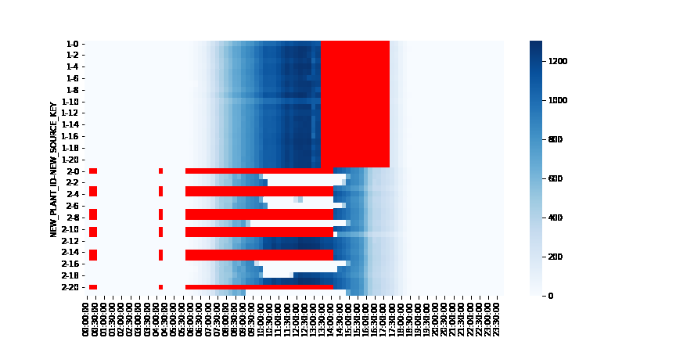
Exploratory Data Analysis
Discovered gaps in AC Power generation that suggest unexpected outages
NORMAL DAY
ABNORMAL DAY
The red areas above correspond with inverters going offline
Notes:
Plant 1 is on top, plant 2 on bottom
x-axis is time of day, y axis is the inverter
White to blue is energy production scale
Red is inverters offline

Slide 7
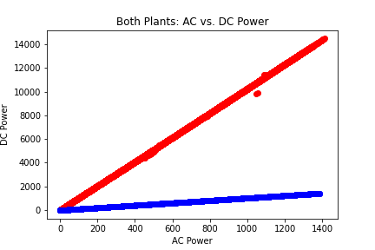
Exploratory Data Analysis
Comparing the output of both plants revealed discrepancies in the DC power output between plants
Plant 1 (red) appears to be generating more DC power than Plant 2 (blue)
Plant 2 may be underperforming by a power of 10
Plant 1
Plant 2
Notes:
The role of the inverter is to convert DC power into AC power

Slide 8
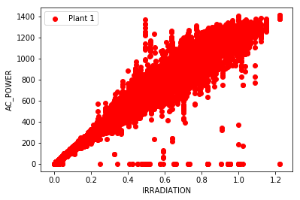
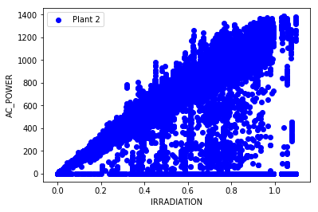
Exploratory Data Analysis
Plotting both plants’ AC Power output against sunlight levels confirms Plant 2’s underperformance
The solid horizontal line along the x-axis indicates periods when the plant is generating zero AC power
Notes:
Each of the points under the main set of data for each power plant indicates a point where the inverter was generating less than optimal levels of power.

Slide 9
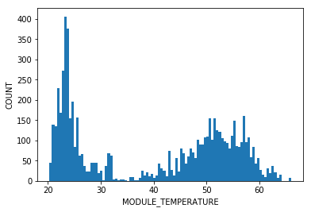
Exploratory Data Analysis
Further investigated Plant 2’s production issues by plotting the frequency of outages against module temperature
Result is a bi-modal pattern with two distinct peaks:
Low light situations in the early morning
Malfunctions possibly caused by overheating at high temperatures
Notes:
Plant 1 and 2 may be in different locations, but this trend is still worth investigating by Plant 2’s management team

Slide 10
Modeling
Objective: Create a predictive model to measure the performance of each plant and predict future power generation based on the illumination and temperature conditions.
Method of Analysis:
Linear Regression model
Training data – first four weeks of data, Testing data – final week
Attempted to use a clustering approach to improve the model with mixed results
Notes:
The benefits of having a predictive model for power generation can be significant.
First, this model would allow a plant to identify underperforming inverters and the attached solar panels for cleaning and maintenance.
More importantly, the model allows for more effective management of the power grid. If this predictive model can be coupled with a model forecasting demand, the plant can ensure that it is able to meet that demand.

Slide 11
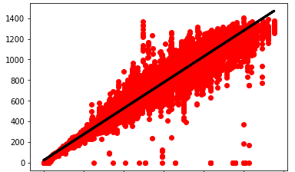
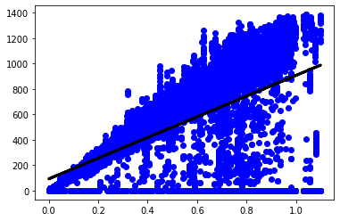
Modeling - Results
Plant 1
Line of best fit for both models shown at right
Model for Plant 1 accurate within 0.5%
Predicted output: 4,042,680 units
Actual output: 4,027,380 units
Model for Plant 2 reveals 16% underperformance
Predicted output: 3,480,916 units
Actual output: 2,924,922 units
Plant 2
Notes:
Models constructed using all the data up to the last 7 days, then the last 7 days were predicted using the true weather data.
Plant 2 model had a higher MSE and lower variance because of all the underperformance data

Slide 12
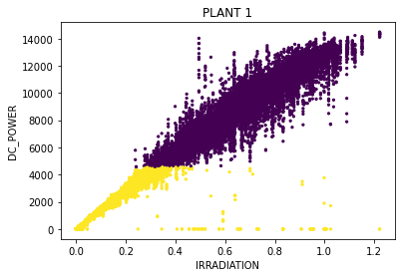
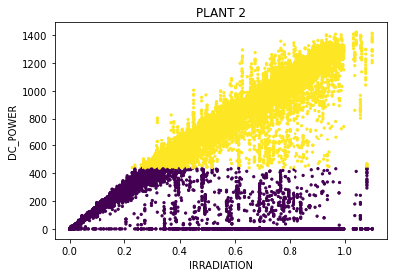
Clustering
Goal is to improve the model by identifying and grouping the data for each plant into clusters using the KMeans clustering method that can then be modeled using regression.
Notes:
For each plant, the best number of clusters was determined by calculating the maximum silhouette score. In this case, both plants appeared optimal with two clusters and reasonably high silhouette scores.
Unfortunately the clusters are not globular, which is a requirement of KMeans clustering. This is borne out in the results of the modelling which showed that the clusters had very low completeness score, which is a measure of clustering accuracy, and only moderately better homogeneity, which measures the clustering accuracy.

Slide 13
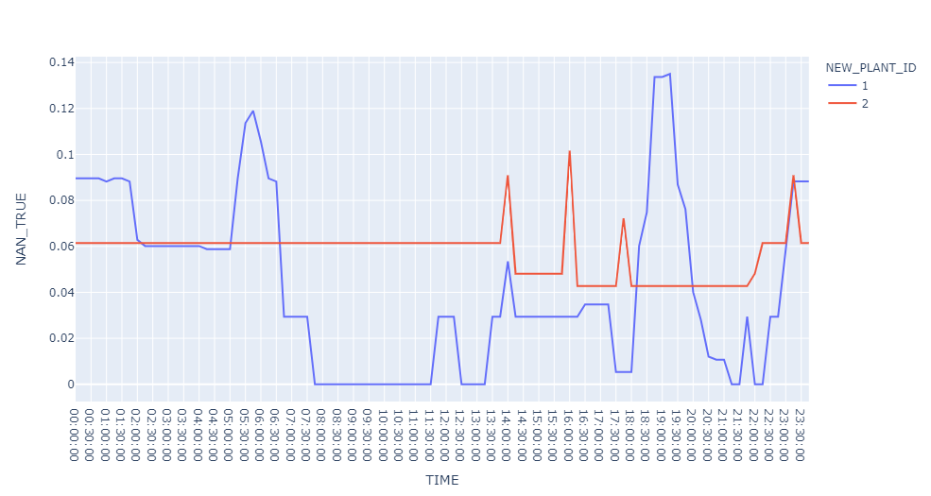
Further Analysis
What could be the cause of Plant 2’s underperformance?
One possibility includes a lack of regularly scheduled maintenance, illustrated by the unusual pattern of shutdowns at the right
The majority of Plant 1’s shutdowns are grouped around the early morning and evening hours which may indicate regular maintenance, while Plant 2 shows a more random pattern of shutdowns
Notes:
This is just a hypothesis - need additional context in order to understand if this is the true root cause

Slide 14

Conclusions
Even with periods of downtime included in the model, Plant 2 still underperformed expected output by 16%
Plant 2’s management team should follow a regular maintenance schedule to improve efficiency
Further investigation is required to understand causes of malfunctioning inverters in both plants

