Slide 1
Detection and Prevention of ARP Spoofing using
Dynamic Port and State Allocation.
Presented By:
Anika Akhtar Lima
ID: 1404058
Supervised By:
Dr. Asaduzzaman
Professor Department of CSE,CUET

Slide 2
Contents
Introduction
Motivation
Previous Work
Objectives
Proposed Algorithm
Experimental Result
Simulation results
Conclusion
References

Slide 3
Introduction
Arp Spoofing:
Request is for mac address.
Reply is from a spoofer.
Attacker copies ip address of desired destination.

Slide 4
Motivation
To ensure the delivery of secure arp packet.
No external software is needed to be installed.
No physical devices are needed
Dynamic port allocation

Slide 5
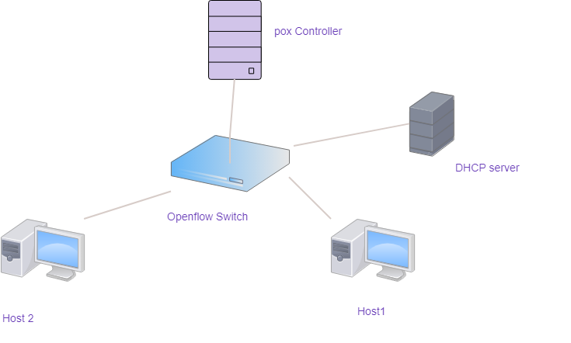
Previous Work(Existing Topology)

Slide 6
Previous Work(cont.)
“Leveraging SDN for ARP security.” [Cox, J. H., Clark, R. J., & Owen, H. L. (2016).]
DhCP offer or acknowledgement
Mac is checked on table
Static port is ignored.
Limitation:
Attacker may send request several times
Constant state values can be easily guessed.

Slide 7
Previous Work(cont.)
Dhcp packet arrival
Check for offer or acknowledgement
If offer=true
Find mac on table
If not, add to d. table

Slide 8
Previous Work(cont.)
If ack =T
Then ip match
State match
If both true
Verified state

Slide 9
Previous Work(cont.)
If ack or offer==F
Check mac on table
If T , then state update
Otherwisw ignore packet

Slide 10
Objectives
To set up a topology on mininet
To generate a poison method
To generate a detection algorithm
To observe output using wireshark tool.

Slide 11
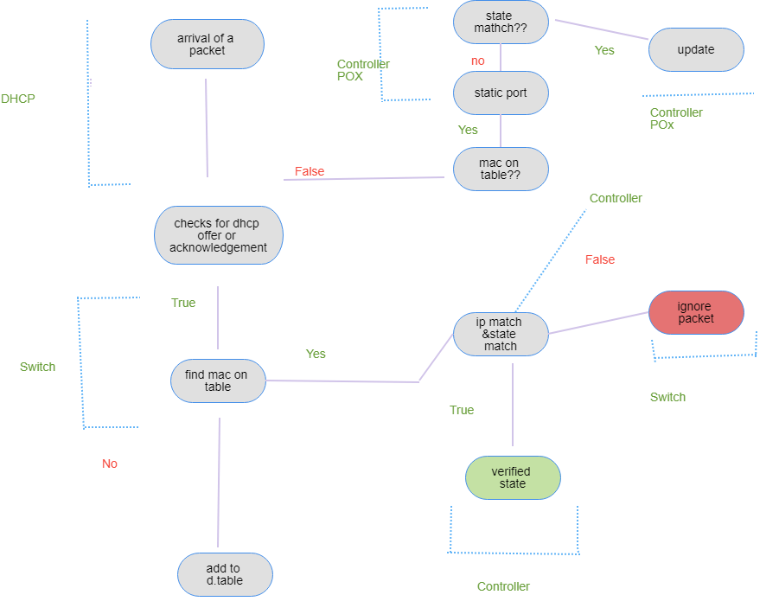
Proposed Method

Slide 12


Route Discovery (cont.)
As its next hop, S chooses the neighbor with the best metric.
S sends RCONF to the selected neighbor.
That node transmits back RACK packet to S.

Slide 13
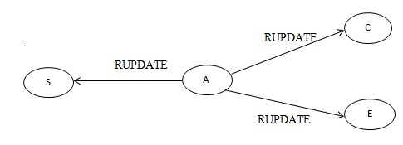
PUs Activity
If A is in the interference range of PU, channel-1 is interrupted.
A sends RUPDATE packet to its neighbors and S.
S broadcasts RNOT packet along the route.

Slide 14
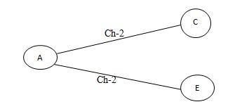
Channel Switching
A switches its channel to new channel.
The neighbors of A calculate T for the new channel.

Slide 15
Implementation Details
Custom simulator written in C++
Steps:
Setting up topology on mininet
Setting up devices on mininet
selecting a controller
Using tools for showing output

Slide 16
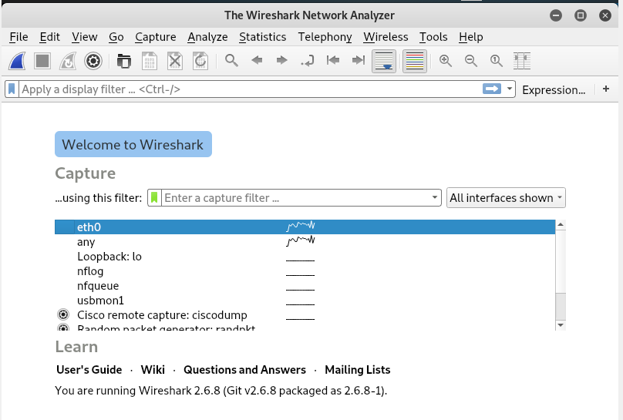
Experimental Result

Slide 17
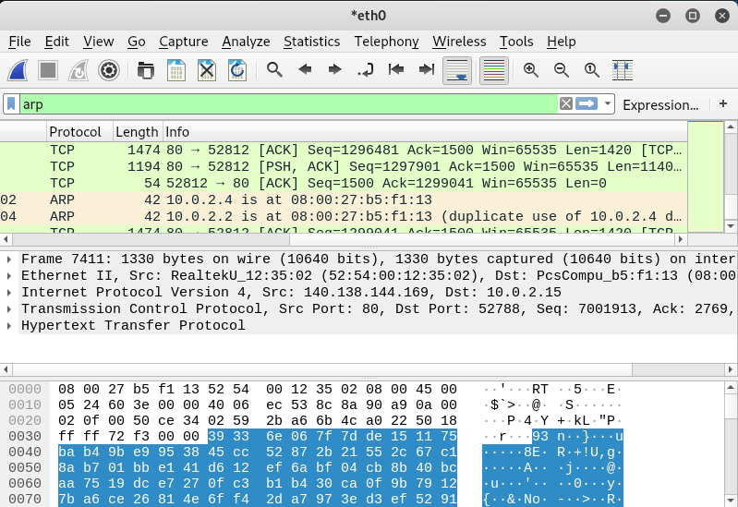
Experimental Result(cont.)

Slide 18
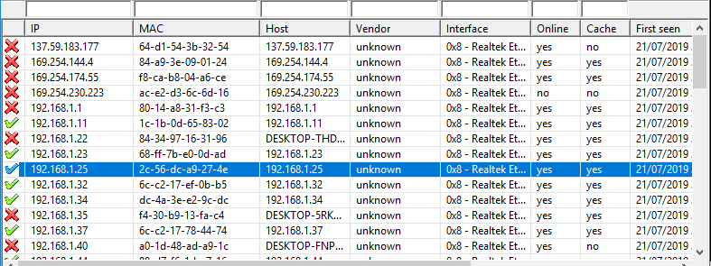
Experimental Result(cont.)

Slide 19
Comparison
 | POX Controller | RYU Controller | Additional Host | Lighttpd Server | Existing Algorithm
Packet Loss | 8.3333333333% | 8% | 12% | 10% | 12.5%
Link Loss Rate | 10.978% | 7.8404% | 8.527% | 8.785% | 10%
Delay | 69.997ms | 87.260ms | 73.766ms | 76.786ms | 63.067ms

Slide 20
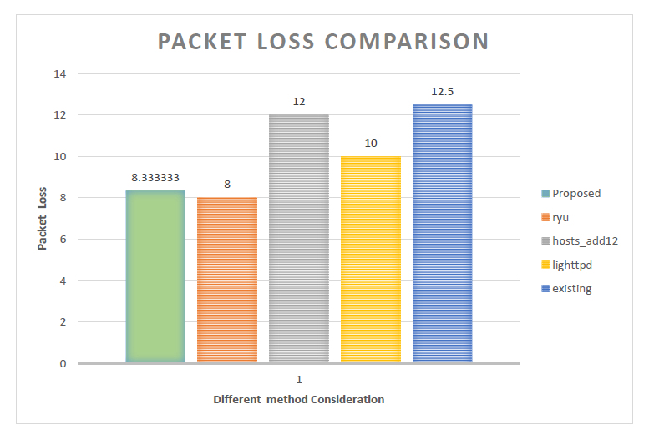
Simulation Results

Slide 21
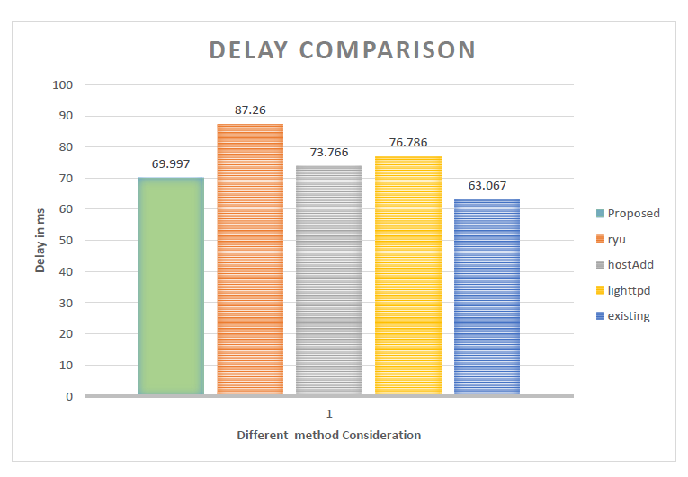
Simulation Results(cont.)

Slide 22
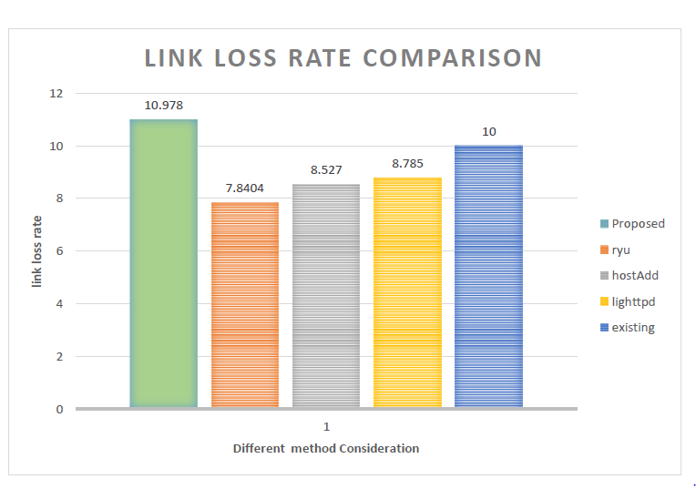
Simulation Results(cont.)

Slide 23
Future Recommendation
Depending on the controller, the algorithm may provide an excellent detection process. So various controller need to be tested for finding a best performance.
Number of hosts detected need to be increased.
The detection procedure need to be executed within a faster time.
Number of packet loss need to be reduced. Although when we used ryu controller, the loss was minimized at an extent.

Slide 24
Conclusion
Dynamic port and state allocation has been used
States are assigned with random values
Requests may arrive only at a limited number of time

Slide 25
References
1. M. Zhao, C. Yin, and X. Wang, "A novel dynamic spectrum access algorithm for cognitive radio networks," Journal of Communications and Networks, vol. 15, no. 1, pp. 38–44, Feb. 2013.
2. Y. R. Kondareddy and P. Agrawal, " A graph based routing algorithm for multi - hop cognitive radio networks", ICST (Institute for Computer Sciences, Social- Informatics and Telecommunications Engineering), 2008, p. 63-69.
3. Mahendra Kumar Murmu, Akheel M. Firoz, Sandeep Meena and Shubham Jain, “A Distributed Minimum Spanning Tree for Cognitive Radio Networks”, Twelfth International Multi-Conference on Information Processing-2016 (IMCIP-2016).
4. Islam Beltagy , Moustafa Youssef , Magdy Abd El-Azim , Mohamed El- Derini ,” Channel assignment with closeness multipath routing in cognitive networks”, Alexandria Engineering journal (2013) 52, 665-670.
5. Karim Habak, Mohammed Abdelatif, Hazem Hagrass and Karim Rizc, “ A Location-Aided Routing Protocol for Cognitive Radio Networks”, Egypt-Japan Univ. of Sc. and Tech. (E-JUST), Alexandria, Egypt

Slide 26
Thank You

