Slide 1
Insights on inequality in Sao Paulo (Brazil)
Luiz Lima
May 2020

Slide 2
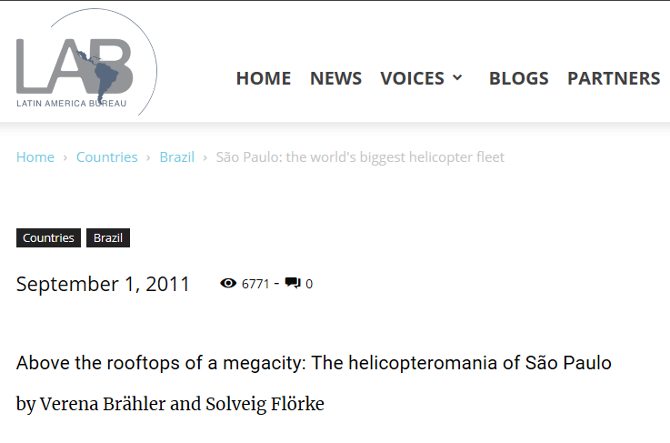
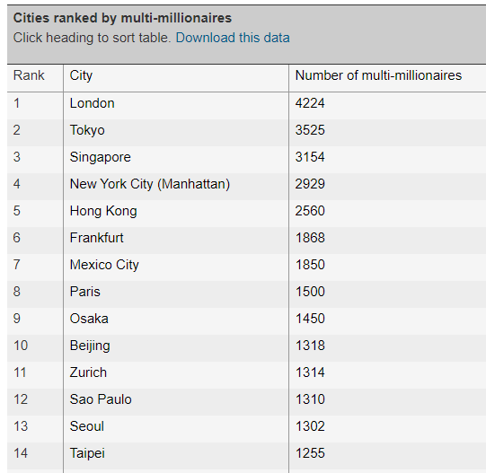
Introduction – Sao Paulo
https://lab.org.uk/sao-paulo-the-worlds-biggest-helicopter-fleet/
Not Brazil’s capital city, but largest GDP
Large amount of wealthy people:
Largest helicopter fleet in the world
12th in city rankings by multi-millionaires
More than 12,000 restaurants, 40 different world cuisines
8th most luxurious street in the world (Oscar Freire street)
https://www.theguardian.com/news/datablog/2013/may/08/cities-top-millionaires-billionaires

Slide 3
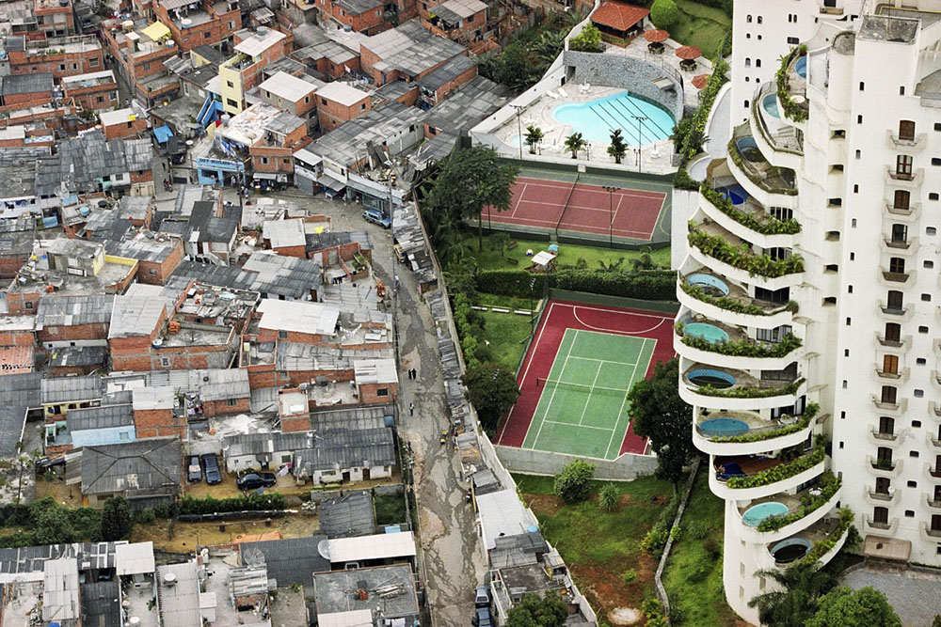
Introduction – Sao Paulo
On the other hand…
More than 100 slums
700,000 people living in extreme poverty
120,000 people have no access to running water
685 murders, 220,000 thefts in 2019
Photo: Tuca Viera / Fair Use exemption

Slide 4
Objectives
Investigate the key venues in the city of Sao Paulo per neighborhood
Verify if a relation can be established between these venues and wealth / inequality indicators
Verify if a predictive model can be proposed to indicate a neighborhood level of wealthy based on the type and count of its venues

Slide 5
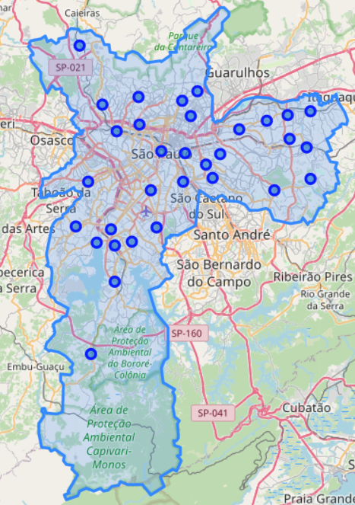
Data gathering
Sao Paulo is divided in 32 sub-regions called “subprefeituras”, which can be seen as neighborhoods
The address of their administration offices are available in the city official website
If the addresses are read and converted into coordinates using GeoPy, they can be superimposed into the city map, as seen to the right

Slide 6
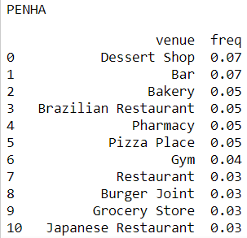
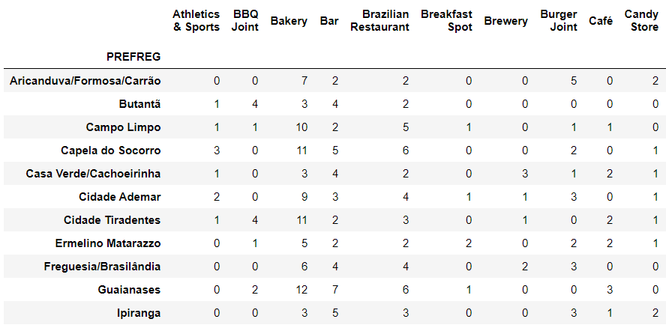
Data gathering
The addresses of the neighborhoods can be input into the FourSquare API to deliver the top venues around these places
An example is shown in the top right picture
The top 50 most frequent venues can be used as a filter, so that a top venue x neighborhood dataframe is obtained, as shown to the right

Slide 7
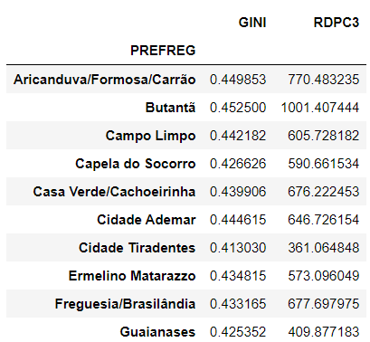
Data gathering
Sao Paulo administration official website also make available key indicators as a function of the neighborhood
For this project, we will use two of these wealth / inequality indicators:
The GINI coefficient, widely used as an indicator of wealth inequality; and
The GDPC3, mean income per capita of the 3rd poorest quartile of the population*
*This is a good indicator of the mean wealth of the neighborhood, more accurate than the simple mean income per capita, which can be distorted by a small amount of people with very large income. Statistically, is the equivalent of choosing the median instead of the mean of this distribution.

Slide 8
Exploratory data analysis
To get a first understanding about the relation between venues and official key indicators, an exploratory data analysis was performed.
The top venues of the city were classified as essential (i.e. market, grocery store, pharmacies, etc) or non-essential (theaters, spas, bistros, etc).
A reasonable hypothesis is that the essential services will be present in both poor and wealthy neighborhoods, but non-essential services will be prevalent in the wealthiest ones.
To check this hypothesis, both GDPC3 and GINI data were be plotted against the amount of essential and non-essential venues per neighborhood.

Slide 9
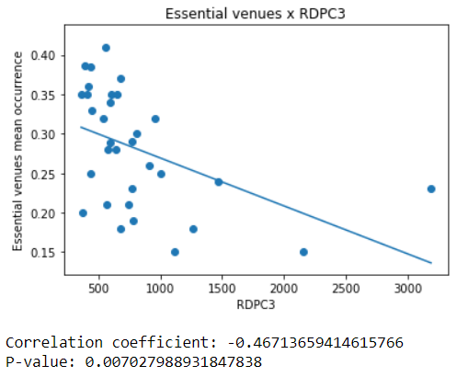
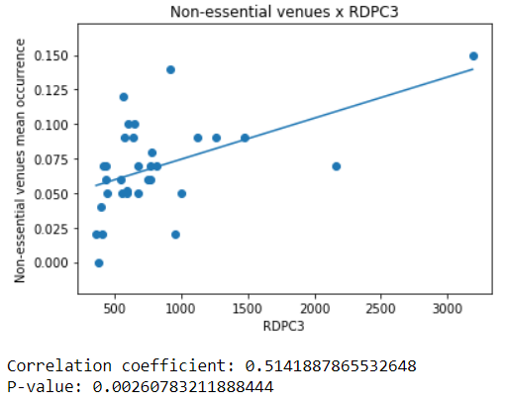
Exploratory data analysis
Good correlation coefficients were found between RDPC3 and both essential and non-essential venues, with excellent statistical significance.
Wealthier neighborhoods are associated with more non-essential venues, resulting in a lower proportion of essential venues. The opposite is also true.

Slide 10
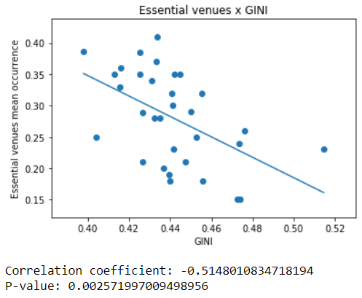
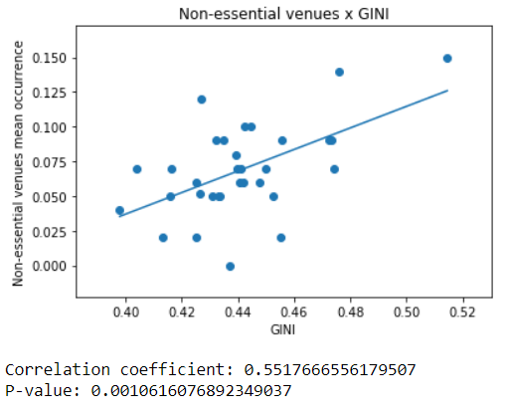
Exploratory data analysis
Similar results were found when the RDPC3 indicator is replaced by GINI. There seems to be a clear relation between non-essential venues occurrence and the wealthiness of the neighborhood.

Slide 11
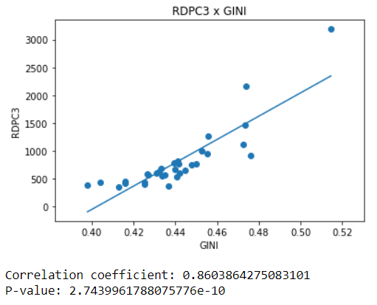
Exploratory data analysis
The similarity between the results for GINI and RDPC3 can be explained if these two variables are plotted against one another – a clear, positive correlation is found
This is explained by the fact that no neighborhood in Sao Paulo is wealthy in absolute numbers – that is, unfortunately there are poor people living in all of the regions
However, there is indeed regions where the poor are vastly prevalent. So, it can be inferred that regions with lower GINIs (i.e. lower inequality) are more equal because all of the residents are living in poor conditions
Similarly, regions with larger GINIs (i.e. higher inequality) have at the same space poor and rich people (as clearly shown in the picture at the slide #3).

Slide 12
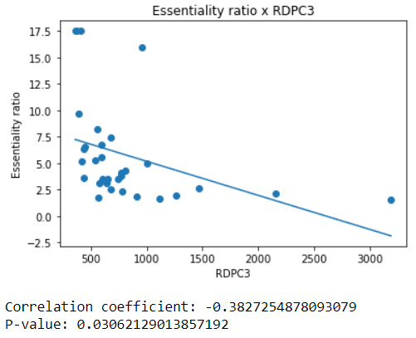
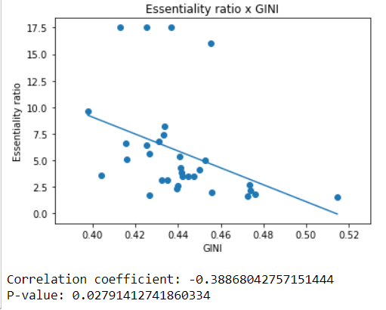
Exploratory data analysis
A simplified way of compiling the results of the slides #9 and #10 is by using a unified metric, the ratio between essential and non-essential venues.
This simplified metric summarizes the idea that wealthy and inequality is moderately correlated with the venues present at each neighborhood.

Slide 13
Modelling
The data exploration shown above supports the hypothesis that there is a clear inequality in the distribution of venues throughout Sao Paulo.
Next step → predictive model to estimate the wealth level of a neighborhood based on the types of venues found there.
Relatively small number of neighborhoods → regression models not suitable
More reasonable: use classifiers to predict, based on the neighborhood venues, if it is a low, medium or high income neighborhood

Slide 14
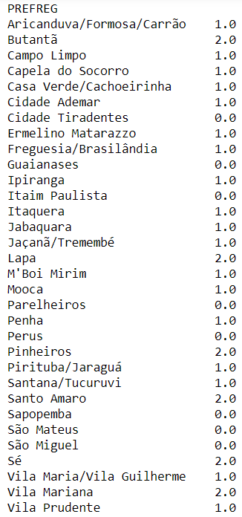
Modelling
The following classifiers were evaluated, all using scikit-learn:
support vector machine (SVM),
naive-Bayes,
logistic regression,
k-means classifier,
multi-layer perceptron (neural network)
The GDPC3 dataset was modified, so that the neighborhoods were classified into 3 categories:
High income (> 1000 BRL) – index = 2
Medium income (> 500 BRL and < 1000 BRL) – index = 1
Low income (< 500 BRL) – index = 0

Slide 15
Modelling
Methodology
Initially, the classifiers were compared in a high level, using default parameters or small variations.
The most promising models were investigated in more detail
The best set of parameters for the 2 most promising models were selected for result discussion

Slide 16
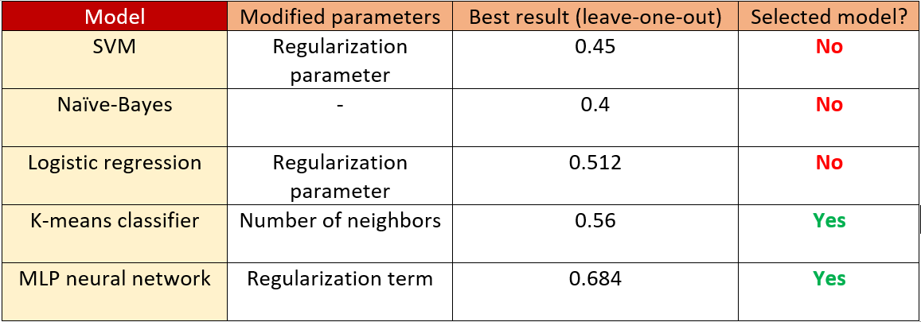
Modelling
Preliminary comparison
The models that showed the best results were the K-means classified and the MLP neural network. These two models were investigated in more depth.

Slide 17
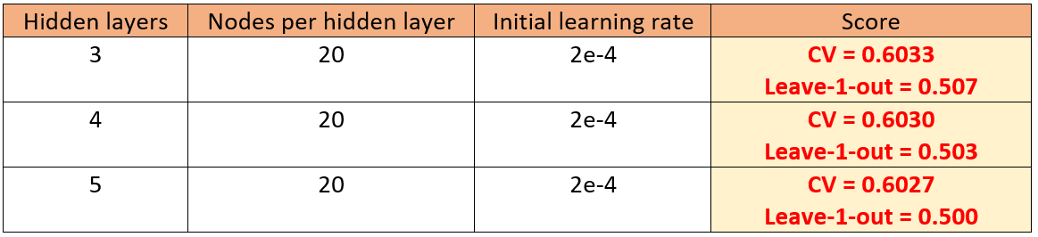
Results
MLP neural network: fine tuning was performed in the three parameters that were found to have the largest influence in the model outcome:
Thus, the fine-tuned models were able to guess the correct level of wealth of a neighborhood based on the local venues on roughly 60% of the cases, compared to 33% expected at blind guess.

Slide 18
Results
K-means classifier: No further improvement was possible in the k-means model, as there are no parameters to tune in this model apart from the value of k, already optimized in the previous step.
However, a cross-validation step was performed, leading to a score of 0.61, i.e. this model was able to guess the correct level of wealth of a neighborhood based on the local venues on roughly 61% of the cases, compared to 33% expected at blind guess

Slide 19
Conclusions / final remarks
The main hypothesis of this work, the relation between the distribution of venues throughout the city of Sao Paulo and its wealth indicators, was successfully confirmed in the exploratory data analysis.
Neural network and k-means classification were the models that shown the best predictive capabilities, in the context of this project.
Although the measured scores are still not good enough to consider these models a proper tool for predicting wealth as a function of venues per neighborhood, the results are considerably better than blind guess.
Results can be further improved if the neighborhoods, considered in this work as the whole “subprefeituras”, could instead be split into sub-neighbors.

