Slide 1

Hifadhi
More convenience!

Slide 2

If it’s fun or associated with fun, it becomes easier to form a habit of it.
Team Hifadhi

Slide 3

Maxwell and his friends want to have a great night out without:
Experiencing long waiting times to get what they order.
Worrying about carrying cash securely
Splitting the bill

Slide 4

Over 1,000 Bars and Restaurants
Accra

Slide 5
Solution
Hifadhi is a restaurant bill payment app that helps Maxwell and his friends discover and make restaurant/bar reservations while easily splitting their bills and paying using mobile money.

Slide 6
Demo

Slide 7

Revenue Model
We believe the app can make money by charging 3% of the total order amount as an order processing fee.

Slide 8
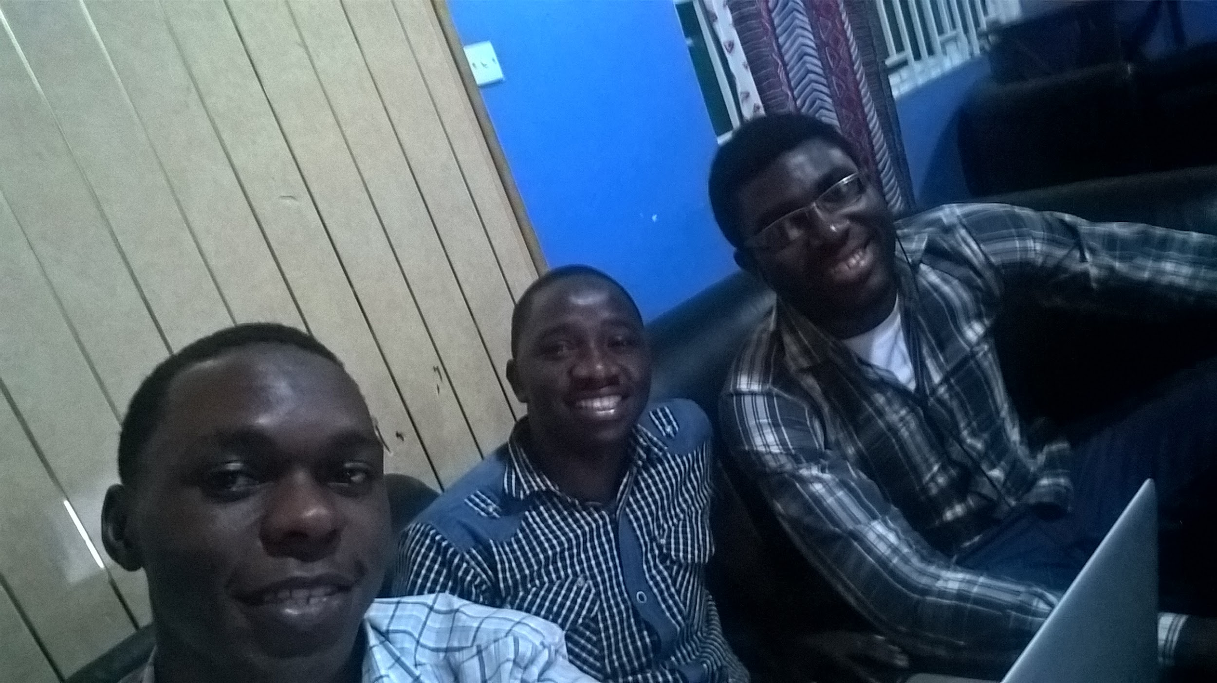
Thank You!
https://invis.io/2D6KC5P4F

Slide 11
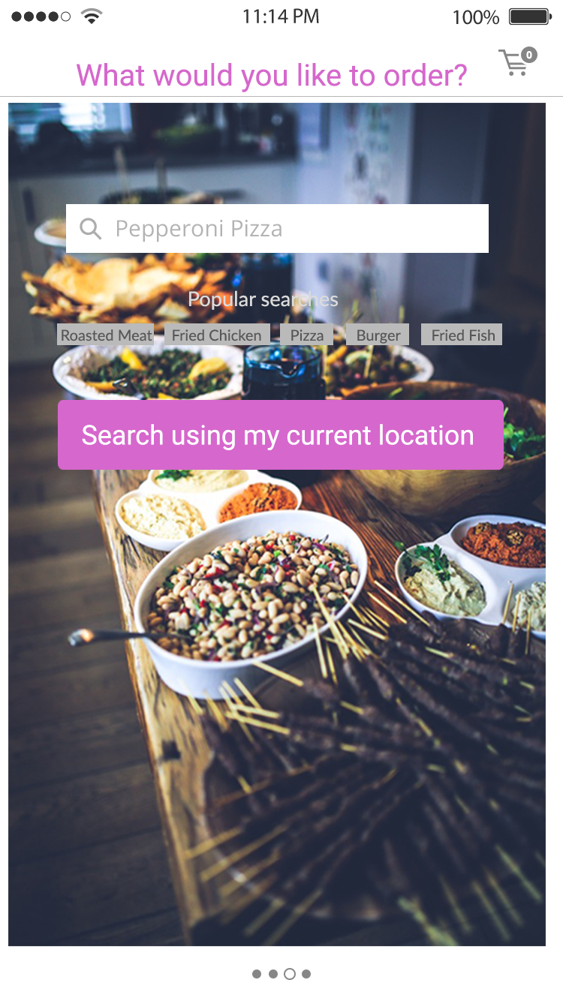
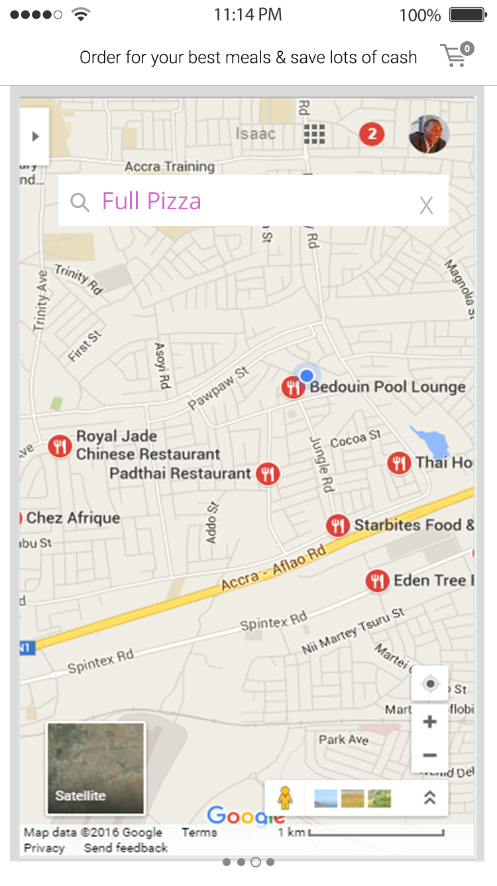

Slide 12
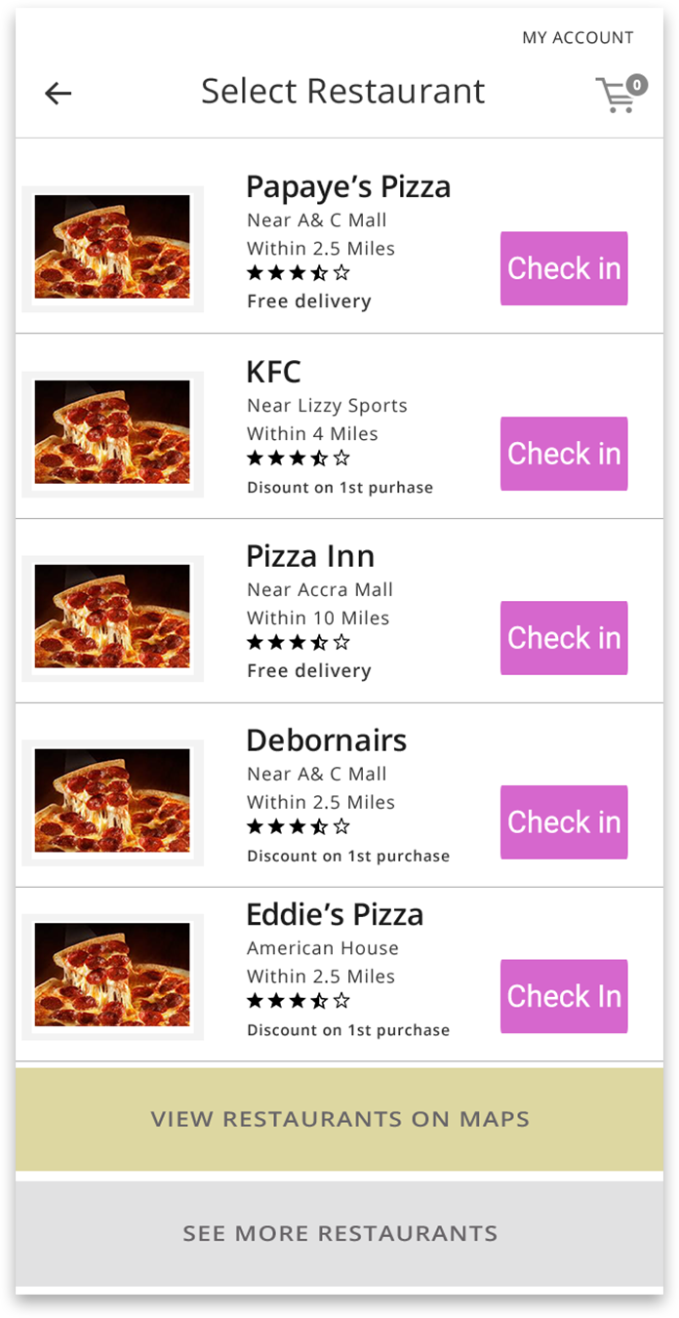
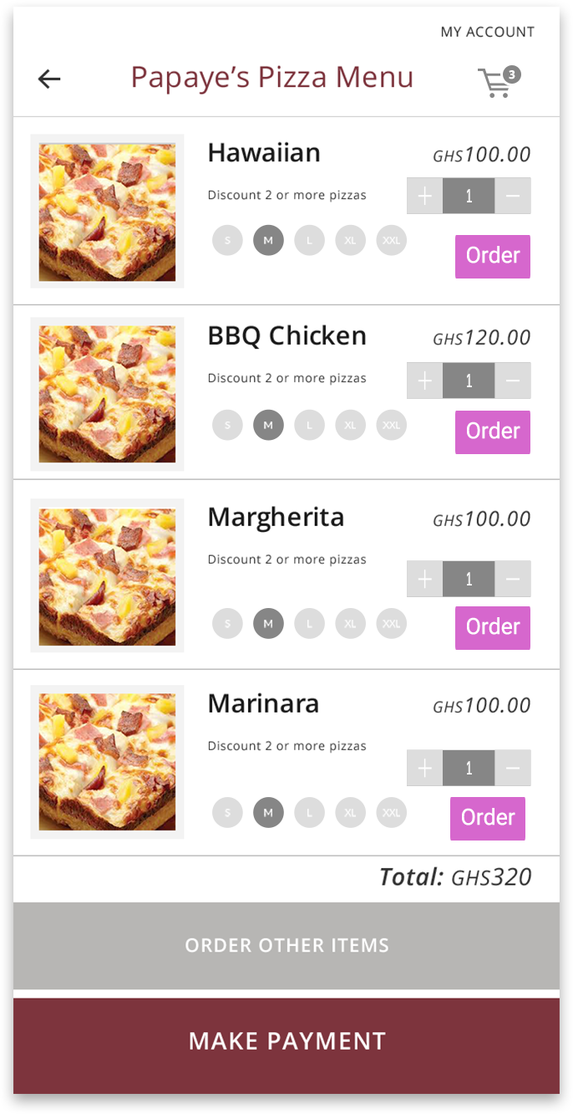

Slide 13
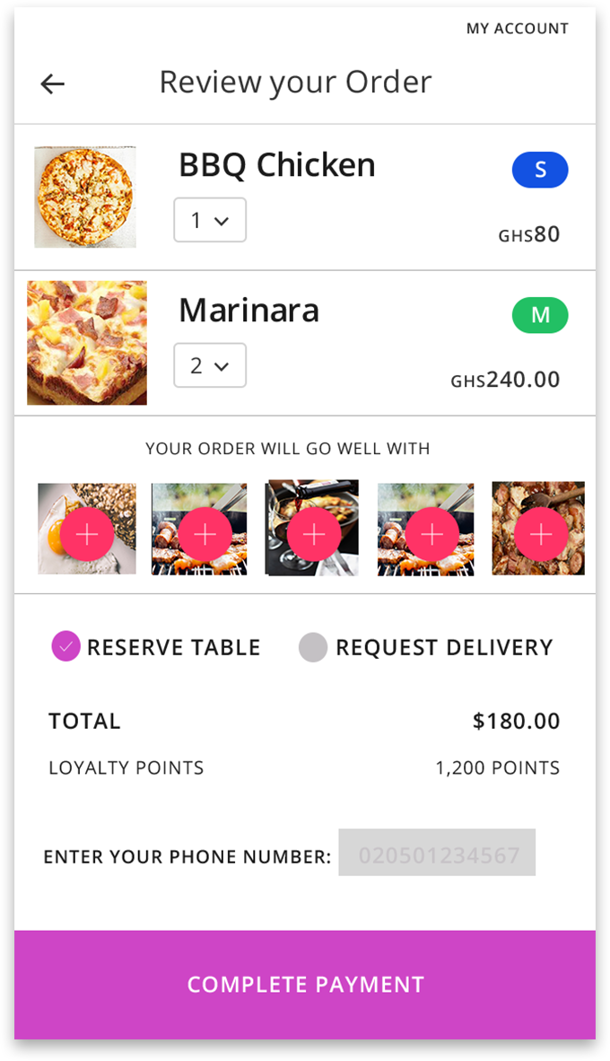
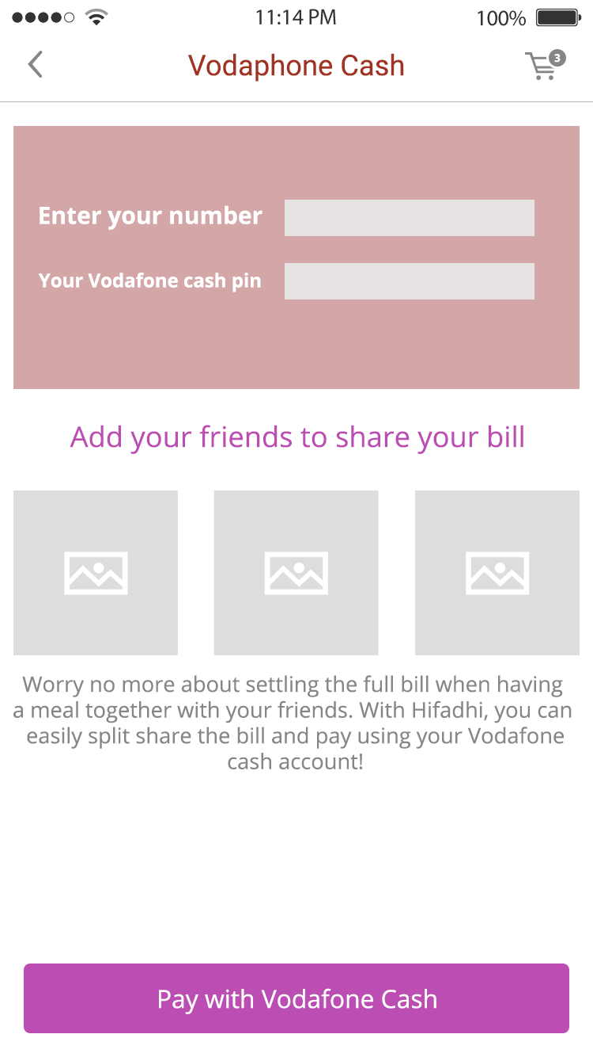

Slide 14
