Slide 1
Intensity Transformation and Spatial Filtering
2020.9

Slide 2
Two domains for image processing
Spatial domain
image plane itself, directly process the intensity values of pixels in the image plane
Transform domain
process the transform coefficients, not directly process the intensity values of the image plane

Slide 3
Spatial Domain Process
g(x,y)=T[f(x,y)]
f(x,y): input image
g(x,y): output image
T:an operator on f defined over a neighborhood of point (x,y)

Slide 4
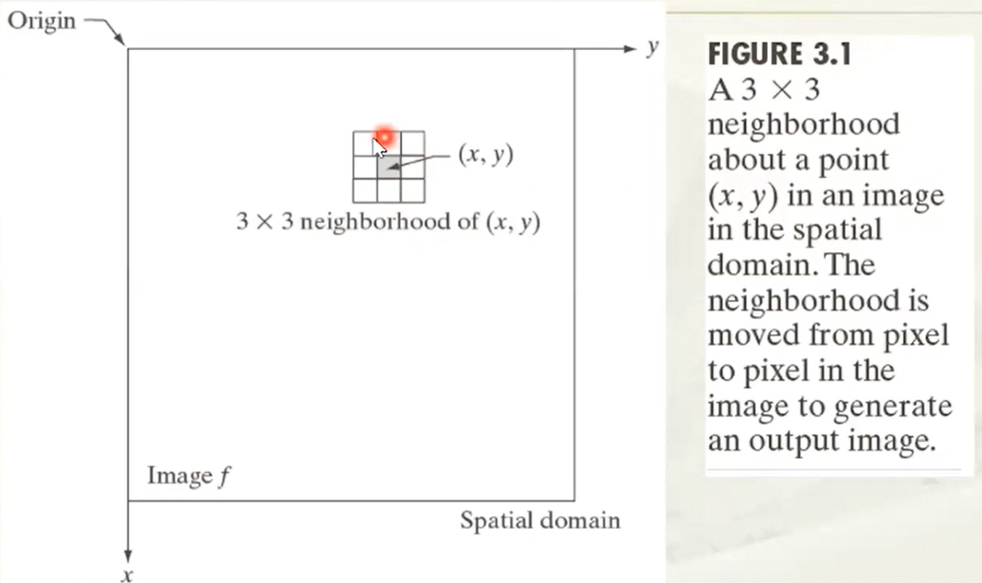
Neighborhood of pixel

Slide 5
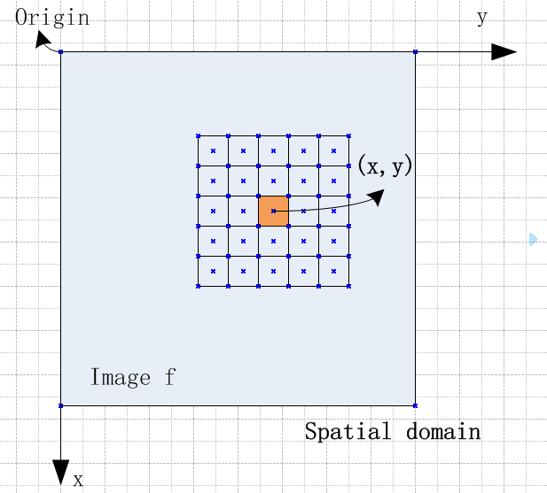
Neighborhood of pixel
5*5 neighborhood,
the neighborhood canbe square, or canbe rectangle, too

Slide 6
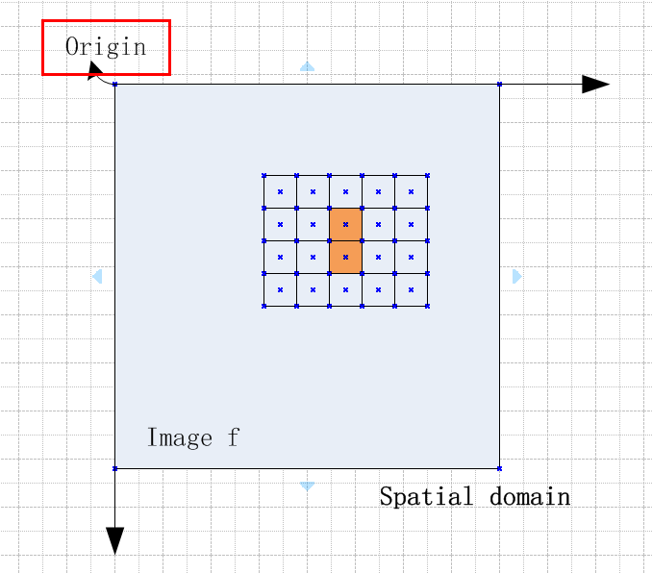
Neighborhood of pixel
4*5 neighborhood,
the neighborhood is rectangle, but you can not define the center of the rectangle.

Slide 7
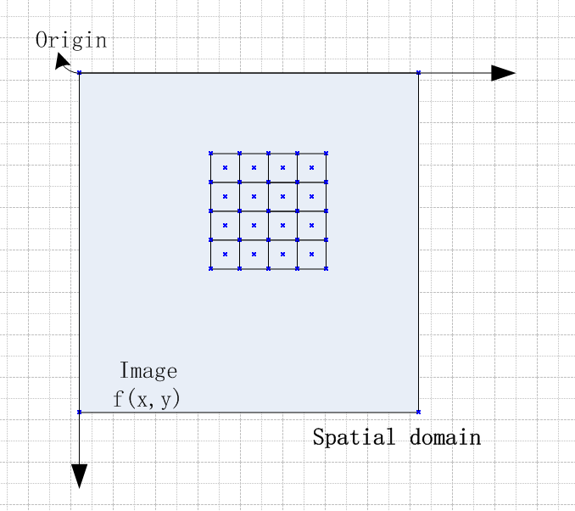
Neighborhood of pixel
4*4 neighborhood,
but you can not define the center of the square due to the even number

Slide 8
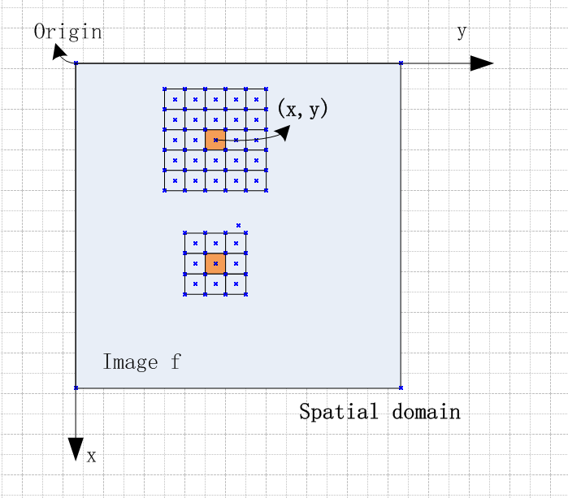
Neighborhood of pixel
So, it is usually use the odd square neiborhood of (x,y), such as [3*3],[5*5]

Slide 9


How to obtain the output image
1st
small squre is one pixel
from the top to the bottom,
from the left to the right,
processing the image pixels
one by one

Slide 10
Step =1 for row
2nd

Slide 11
Step =1 for row
3rd

Slide 12
Step =1 for row
4th
move patch window one pixel by one pixel, ending to the whole image

Slide 13
Step =1 for row
10th
one row by one row

Slide 14
Step =1 for row

Slide 15
Step =1 for row

Slide 16
Step =1 for row

Slide 17
with move N steps at the first row

Slide 18
then the second row

Slide 19
then the second row

Slide 20
then the second row

Slide 21
then the second row

Slide 22
then the second row

Slide 23
then the whole image

Slide 24
then the whole image

Slide 25
then the whole image

Slide 26
then the whole image

Slide 27
then the whole image

Slide 28
then the whole image

Slide 29
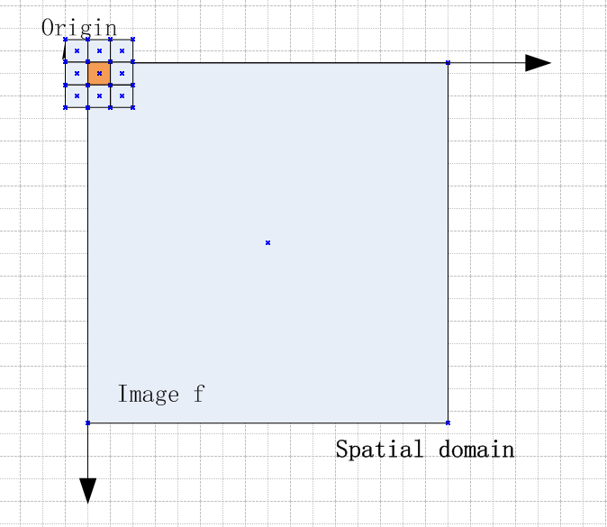
Question: how to process the fisrt pixel
at the right-bottom, right and bottom has the
neighborhood pixels, but at the top, top-right,
top-left, left, bottom-right has no neighborhood

Slide 30
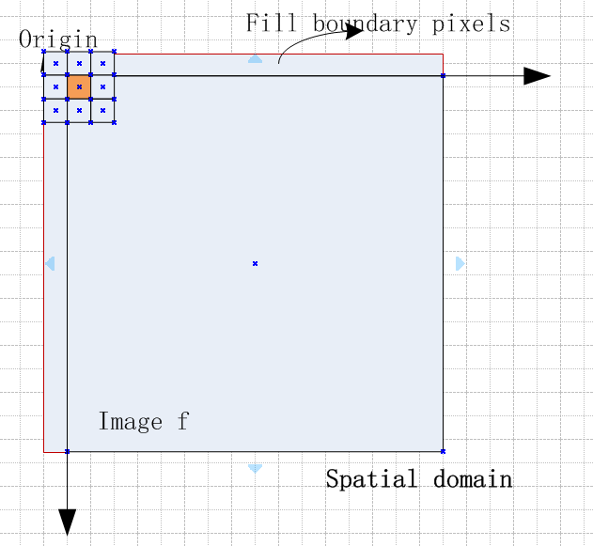
Answer: fill the boundary with neighborhood pixels
3*3 neighborhood, we can fill the image
boundary with 1 pixel
5*5 neighborhood, we need to fill the
image with ? pixels

Slide 31

Special case of neighborhood
What is the spcecial case of spatial domain in the neighborhood??

Slide 32
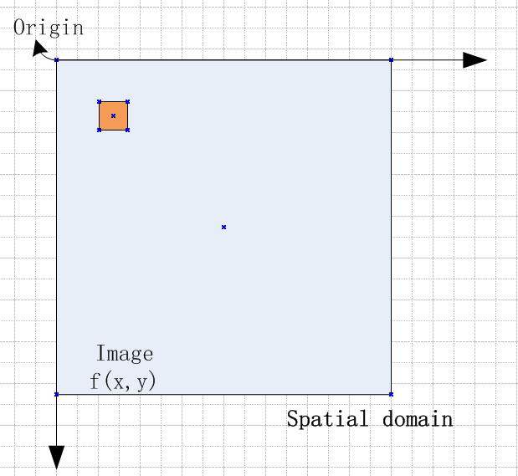
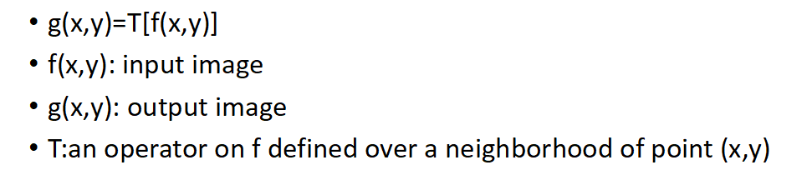
Spatial Domain Process
The smallest neighborhood is of size 1*1. In this case, T reduces to an Intensity Transformation function:
s=T(r) where s and r denote the intensity of g and f at any point (x,y)

Slide 33

Exercise !!
Do some exercise on the image spatial domain.

Slide 34
Operation on image neighborhood with python
Read an image and do the operation: s=T(r) where T(x) = 0.5x
Compute the mean of 3*3 neighborhood for every pixel in one image

Slide 35
Tips for the exercise
s=T(r) where T(x) = beta*x (5 minutes)
0. import the packages: including cv2, numpy, and the matplotlib
1. im = read one image (color, gray)-using the opencv cv2.imread
2. im = im*beta --use the numpy
3. display it -- matplotlib.pyplot
4. you can show the difference of the two images, just show top-left (10*10) pixel values

Slide 36
Another exercise !!
Operation on 3*3 the neighborhood, assigning the mean of 3*3 neighborhood to the pixels one by one.
What should the output of the image be?

Slide 37
Tips of the exercise
Mean of 3*3 neighborhood (10 minutes)
0. import packages (import cv2, matplotlib, numpy)
1. im = read one image (cv2.imread(''))
2. considering the boundaries of the images to process the pixeles around the image
add the new values around the image
3. for loop compute pixel one by one

Slide 38
Image filtering
https://blog.csdn.net/zy010101/article/details/104857551/

Slide 39
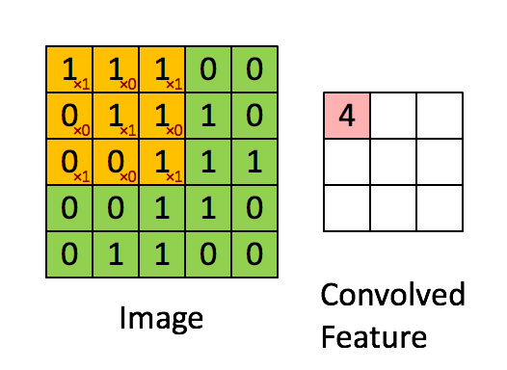
kernel operations
1 | 0 | 1
0 | 1 | 0
1 | 0 | 1

Slide 40
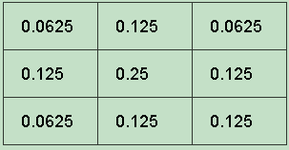
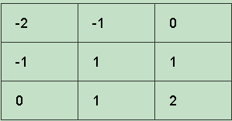
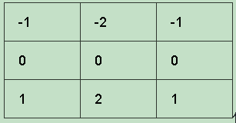
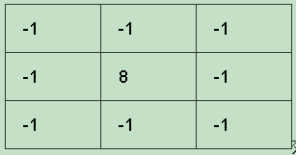
Some common kernels
blur kernel
sobel kernel
emboss kernel
outline kernel

Slide 41
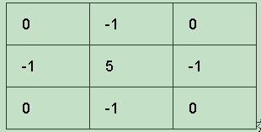
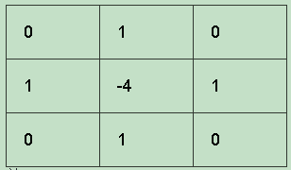
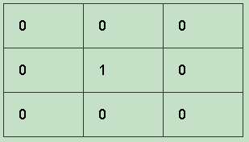
sobel kernel
sharpen kernel
laplacian operator
identity

Slide 42
Thank you

