Slide 1
Image segmentation
2020.10

Slide 2
Contents
Image segmentation
Watershed

Slide 3
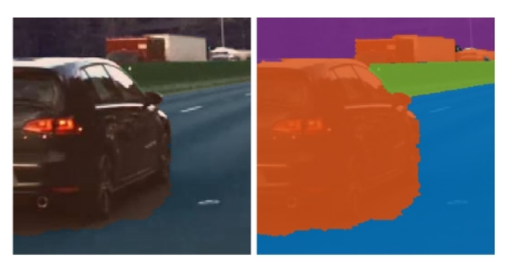
What is image segmentation
Partite an image into multiple parts or regions, often based on the characteristics of the pixels in the image.

Slide 4
classificantion of image segmentation
Many image segmentation methods，including thresholding, clustering, graph-based segmentation, and region growing.

Slide 5
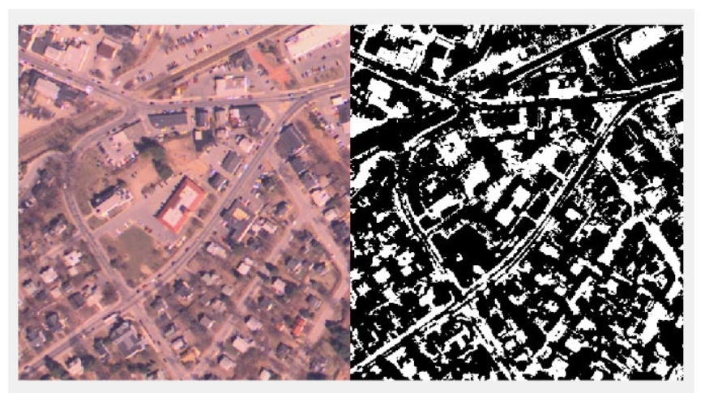
Thresholding
remote sensing image?
Using Otsu’s method, cv2.binary() performs thresholding on a 2D or 3D grayscale image to create a binary image.

Slide 6
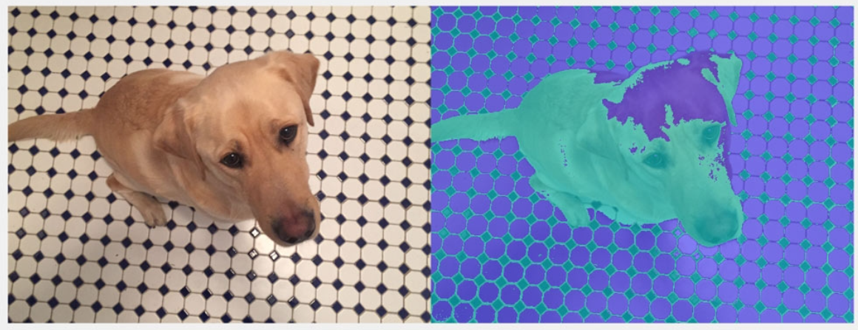
Clustering
k=2?
Using K-means clustering–based segmentation to segment an image into K number of clusters.

Slide 7
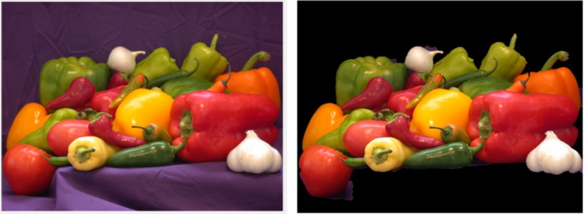
Graph-Based Segmentation
Lazy-snapping to separate the foreground and background regions.

Slide 8
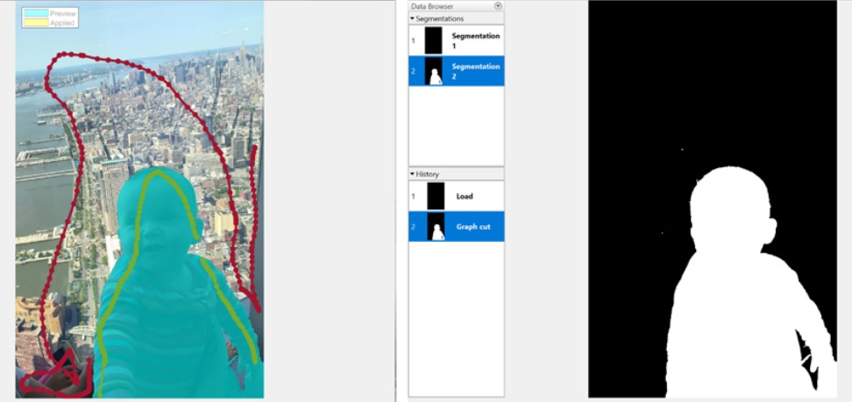
graph cut
graph cut to segment the image

Slide 9
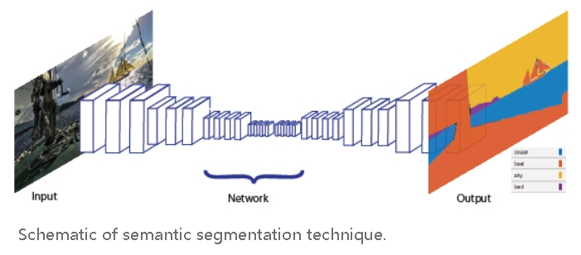
Deep Learning for Image Segmentation
Using convolutional neural networks (CNNs), a deep learning technique called semantic segmentation lets you associate every pixel of an image with a class label.

Slide 10
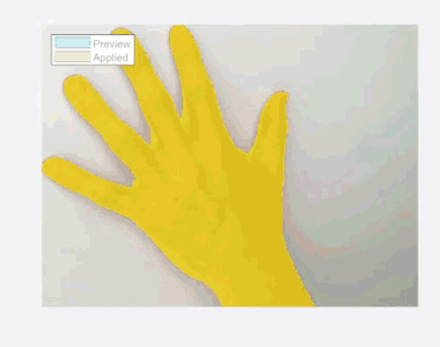
Region Growing
Region growing is a simple region-based (also classified as a pixel-based) image segmentation method.

Slide 11
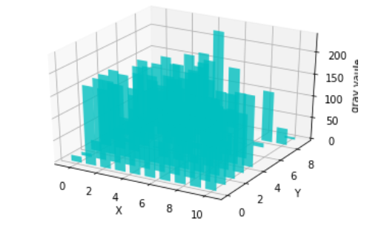
Watershed segmentation(region growing)
Any grayscale image can be viewed as a topographic surface where high intensity denotes peaks and hills while low intensity denotes valleys.

Slide 12
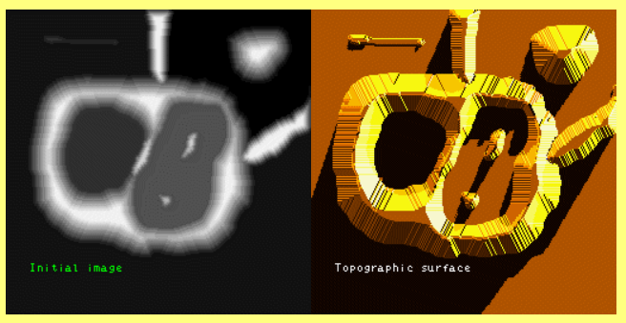
If we flood this surface from its minima and, if we prevent the merging of the waters coming from different regions, we segment the image into two different sets: the catchment basins and the watershed lines.

Slide 13
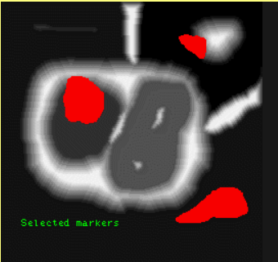
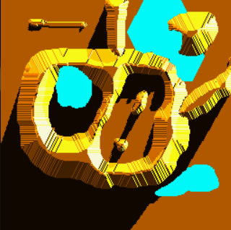



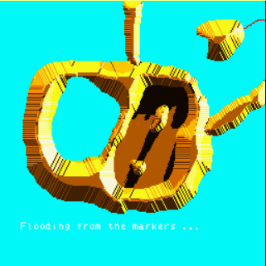
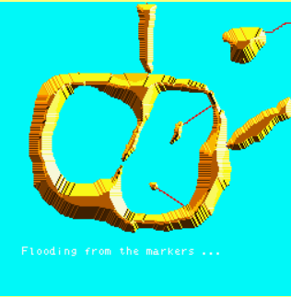
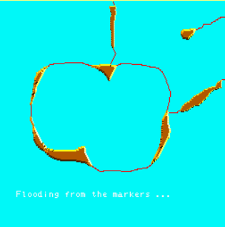
Sample of watershed
1
2
3
4
5
6
7
8

Slide 14
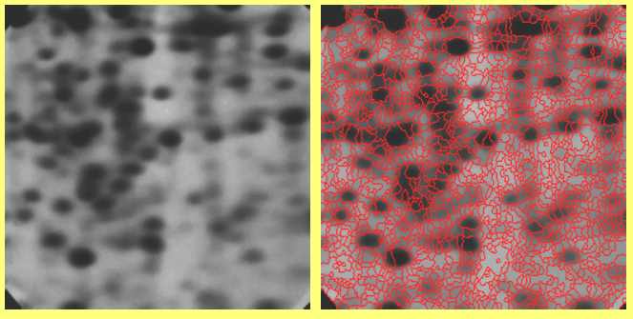
However, in practice, this transform produces an important over-segmentation due to noise or local irregularities in the gradient image.

Slide 15
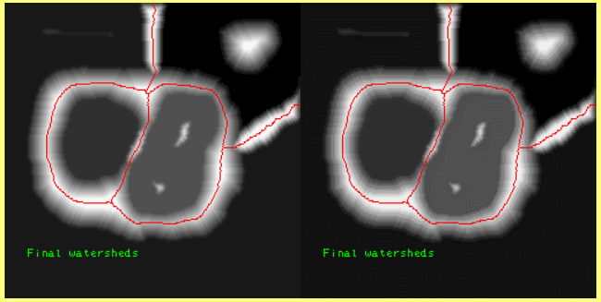
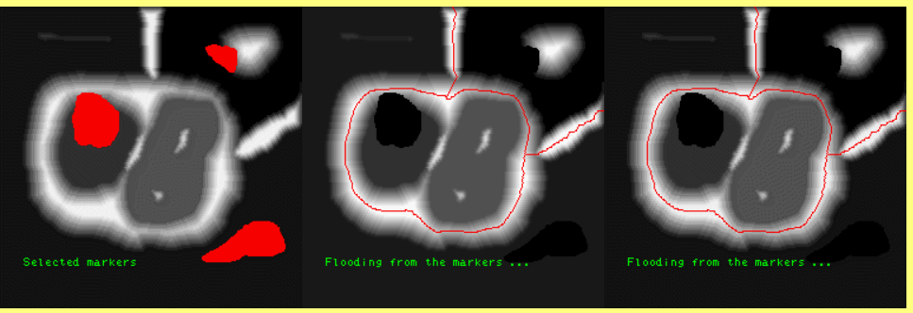
Marker-controlled watershed
A major enhancement of the watershed transformation consists in flooding the topographic surface from a previously defined set of markers.

Slide 16
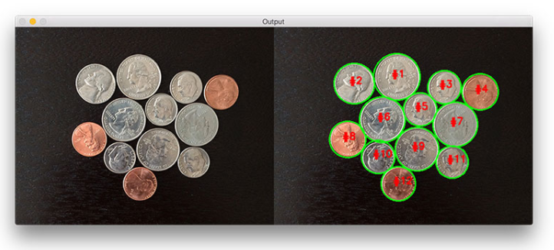
Homework for watershed
The watershed algorithm is a classic algorithm used for segmentation and is especially useful when extracting touching or overlapping objects in images,

Slide 17
Requirements
finishing the homework using jupyter file(.ipynb)
please upload the homework to my wechat or my email 275268490@qq.com

